Slide 1
Using Hypothes.is in an Experimental Book Publication
Janneke Adema
Centre for Postdigital Cultures
Open Humanities Press series editor

Slide 2
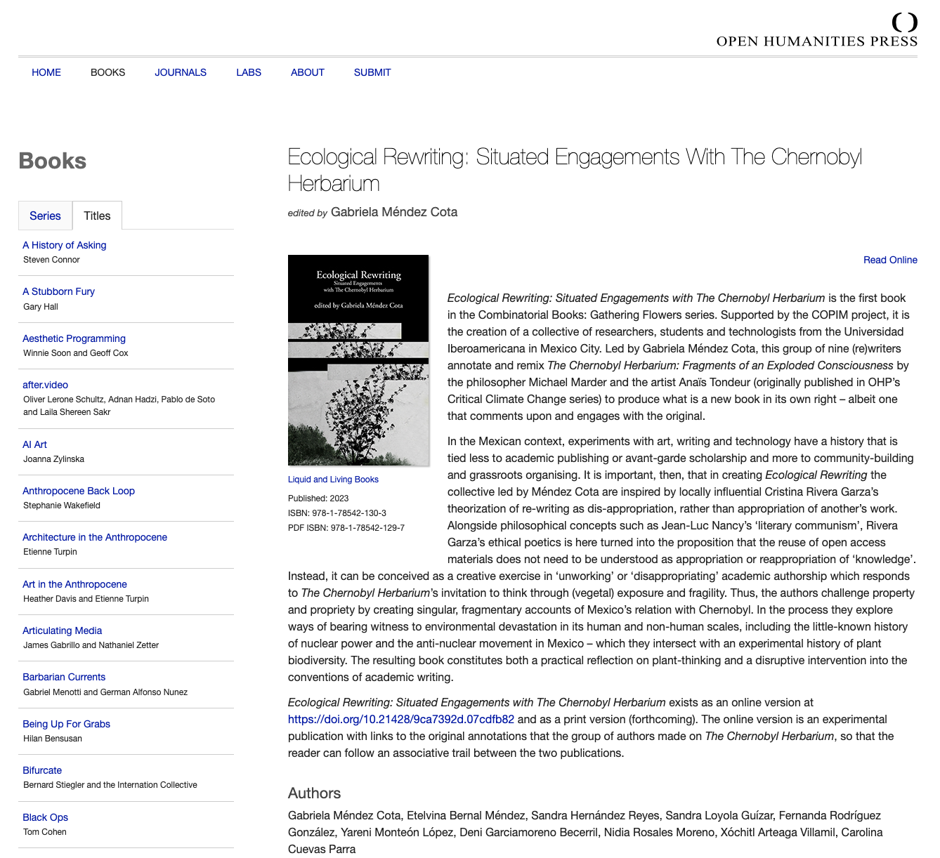
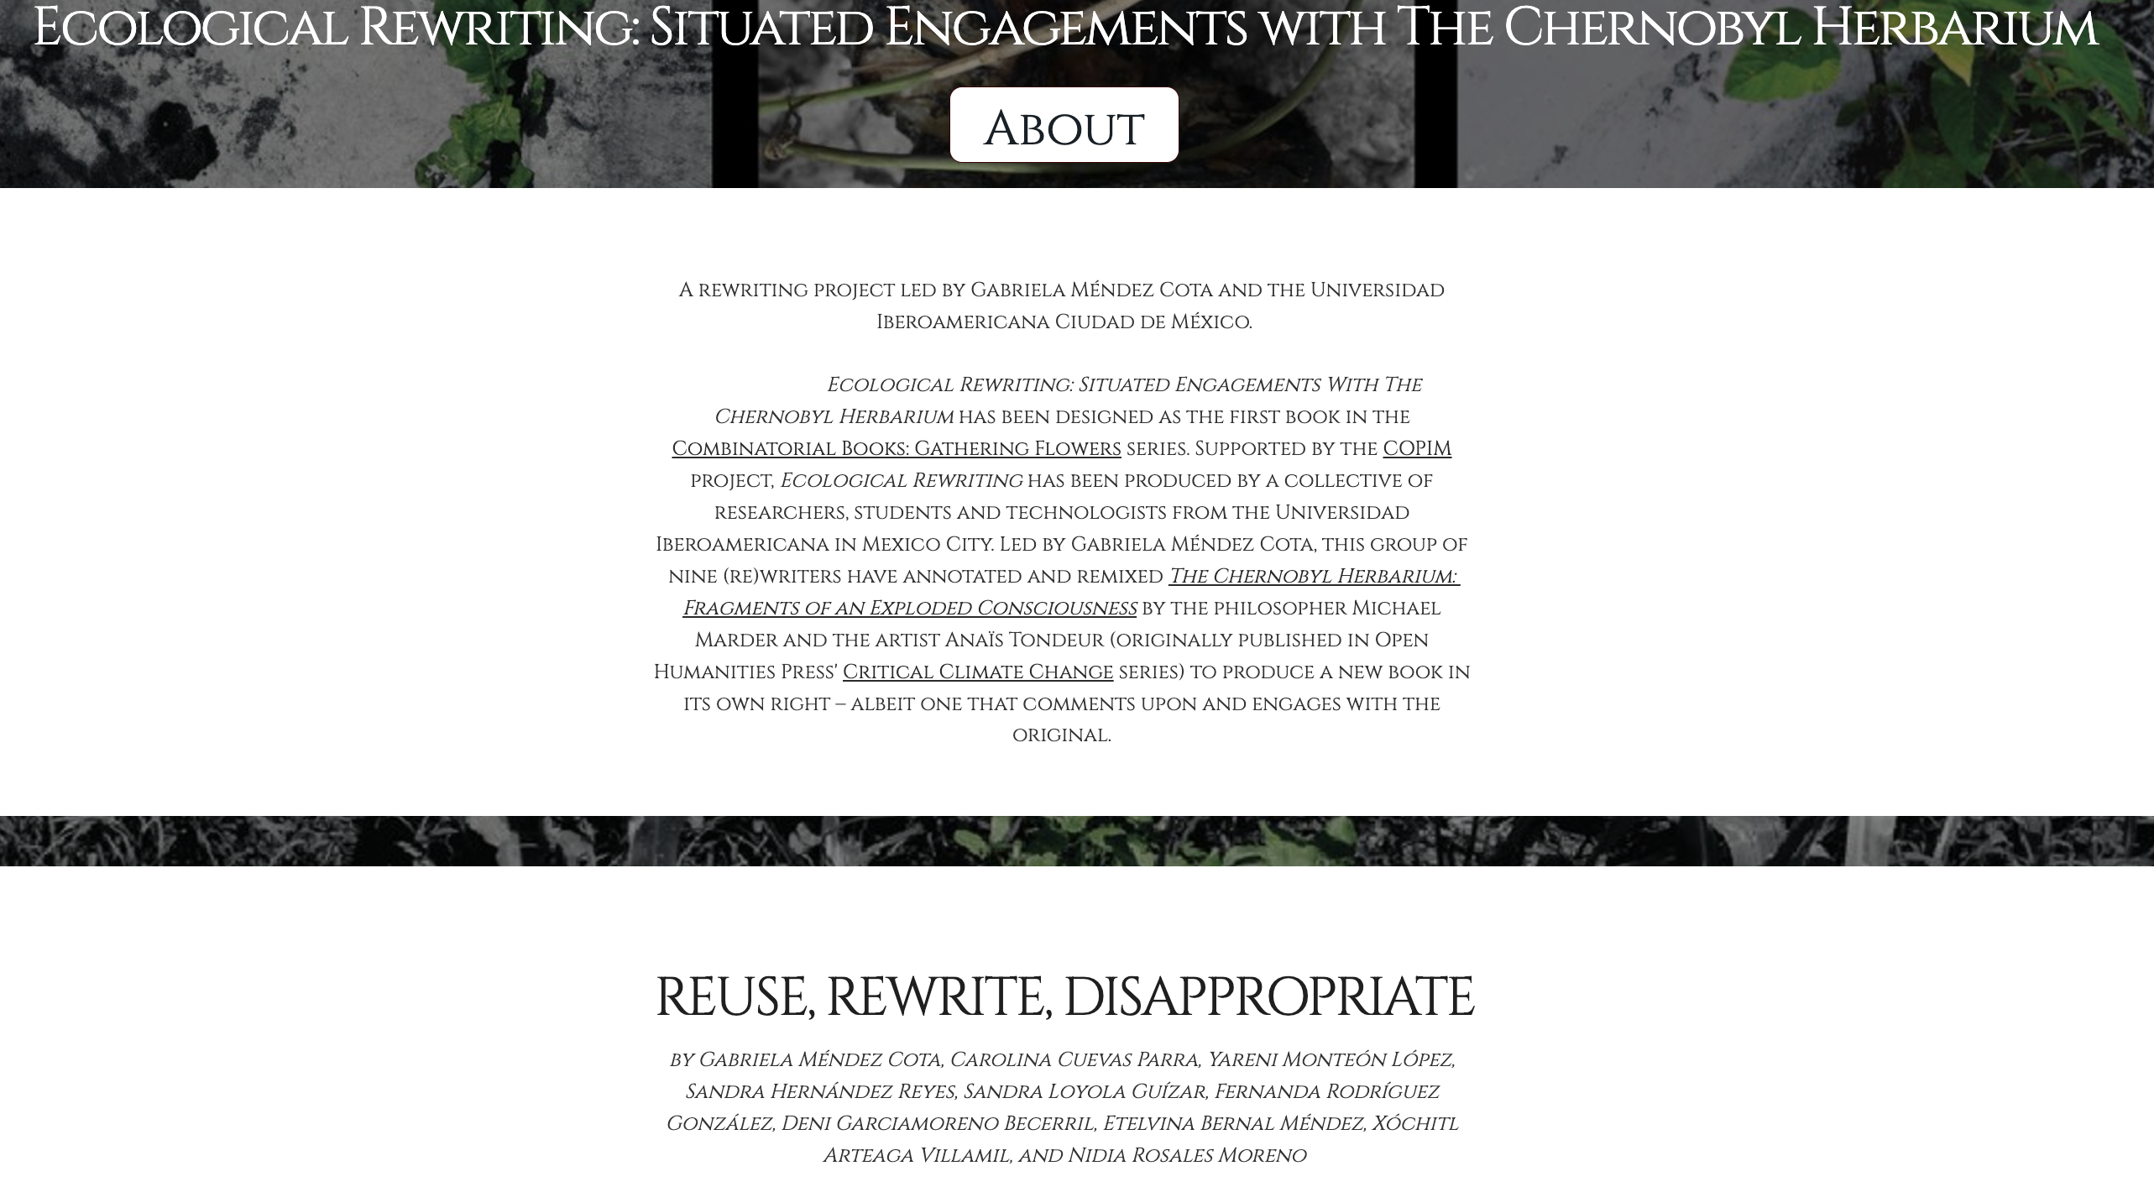
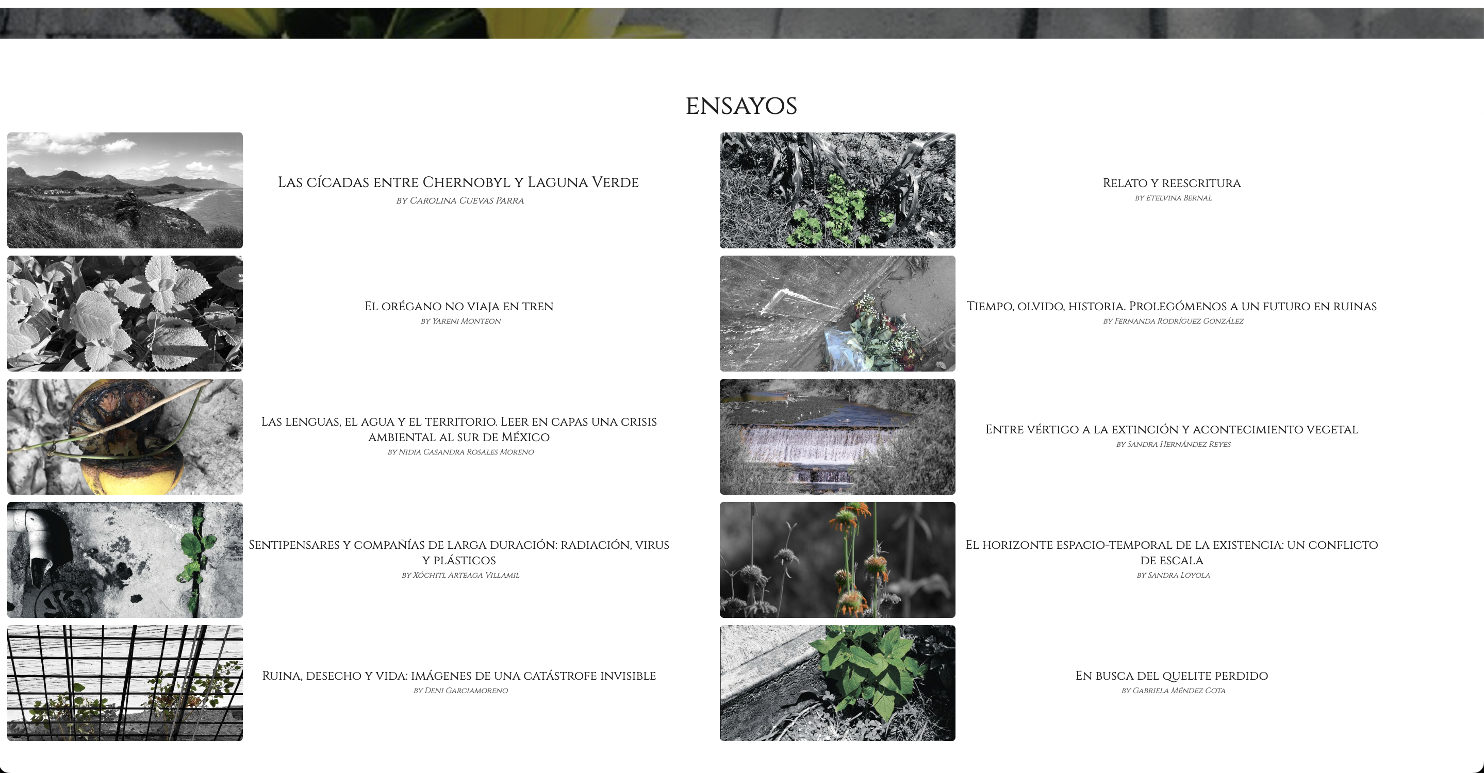
Ecological Rewriting: Situated Engagements
with The Chernobyl Herbarium, ed. Gabriela
Méndez Cota, Open Humanities Press, 2023
https://doi.org/10.21428/9ca7392d.07cdfb82

Slide 3
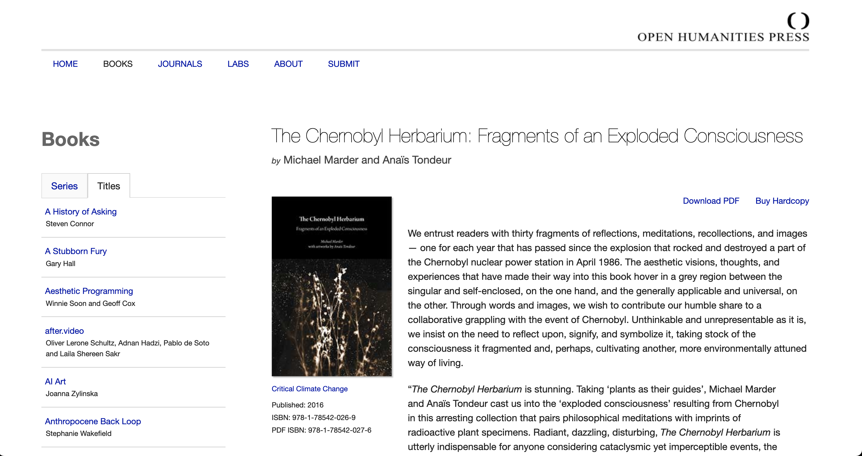

Slide 4
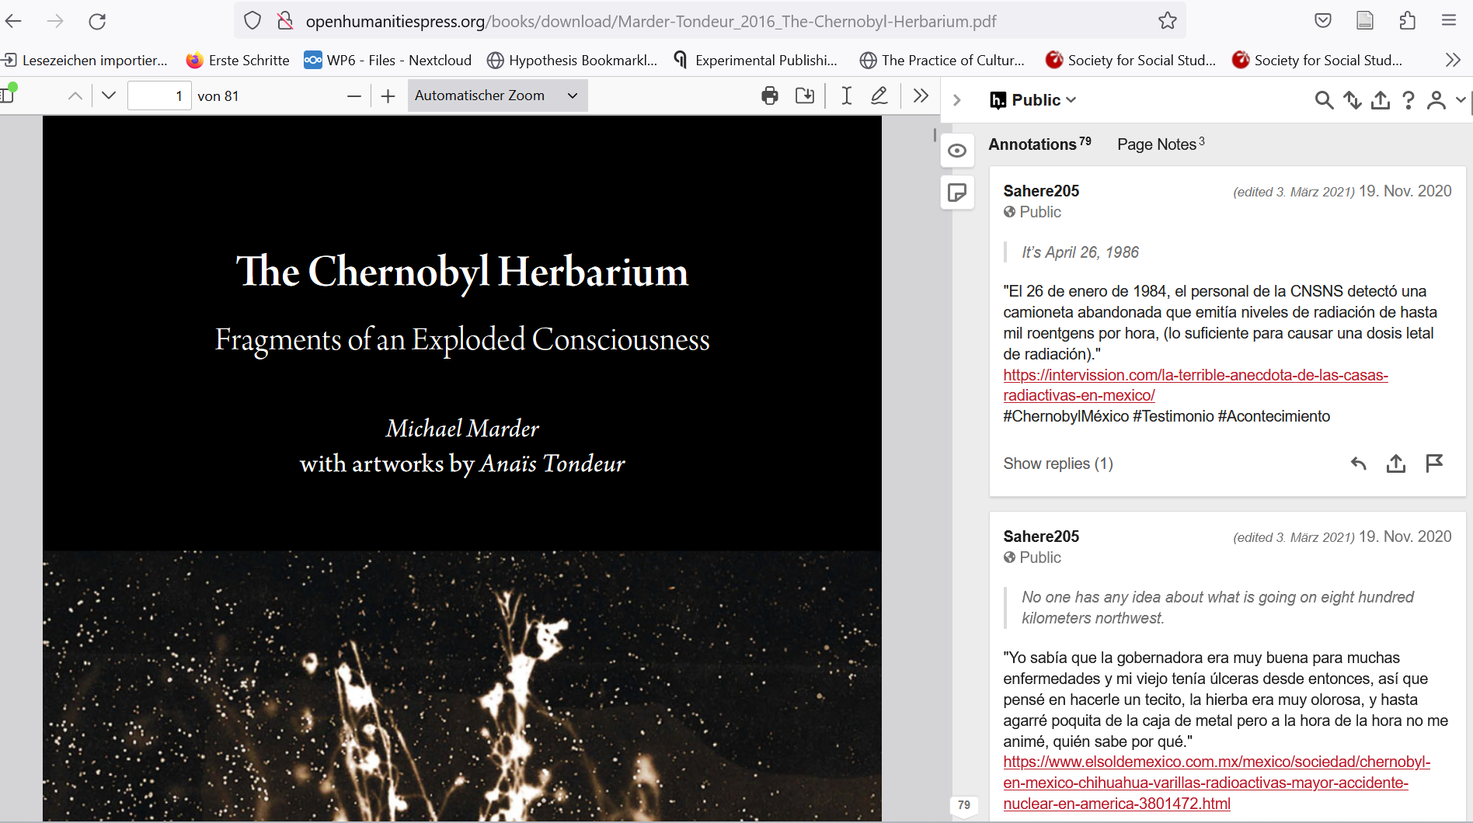
Collaborative hypothes.is annotations of the PDF version of Michael Marder’s and Anaïs Tondeur’s The Chernobyl Herbarium (2016) published on the Open Humanities Press website.

Slide 5
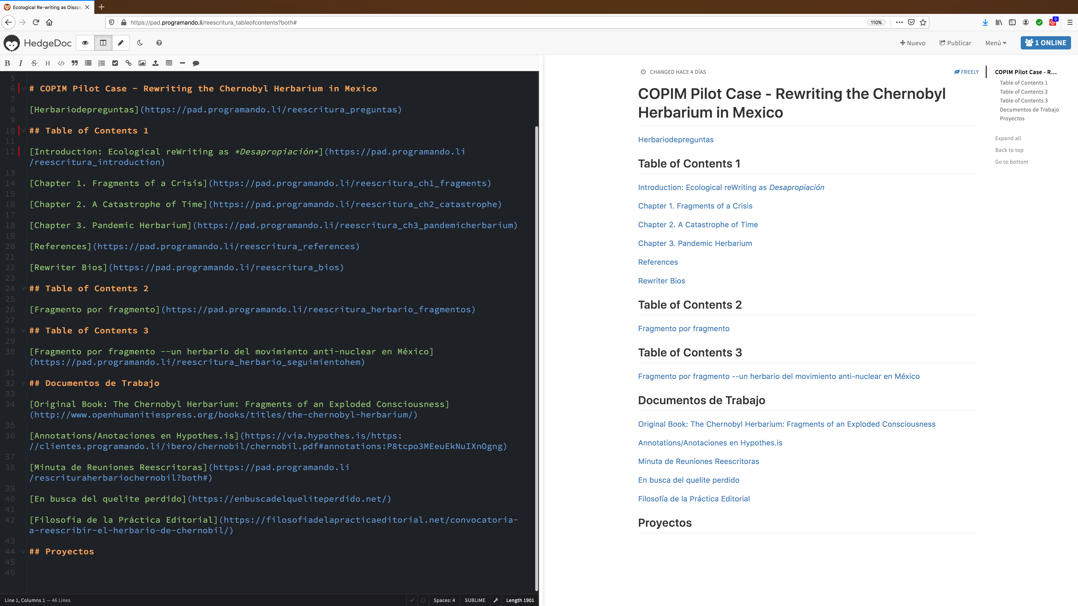
Collaborative writing pad on HedgeDoc.

Slide 6
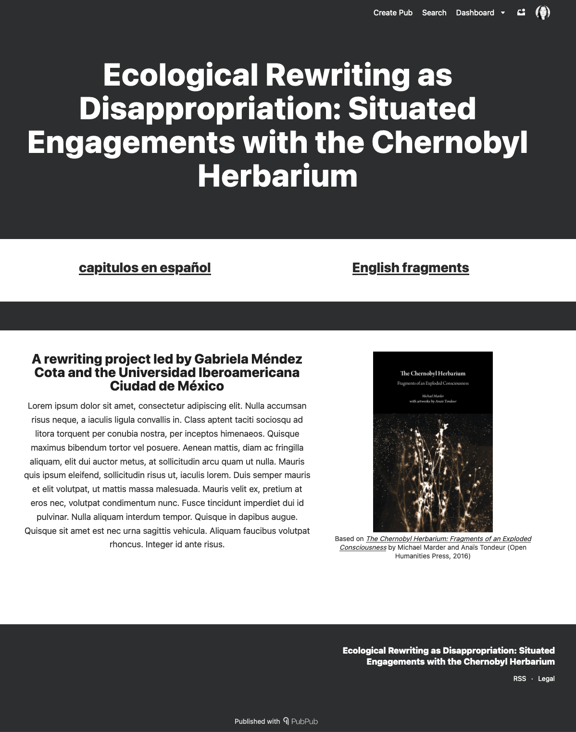
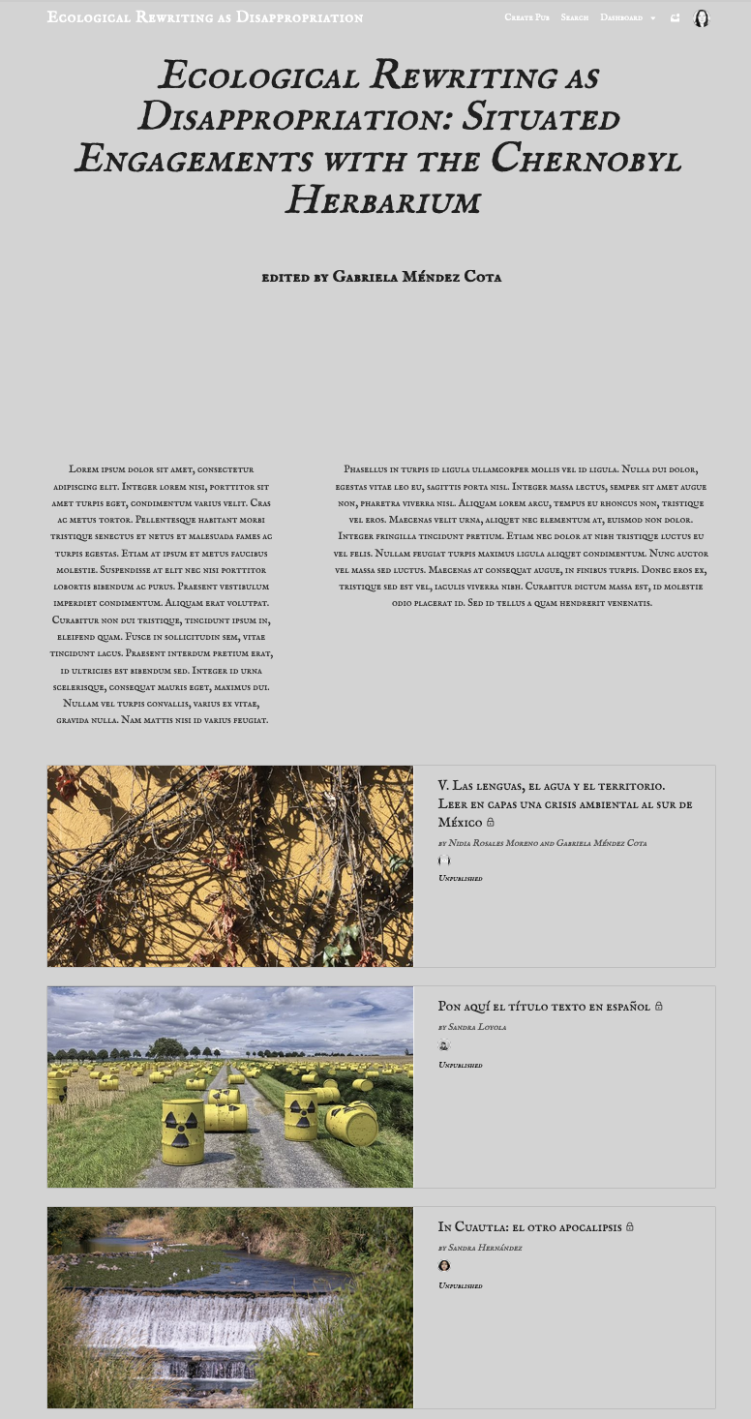
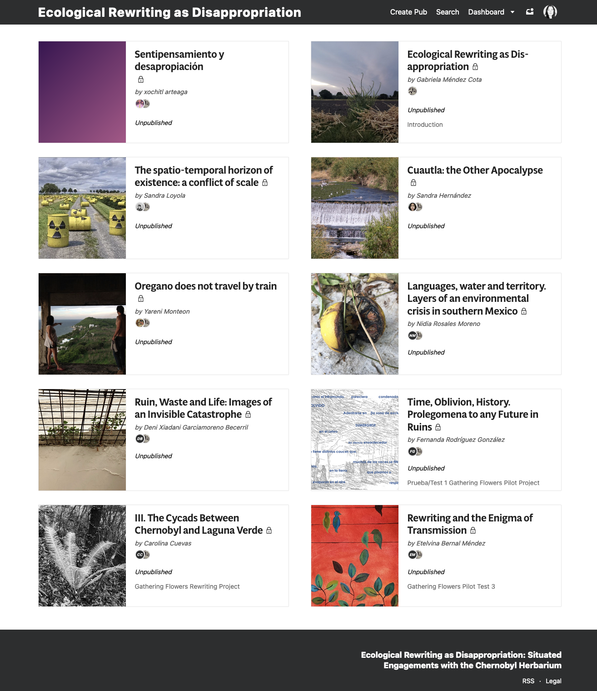
Ecological Rewriting as Disappropriation – Earlier versions of the book in development /Reescritura ecológica como desapropiación: versiones anteriores del libro en desarrollo

Slide 7
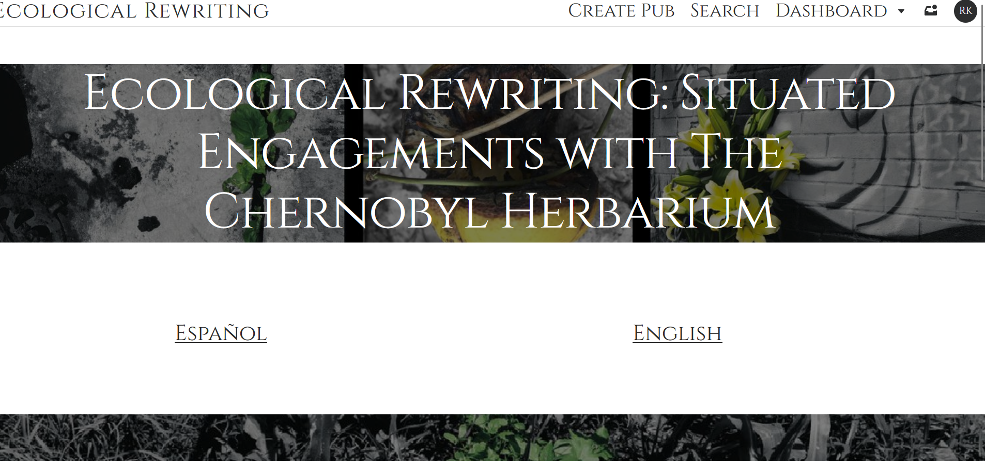
Draft version of Ecological Rewriting on PubPub.

Slide 8
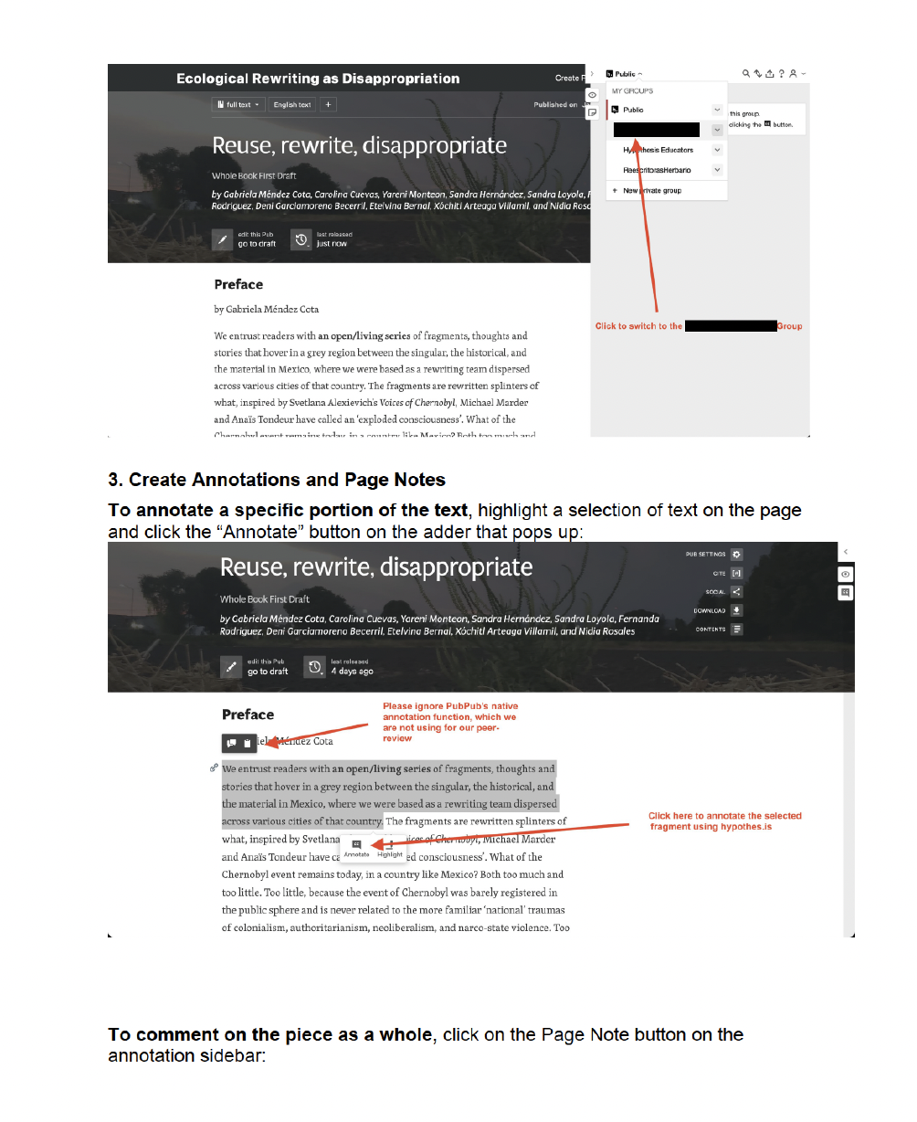
To guide the review process, we wrote both contextual and technical instructions for both authors and reviewers
Contextual instructions: https://cloud.copim.ac.uk/s/SYogg36rAL7fyey
Technical instructions: https://cloud.copim.ac.uk/s/Lk3mxRxZBSoNape
Code of conduct: https://cloud.copim.ac.uk/s/L7e23FGnFSYKRPB

Slide 9
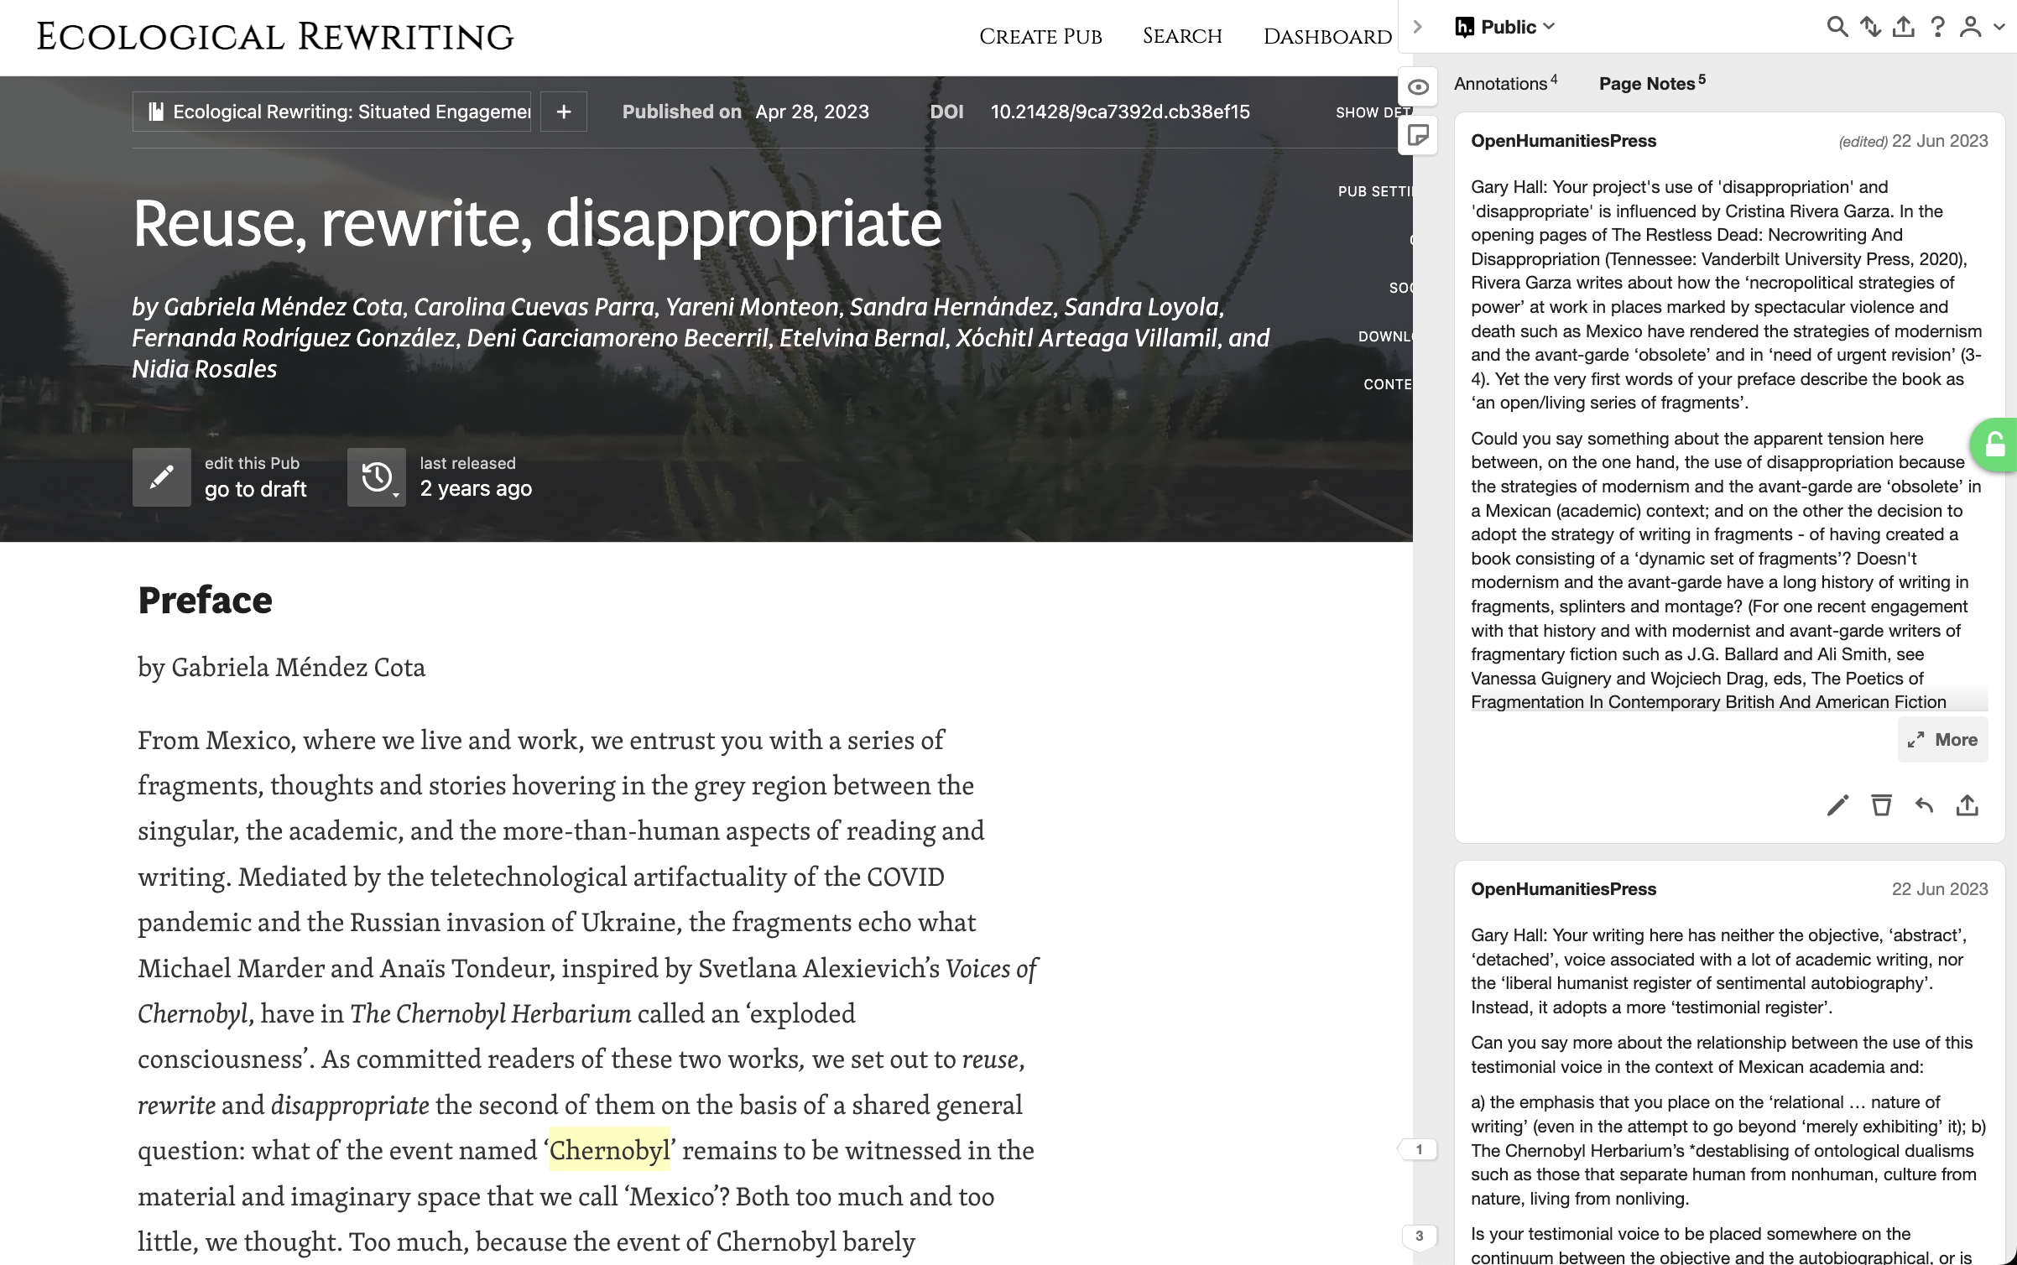
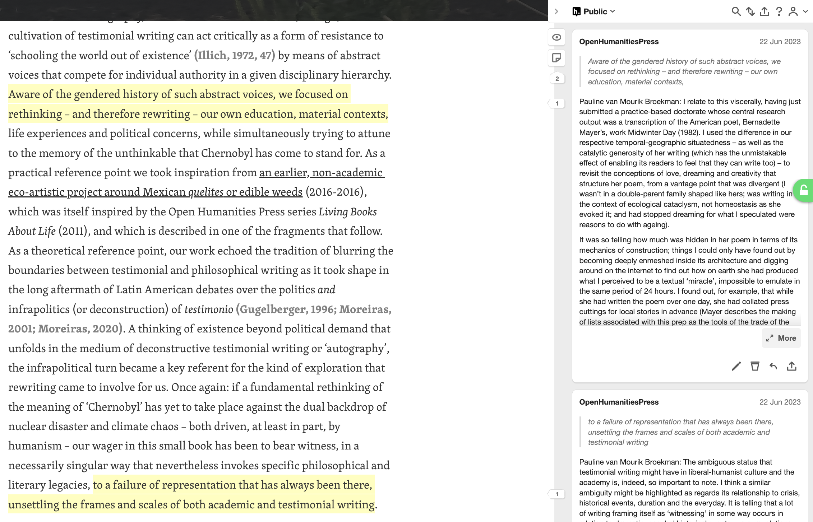

Slide 10
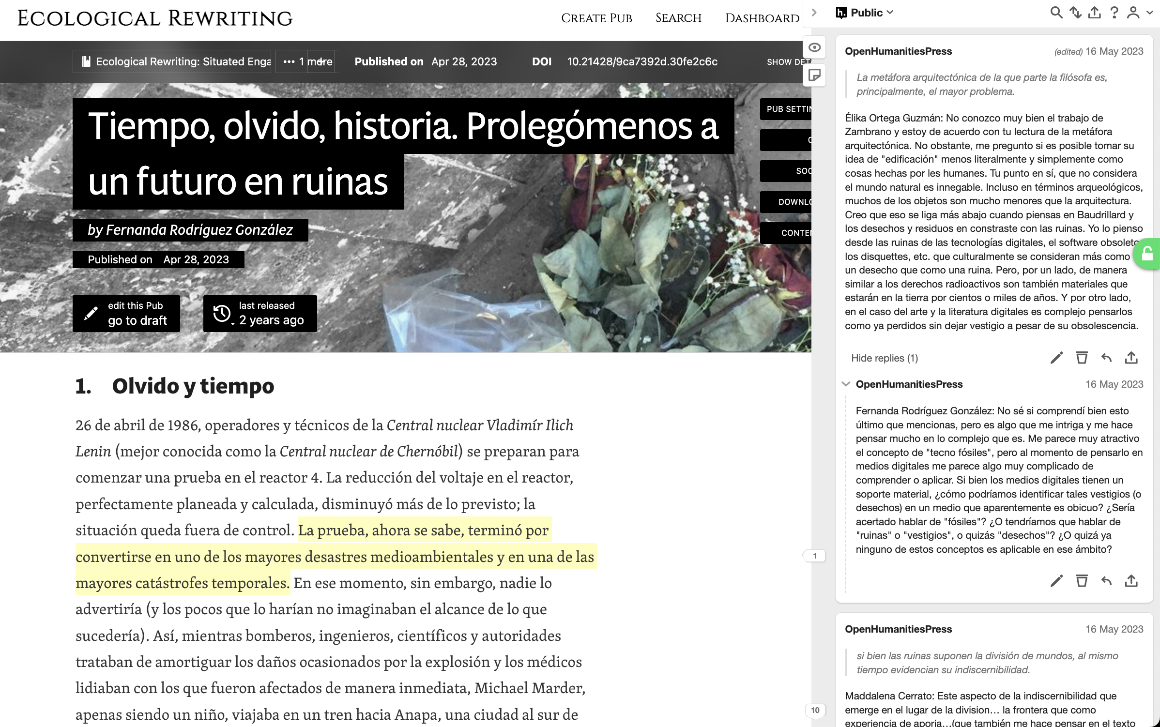

Slide 11
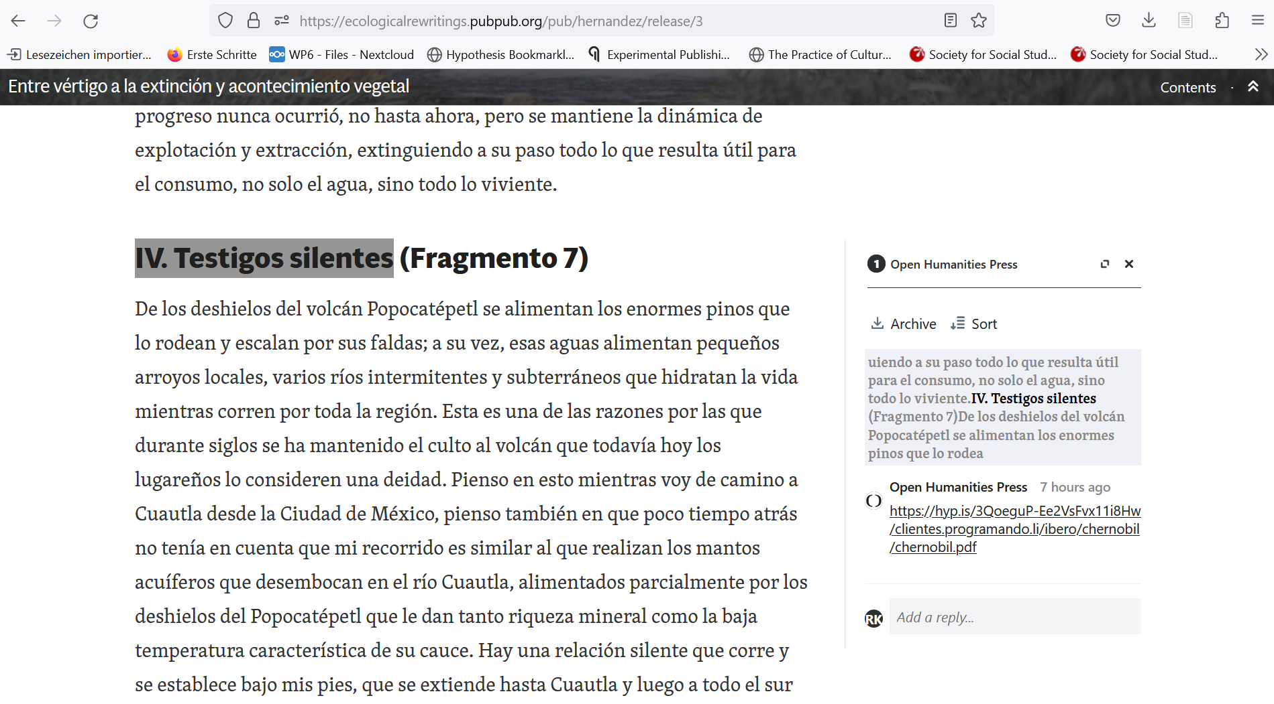

Slide 12
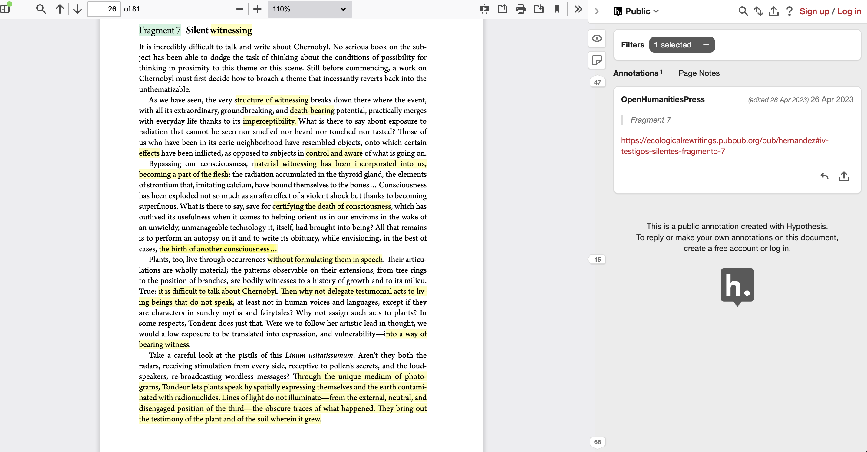

Slide 14
