Slide 1
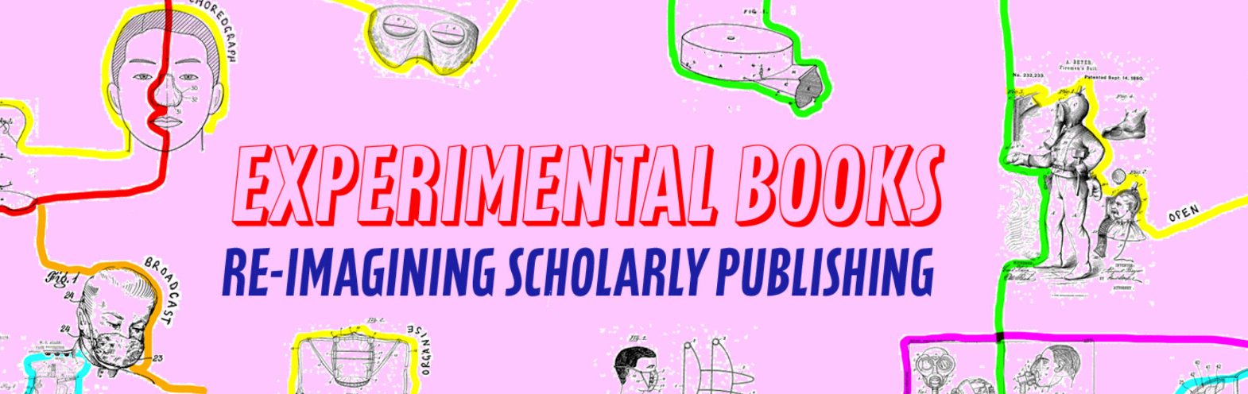
An Update from Copim’s Experimental Publishing Group
Janneke Adema (Coventry University) & Simon Bowie (Coventry University)
Copim’s Open Book Futures project: an update and showcase of our work - September 25th 2024

Slide 2

Who we are: Janneke Adema, Simon Bowie, Rebekka Kiesewetter (all Coventry University), Julien McHardy (Mattering Press)
What we do: we research ways to more closely align existing software, tools and technologies, workflows and infrastructures for experimental publishing with the workflows of open access book publishers
We maintain the Experimental Publishing Compendium (https://compendium.copim.ac.uk/), a guide and catalogue bringing together tools, practices, and books to promote the publication of experimental scholarly works
We conduct and support experimental book publishing pilot projects, working with publishers, authors and open-source platform providers to foster and encourage practices of experimentation and reuse

Slide 3
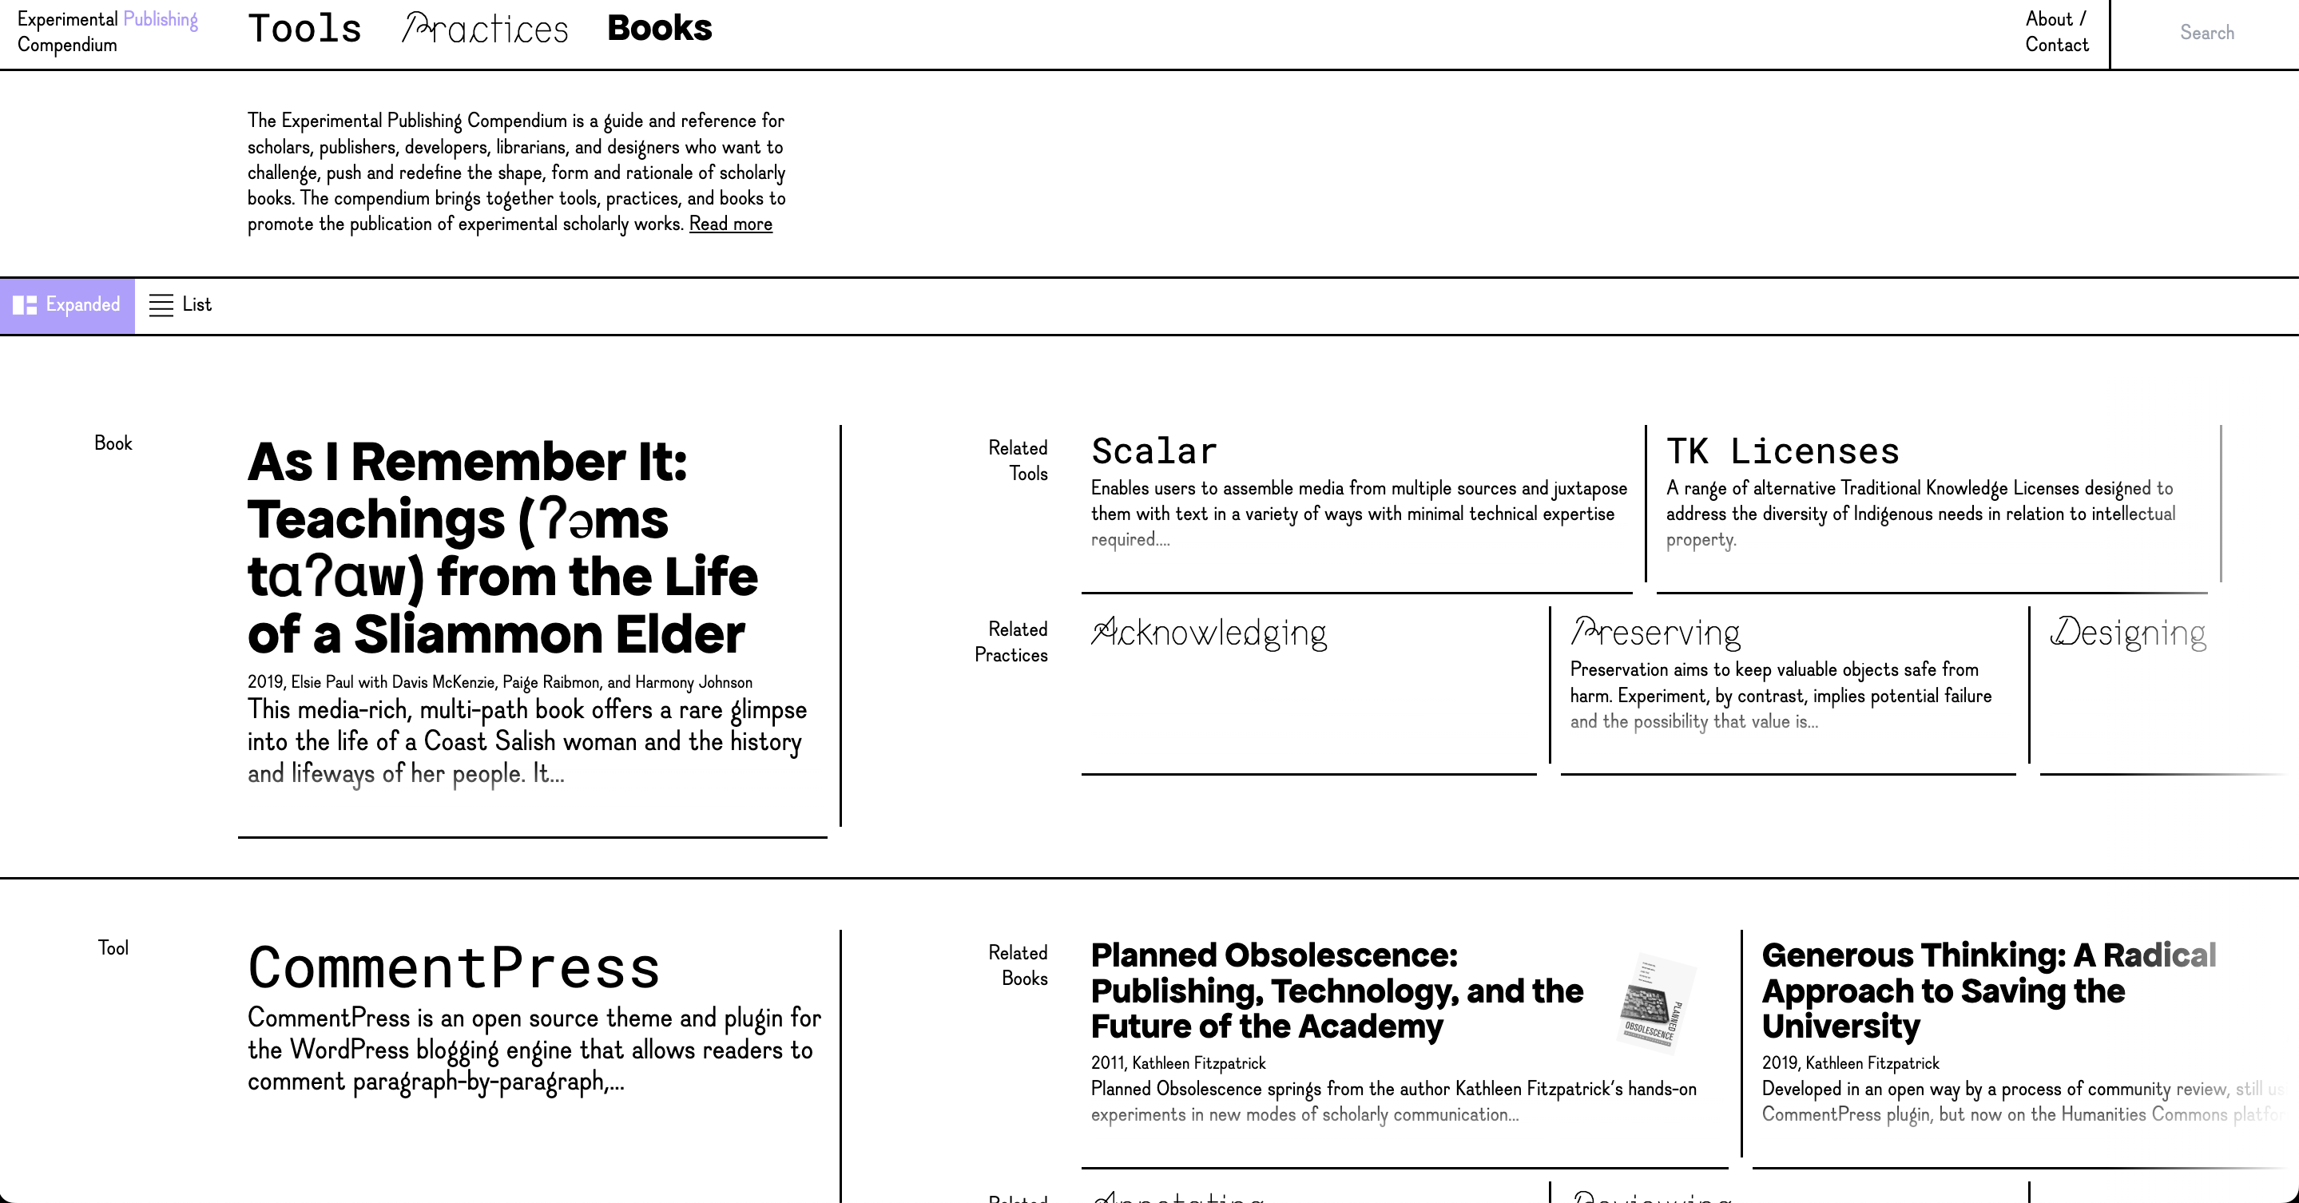
Experimental Publishing Compendium
https://compendium.copim.ac.uk/

Slide 4
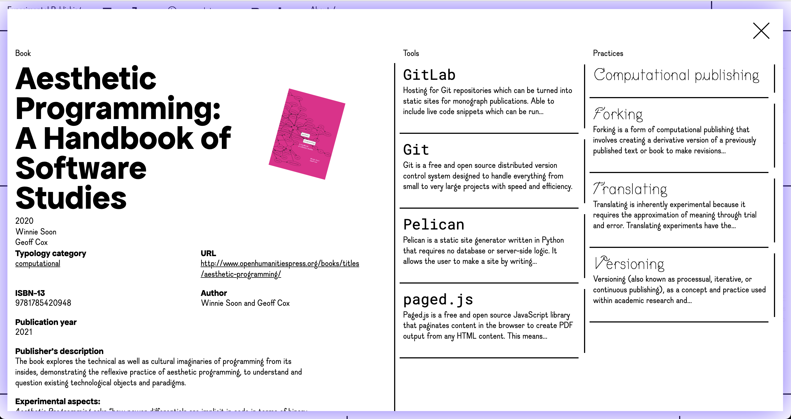

Slide 5
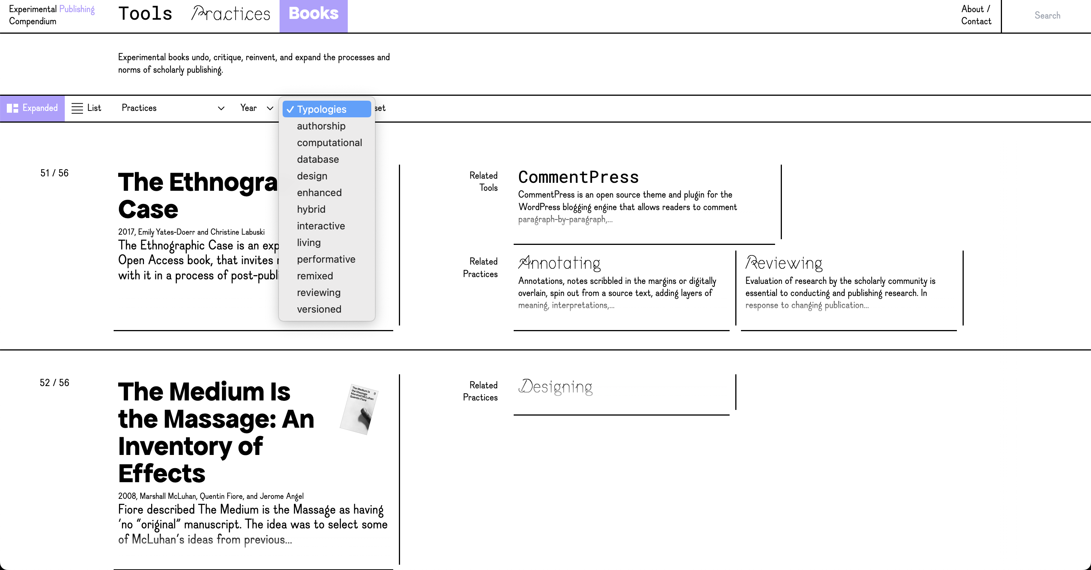

Slide 6
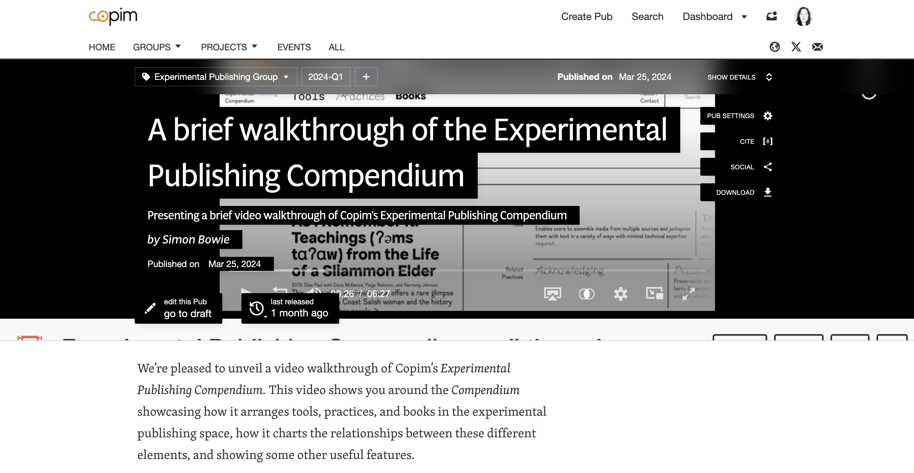
Video walk-through of the Experimental Publishing Compendium
Talks and conferences
Linköping University
The Centre for the Study of the Networked Image (London South Bank University)
Utrecht University Library
The Alan Turing Institute
Northumbria University Library
The Multimodal Appreciation project (Berlin)
The Sonic Screen Lab (London College of Communication – University of the Arts London)
The Centre for Practice Research in the Arts (CePRA – Leeds University)
The 4S/EASST conference (Vrije Universiteit Amsterdam)
Art Hub (Copenhagen)
https://archive.org/details/Experimental_Publishing_Compendium_walkthrough

Slide 7
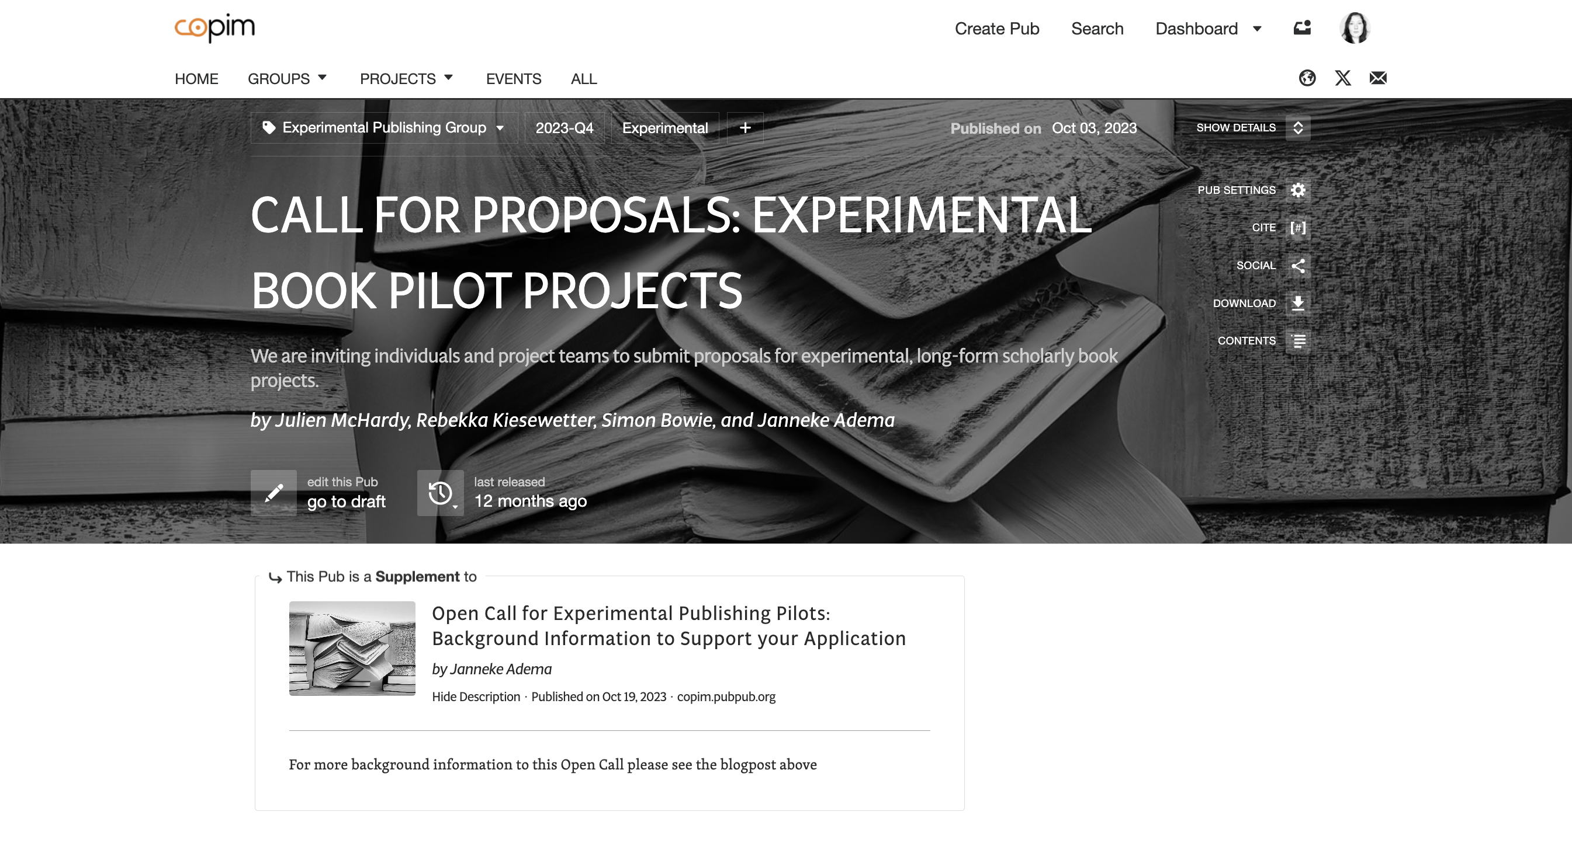

Slide 8
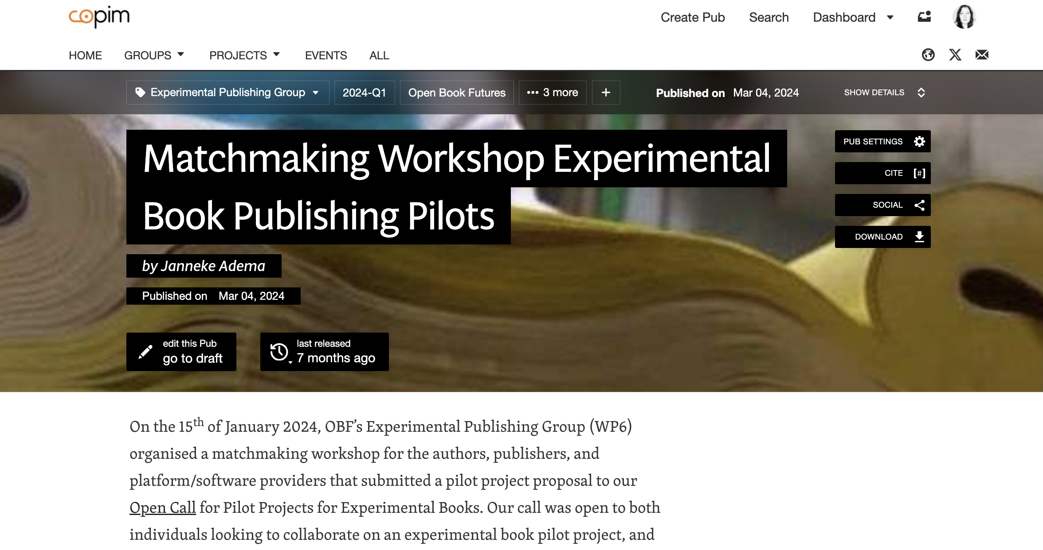

Slide 9
Database as Book and Lively Community Archive, an experimental book project which will build a “database as book” to support an emergent collective of critical STS scholars in Kenya in collaboration with the Research Data Share Collective, African Minds, and Platform for Experimental Collaborative Ethnography (PECE)
Deep Maps: Blue Humanities, a digital-first monograph which will explore deep mapping in content and form in collaboration with James Louis Smith, University of Westminster Press, and JSTOR Labs
Servpub – A Collective Infrastructure to Serve and Publish expands the idea of books as networked objects towards the infrastructures facilitating their creation & distribution, a collaboration of Slade School of Fine Art, CSNI, SHAPE, Minor Compositions, In-grid, Syster Server, and Creative Crowds

Slide 10
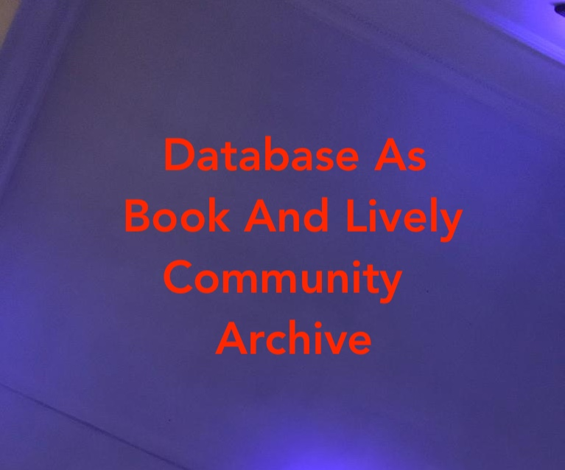


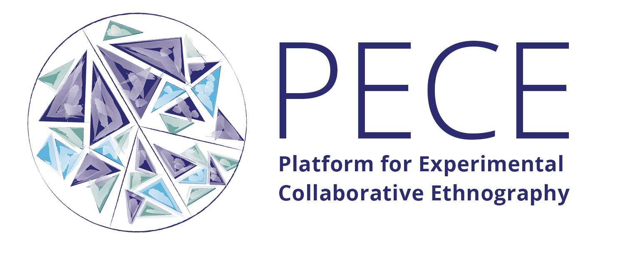
Author team: Aurelia Munene, Syokau Mutonga, Leonida Mutuku, Dr. Angela Okune, Dr. Wambui Wamunyu | Quotidian Data (Nairobi, Kenya) & Eider Africa (Nairobi, Kenya)
Publisher: Dr. François van Schalkwyk | African Minds (Cape Town, South Africa)
Open Source Platform Team: Professors Kim Fortun, Mike Fortun, and Lindsay Poirier | University of California Irvine (Irvine, CA, USA) & Smith College (Northampton, MA, USA)

Slide 11



Deep Maps: Blue Humanities
James Louis Smith
Photo by Cristian Palmer on Unsplash

Slide 12
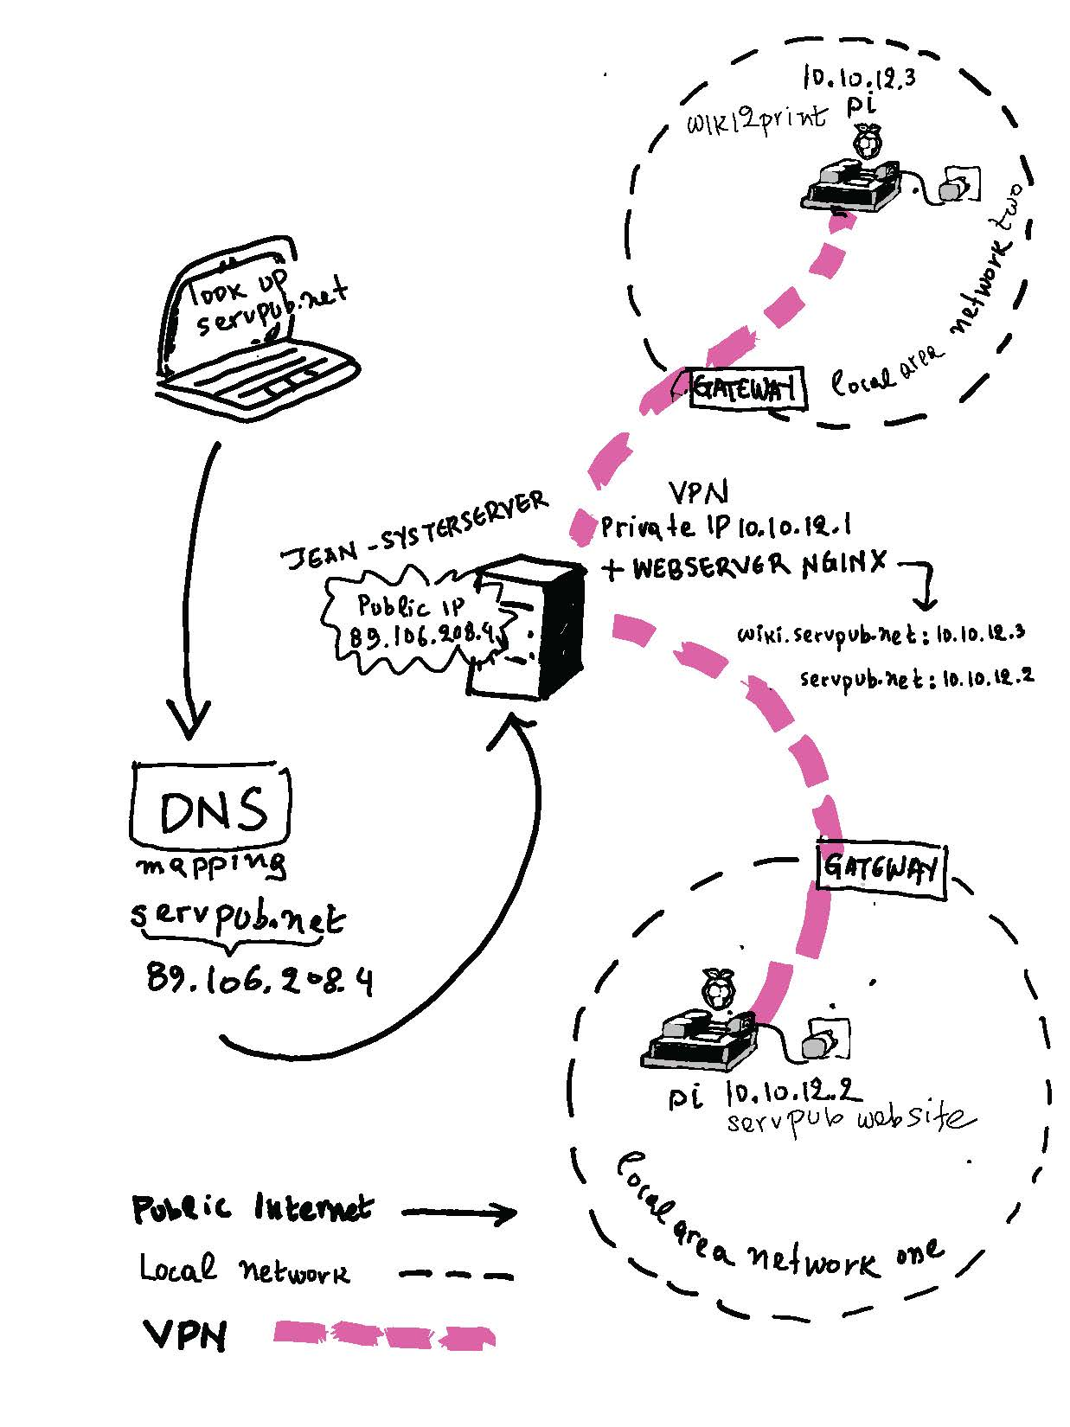
A diagram of the ServPub setup on the Jean Server by Mara Karagianni
ServPub – A Collective Infrastructure to Serve and Publish
Winnie Soon & Geoff Cox
Minor Compositions

