Slide 1


Promoting Interactions and Engagement with Scholarly Research: Speculations on the Role of the Librarian in Advancing Experimental Publishing
Janneke Adema
Copim/Open Book Futures
Centre for Postdigital Cultures, Coventry University
Department of Knowledge and Information Stewardship (DKIS) Conference on Advancing Social Justice Through Curriculum Realignment: Centering Scholarly Communication in LIS Curricula
University of Cape Town, 8-9 December 2024
2nd Global Summit on Diamond Open Access: Centering Social Justice in Scholarly Communication to Advance Research as a Public Good.

Slide 2
What role can librarians and LIS curricula play in promoting experimental publishing and in nurturing and facilitating interactions with openly available books?
Supporting experimental publishing as an extension of the traditional role of librarians to promote interactions and engagement with research
Lines up with growing demands from libraries and faculties for scholarly communication services
Lines up with library efforts to promote social justice, decolonisation, and excluded and indigenous knowledges
Reflects on the growth of libraries as publishers, and the important role library presses have played in promoting open access and innovative forms of publishing.

Slide 3
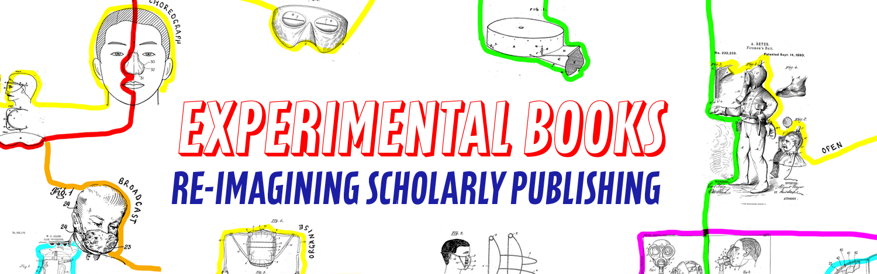

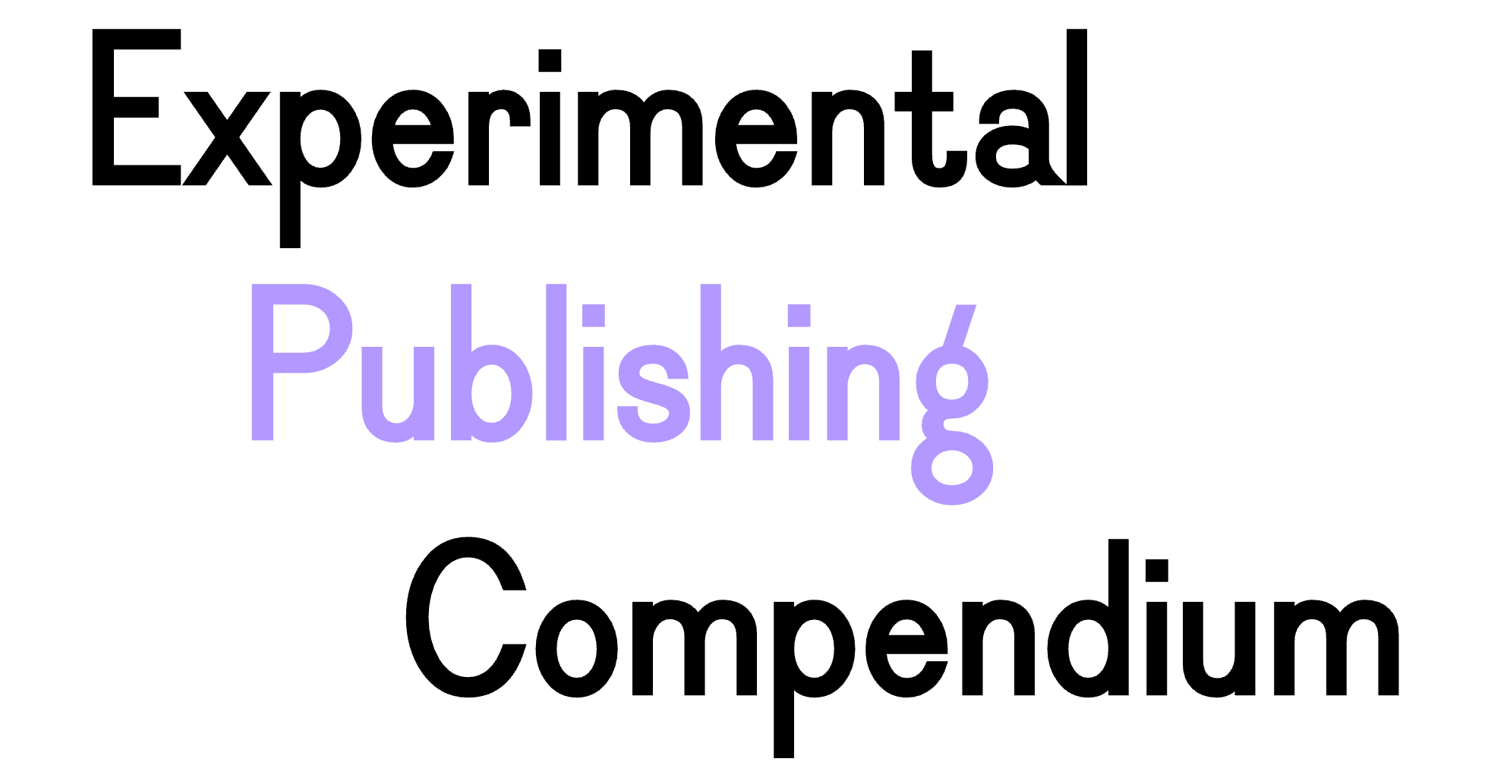


A community working to build a fairer, more open future for scholarly books: https://copim.pubpub.org/
The OBF project will significantly expand key infrastructures created by COPIM to
achieve a step change in how community-owned OA book publishing is delivered.
https://copim.pubpub.org/open-book-futures-project
a guide and reference which brings together tools, practices, and books to promote
the publication of experimental scholarly works. https://compendium.copim.ac.uk/
Our funders:

Slide 4
Situating Experimental Publishing
Experimental publishing examines, questions, critiques, and explores established publishing practices, workflows, and models, which reflect solidified print- and codex-based publishing conventions and neo-colonial and commercial hegemonies in academic publishing and knowledge production.
Experimental forms of publishing challenge the dominance of print-based processes within conventional forms of academic publishing (as being natural and the most suitable for all forms of research), and question models and relationalities of knowledge production that simply reproduce humanist, neoliberal, and epistemic legacy systems, which are often taken for granted or repeated uncritically.

Slide 5
Different kinds of experiments
Experiments with the form and format of the scholarly book;
Experiments with the various (multi)media through which books can be performed;
Experiments with the ways in which scholarship can be produced, disseminated, and consumed;
Experiments that reimagine the relationalities that constitute academic writing, research, and publishing.

Slide 6
Scholarly Interaction Around Open Access Books
Open Annotations
Open Peer Review
Remix and Reuse
Open and Social Scholarship
Versioning and Processual Publishing

Slide 7
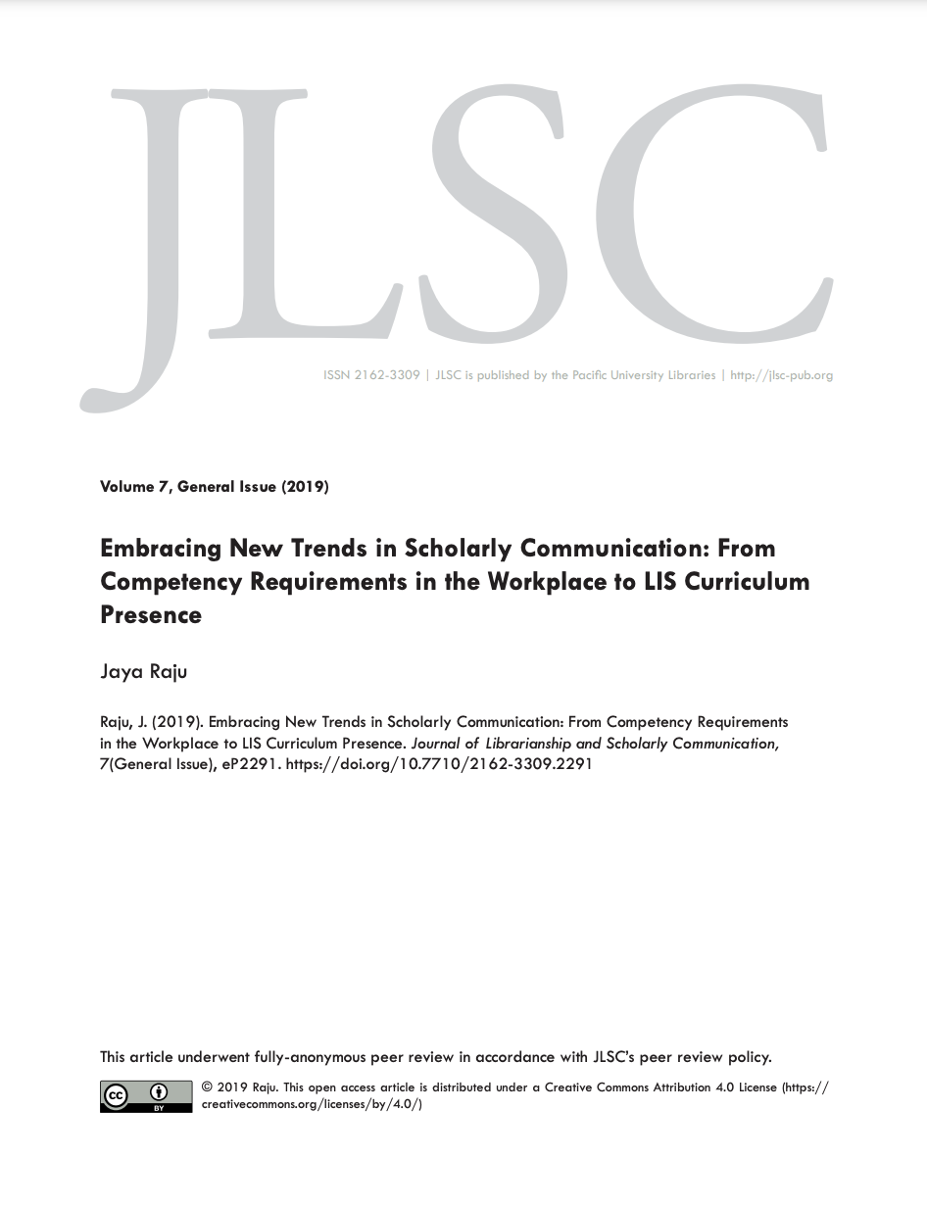
Raju, J. (2019). Embracing New Trends in Scholarly Communication: From Competency Requirements in the Workplace to LIS Curriculum Presence. Journal of Librarianship and Scholarly Communication, 7(1), Article 1. https://doi.org/10.7710/2162-3309.2291

Slide 8
Extending the roles of librarians
e.g. liaison and schol com librarians are well positioned to incorporate additional scholarly communication roles (including the promotion of experimental publishing) as “active partners in the creation and dissemination of research”
Advancing social and epistemic justice
Experiments with open peer review, collaborative authorship and knowledge production, and increased community interactions around books, can contribute to and support participatory research or the co-creation of knowledge. This is in line with practices of critical and progressive librarianship, a focus on community-led infrastructuring, and local and situated forms of scholarship
Libraries as publishers
Library publishing has a preference for Open Access dissemination as well as a willingness to embrace informal and experimental forms of scholarly communication and to challenge the status quo

Slide 9
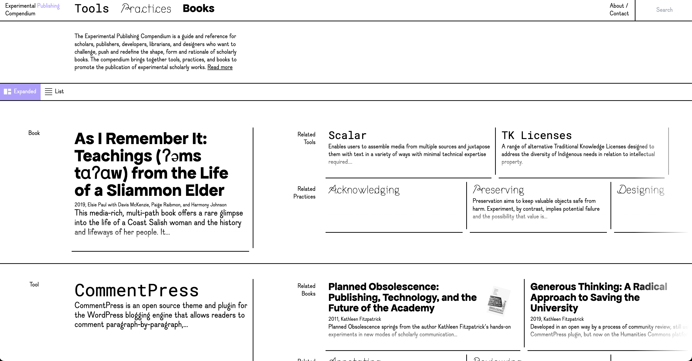
Experimental Publishing Compendium https://compendium.copim.ac.uk/
https://compendium.copim.ac.uk/

Slide 10
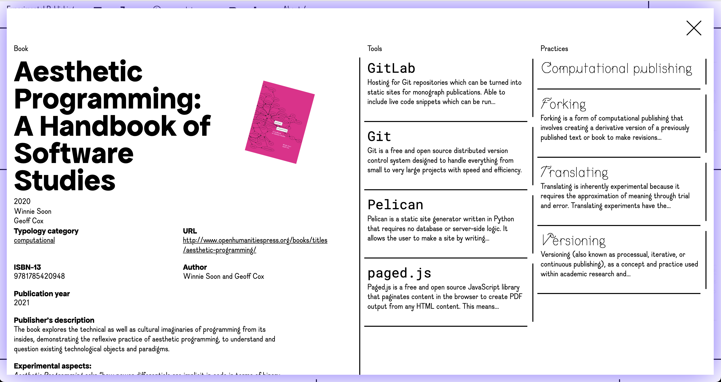

Slide 11
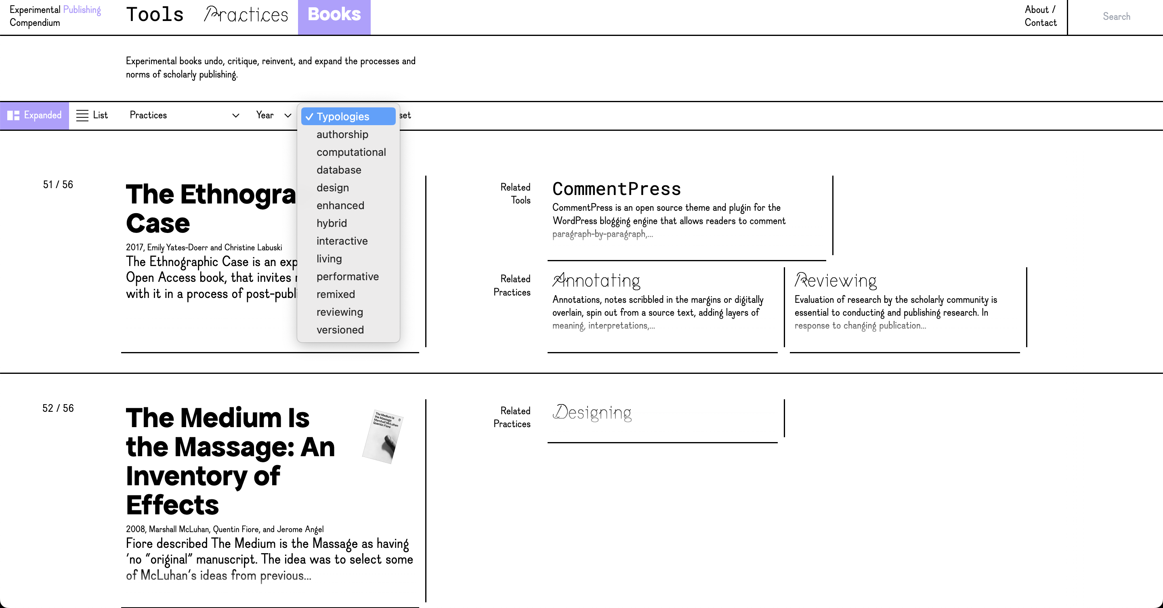

Slide 12
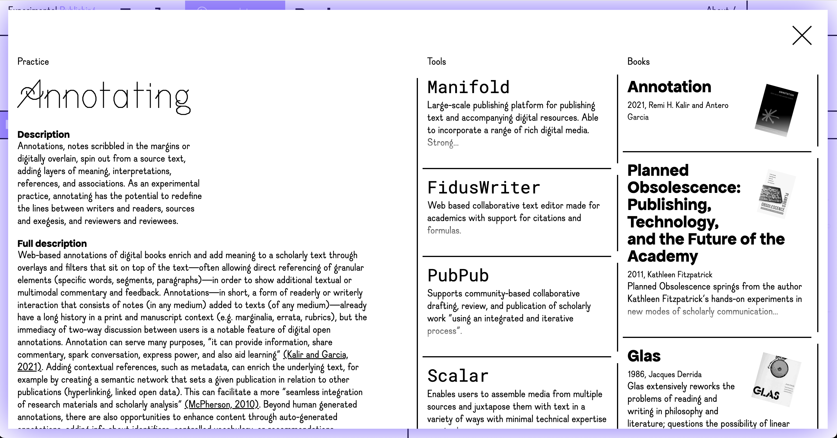

Slide 13
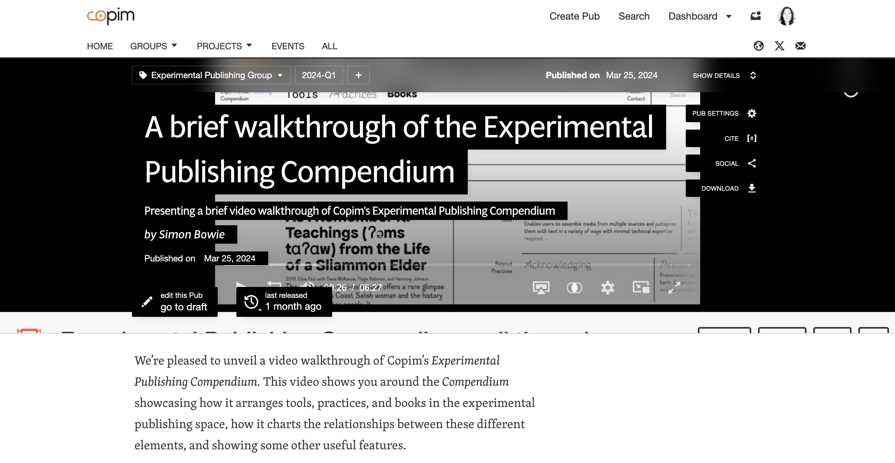
Video walk-through of the Experimental Publishing Compendium
https://archive.org/details/Experimental_Publishing_Compendium_walkthrough

