Slide 1


Community Governance Explored - Lessons for COPIM on how to scale small
Janneke Adema (Coventry University)
Equity And Inclusion: Community-owned
Infrastructures For Open Science.
A joint EIFL/COAR/OpenAIRE panel session. 21 October 2020

Slide 2
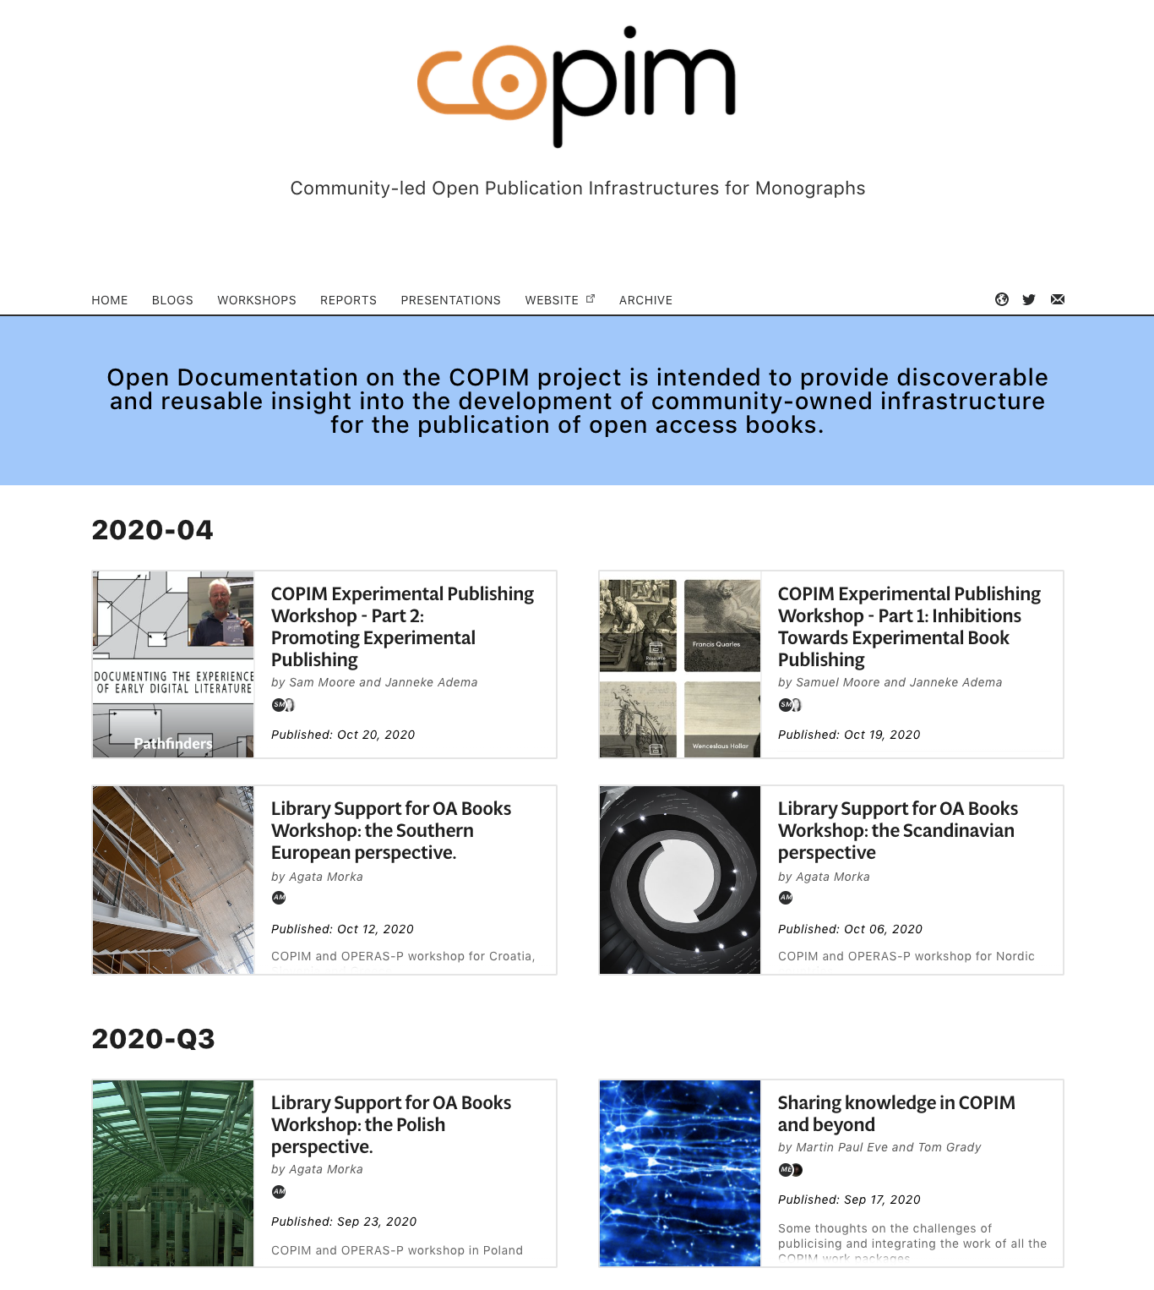
https://copim.pubpub.org/

Slide 3
COPIM Open Documentation Site
Moore, S., & Adema, J. (2020). Community Governance Explored. COPIM. https://doi.org/10.21428/785a6451.20a5c646
Moore, S., & Adema, J. (2020). COPIM Community Governance Workshop Recap: Part 1. COPIM. https://doi.org/10.21428/785a6451.6a3a2ca2
Moore, S., & Adema, J. (2020). COPIM Community Governance Workshop Recap: Part 2 - On the Meaning of Community. COPIM. https://doi.org/10.21428/785a6451.dfe7dc68

Slide 4
COPIM (Community-led Open Publication Infrastructures for Monographs)
3 years: November 1st 2019 – 31 October 2022
Funded by Research England, Arcadia, and by contributions from consortium partners
An international consortium of universities, scholar-led open access presses, libraries, and infrastructure providers
https://www.copim.ac.uk/ and https://copim.pubpub.org/
Notes:
COPIM, is an international partnership of presses, universities, libraries, and technology providers. Its aim to realign OA book publishing away from competing commercial service providers to embrace a more horizontal and cooperative knowledge-sharing approach instead. In doing so COPIM aims to address the key technological, structural, and organisational hurdles—around funding, production, dissemination, discovery, reuse, and archiving—which are standing in the way of the wider adoption and impact of open access books

Slide 5
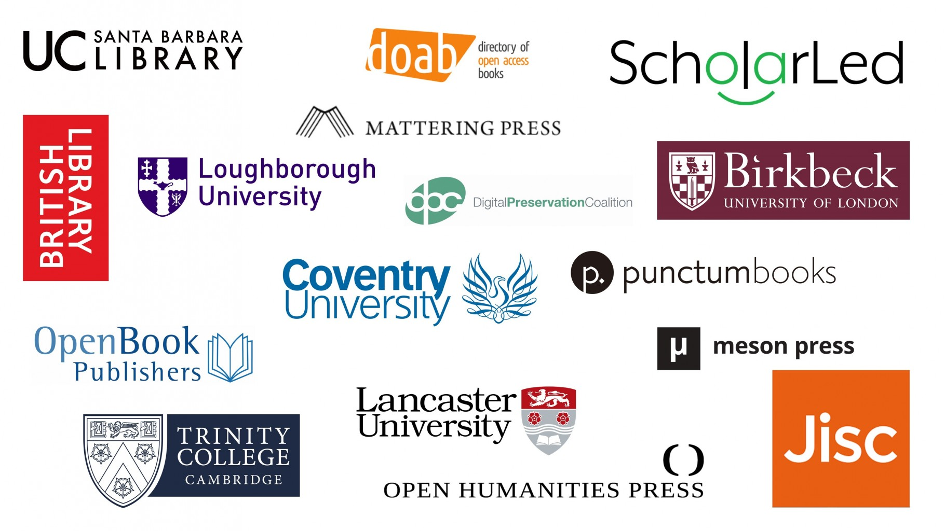

Slide 6


Slide 7

Revenue Infrastructures & Management Platform
Knowledge Exchange & Piloting Alternative Business Models
Community Governance
Project Management
Building an Open Dissemination System
Experimental Publishing and Re-use
Archiving & Digital Preservation
Notes:
The work on COPIM is divided into 7 work packages (including a project management WP), which I will shortly describe here
WP2 is developing and launching a modular, scalable revenue generation and management platform for OA books, to be made available to publishers and libraries.
WP 3 is working with selected publishers to assist them in migrating their economic models to OA versions, while documenting the process
WP4 is developing the governance procedures of COPIM’s open publication ecosystem for monographs, which Sam will talk about more in his presentation
WP5 is developing technical protocols and infrastructure to better integrate OA books into institutional library, digital learning and repository systems.
WP 6 is producing a set of pilot cases of experimental books which will be developed with the aid of the new tools and platforsm focused on experimental long-form publications
WP7 is identifying the key challenges associated with archiving research monographs and is looking at archiving solutions for more complex and experimental long-form publications
I am very much looking forward to the next couple of days and to discussing everything governance with all of you!

Slide 8
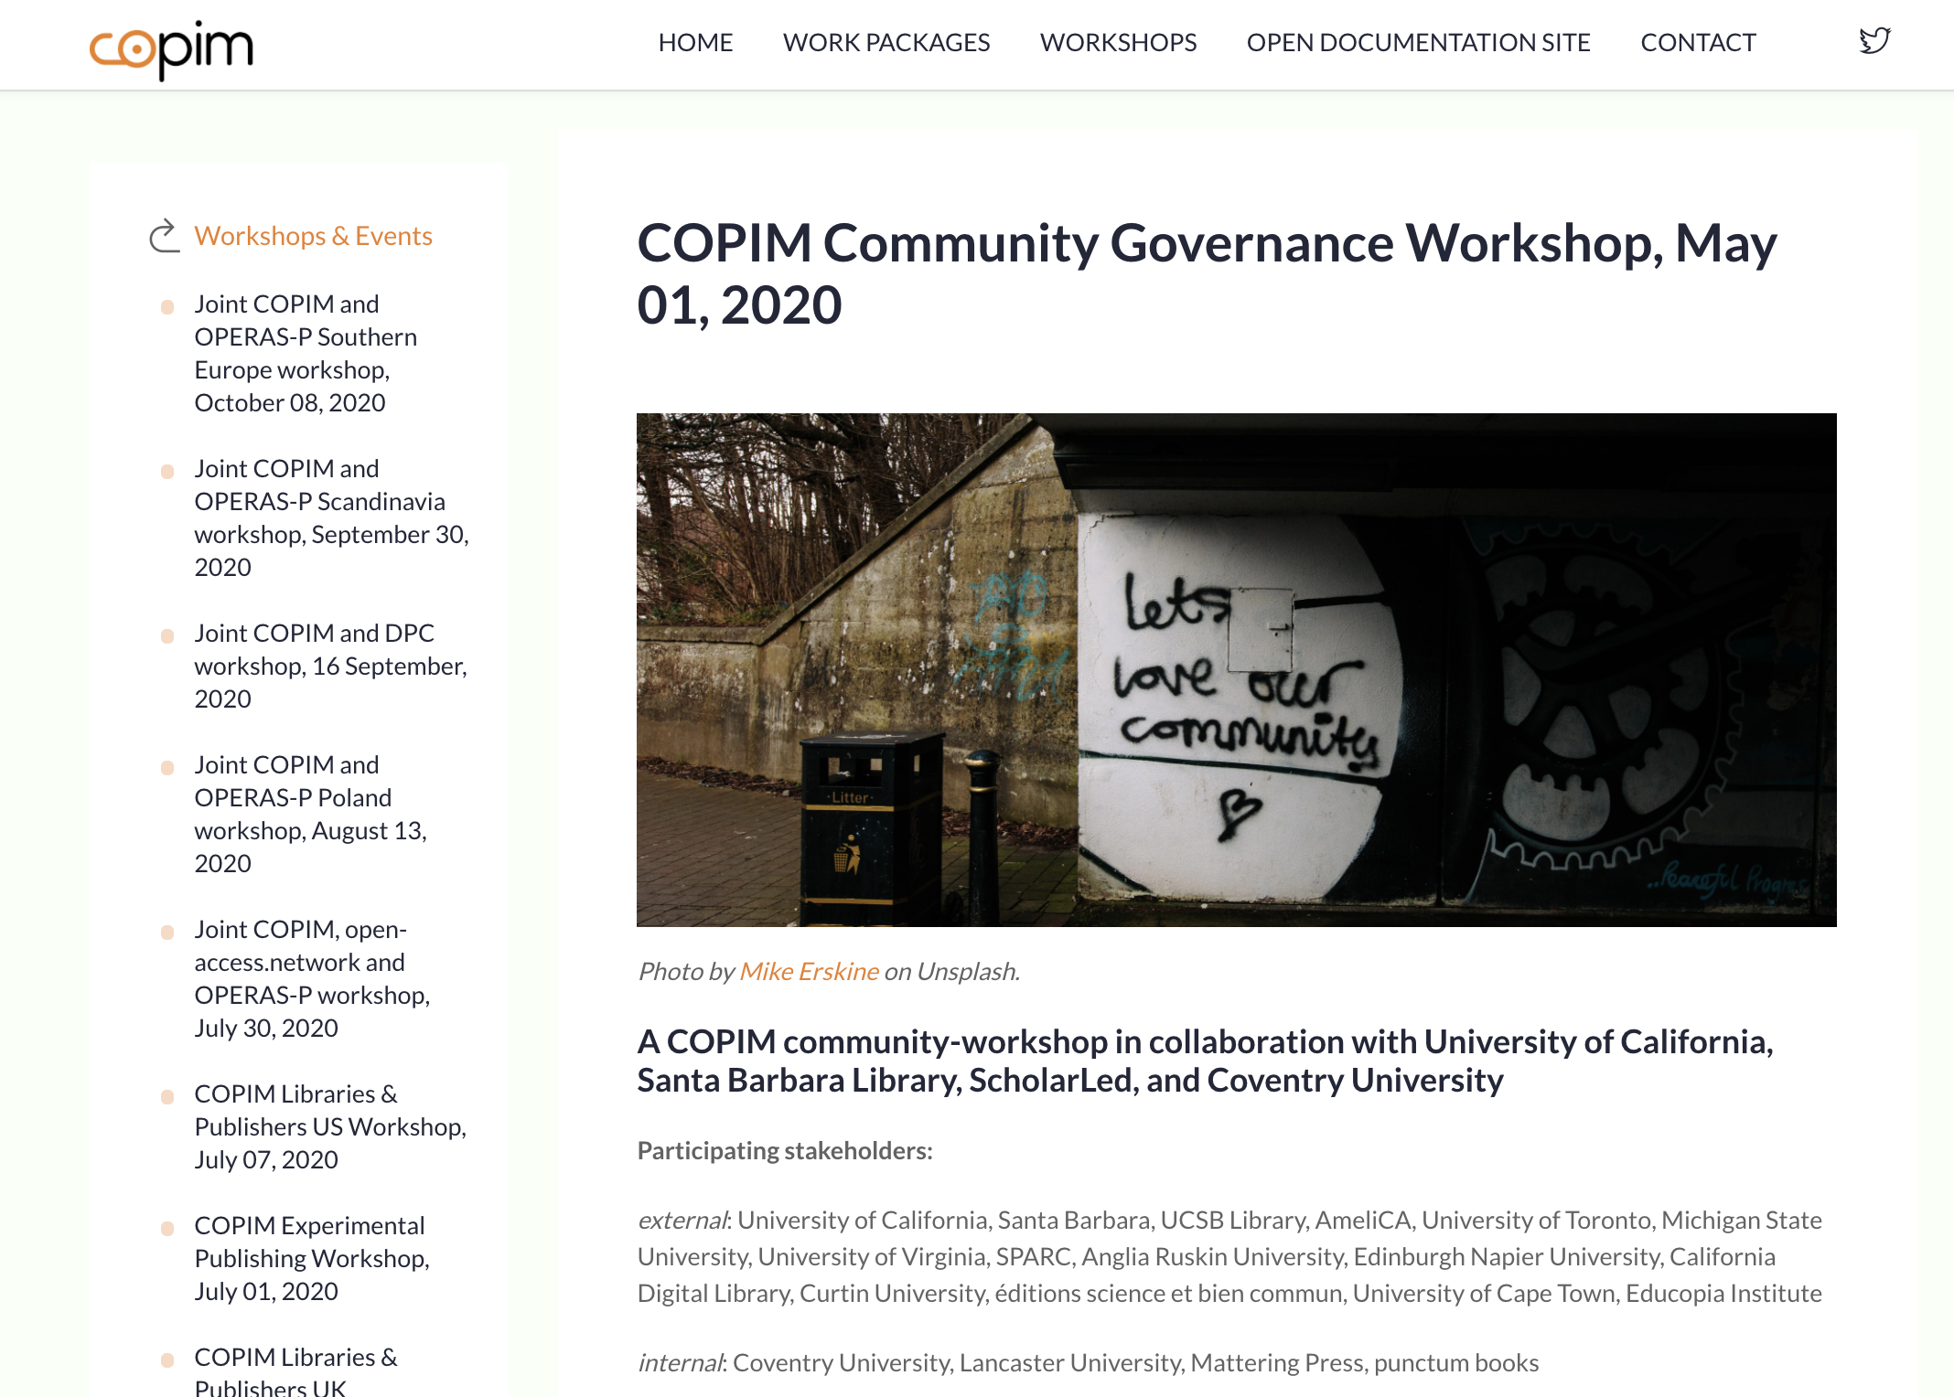

Slide 9
What is good governance?
Situatedness
Formality
Process
Diversity

Slide 10
Who or what is our community?
Defining communities?
Homogenisation and exclusion
Community-Building

Slide 11
Community
“Community can be the warmly persuasive word to describe an existing set of relationships, or the warmly pervasive word to describe an alternative set of relationships. What is most important, perhaps, is that unlike all other terms of social organization (state, nation, society, etc.) it seems never to be used unfavorably, and never to be given any positive opposing or distinguishing term” (Raymond Williams, Keywords, p. 76)

Slide 12
Who or what is our community?
Defining communities?
Homogenisation and exclusion
Community-Building

Slide 13
Scaling Small

Slide 14
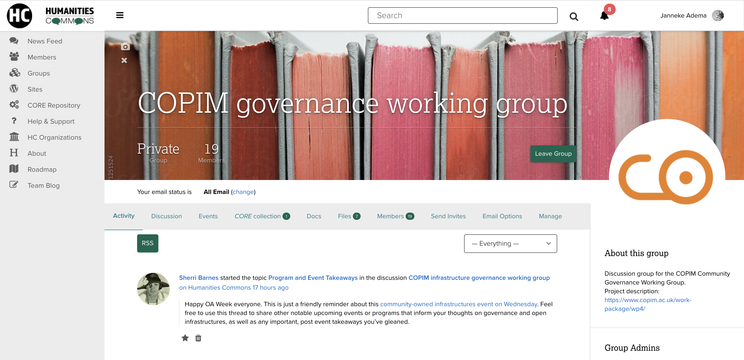

Slide 15
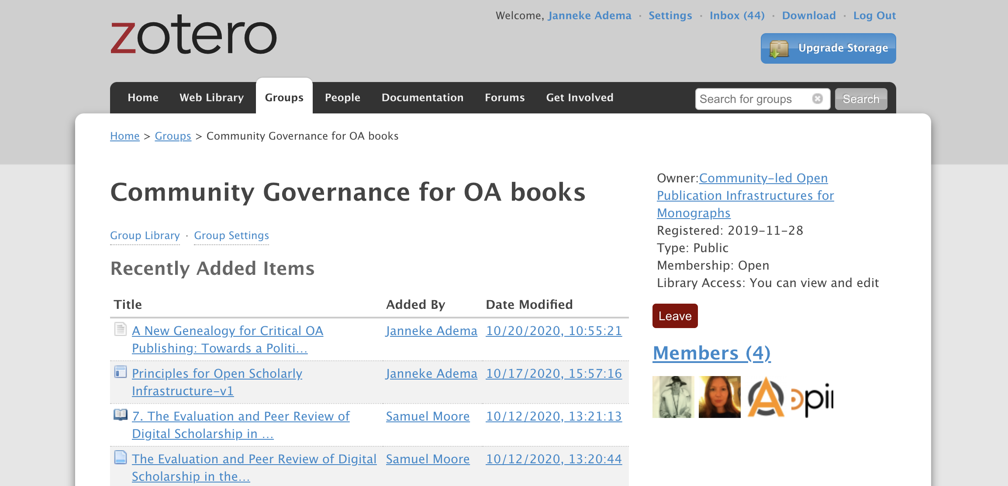

Slide 16
Website: https://www.copim.ac.uk/
Open Documentation Site: https://copim.pubpub.org/
Twitter: @COPIMproject
Email: info@copim.ac.uk

