Slide 1


Scaling Small: Enabling A More Diverse Ecosystem For Scholarly Book Publishing
Janneke Adema (Coventry University)
Open and Engaged Conference 2020: Inequities in Scholarly Communications
British Library, October 19th

Slide 2
Overview
COPIM: Project Introduction
Scaling Small: Caring for a Diverse Publishing Ecosystem

Slide 3
COPIM (Community-led Open Publication Infrastructures for Monographs)
3 years: November 1st 2019 – 31 October 2022
Funded by Research England, Arcadia, and by contributions from consortium partners
An international consortium of universities, scholar-led open access presses, libraries, and infrastructure providers
https://www.copim.ac.uk/ and https://copim.pubpub.org/
Notes:
COPIM, is an international partnership of presses, universities, libraries, and technology providers. Its aim to realign OA book publishing away from competing commercial service providers to embrace a more horizontal and cooperative knowledge-sharing approach instead. In doing so COPIM aims to address the key technological, structural, and organisational hurdles—around funding, production, dissemination, discovery, reuse, and archiving—which are standing in the way of the wider adoption and impact of open access books

Slide 4
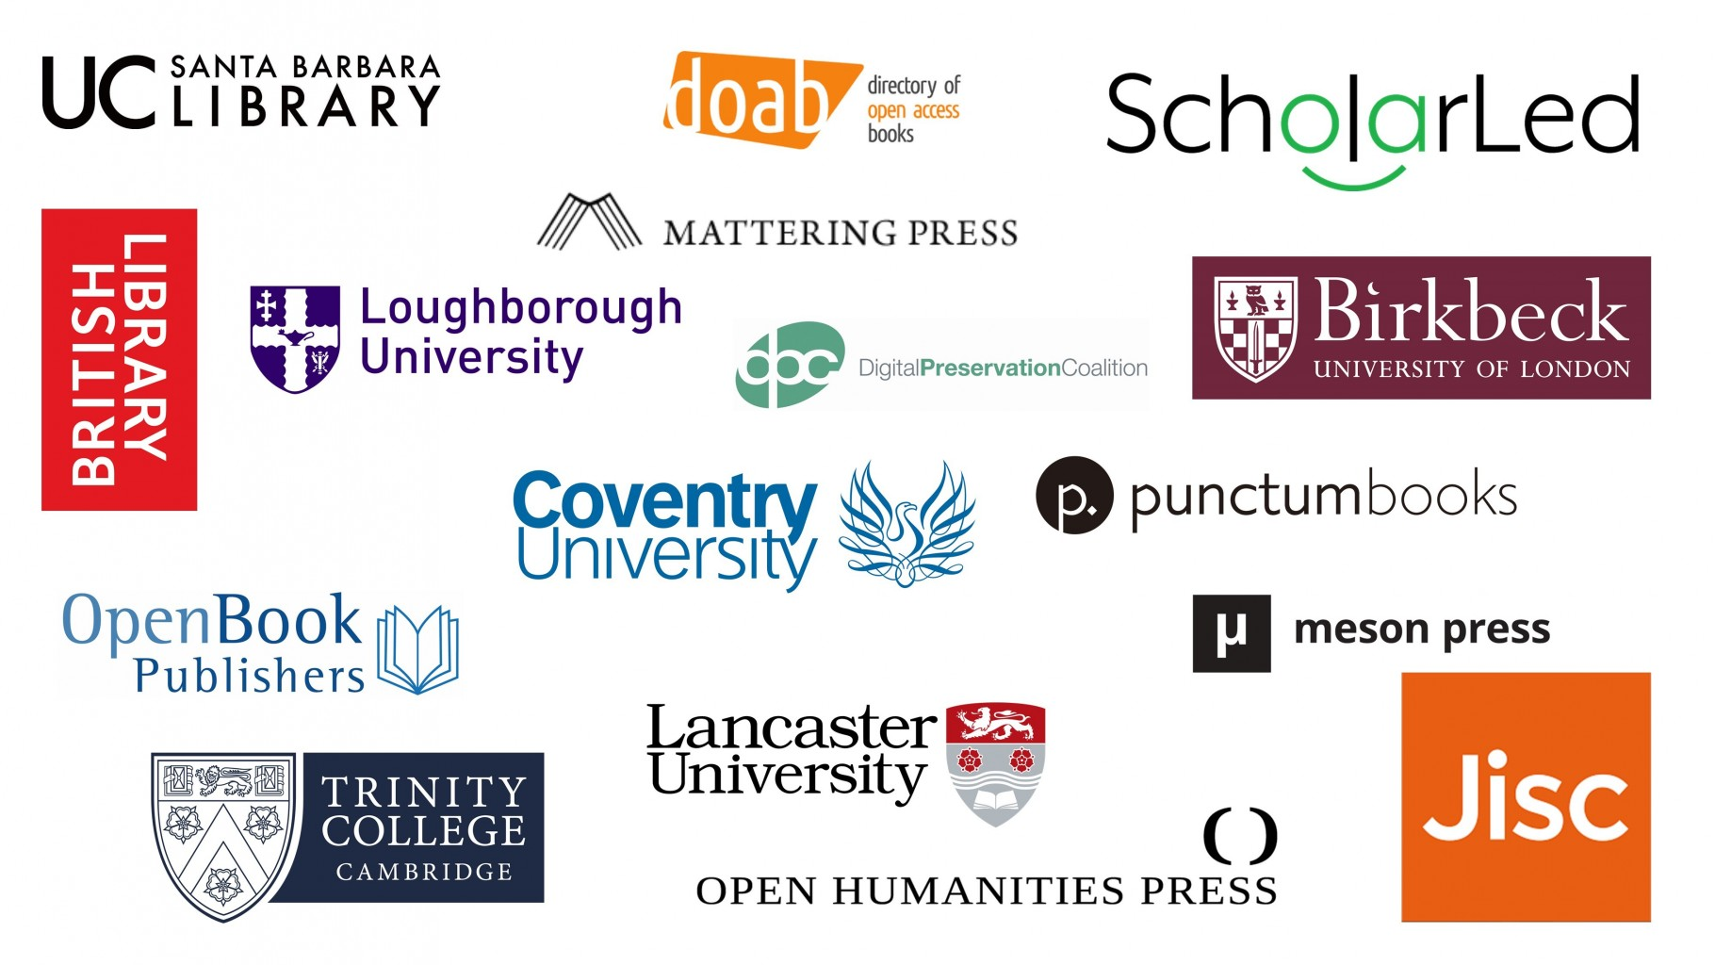

Slide 5



Slide 6
Revenue Infrastructures & Management Platform
Knowledge Exchange & Piloting Alternative Business Models
Community Governance
Project
Management
Building an Open Dissemination System
Experimental Publishing,
Re-use and Impact
Archiving & Digital Preservation
Notes:
The work on COPIM is divided into 7 work packages (including a project management WP), which I will shortly describe here
WP2 is developing and launching a modular, scalable revenue generation and management platform for OA books, to be made available to publishers and libraries.
WP 3 is working with selected publishers to assist them in migrating their economic models to OA versions, while documenting the process
WP4 is developing the governance procedures of COPIM’s open publication ecosystem for monographs, which Sam will talk about more in his presentation
WP5 is developing technical protocols and infrastructure to better integrate OA books into institutional library, digital learning and repository systems.
WP 6 is producing a set of pilot cases of experimental books which will be developed with the aid of the new tools and platforsm focused on experimental long-form publications
WP7 is identifying the key challenges associated with archiving research monographs and is looking at archiving solutions for more complex and experimental long-form publications
I am very much looking forward to the next couple of days and to discussing everything governance with all of you!

Slide 7
Scaling Small

Slide 8
“Scalability is possible only if project elements do not form transformative relationships that might change the project as elements are added. But transformative relationships are the medium for the emergence of diversity. Scalability projects banish meaningful diversity, which is to say, diversity that might change things.”
Tsing, Anna Lowenhaupt. 2012. “On Nonscalability. The Living World Is Not Amenable to Precision-Nested Scales.” Common Knowledge 18 (3): 507. https://doi.org/10.1215/0961754X-1630424.

Slide 9
Scaling Small
Working to capacity: 50 books (punctum), 30 (LSP/OBP), 5 (OHP/Mattering) a year
Scaling through horizontal and vertical collaborations
Open source infrastructures: software, platforms, and tools
Transparency and openness about funding models and costs
No or low BPCs and fee-waivers
Resources and skills sharing
Experimenting with models and formats
Situatedness

Slide 10

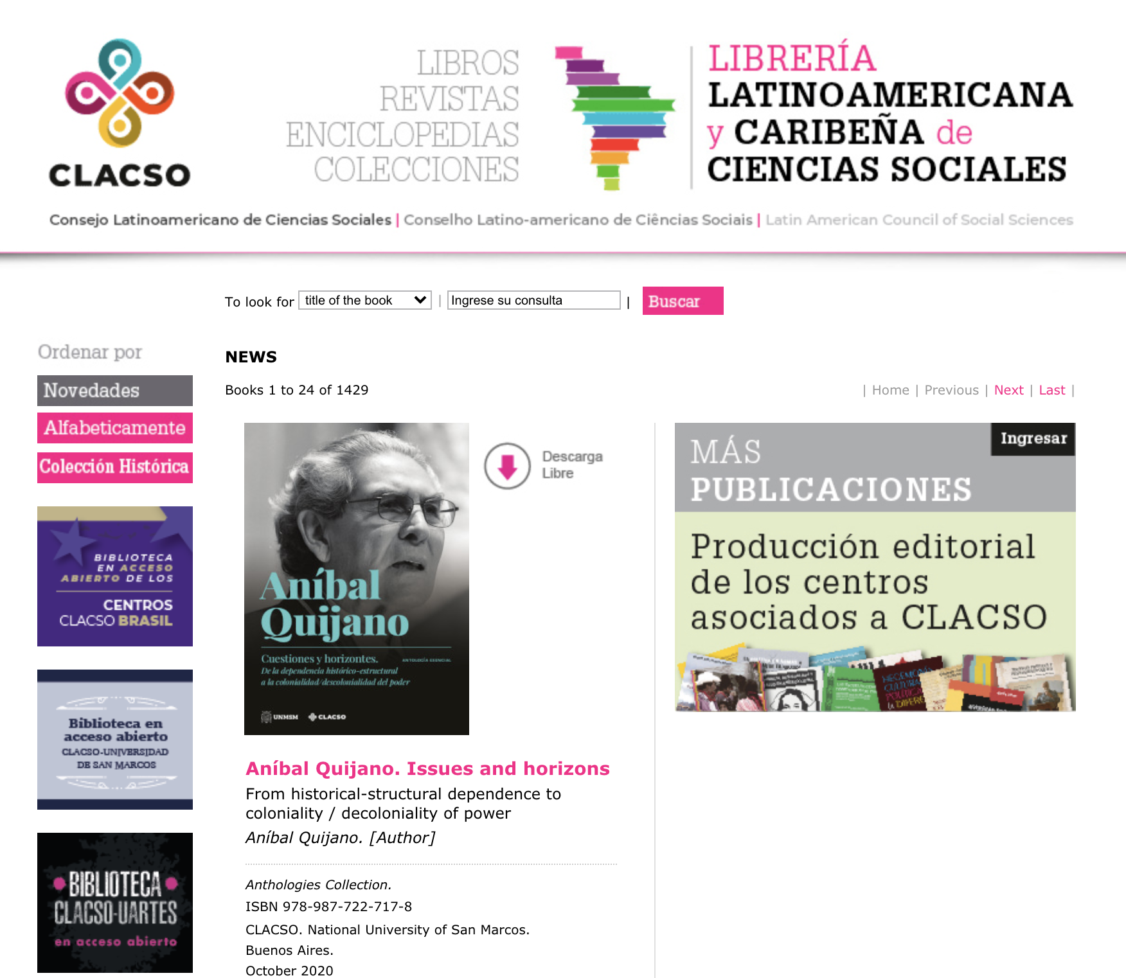
Resources and skills sharing

Slide 11
Scaling Small
Working to capacity: 50 books (punctum), 30 (LSP/OBP), 5 (OHP/Mattering) a year
Scaling through horizontal and vertical collaborations
Open source infrastructures: software, platforms, and tools
Transparency and openness about funding models and costs
No or low BPCs and fee-waivers
Resources and skills sharing
Experimenting with models and formats
Situatedness

Slide 12
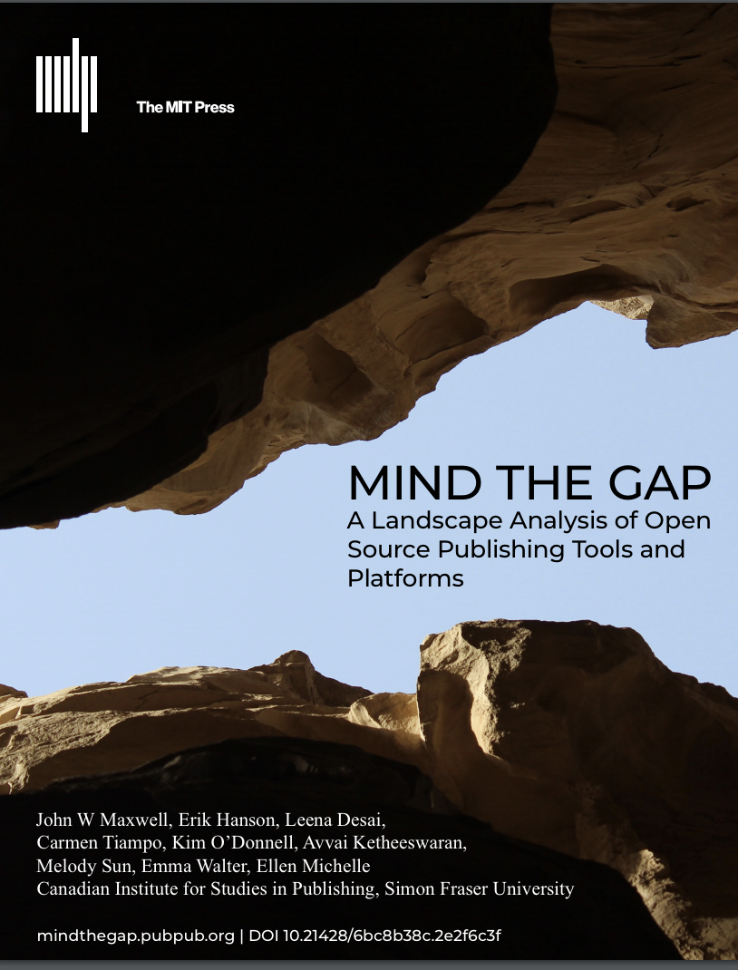

Slide 13
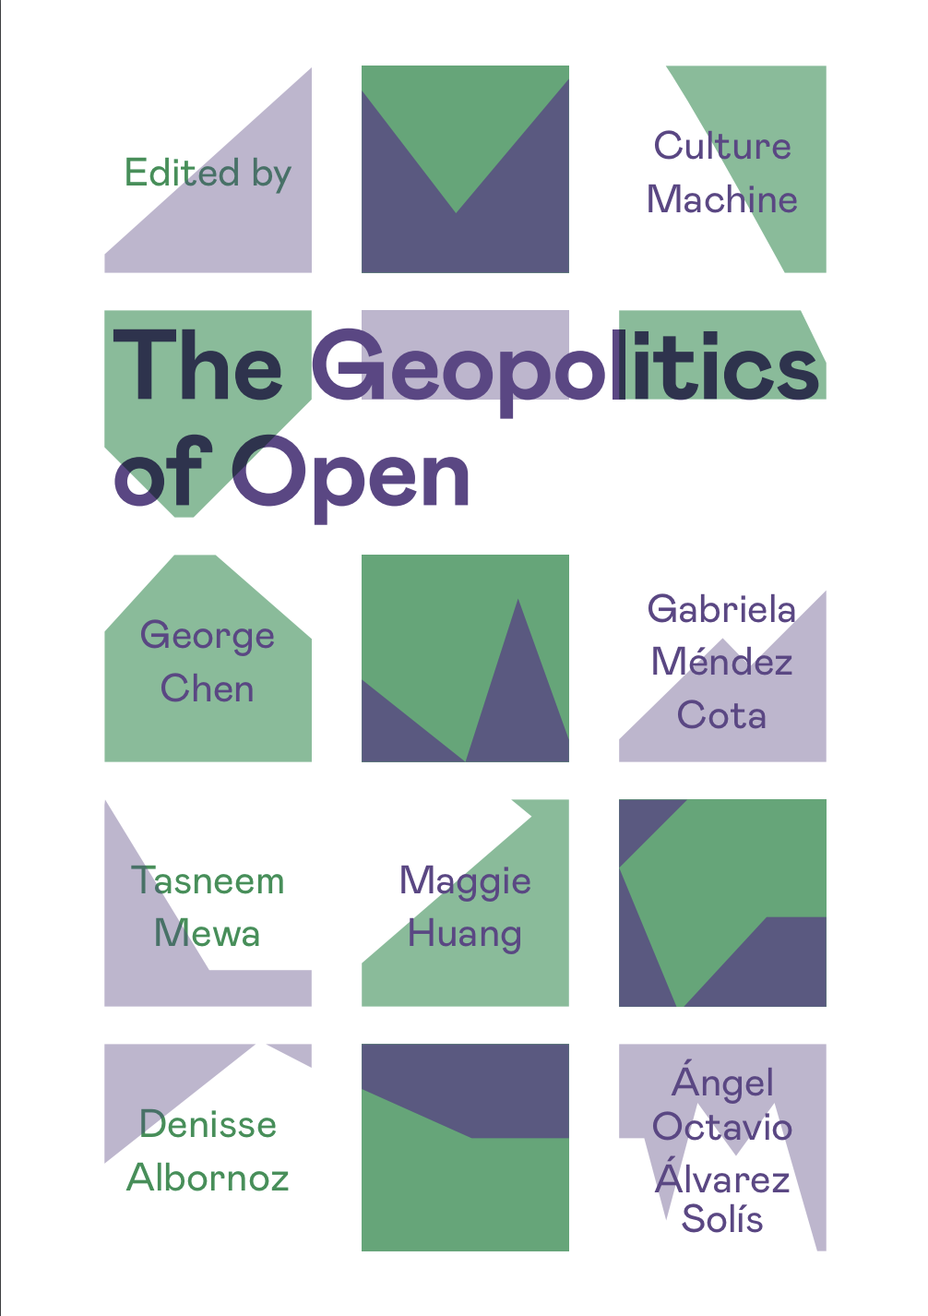
‘A more ethical approach to inclusive knowledge infrastructures, as posed by the work developed by the the Open and Collaborative Development Network, not only considers the tools, protocols and platforms that need to be in place in order to advance collaborative research production, but also considers socio-technical mechanisms that could deliberately allow for multiple forms of participation amongst a diverse set of actors, and actively seeks to redress power relations within a given context’ (Chen et al. 2018, pp. 11–12)

Slide 14
Scaling Small
Working to capacity: 50 books (punctum), 30 (LSP/OBP), 5 (OHP/Mattering) a year
Scaling through horizontal and vertical collaborations
Open source infrastructures: software, platforms, and tools
Transparency and openness about funding models and costs
No or low BPCs and fee-waivers
Resources and skills sharing
Experimenting with models and formats
Situatedness

Slide 15
“We want to facilitate a more powerful expansion of OA book publishing—by facilitating the growth of more presses like ourselves, which publish OA books without charging authors.”
Lucy Barnes and Rupert Gatti, ‘The Cost of Open Access Books: A Publisher Writes’, Open Book Publishers Blog, 28 May 2020, https://doi.org/10.11647/OBP.0173.0143

Slide 16
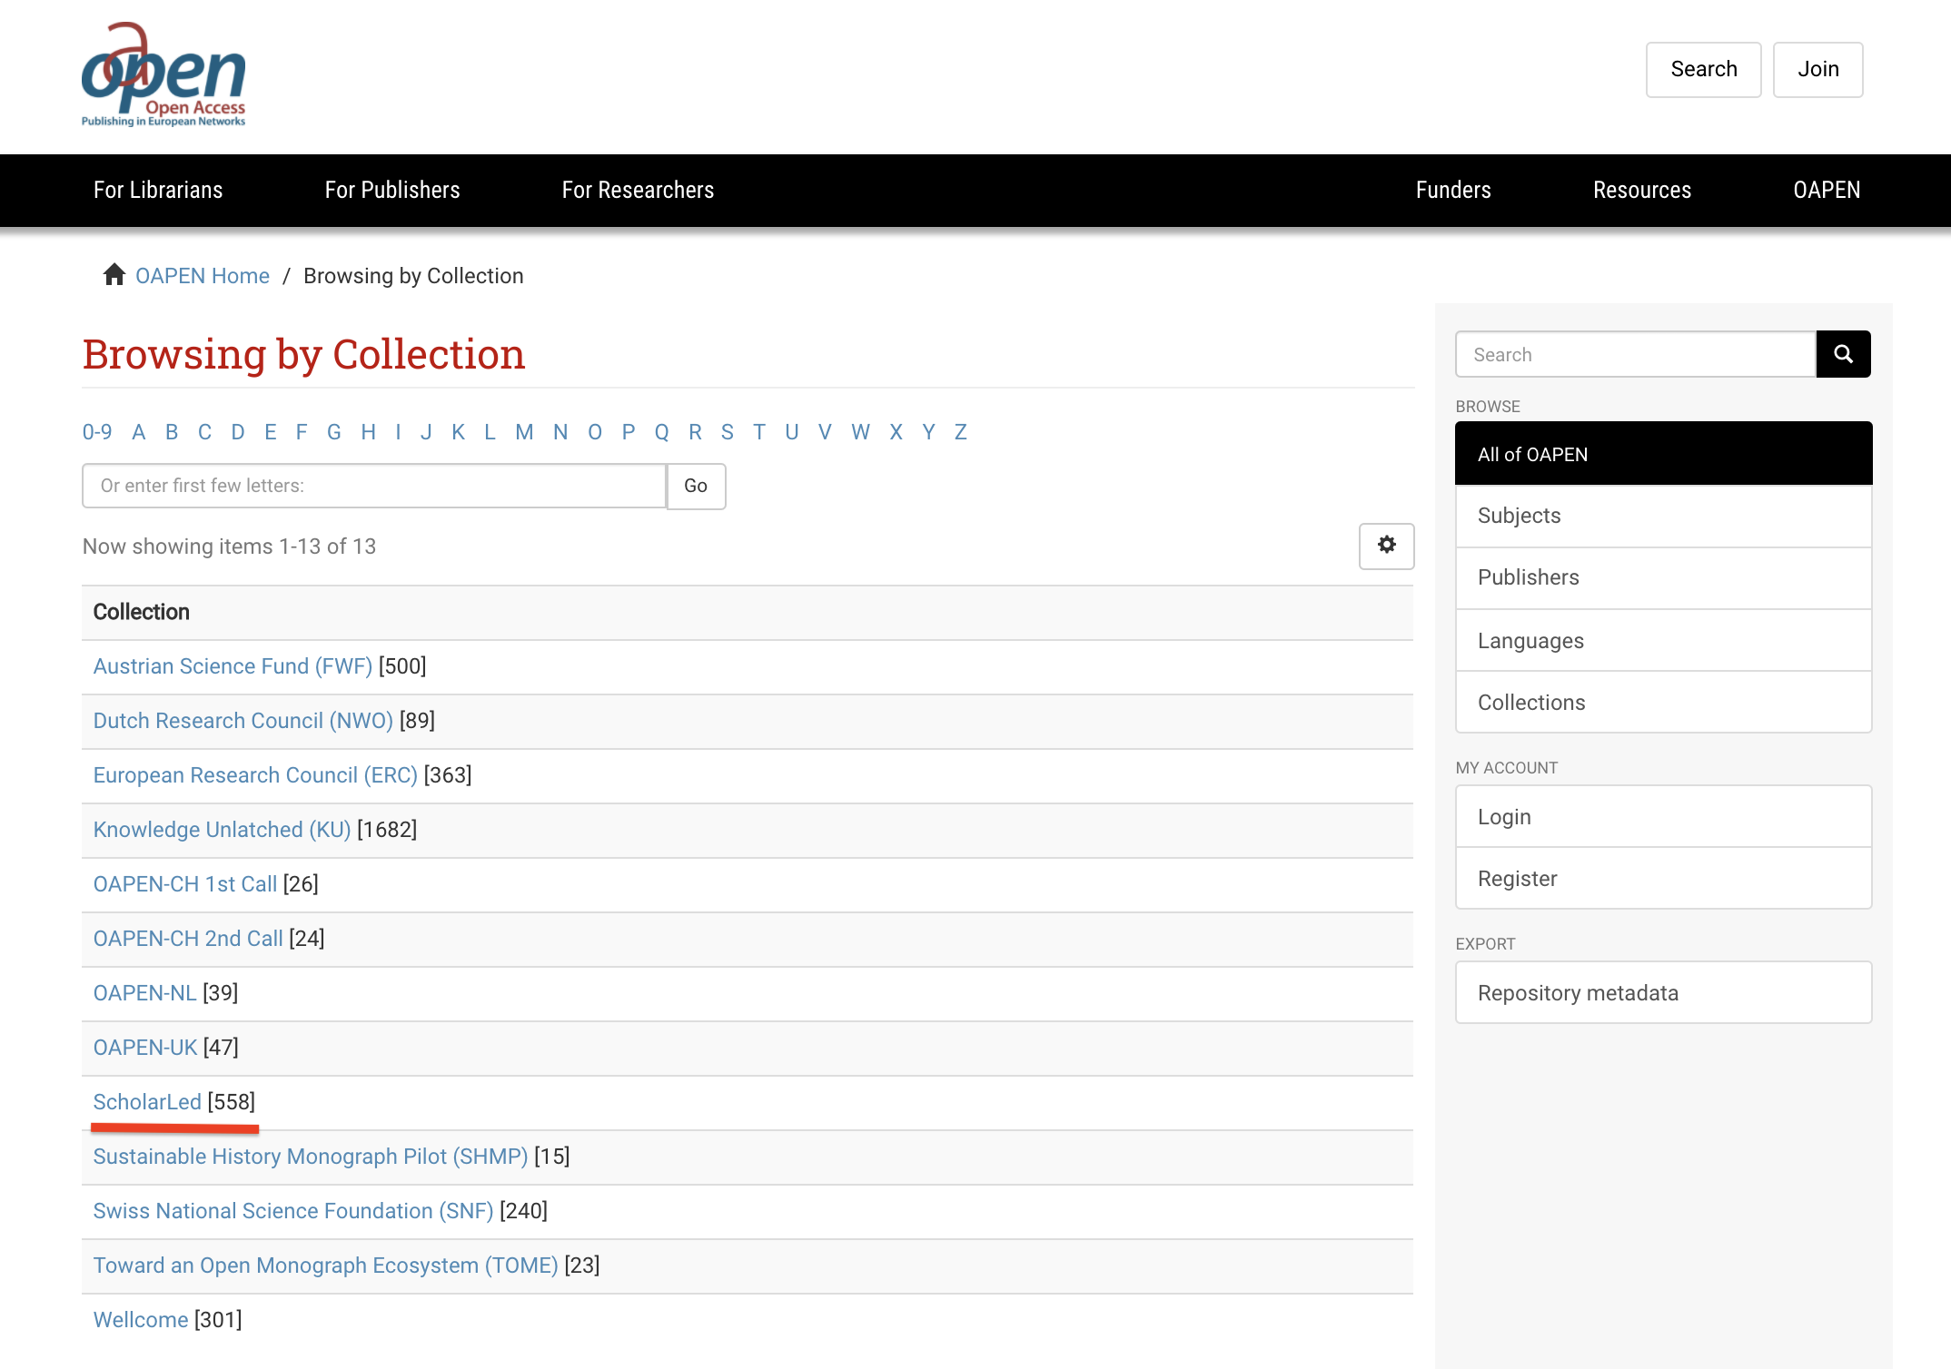

Slide 17
Scaling Small
Working to capacity: 50 books (punctum), 30 (LSP/OBP), 5 (OHP/Mattering) a year
Scaling through horizontal and vertical collaborations
Open source infrastructures: software, platforms, and tools
Transparency and openness about funding models and costs
No or low BPCs and fee-waivers
Resources and skills sharing
Experimenting with models and formats
Situatedness

Slide 18
Transparency on Costs
Eve, Martin, ‘How much does it cost to run a small scholarly publisher?’ (2017) Martin Paul Eve https://www.martineve.com/2017/02/13/how-much-does-it-cost-to-run-a-small-scholarly-publisher/
Gatti, Rupert, ‘Introducing Some Data to the Open Access Debate: OBP’s Business Model’ (2015) Open Book Publishers Blog https://blogs.openbookpublishers.com/introducing-some-data-to-the-open-access-debate-obps-business-model-part-one/
Hall, Gary ‘Open Humanities Press: Funding and Organisation’ (2015) Media Gifts http://garyhall.squarespace.com/journal/2015/6/13/open-humanities-press-funding-and-organisation.html
Nordhoff, Sebastian, ‘Calculating the costs of a community-driven publisher’ (2016) Language Science Press Blog https://userblogs.fu-berlin.de/langsci-press/2016/04/18/calculating-the-costs-of-a-community-driven-publisher/
Van Gerven Oei, Vincent W. J. et al. ‘We Got the Receipts: The Punctum Books Financial and Activity Report 2016–2019’, Punctum Books, 7 July 2020, https://punctumbooks.pubpub.org/pub/punctum-books-financial-activity-report-2016-2019/release/5.

Slide 19
Scaling Small
Working to capacity: 50 books (punctum), 30 (LSP/OBP), 5 (OHP/Mattering) a year
Scaling through horizontal and vertical collaborations
Open source infrastructures: software, platforms, and tools
Transparency and openness about funding models and costs
No or low BPCs and fee-waivers
Resources and skills sharing
Experimenting with models and formats
Situatedness

Slide 20
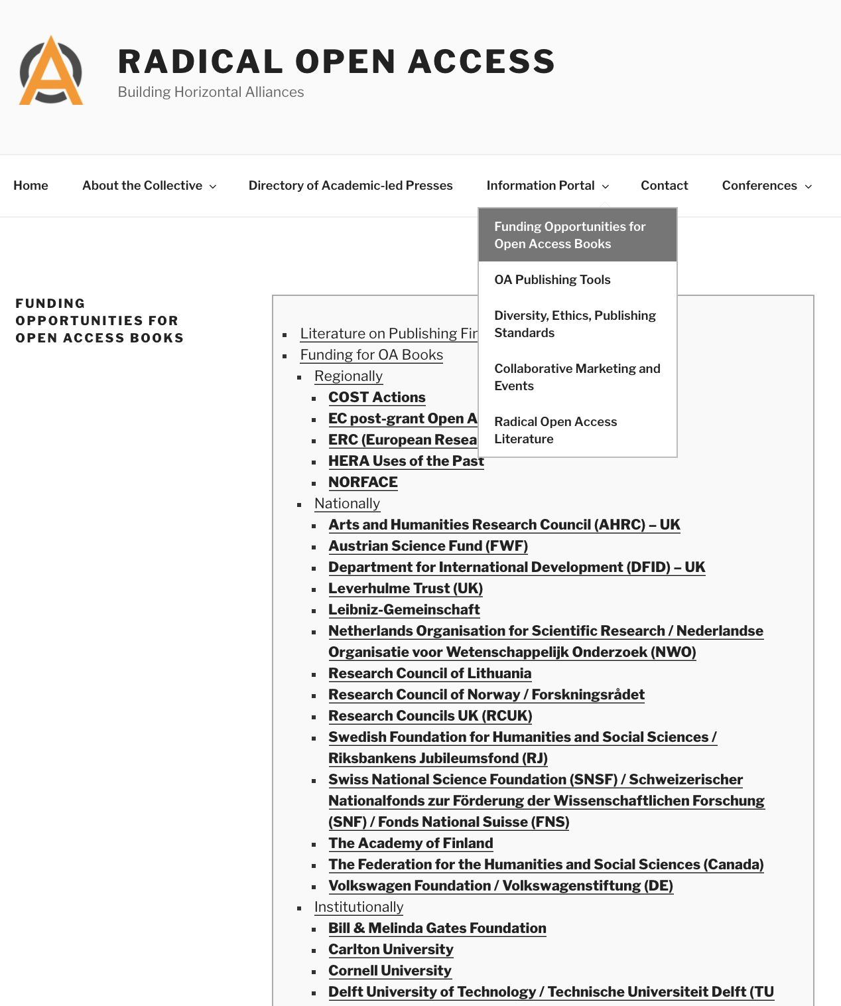
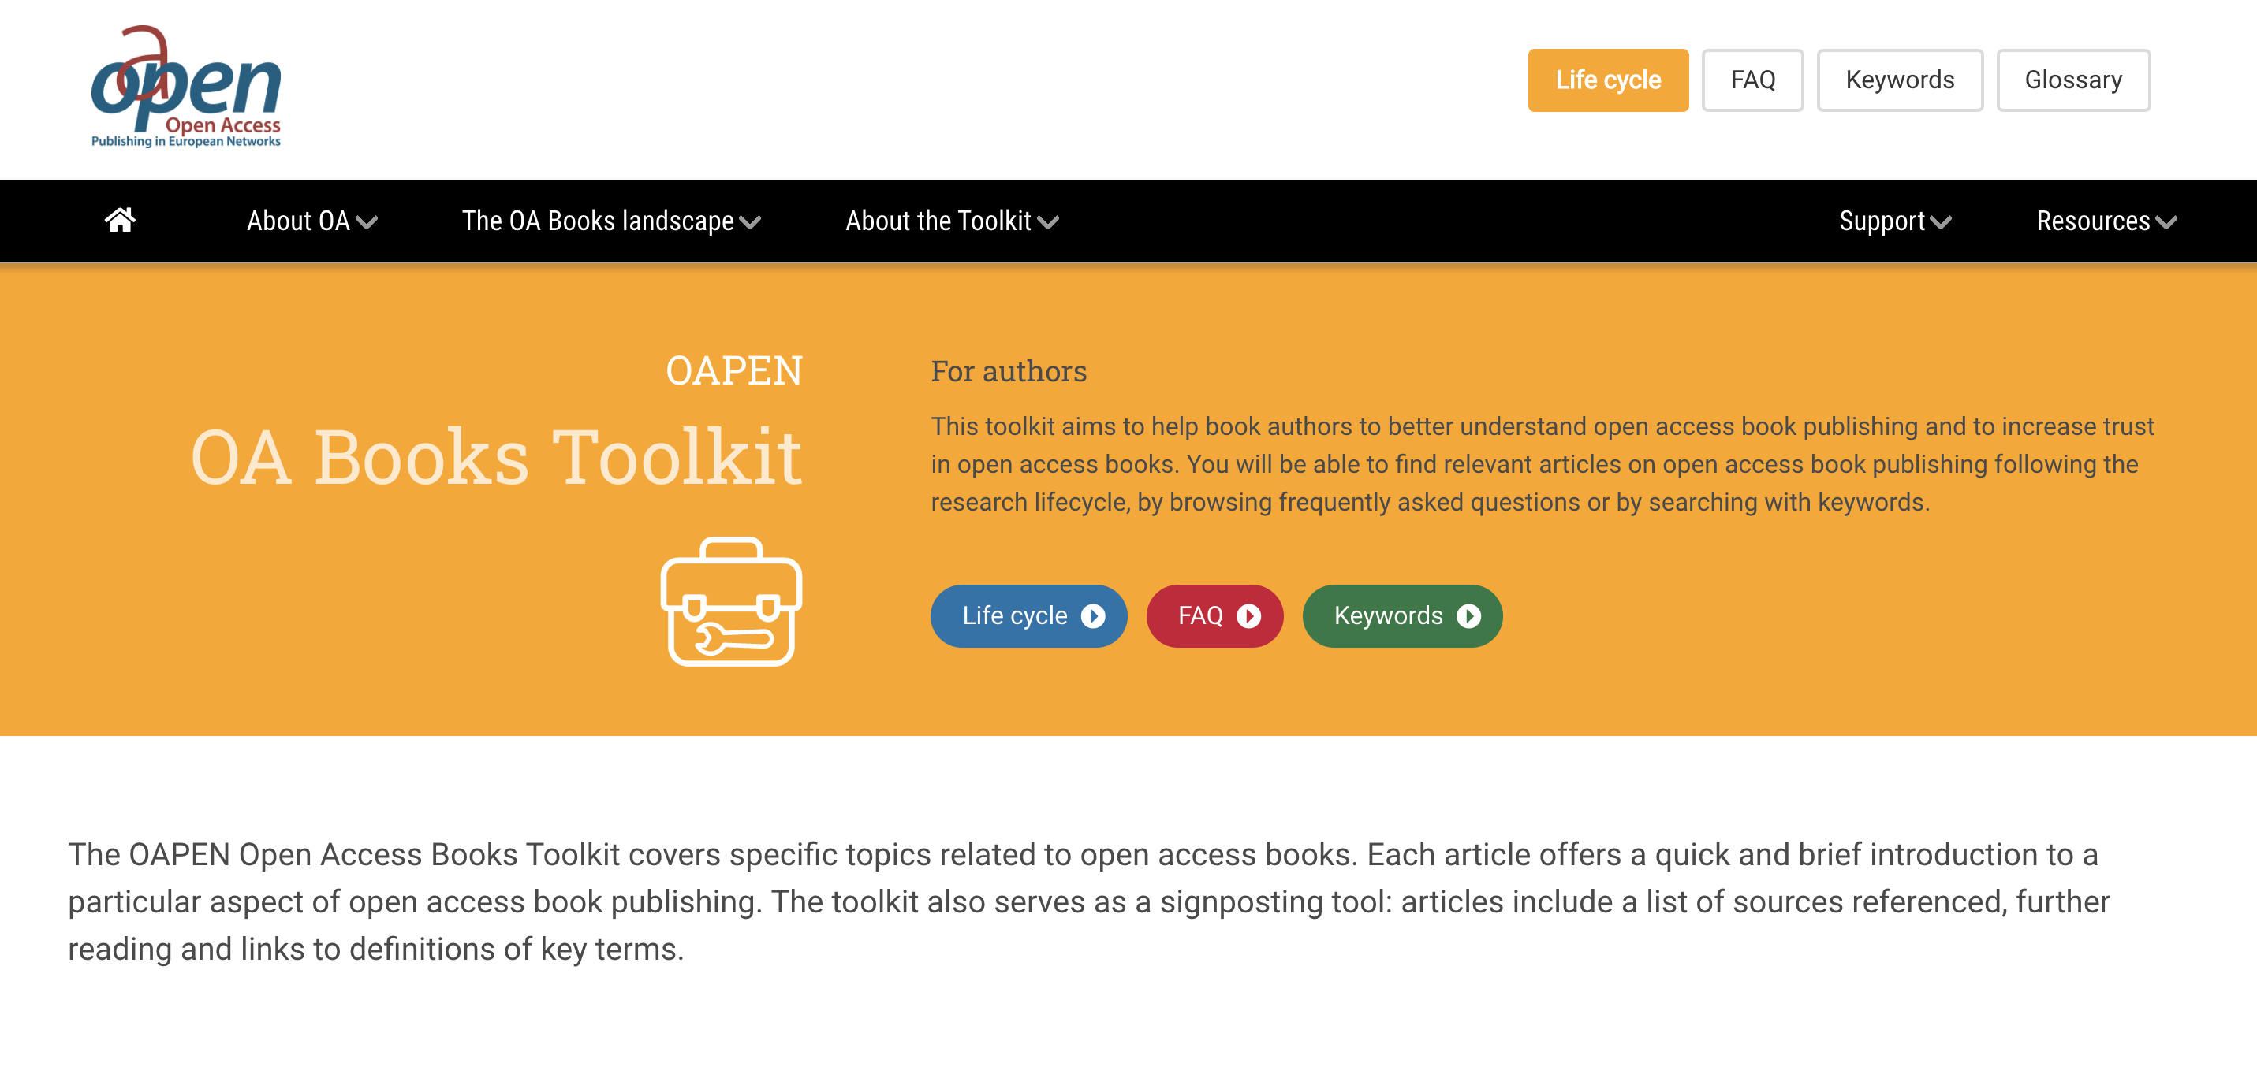

Slide 21
Scaling Small
Working to capacity: 50 books (punctum), 30 (LSP/OBP), 5 (OHP/Mattering) a year
Scaling through horizontal and vertical collaborations
Open source infrastructures: software, platforms, and tools
Transparency and openness about funding models and costs
No or low BPCs and fee-waivers
Resources and skills sharing
Experimenting with models and formats
Situatedness

Slide 22
“Developing in terms of collaboration and reiteration - rather than growth and expansion - can help prevent the reproduction of this state of affairs not simply by enabling us to place more emphasis on privileging non-standard contributions from others, understood geographically (i.e. in terms of the global South and East), but also in terms of BAME, LGBTQIPA, working class and other nonconforming identities.”
Gary Hall, ‘The Left Can’t Meme?’, Media Gifts (blog), 18 February 2019, http://garyhall.squarespace.com/journal/2019/2/18/the-left-cant-meme.html

Slide 23
Website: https://www.copim.ac.uk/
Open documentation site: https://copim.pubpub.org/
Twitter: @COPIMproject
Email: info@copim.ac.uk

