Slide 1
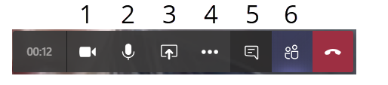
Welcome to the TiM Online Seminar
A few practical notes:
Turn off your camera and your microphone.
You do this by clicking on the two leftmost icons in the black bar. (1 and 2)
Use the chat to ask questions.
Click on the fifth icon from the right, the chat cloud. (5)
You can turn on your microphone if necessary during the Q&A. (2)
The lecture is recorded.

Slide 2


Post-Publishing and Performative Publications
Janneke Adema
Centre for Postdigital Cultures
Coventry University
Transmission in Motion Seminar
Utrecht University, 22nd April 2020

Slide 3
”What are the implications of the decentering of the human and of the rise of digital technologies for the humanities, for theory, for how we practice the (digital) humanities, for how we create, perform, disseminate and access it?”

Slide 4
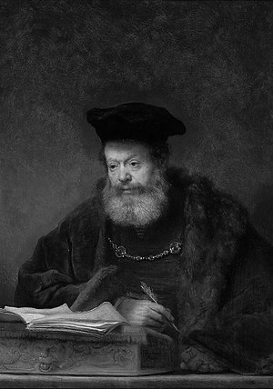


Slide 5
Post
Post
Post
Post humanities
Post
Post
Post

Slide 6
forms of experimental publishing: hybrid, enhanced, remixed and multimodal, iterative, and living, webtexts and post-digital works
alternative forms of distribution: piracy, P2P file-sharing, radical open access, wikis, distributed networks, postdigital print
and distributed authorship practices: collaborative, anonymous, including personas, aliases, pseudonyms, as well as machinic, automatic, generative, and algorithmic authorship

Slide 7


Slide 8
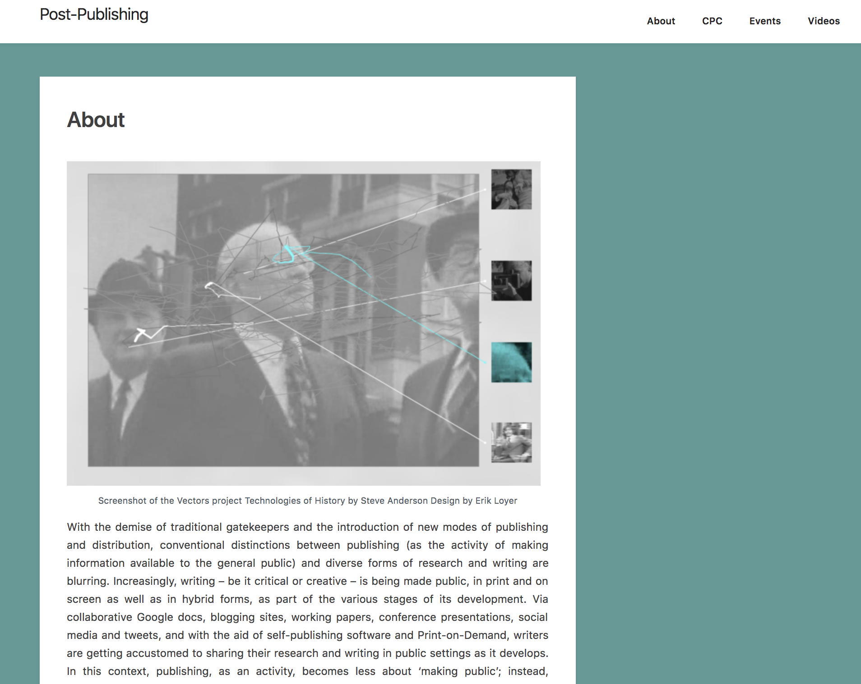
          HTTPS://POST-PUBLISHING.ORG

Slide 9
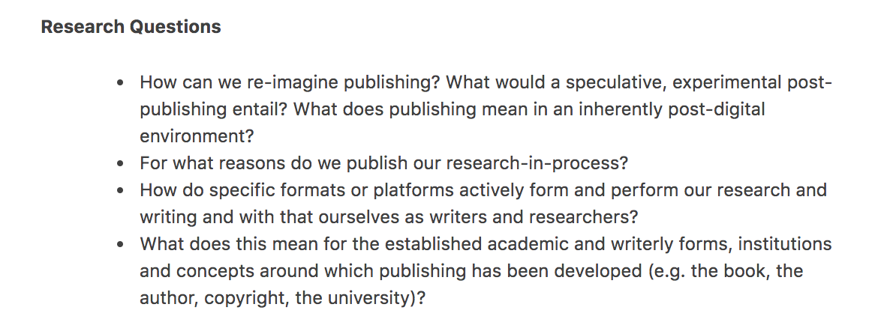

Slide 10
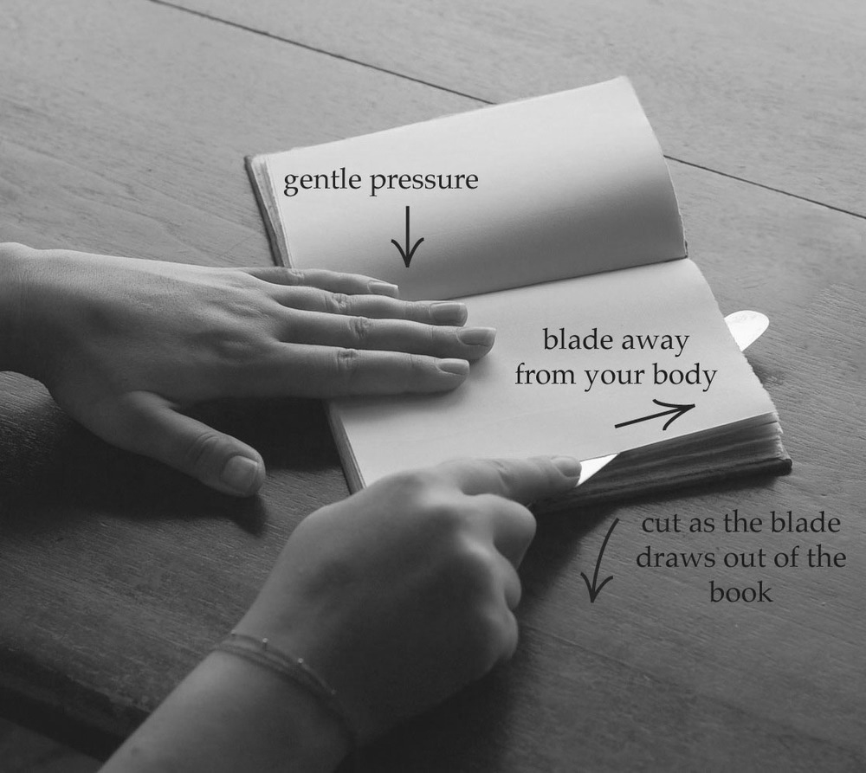
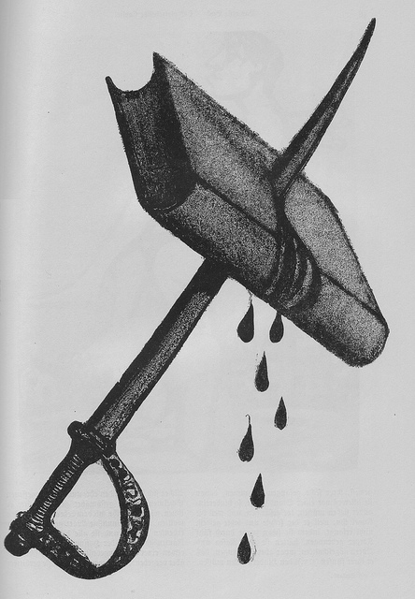

Slide 11
Living Books about Life (Open Humanities Press)
livingbooksaboutlife.org

Slide 13
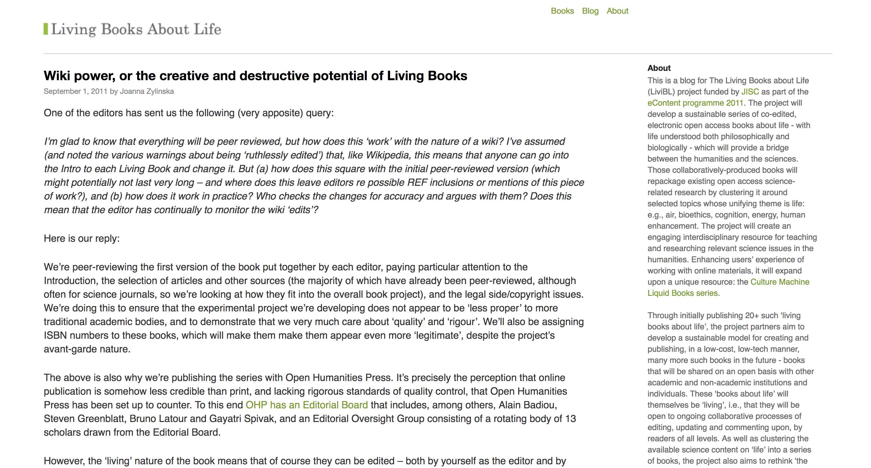

Slide 14
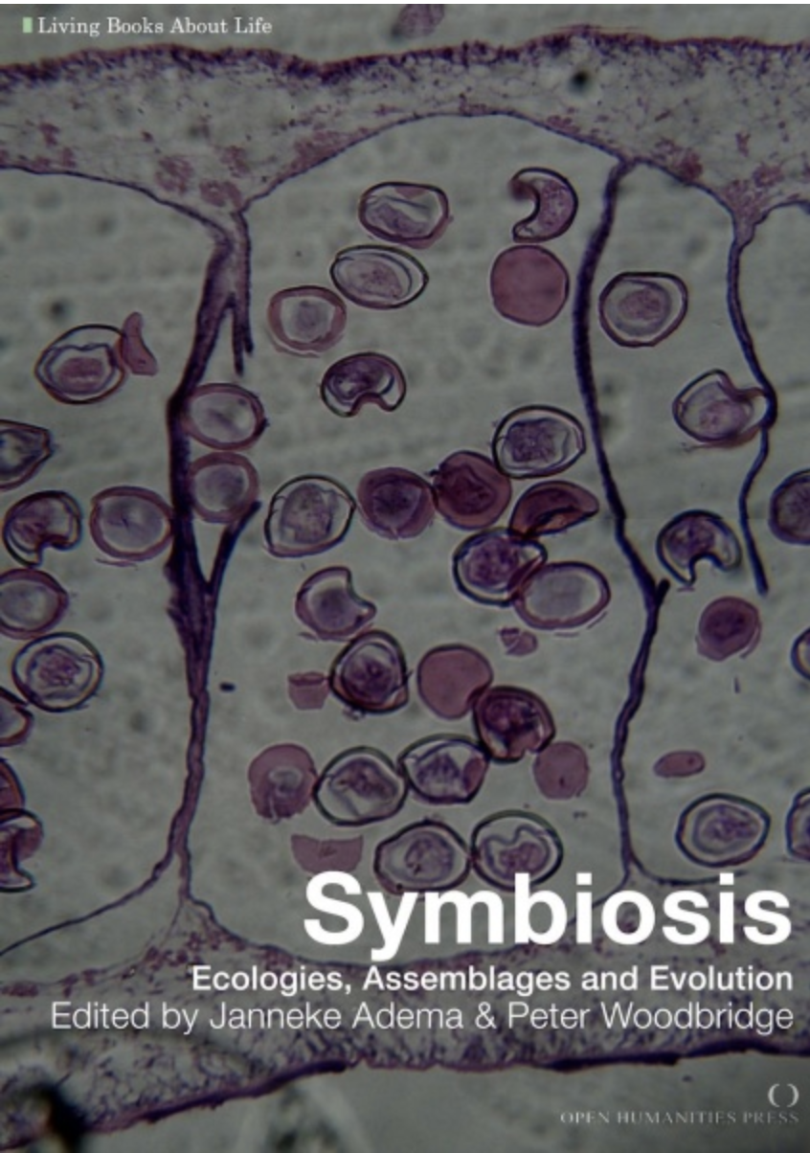
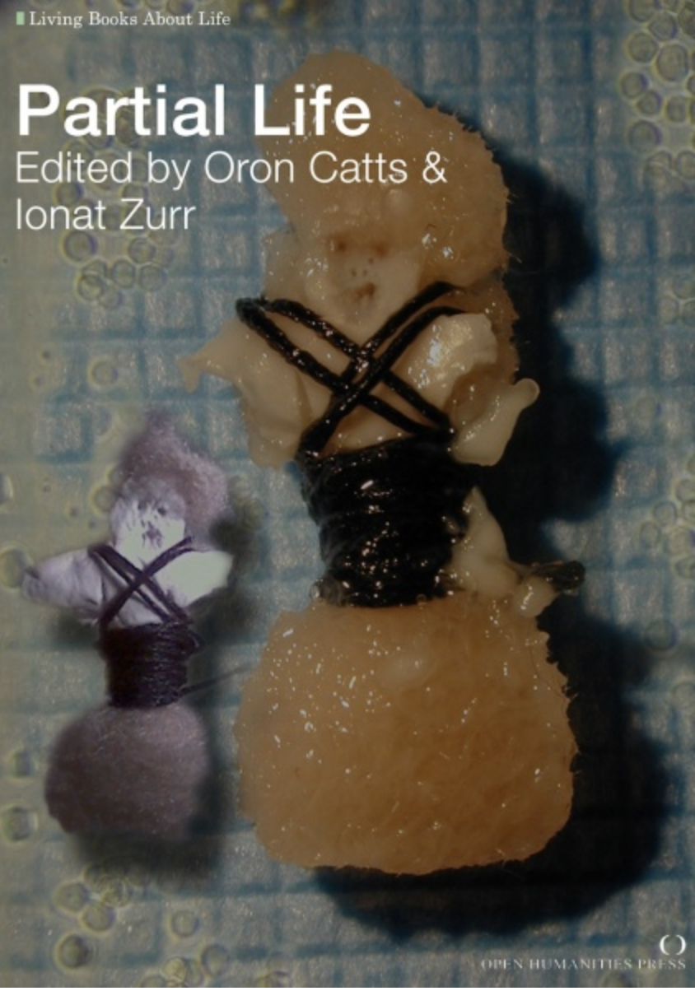

Slide 15
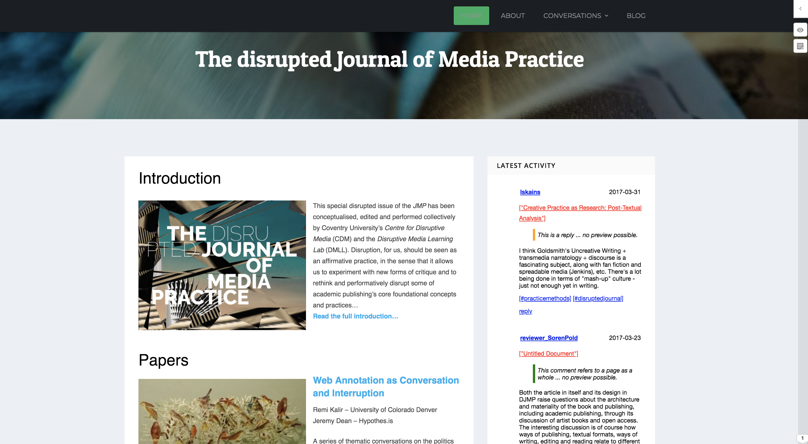

Slide 16
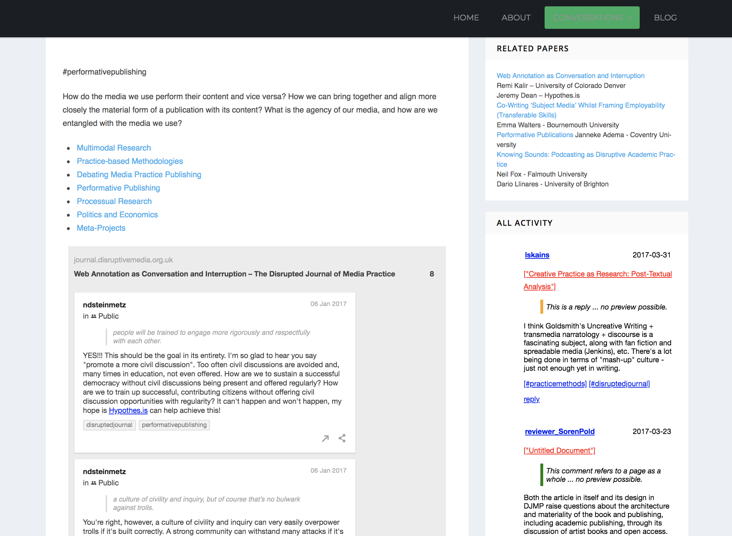

Slide 17
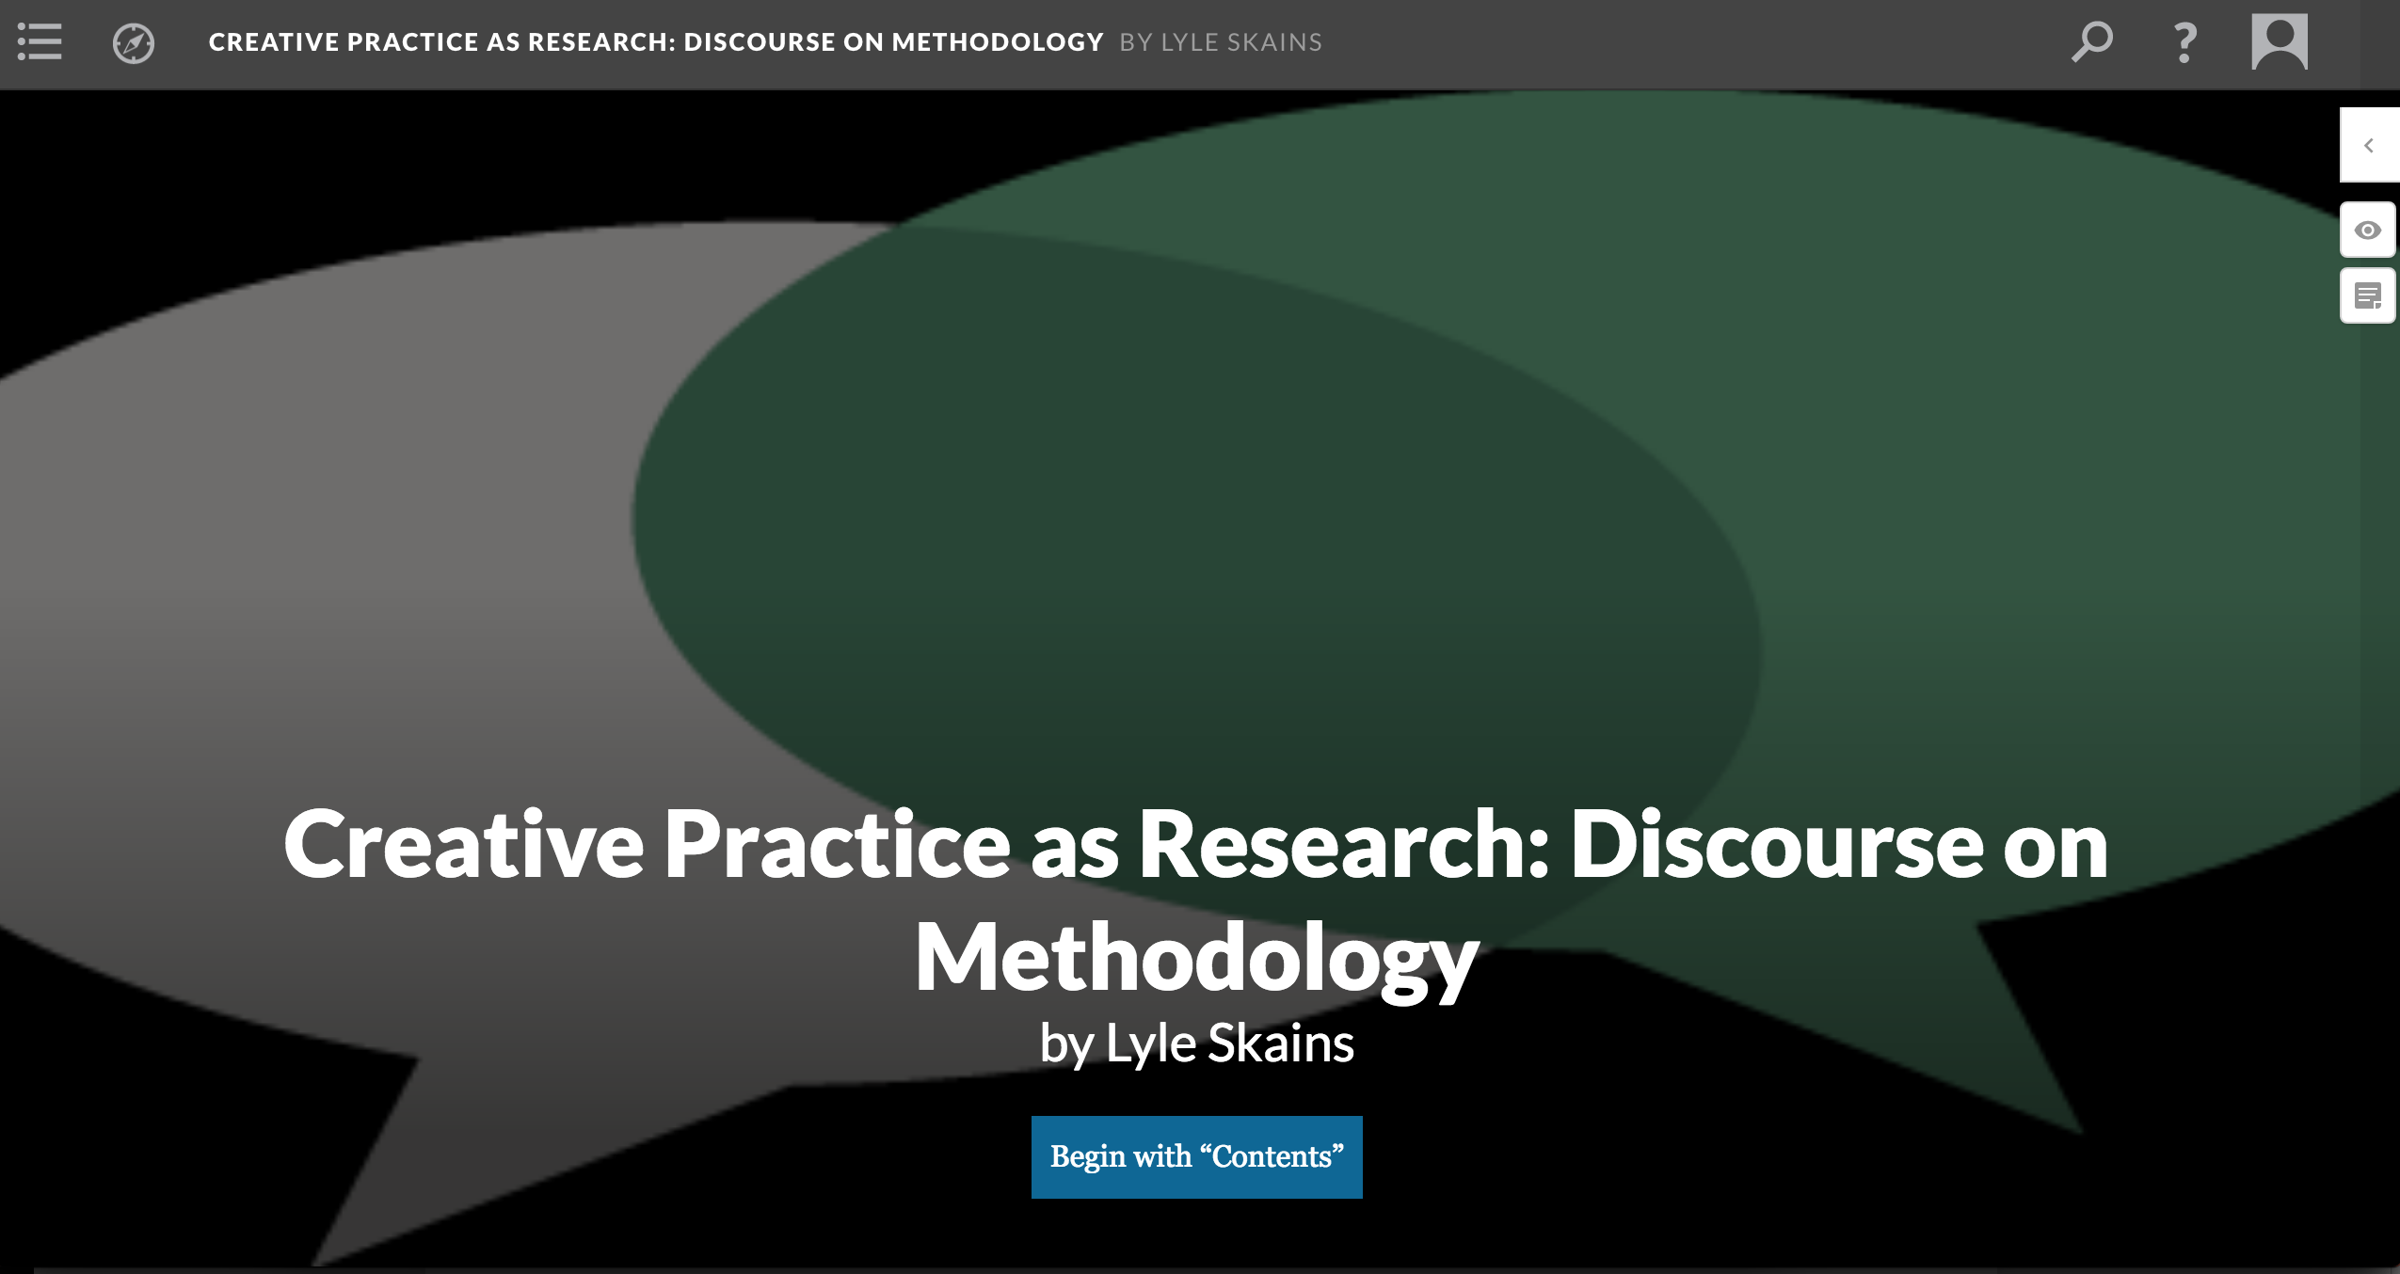

Slide 18
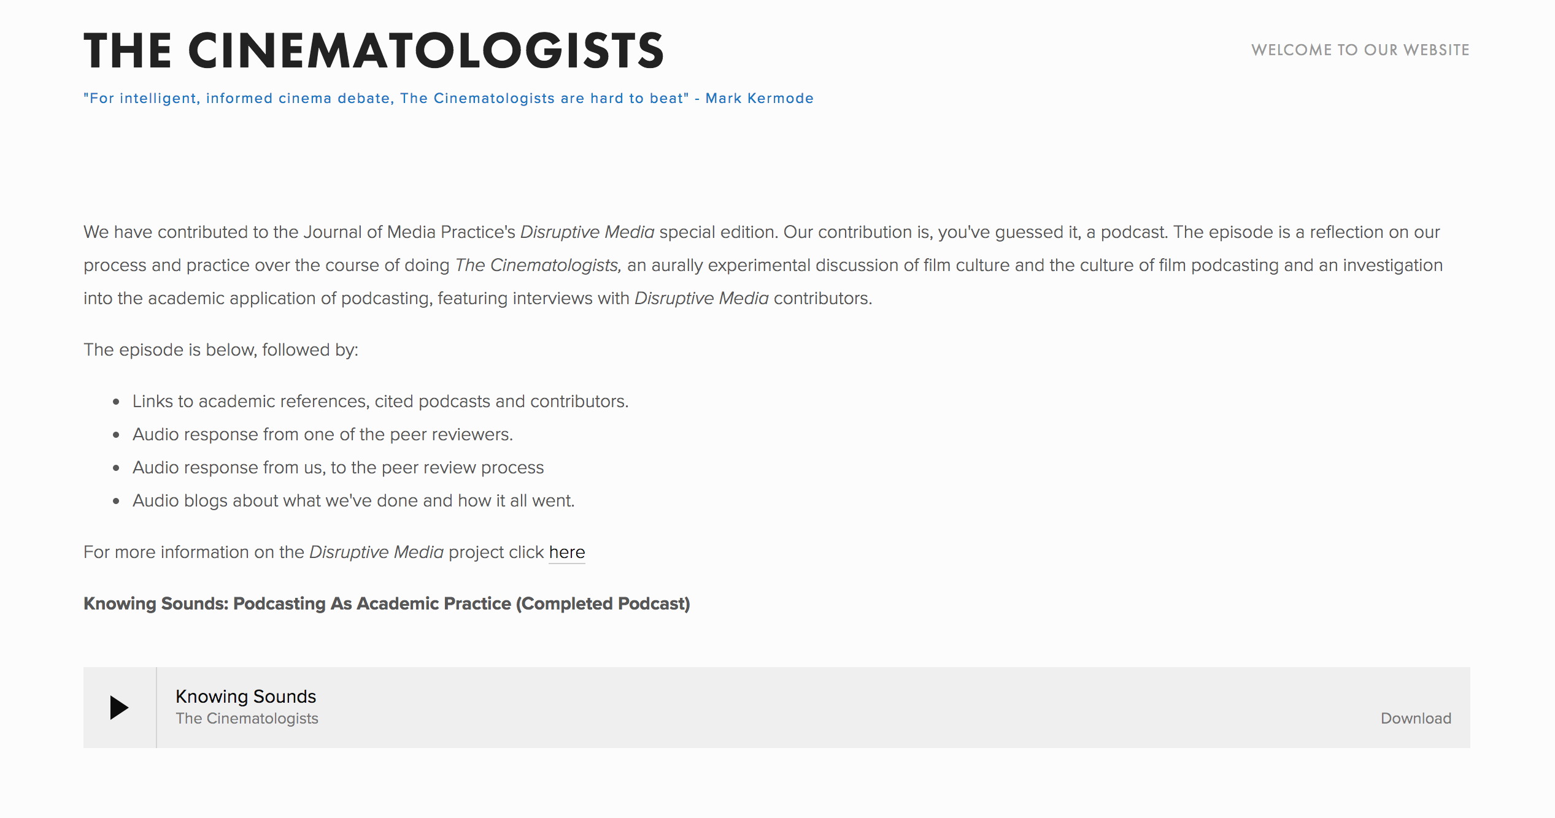

Slide 19
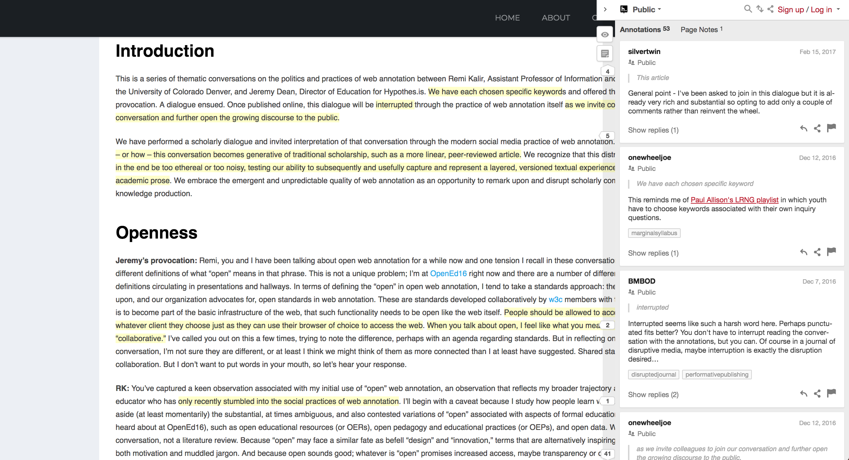
Open Peer Review

Slide 20
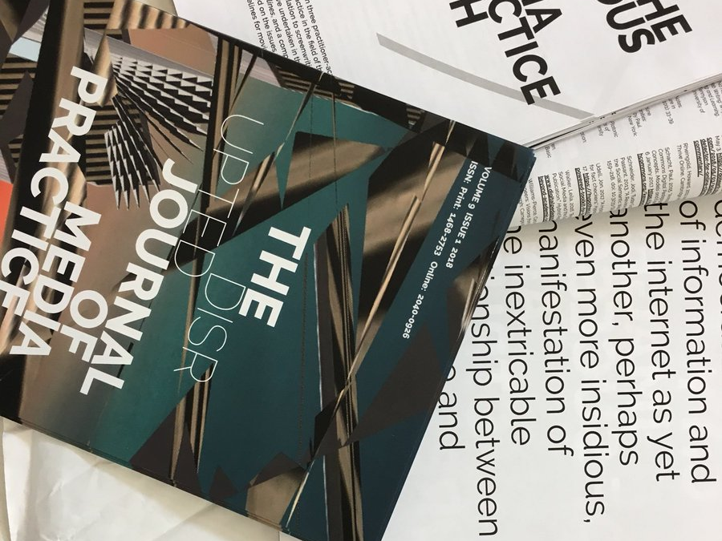
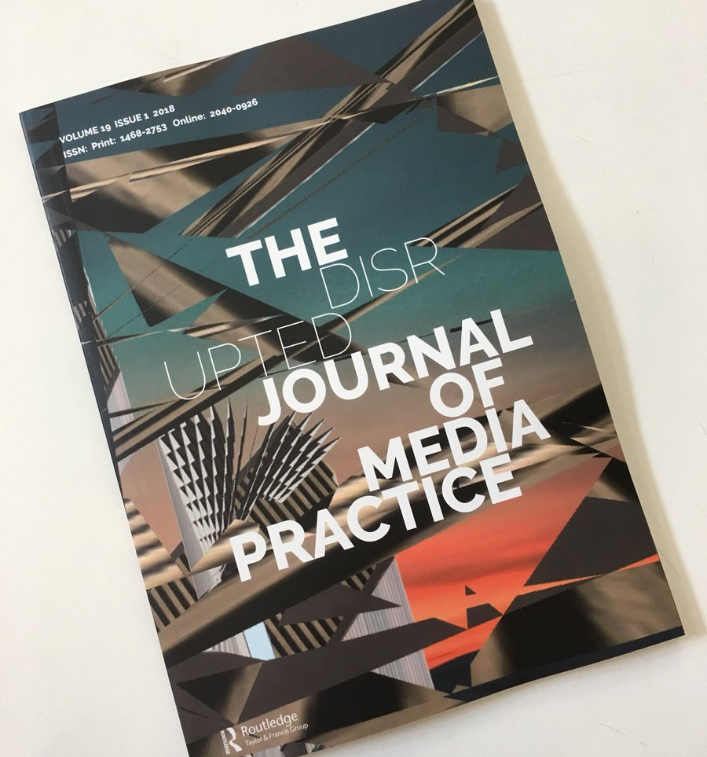

Slide 21
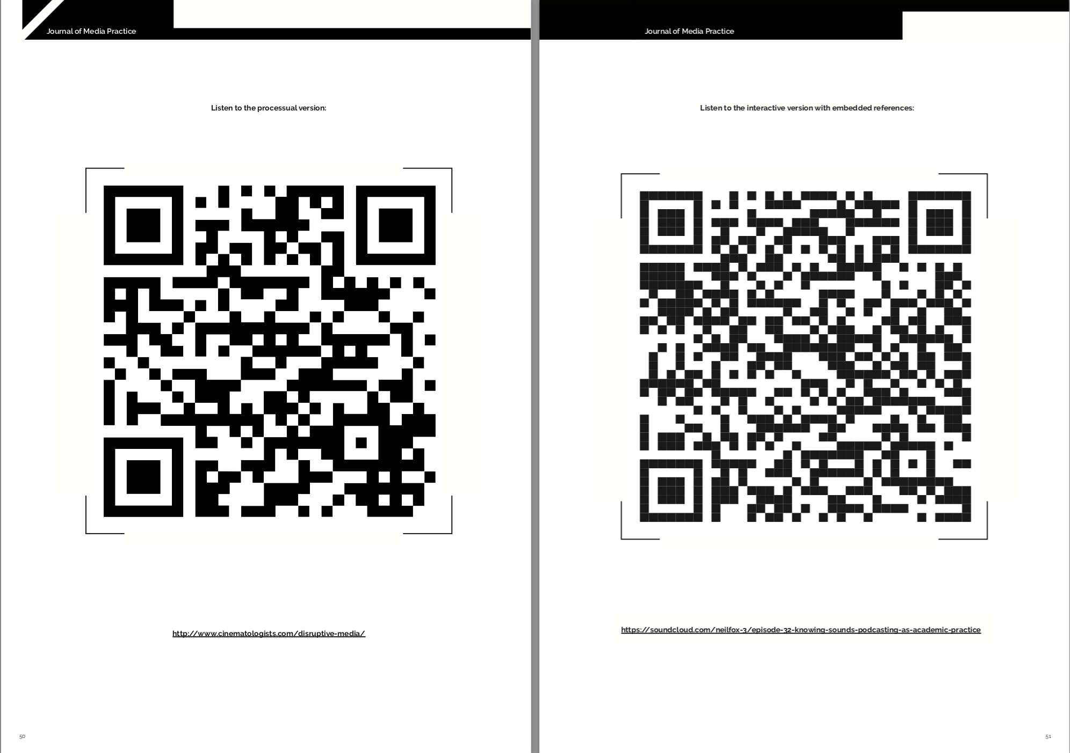

Slide 22
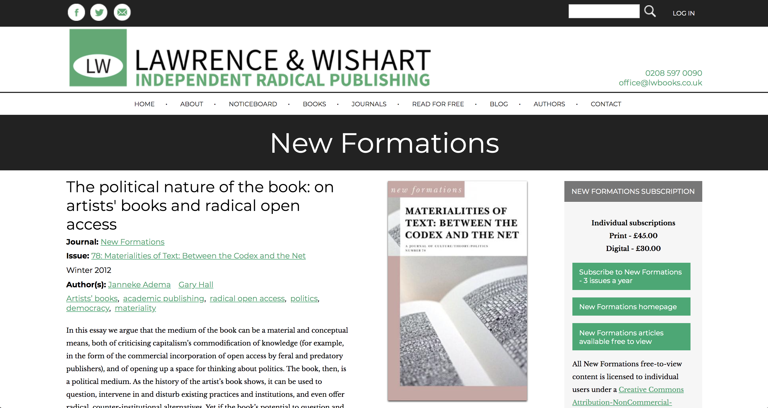

Slide 23
Performative Publication – Chris Long
‘The mode of publication performs one of the central ideas the text itself seeks to articulate and explore’ (Long 2013)

Slide 24
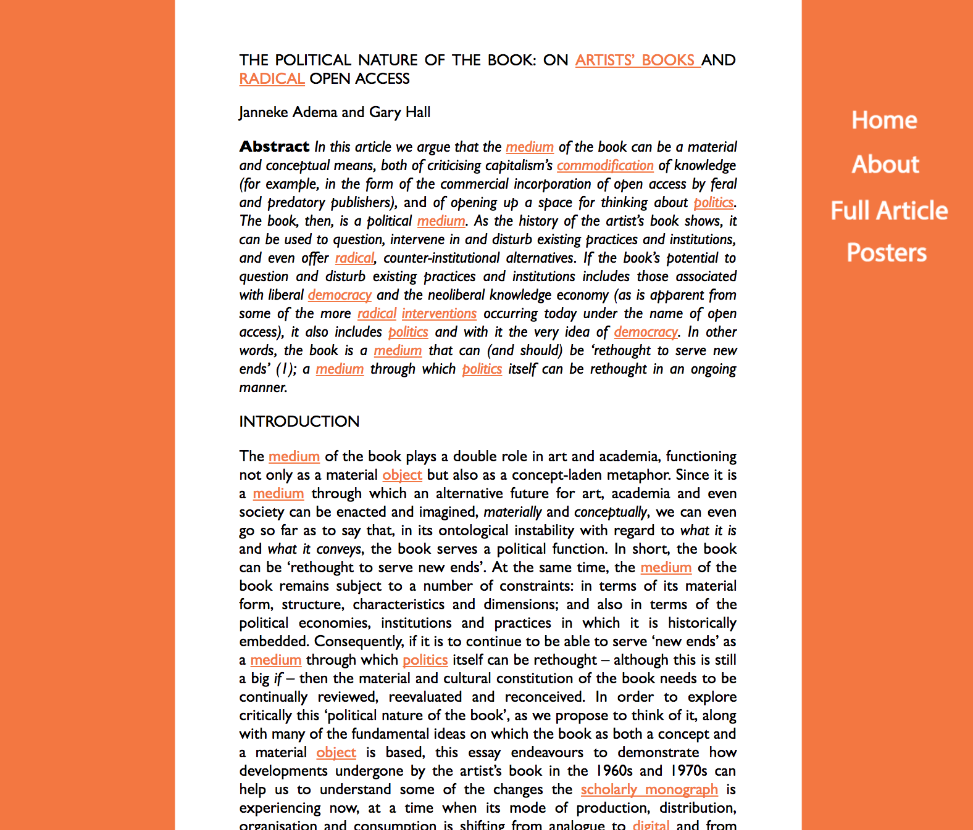

Slide 25
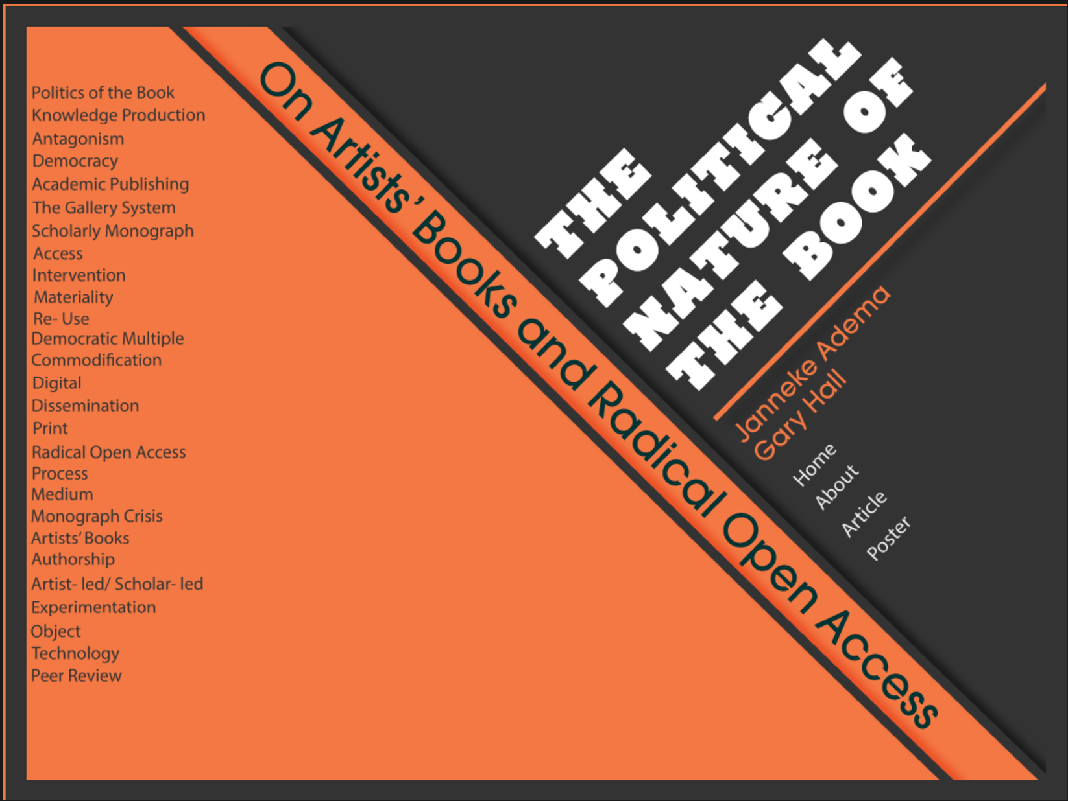
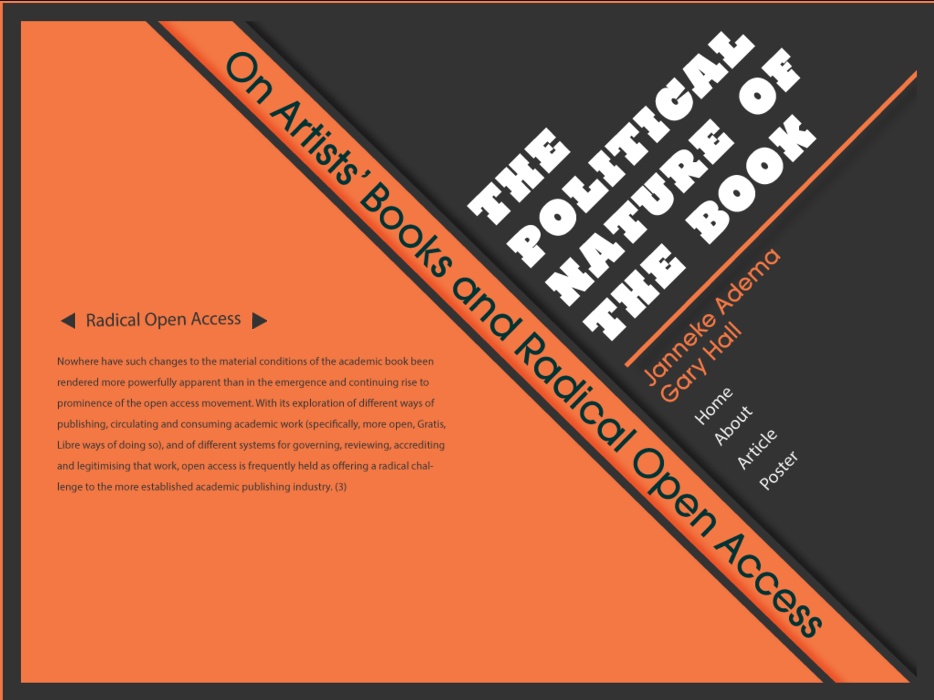

Slide 27
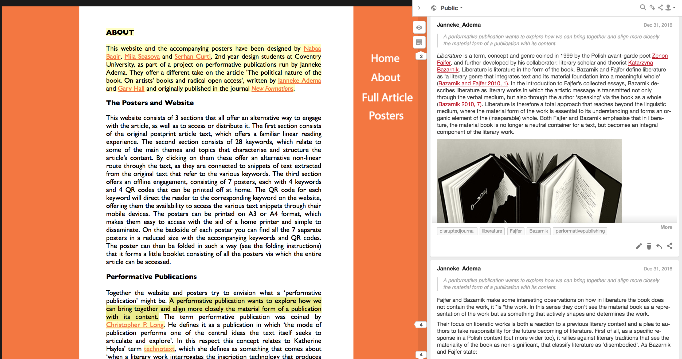

Slide 28
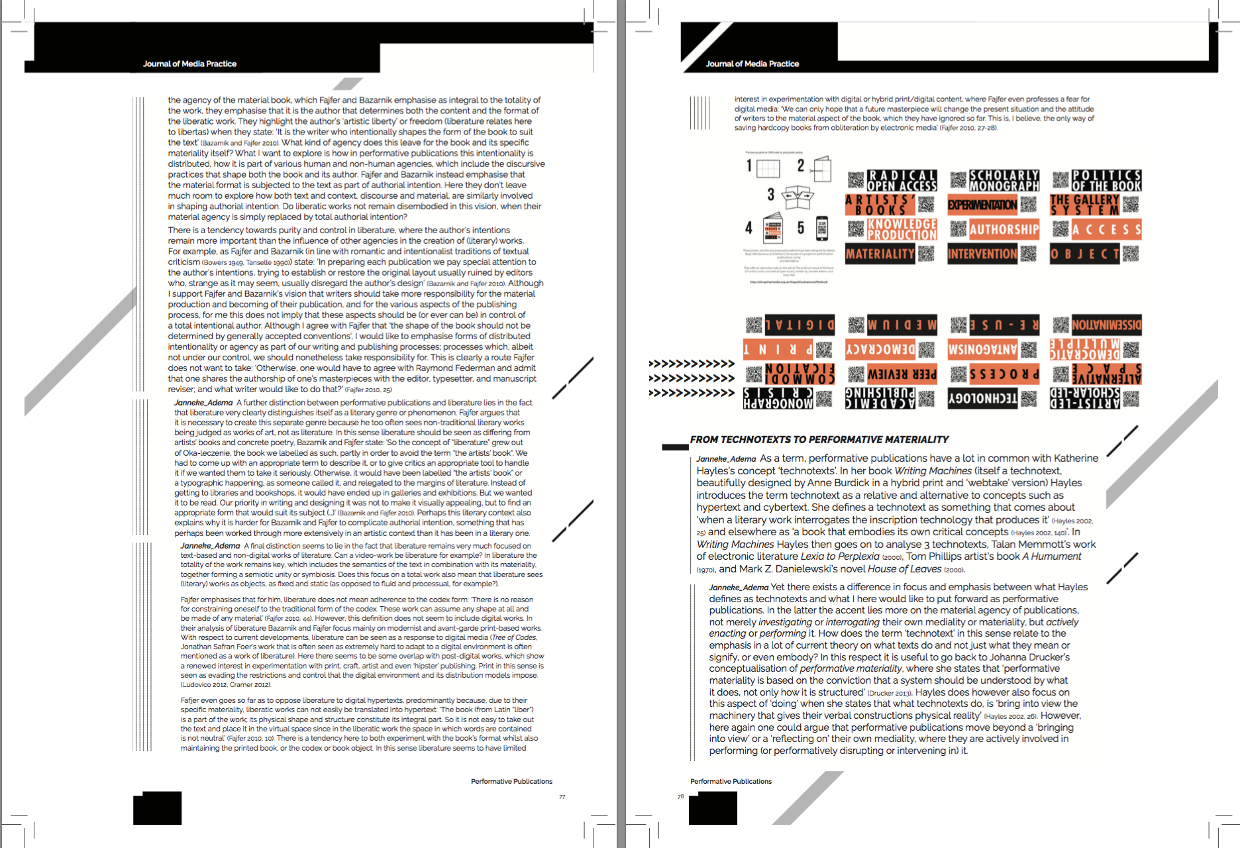
Print design versioning

