Slide 1


Experiments in Post-Publishing and Posthumanities Publishing
Janneke Adema
Centre for Postdigital Cultures
Coventry University

Slide 2
Posthumanities Publishing

Slide 3
forms of experimental publishing: hybrid, enhanced, remixed and multimodal, iterative, and living, webtexts and post-digital works
alternative forms of distribution: piracy, P2P file-sharing, radical open access, wikis, distributed networks, postdigital print
and distributed authorship practices: collaborative, anonymous, including personas, aliases, pseudonyms, as well as machinic, automatic, generative, and algorithmic authorship

Slide 4
”What are the implications of the decentering of the human and of the rise of digital technologies for the humanities, for theory, for how we practice the (digital) humanities, for how we create, perform, disseminate and access it?”

Slide 5
Post-Publishing

Slide 6
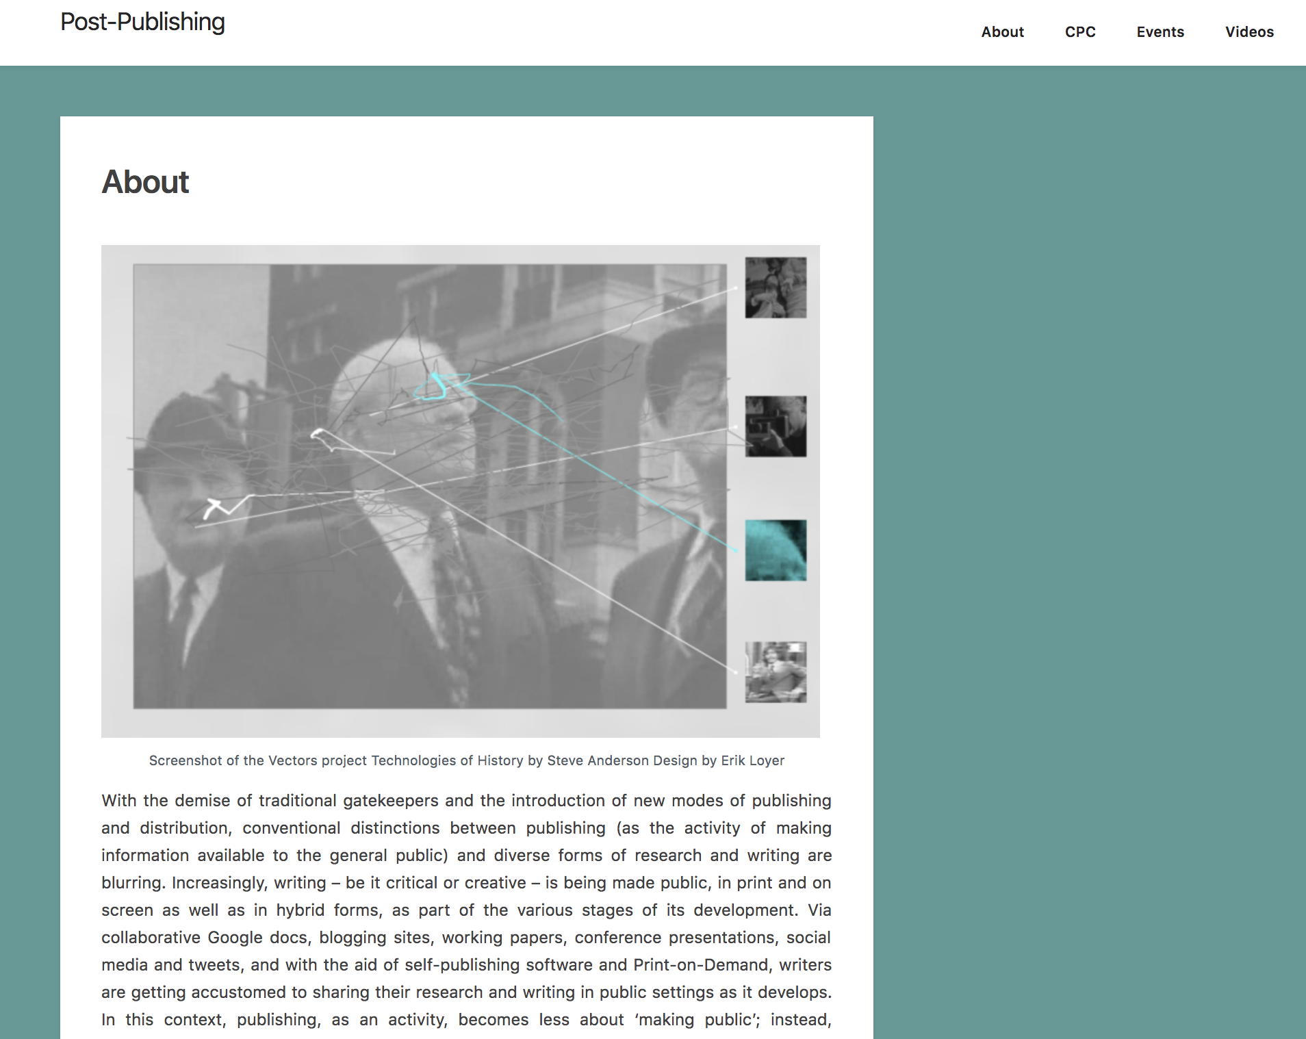
          HTTPS://POST-PUBLISHING.ORG

Slide 7
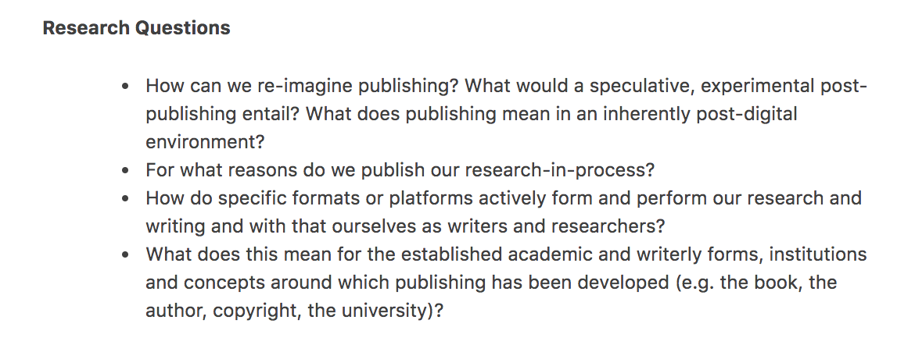

Slide 8
Living Books about Life (Open Humanities Press)
livingbooksaboutlife.org

Slide 10
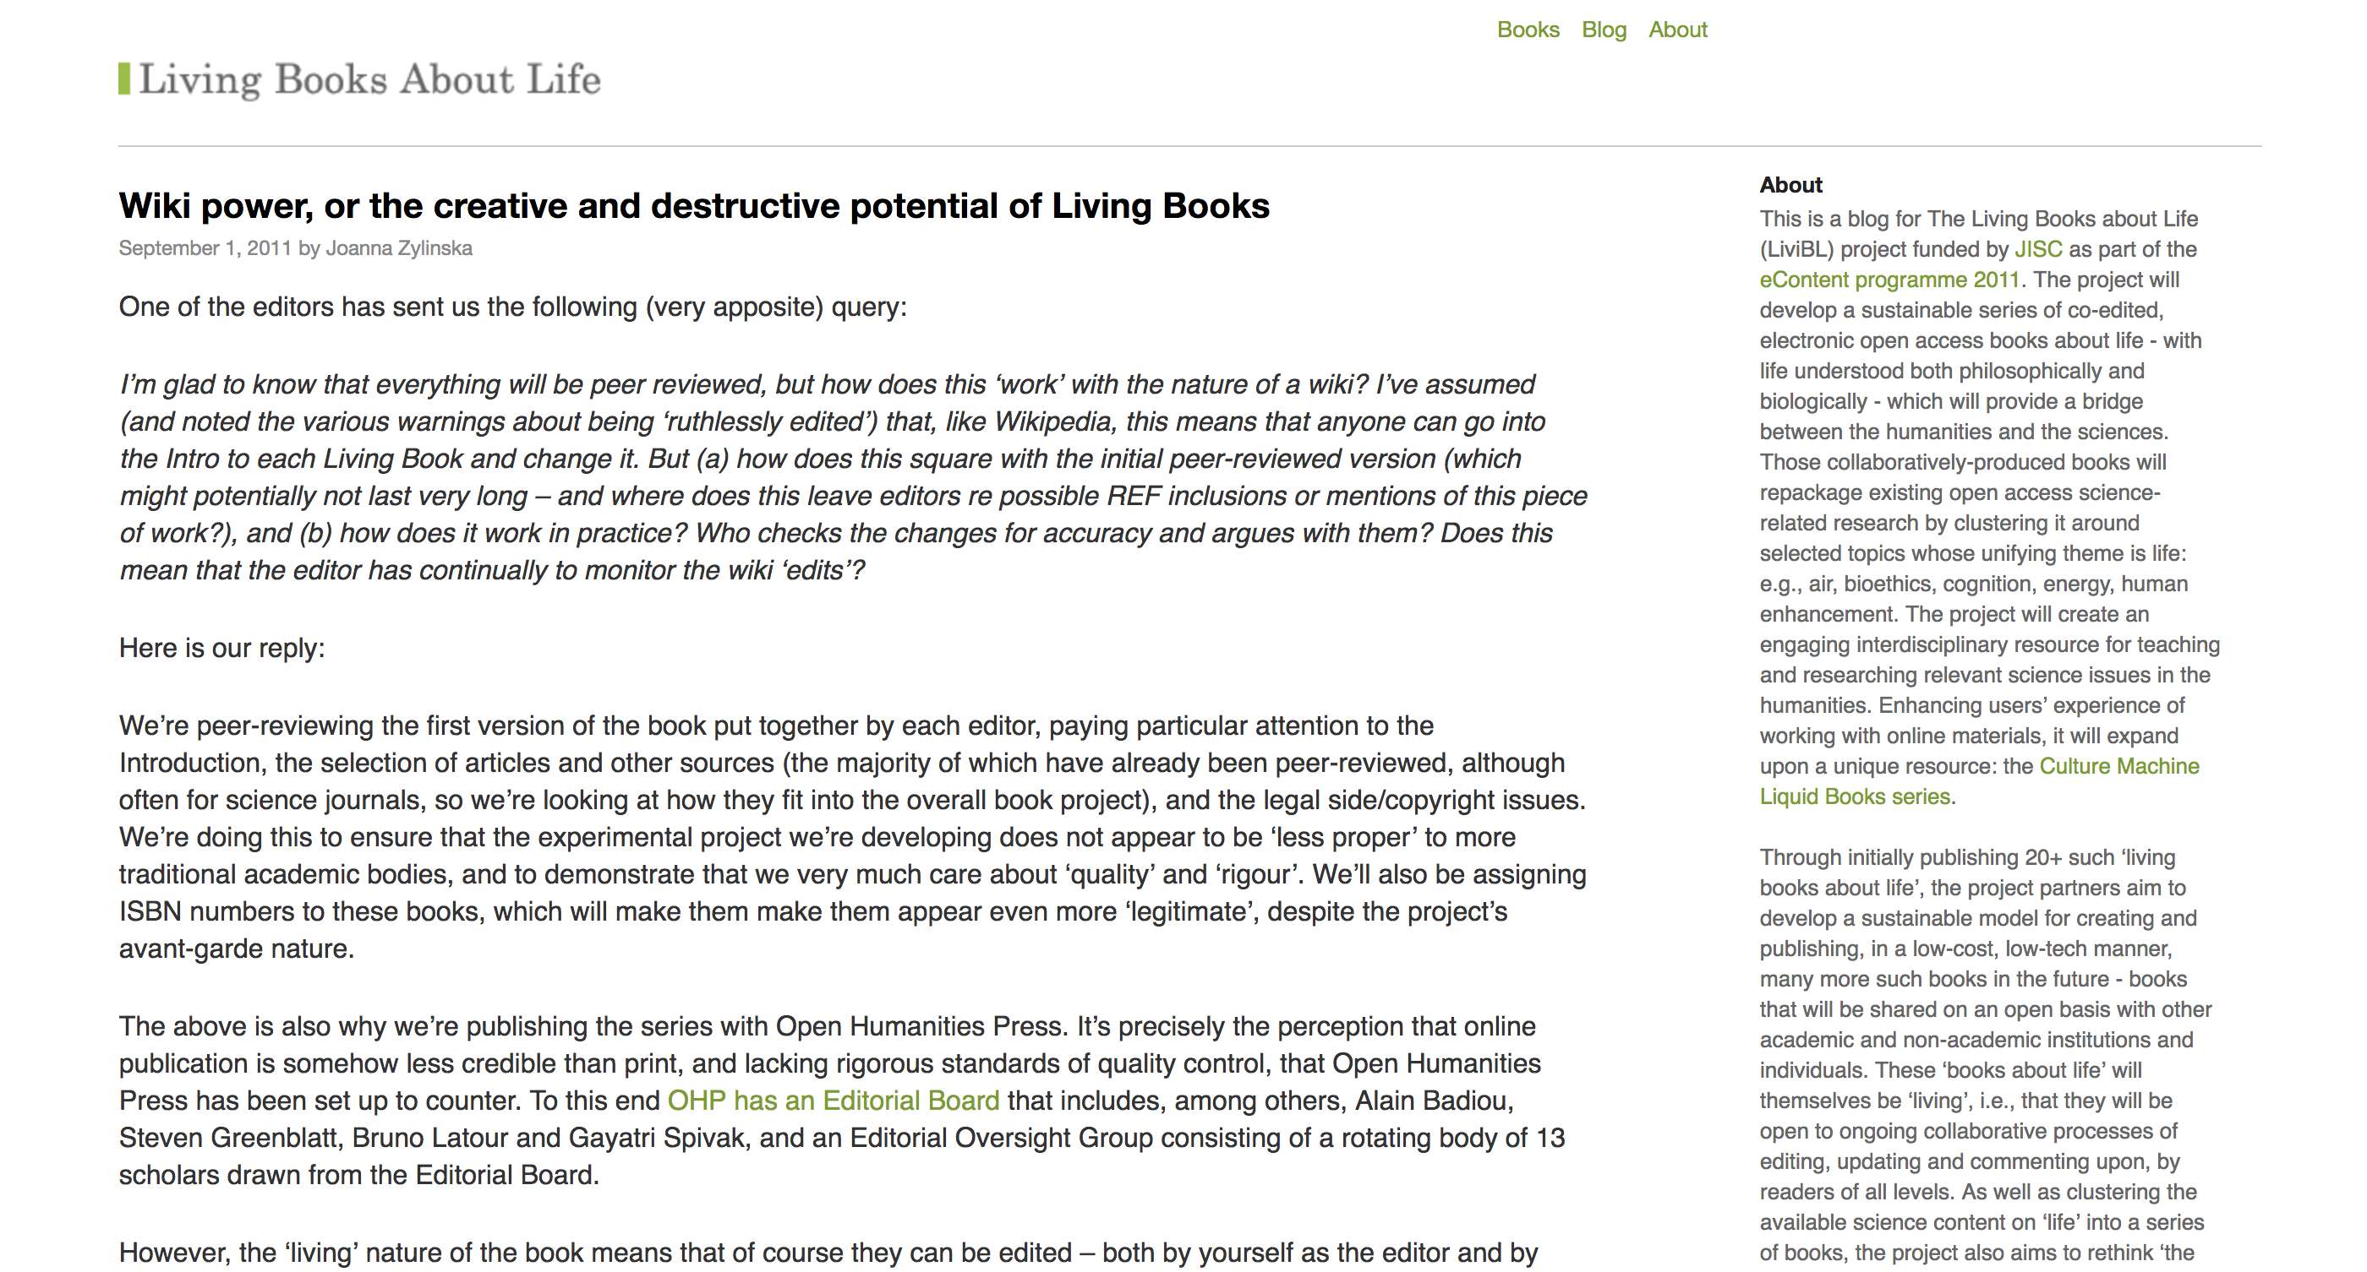

Slide 11
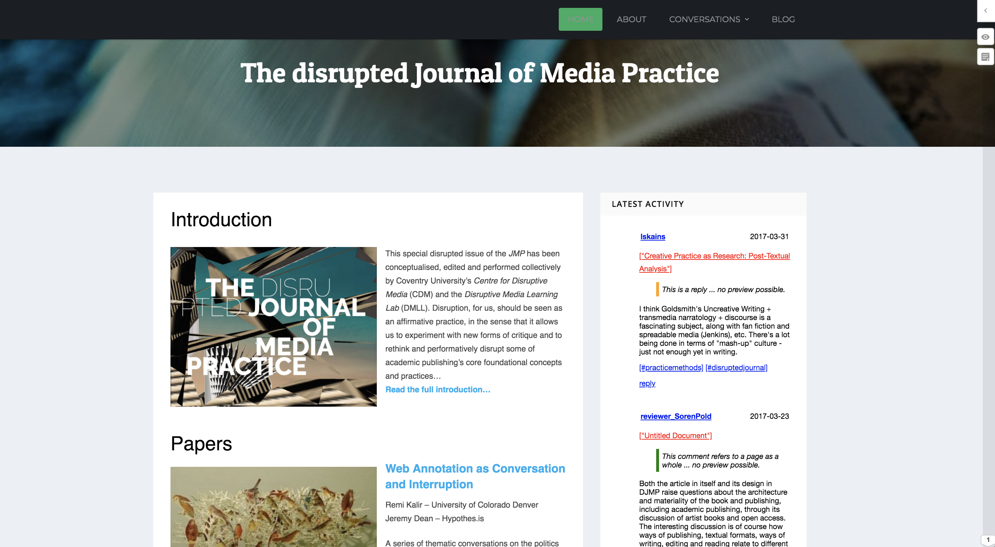

Slide 12
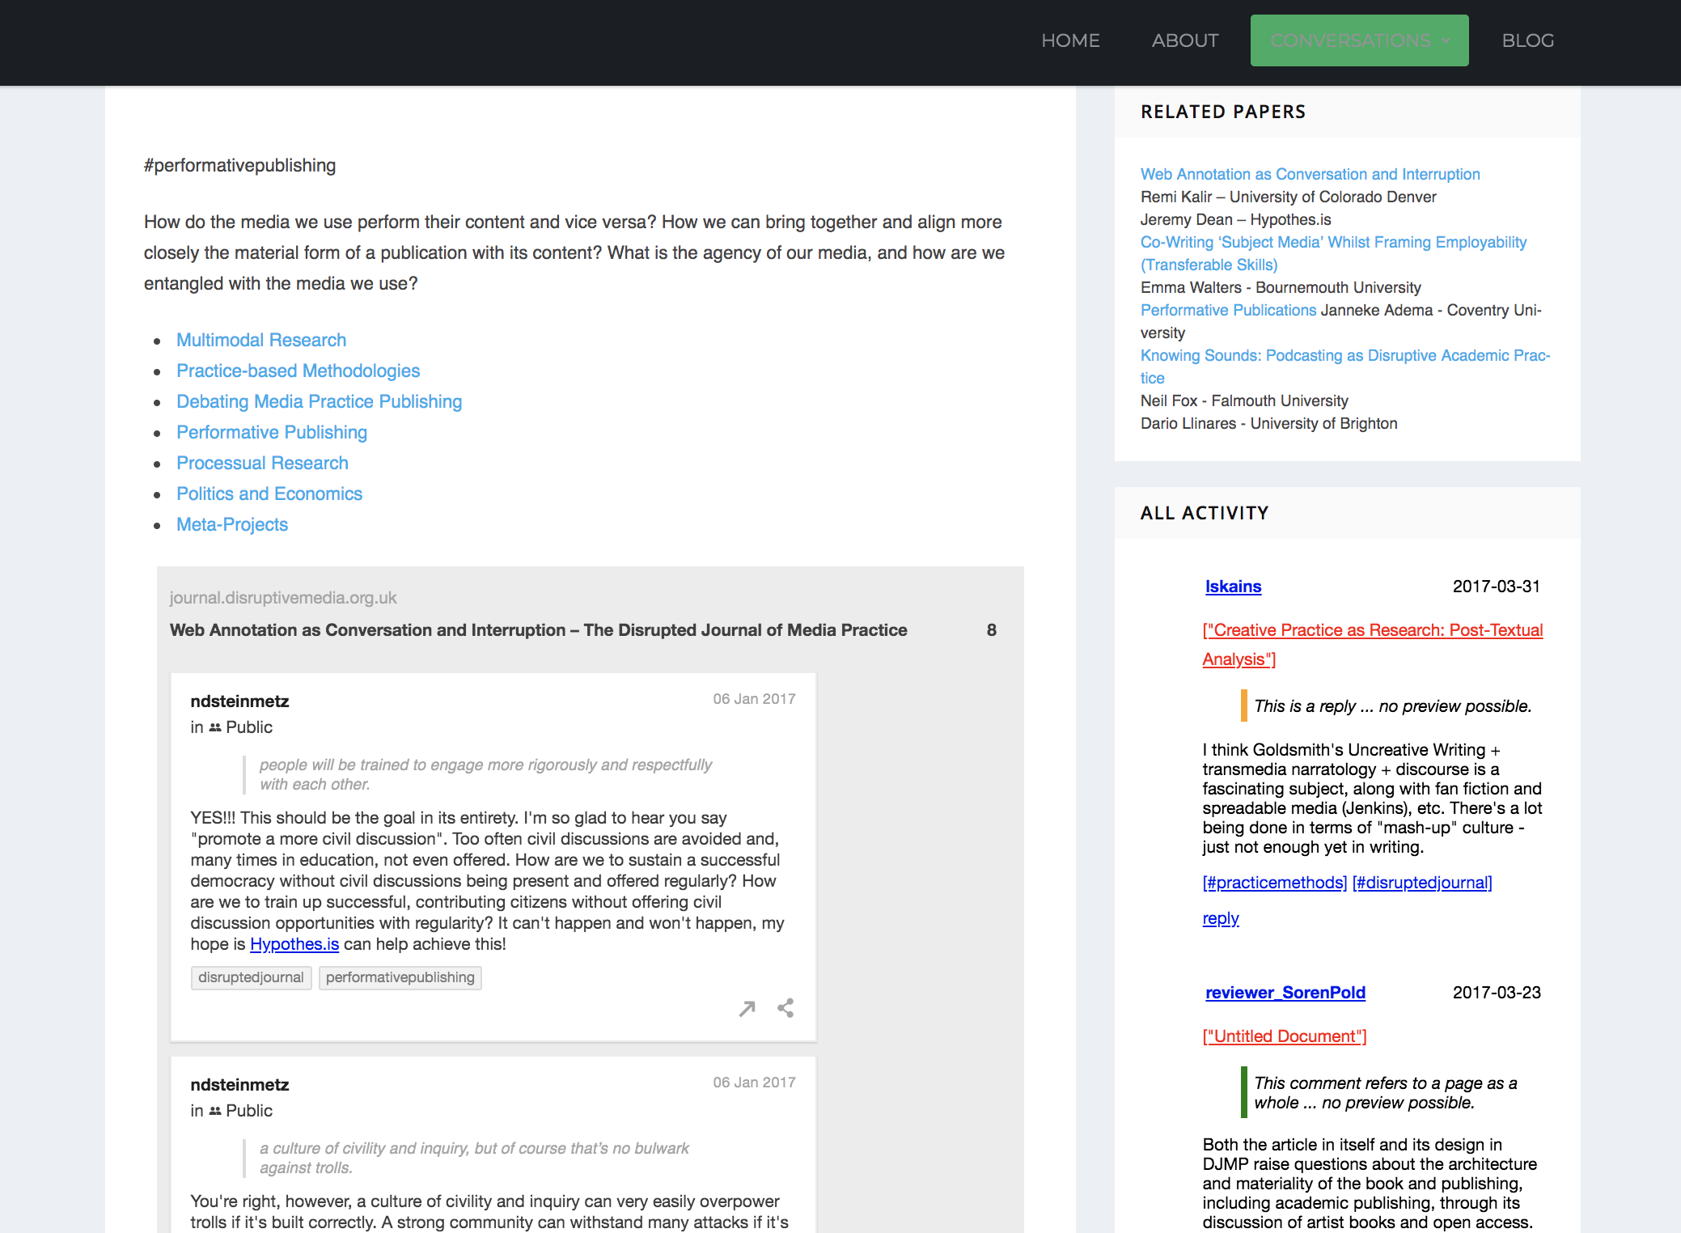

Slide 13
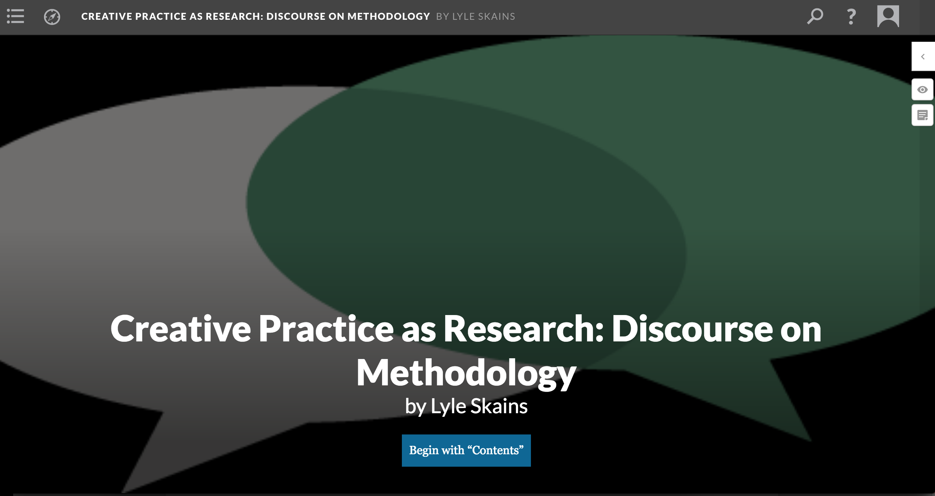

Slide 14
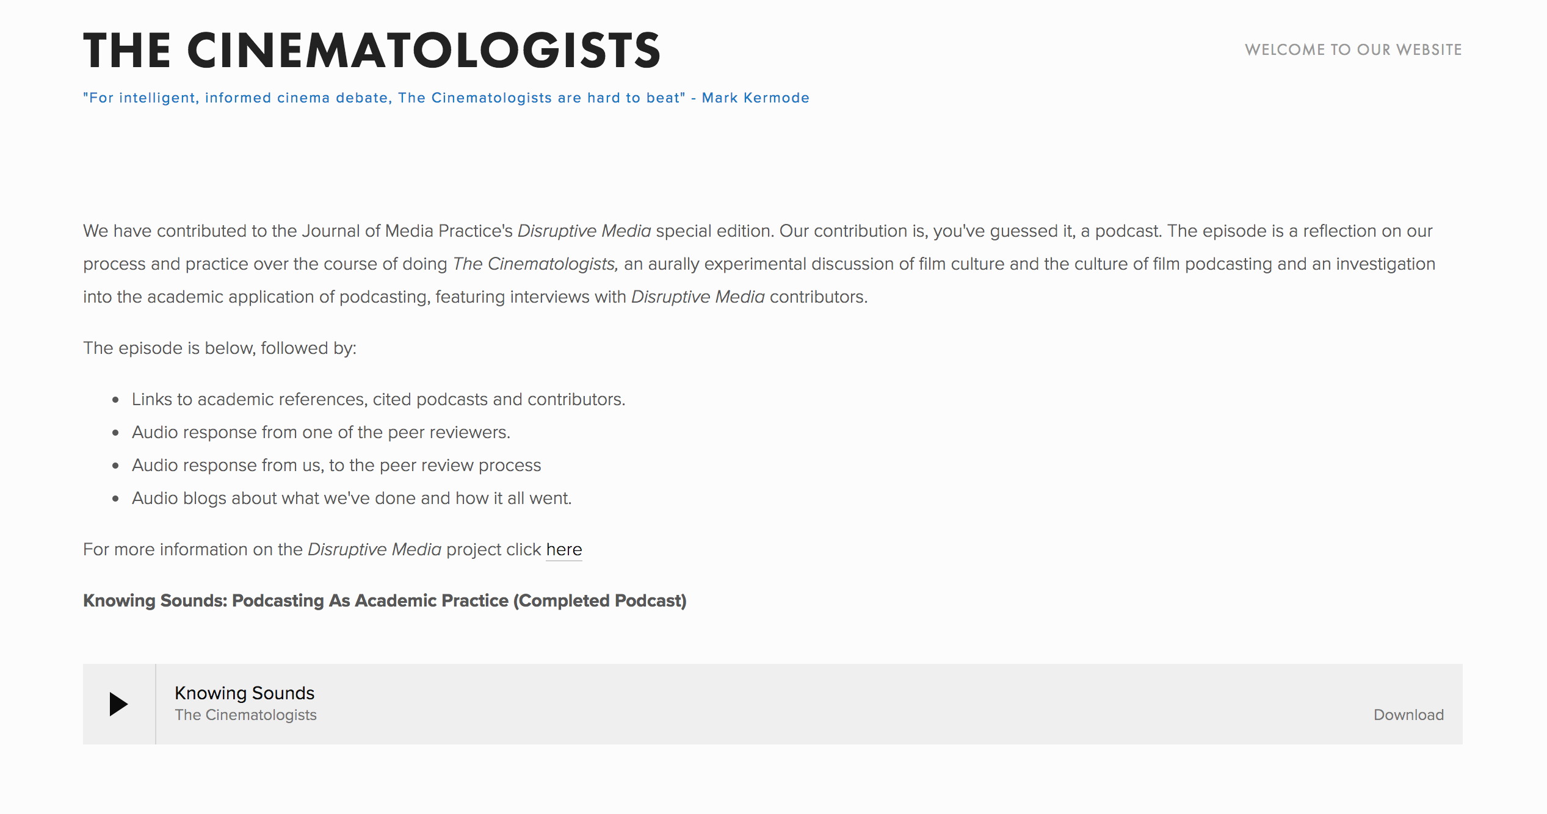

Slide 15
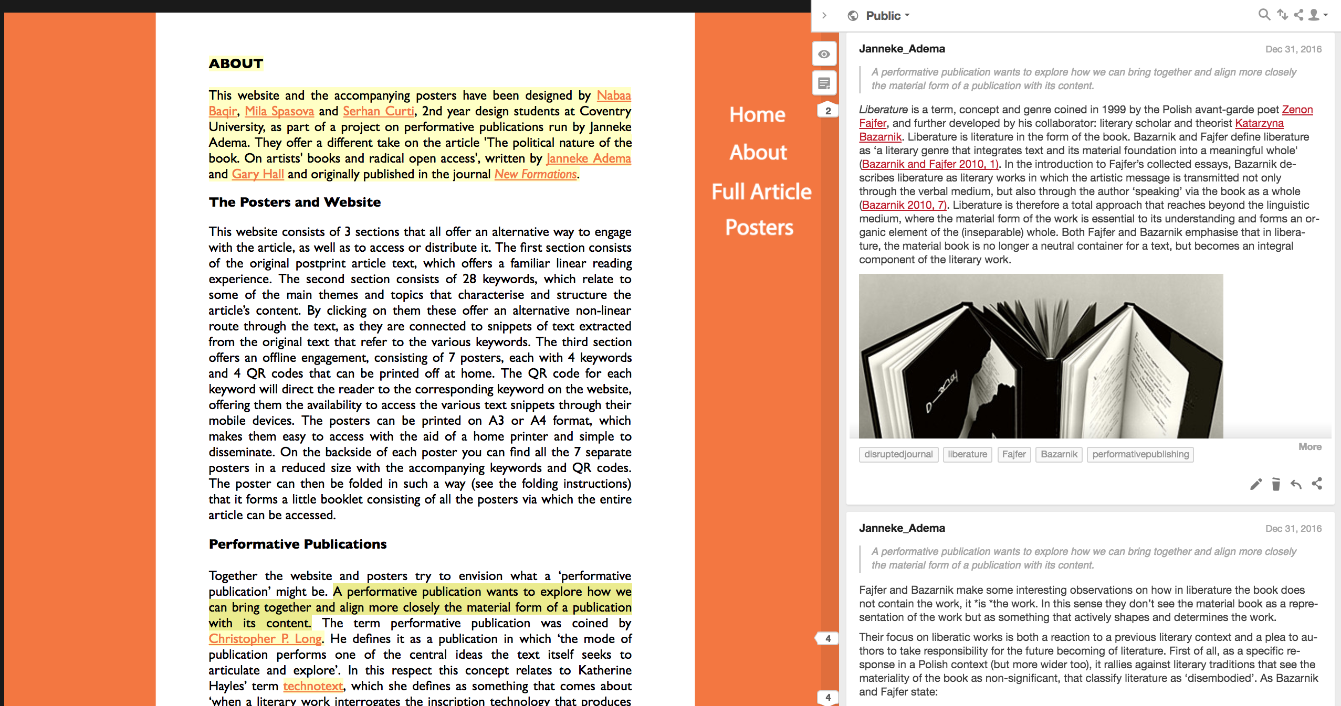

Slide 16
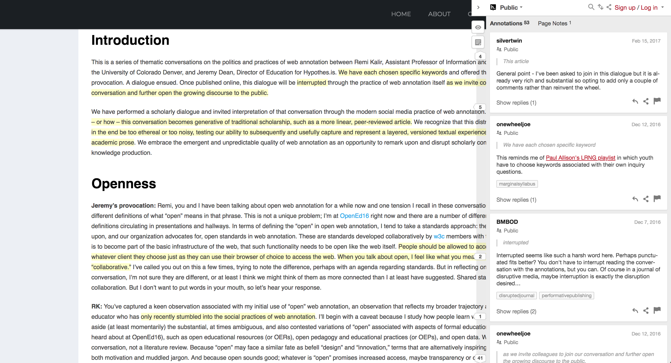
Open Peer Review

Slide 17
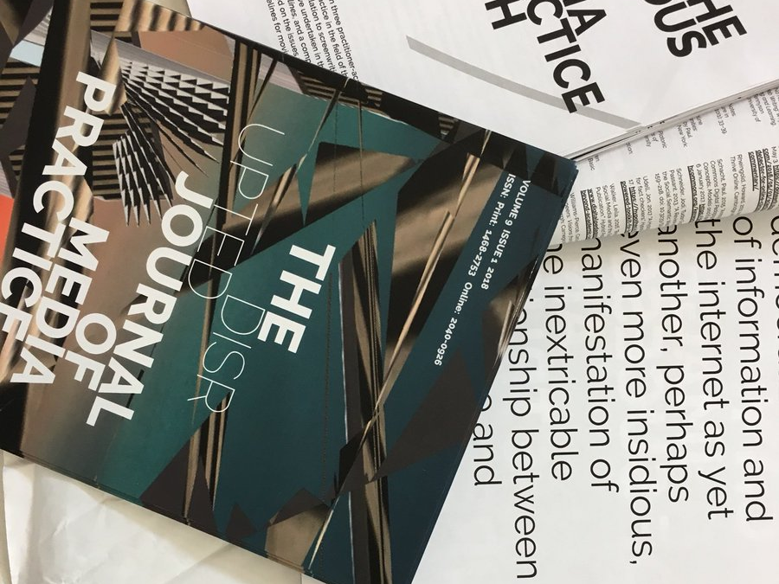
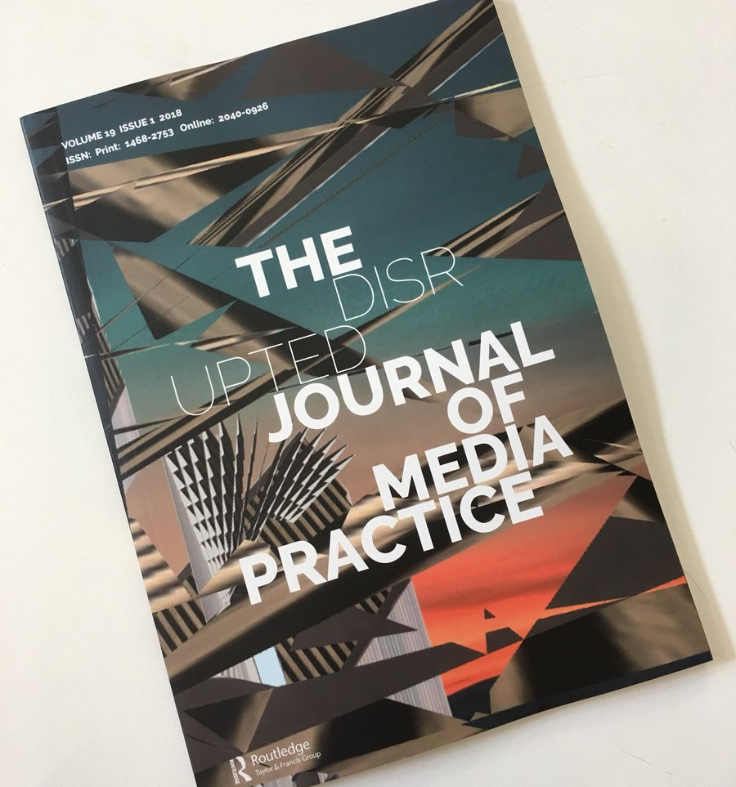

Slide 18
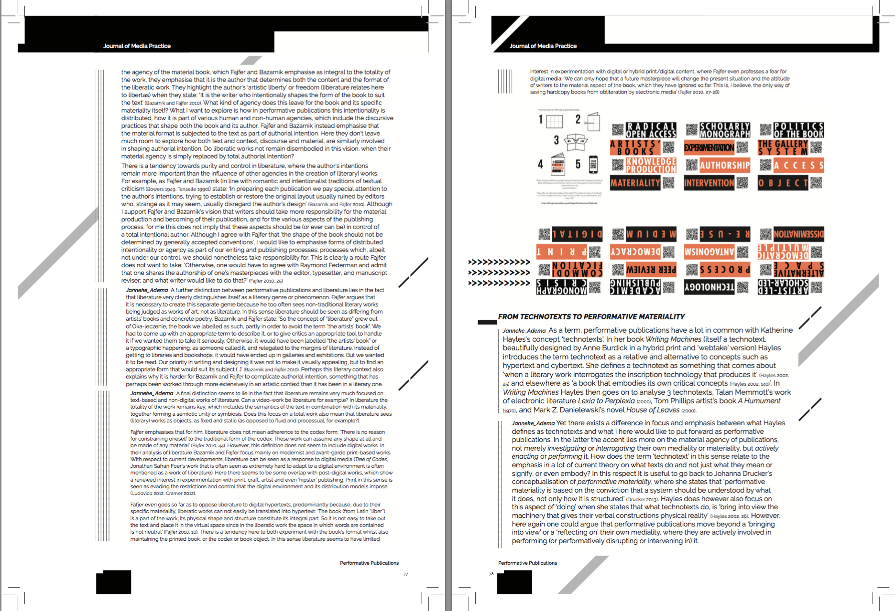
Print design versioning

Slide 19
Implications for Doctoral Education
Focus remains on research and not on publishing/communication
Individual PhD-student as author instead of emphasizing the collective nature of scholarship
Thesis as object instead as a processual entity (lack of focus on process as in practice-based research)
Disconnect between the thesis as a publication form and more formal academic publication forms (the article/the monograph)
PhDs are seen as “students” instead as researchers/colleagues in their own right

