Slide 1


The Future of Publishing: Post-Publishing and Performative Publications
Janneke Adema
Centre for Postdigital Cultures
Coventry University
Culture Unbound Turns 10!
Publishing, Property and Academic Labour Workshop

Slide 2
”What are the implications of the decentering of the human and of the rise of digital technologies for the humanities, for theory, for how we practice the (digital) humanities, for how we create, perform, disseminate and access it?”

Slide 3



Slide 4
Post
Post
Post
Post humanities
Post
Post
Post

Slide 5
forms of experimental publishing: hybrid, enhanced, remixed and multimodal, iterative, and living, webtexts and post-digital works
alternative forms of distribution: piracy, P2P file-sharing, radical open access, wikis, distributed networks, postdigital print
and distributed authorship practices: collaborative, anonymous, including personas, aliases, pseudonyms, as well as machinic, automatic, generative, and algorithmic authorship

Slide 6


Slide 7
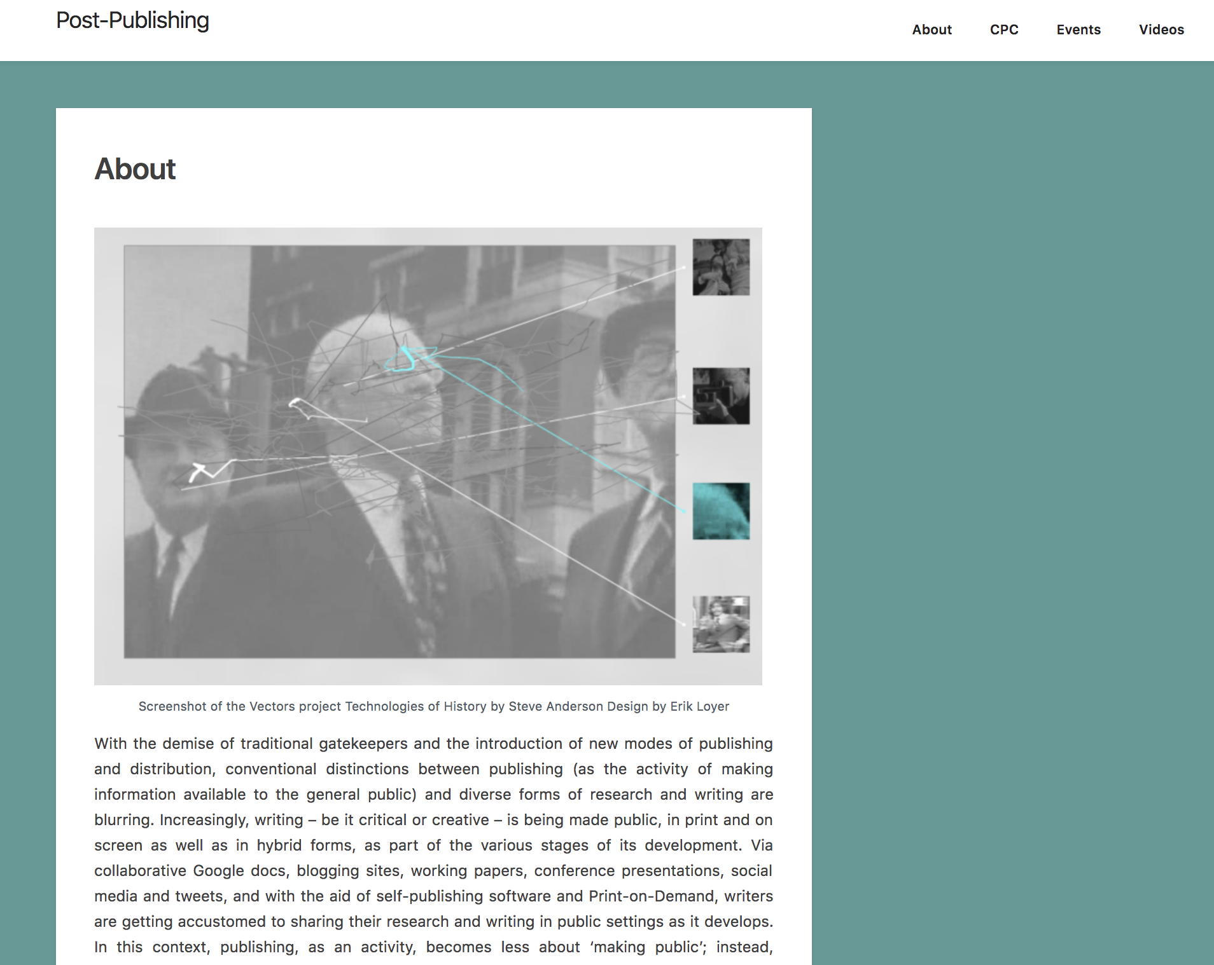
          HTTPS://POST-PUBLISHING.ORG

Slide 8
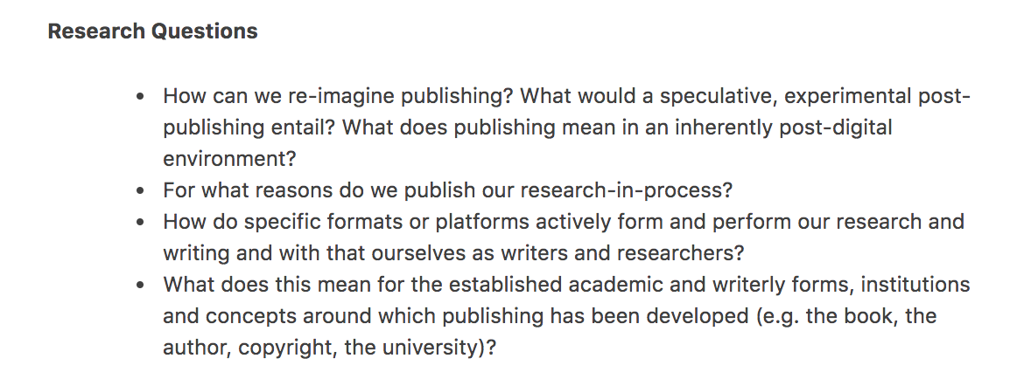

Slide 9
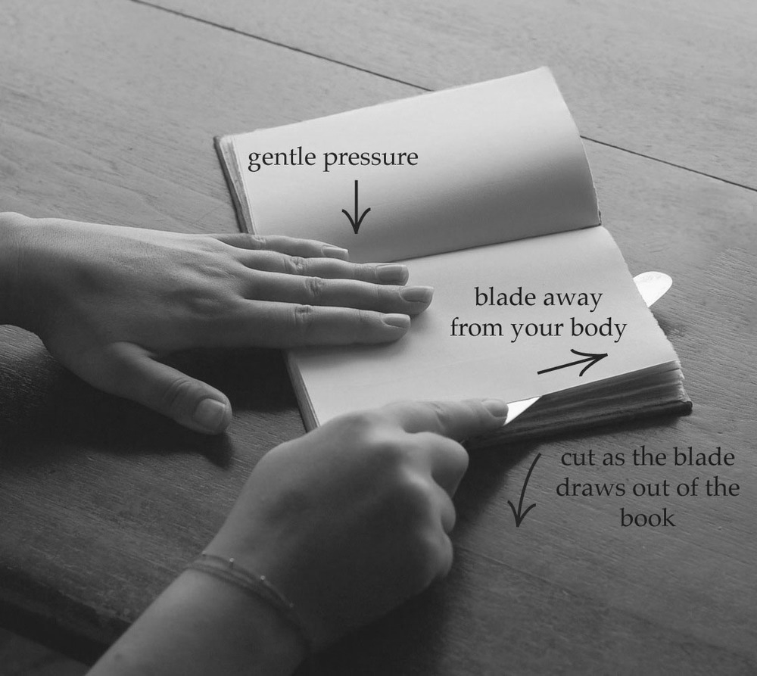
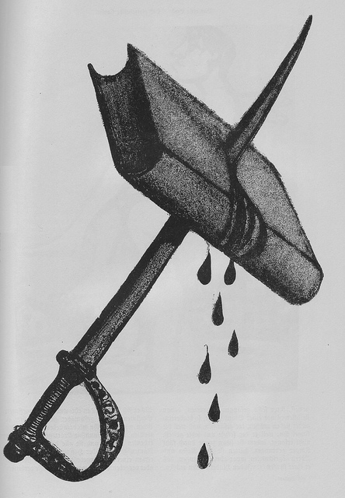

Slide 10
Living Books about Life (Open Humanities Press)
livingbooksaboutlife.org

Slide 12
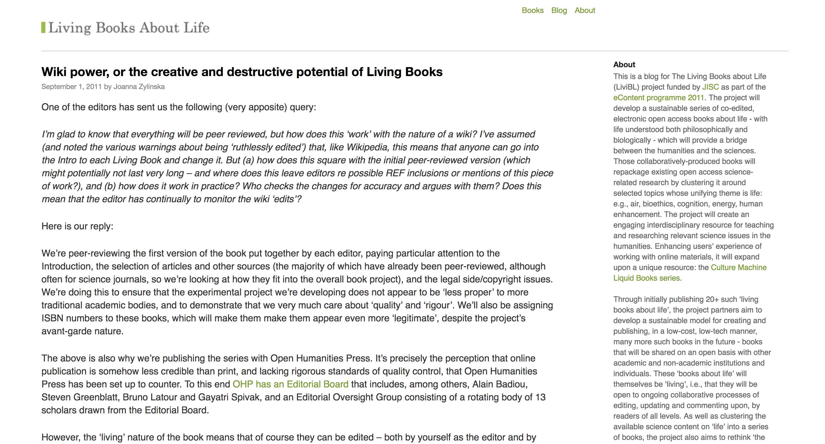

Slide 13
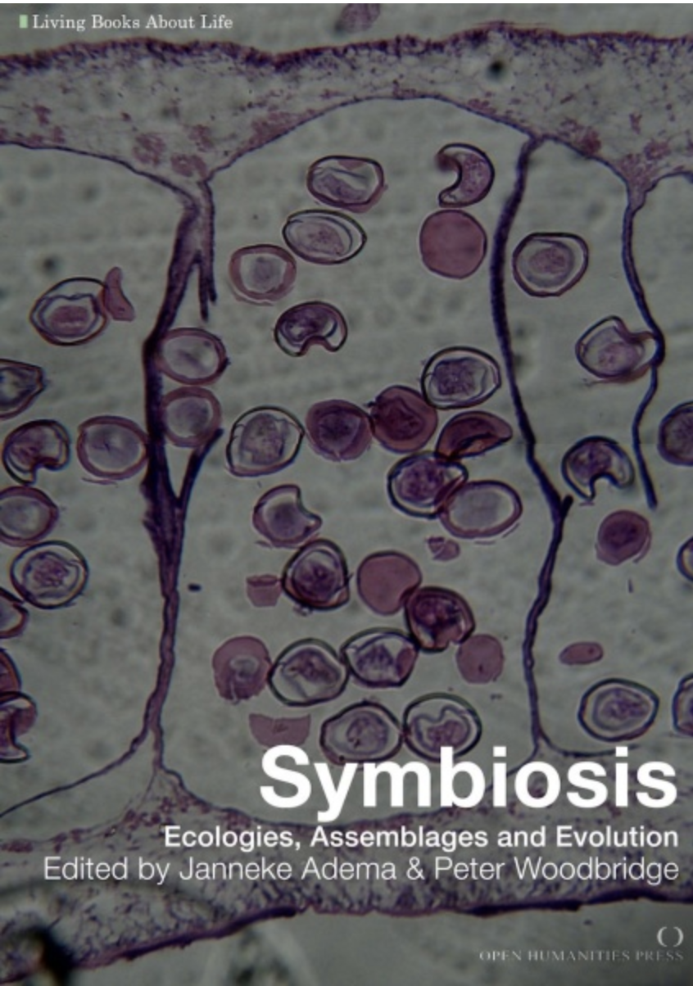


Slide 14
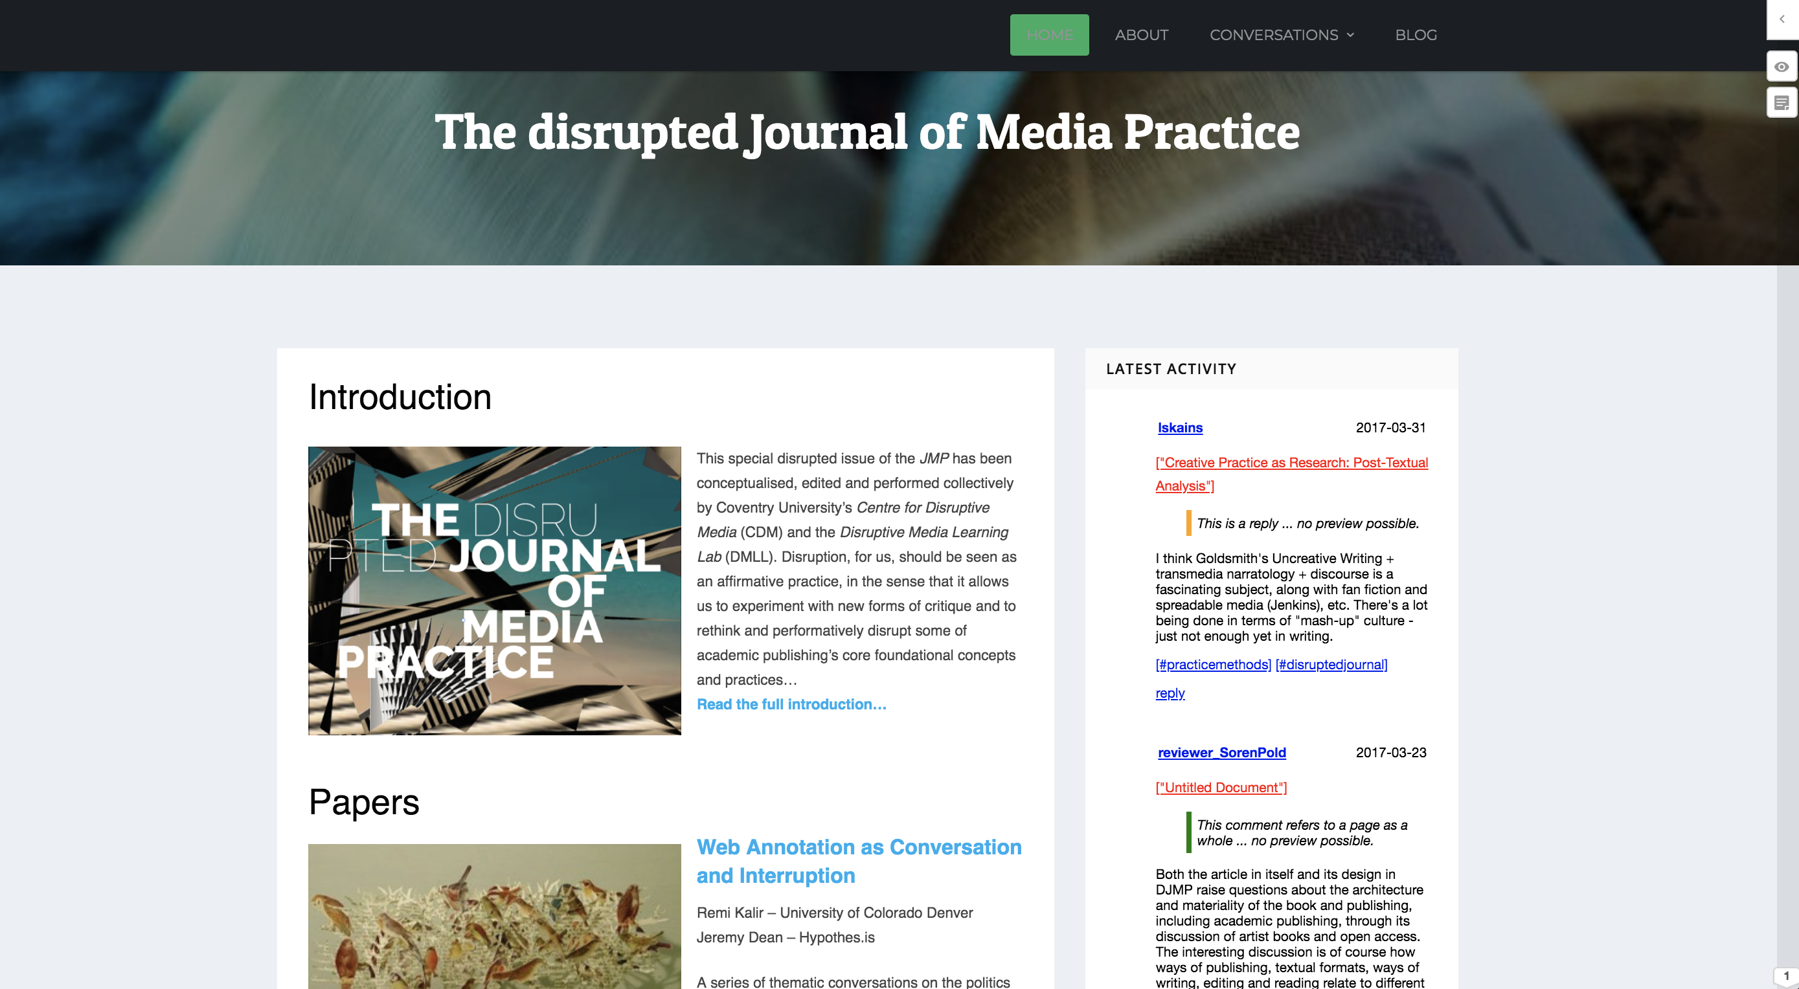

Slide 15
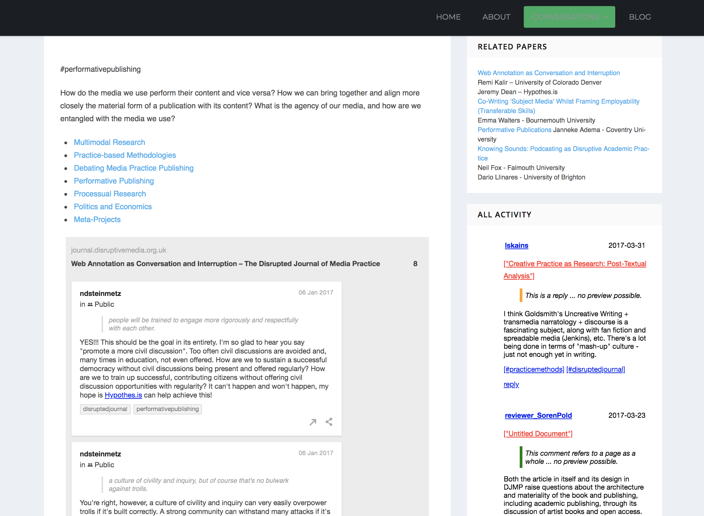

Slide 16
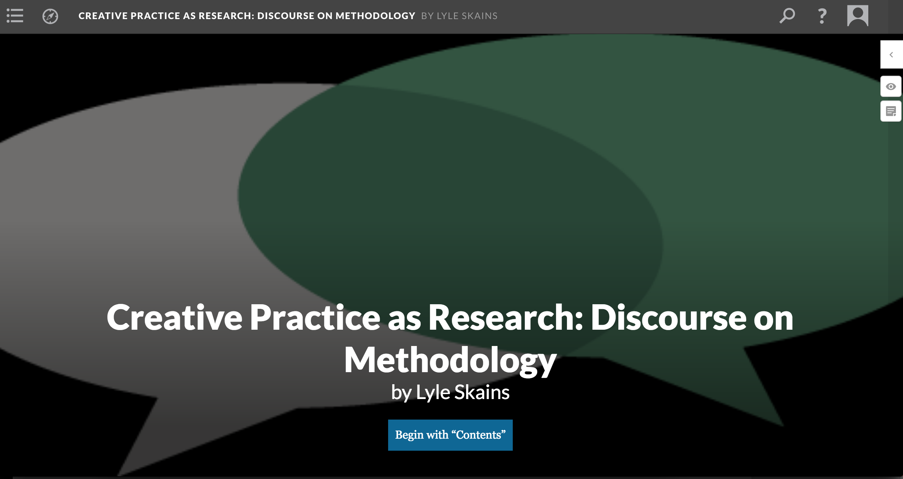

Slide 17
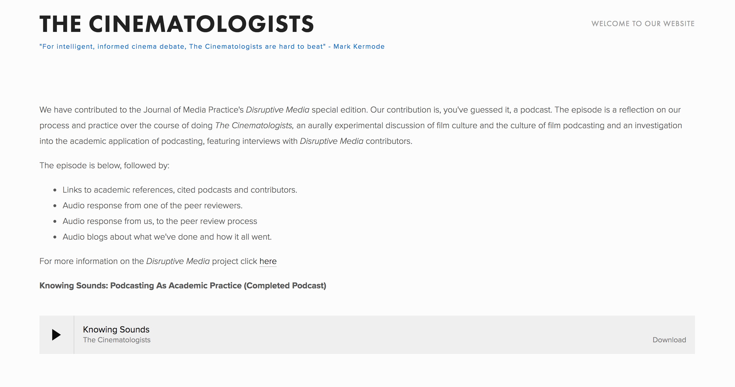

Slide 18
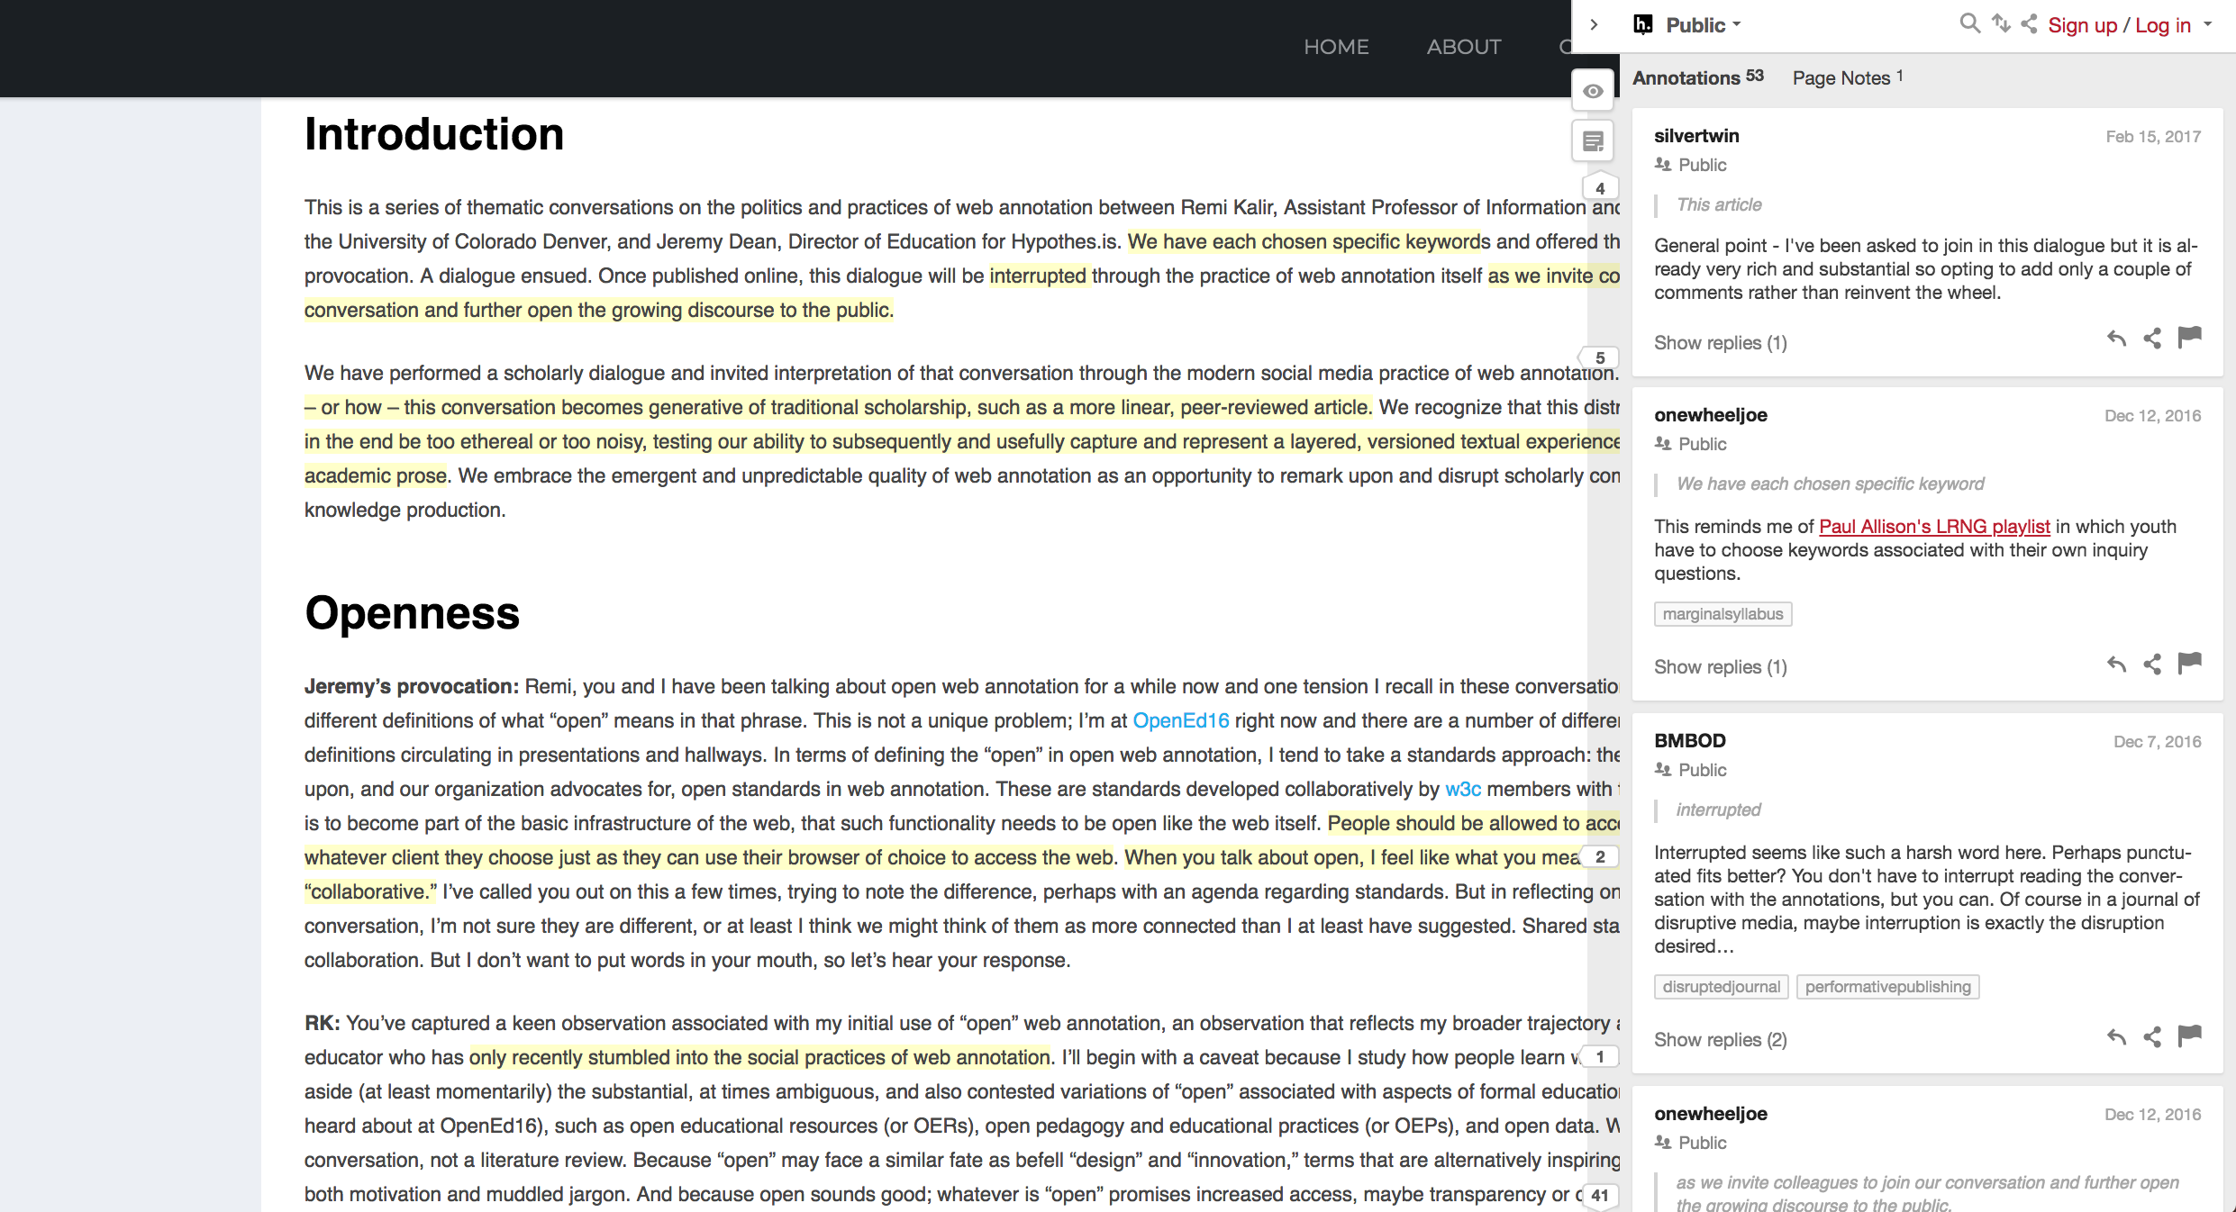
Open Peer Review

Slide 19
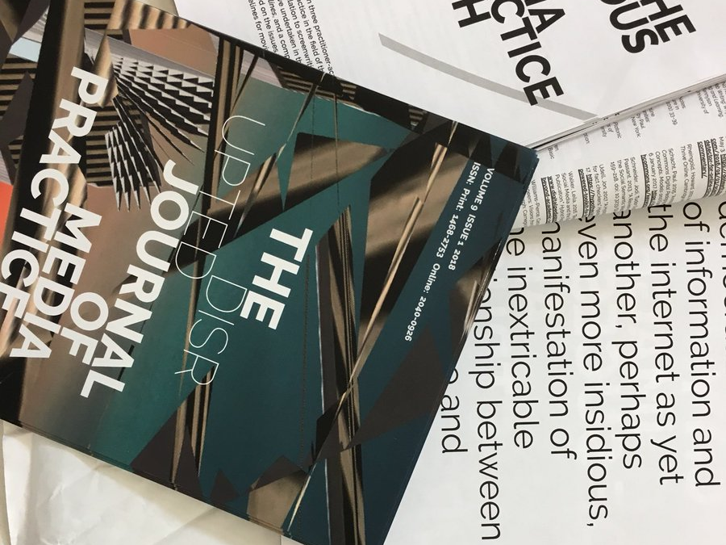
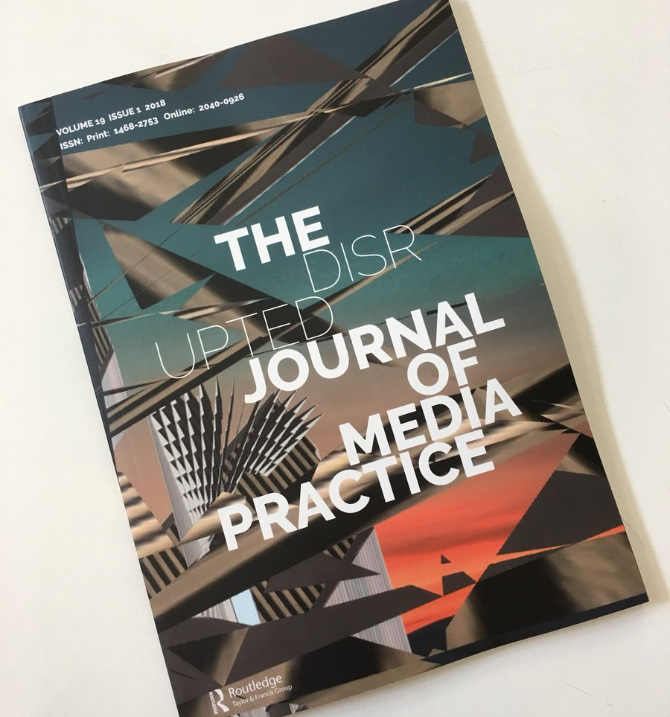

Slide 20
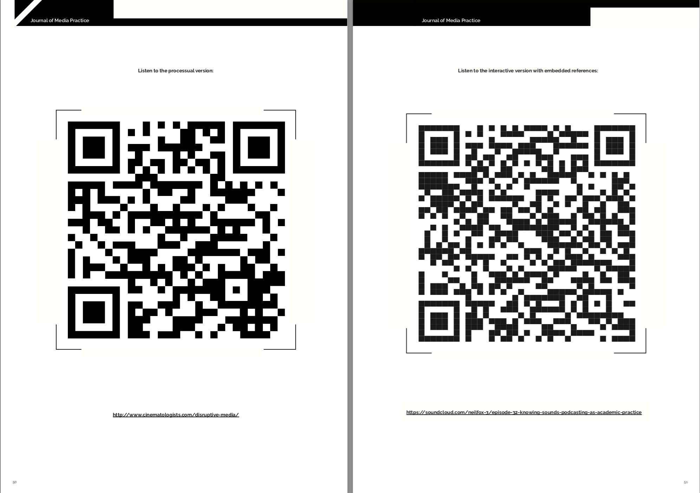

Slide 21
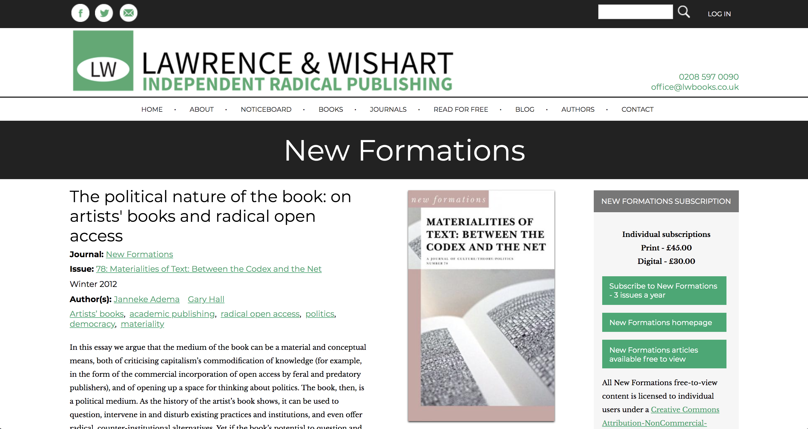

Slide 22
Performative Publication – Chris Long
‘The mode of publication performs one of the central ideas the text itself seeks to articulate and explore’ (Long 2013)

Slide 23
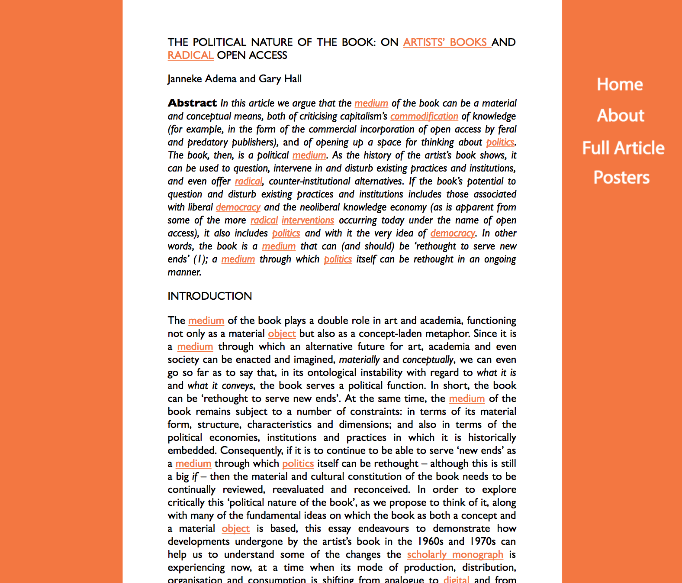

Slide 24
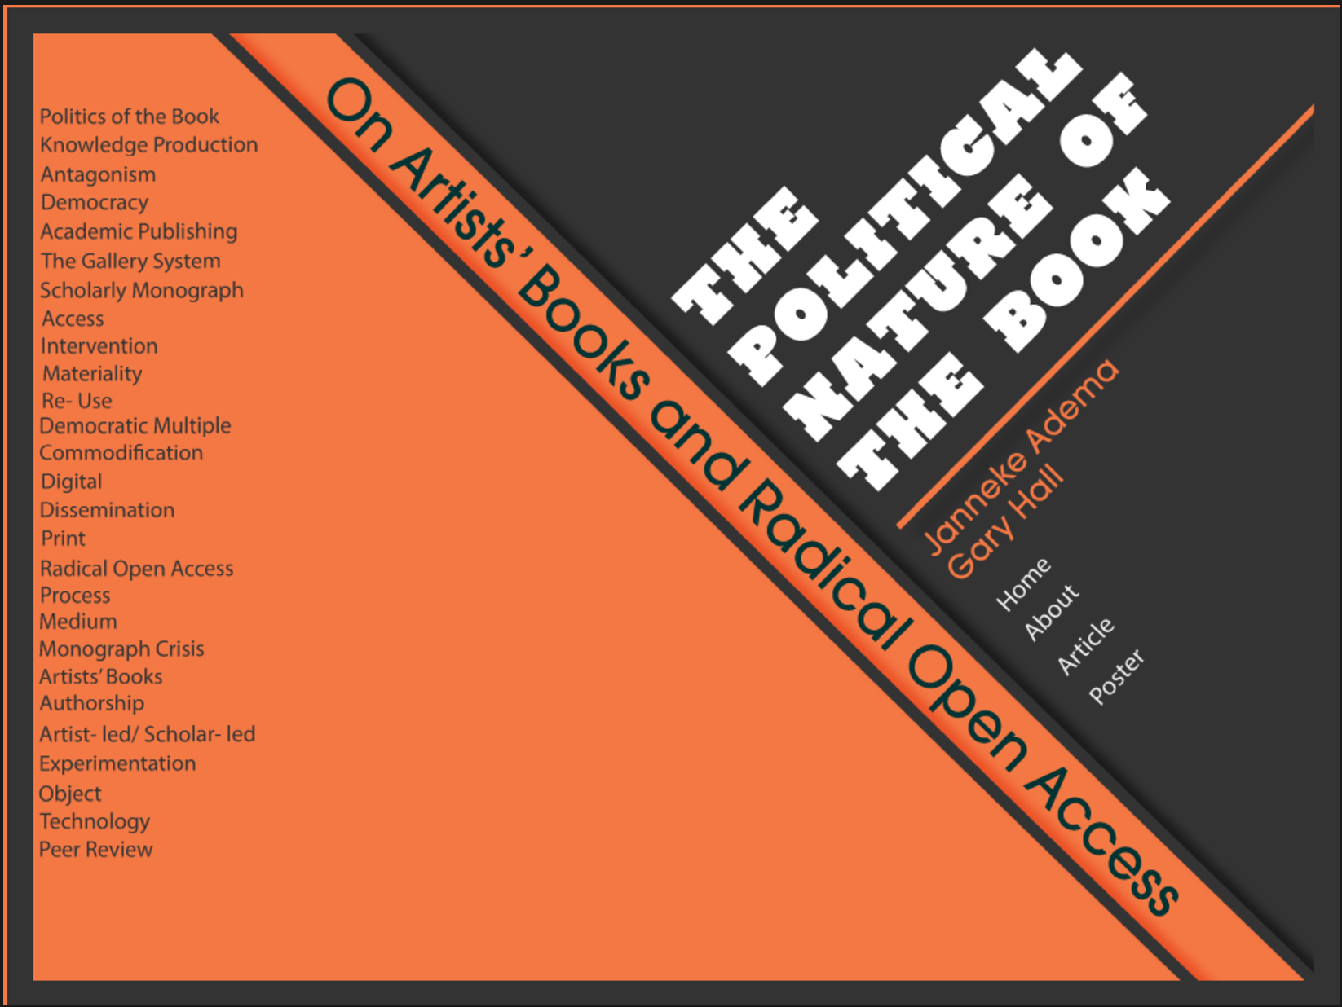
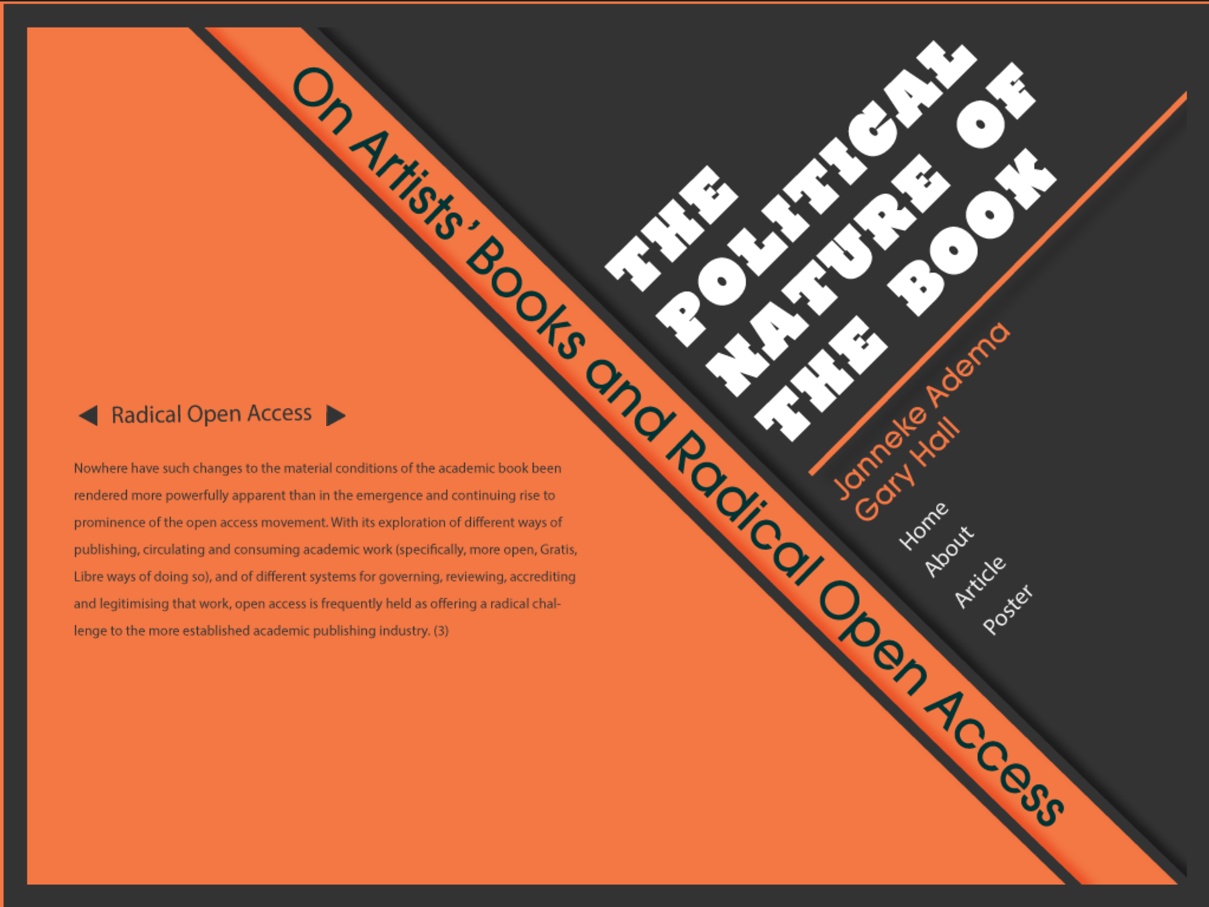

Slide 26
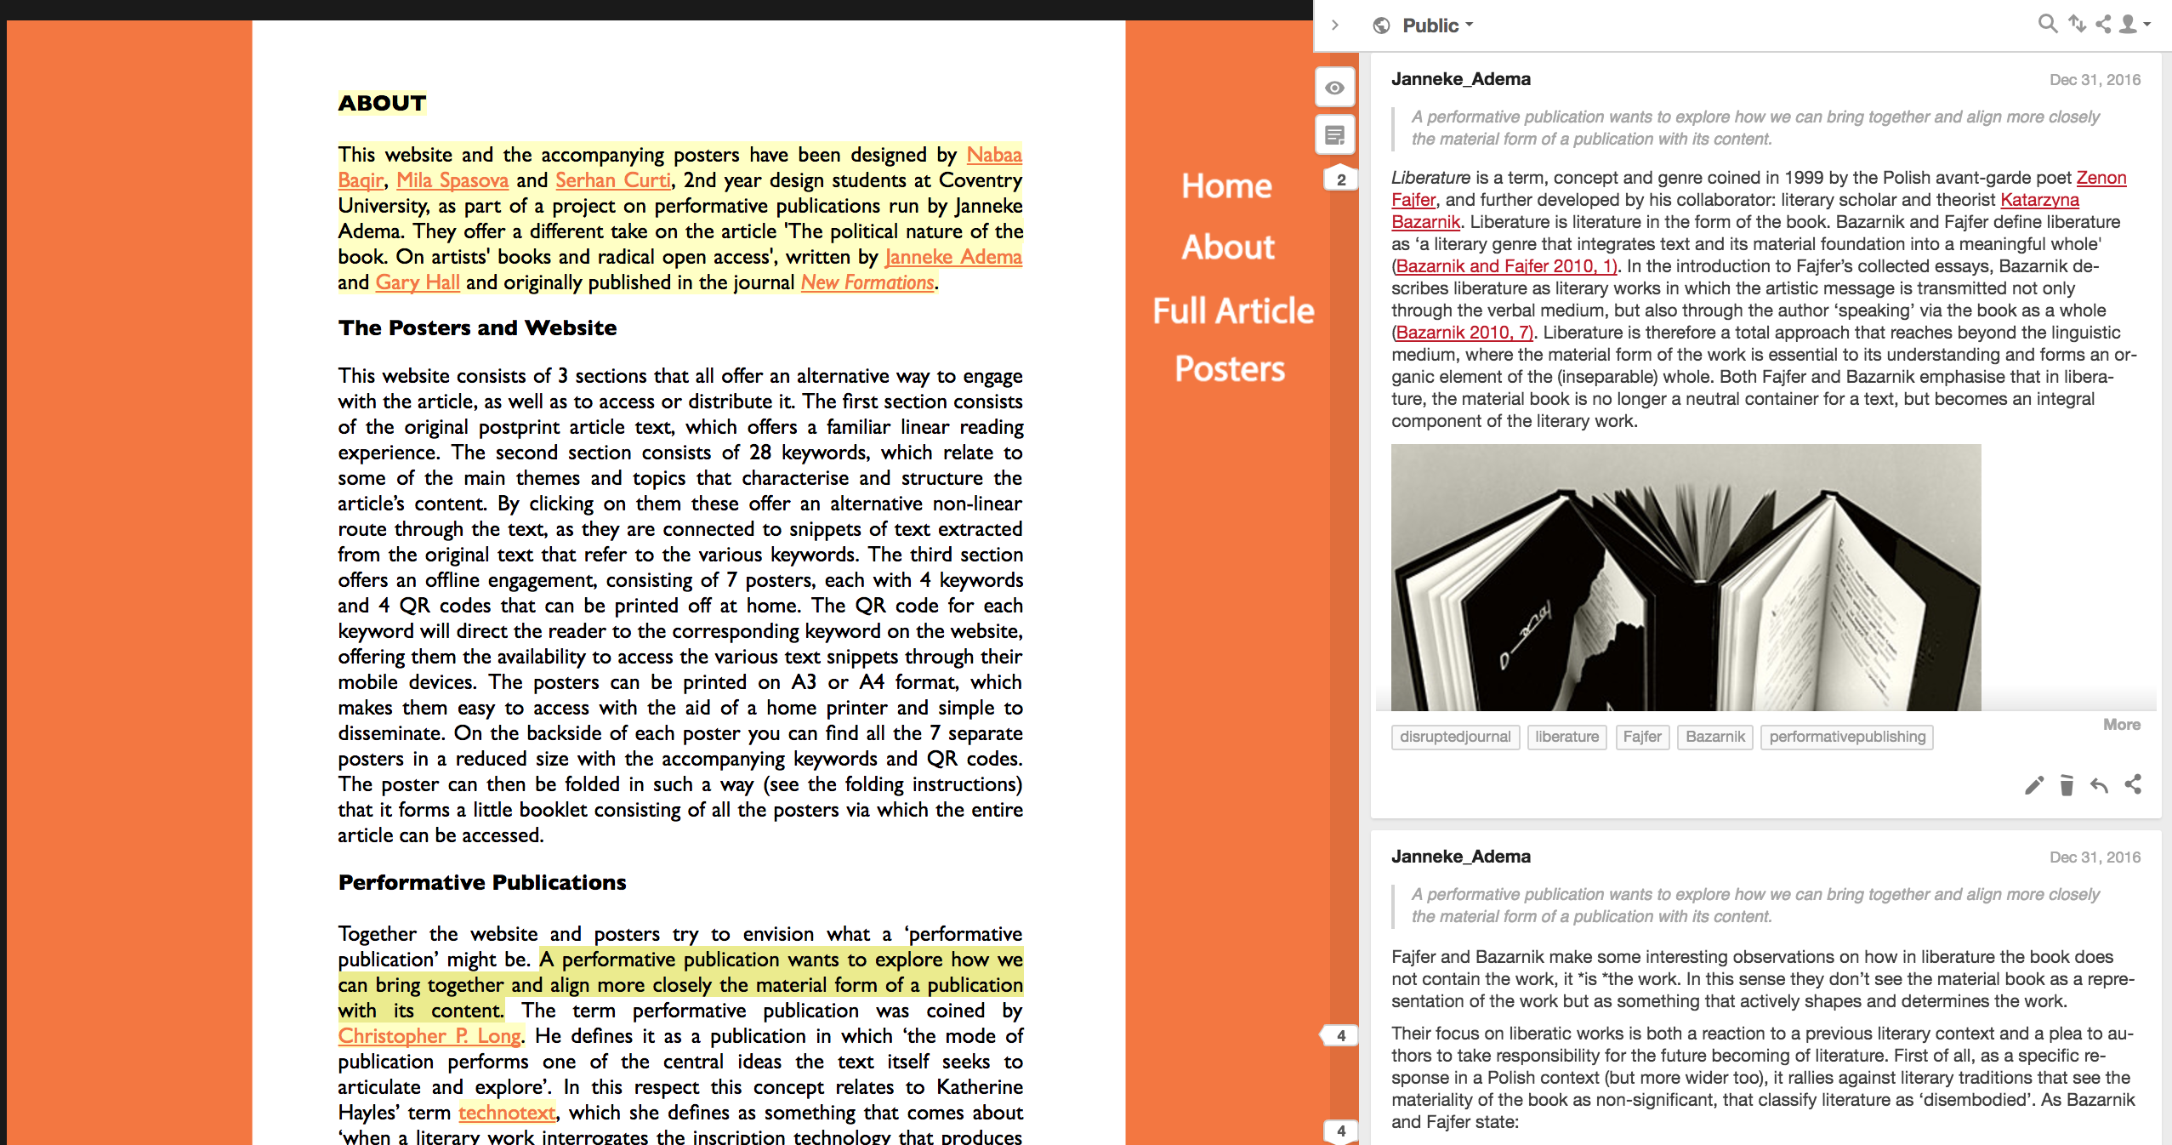

Slide 27
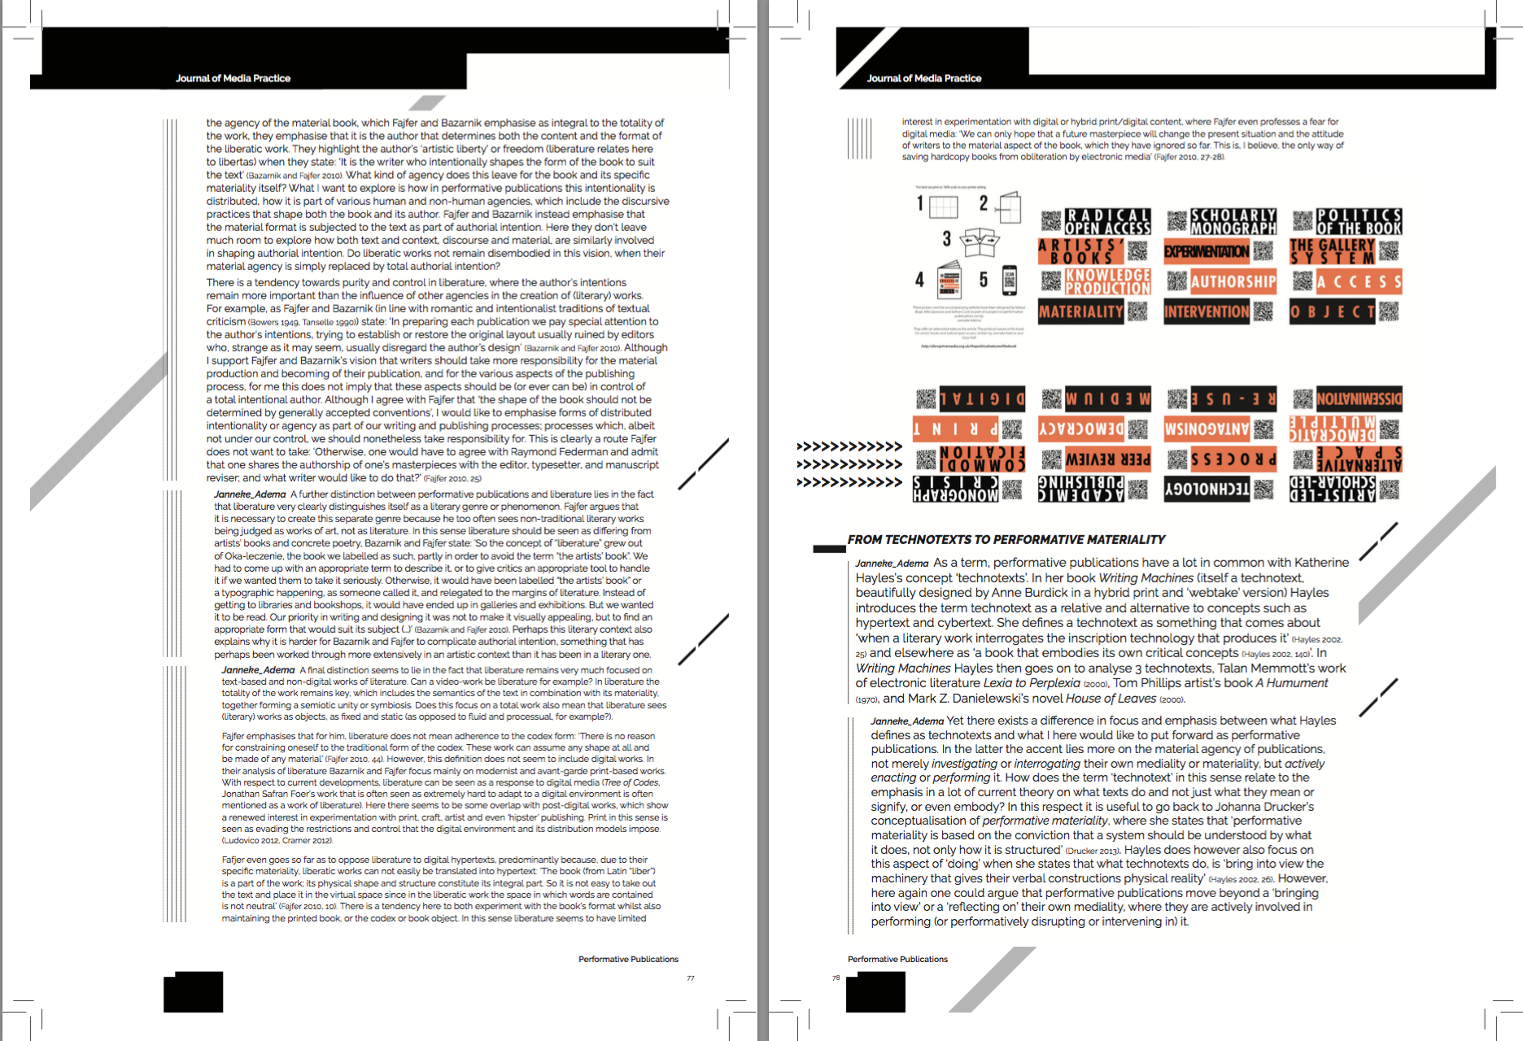
Print design versioning

