Slide 1


Posthumanities Publishing
Janneke Adema and Gary Hall
Centre for Postdigital Cultures
Coventry University
SESSION 1:
THE CARRIER BAG THEORY OF NON-FICTION
Urgent Publishing

Slide 2
“helping cultural bits move around more easily”
Lev Manovich
The Language of New Media

Slide 3
“a logic of the fragment or the chunk, a way of seeing the world as discrete modules or nodes, a mode that suppresses relation and context. As such, the lenticular also manages and controls complexity.”
Tara McPherson
‘Why Are The Digital Humanities So White?’

Slide 4
forms of experimental publishing: hybrid, enhanced, remixed and multimodal, iterative, and living, webtexts and post-digital works
alternative forms of distribution: piracy, P2P file-sharing, radical open access, wikis, distributed networks, postdigital print
and distributed authorship practices: collaborative, anonymous, including personas, aliases, pseudonyms, as well as machinic, automatic, generative, and algorithmic authorship

Slide 5
”What are the implications of the decentering of the human and of the rise of digital technologies for the humanities, for theory, for how we practice the (digital) humanities, for how we create, perform, disseminate and access it?”

Slide 6
Living Books about Life (Open Humanities Press)
livingbooksaboutlife.org

Slide 8
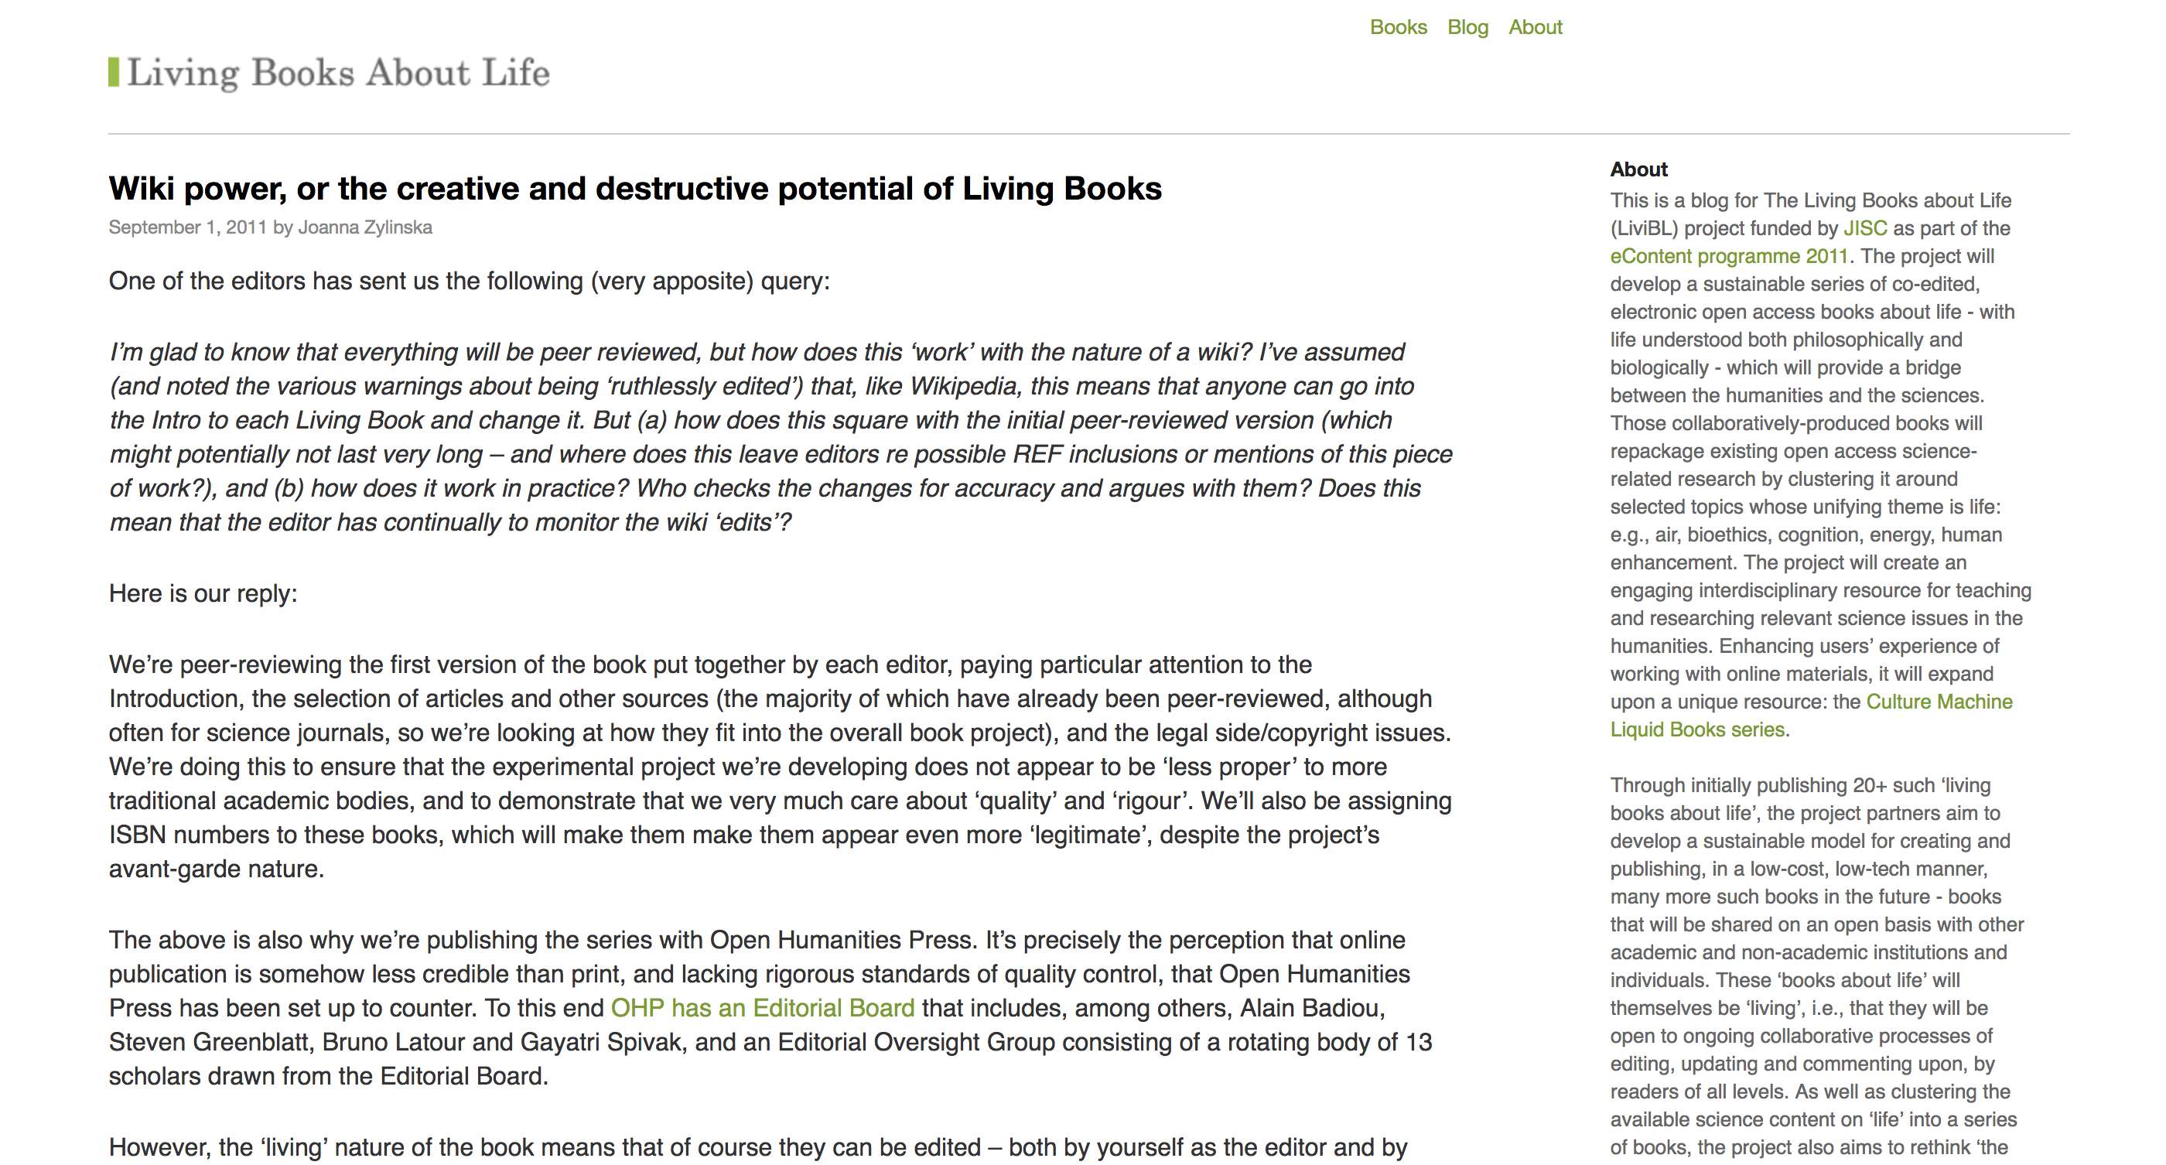

Slide 9
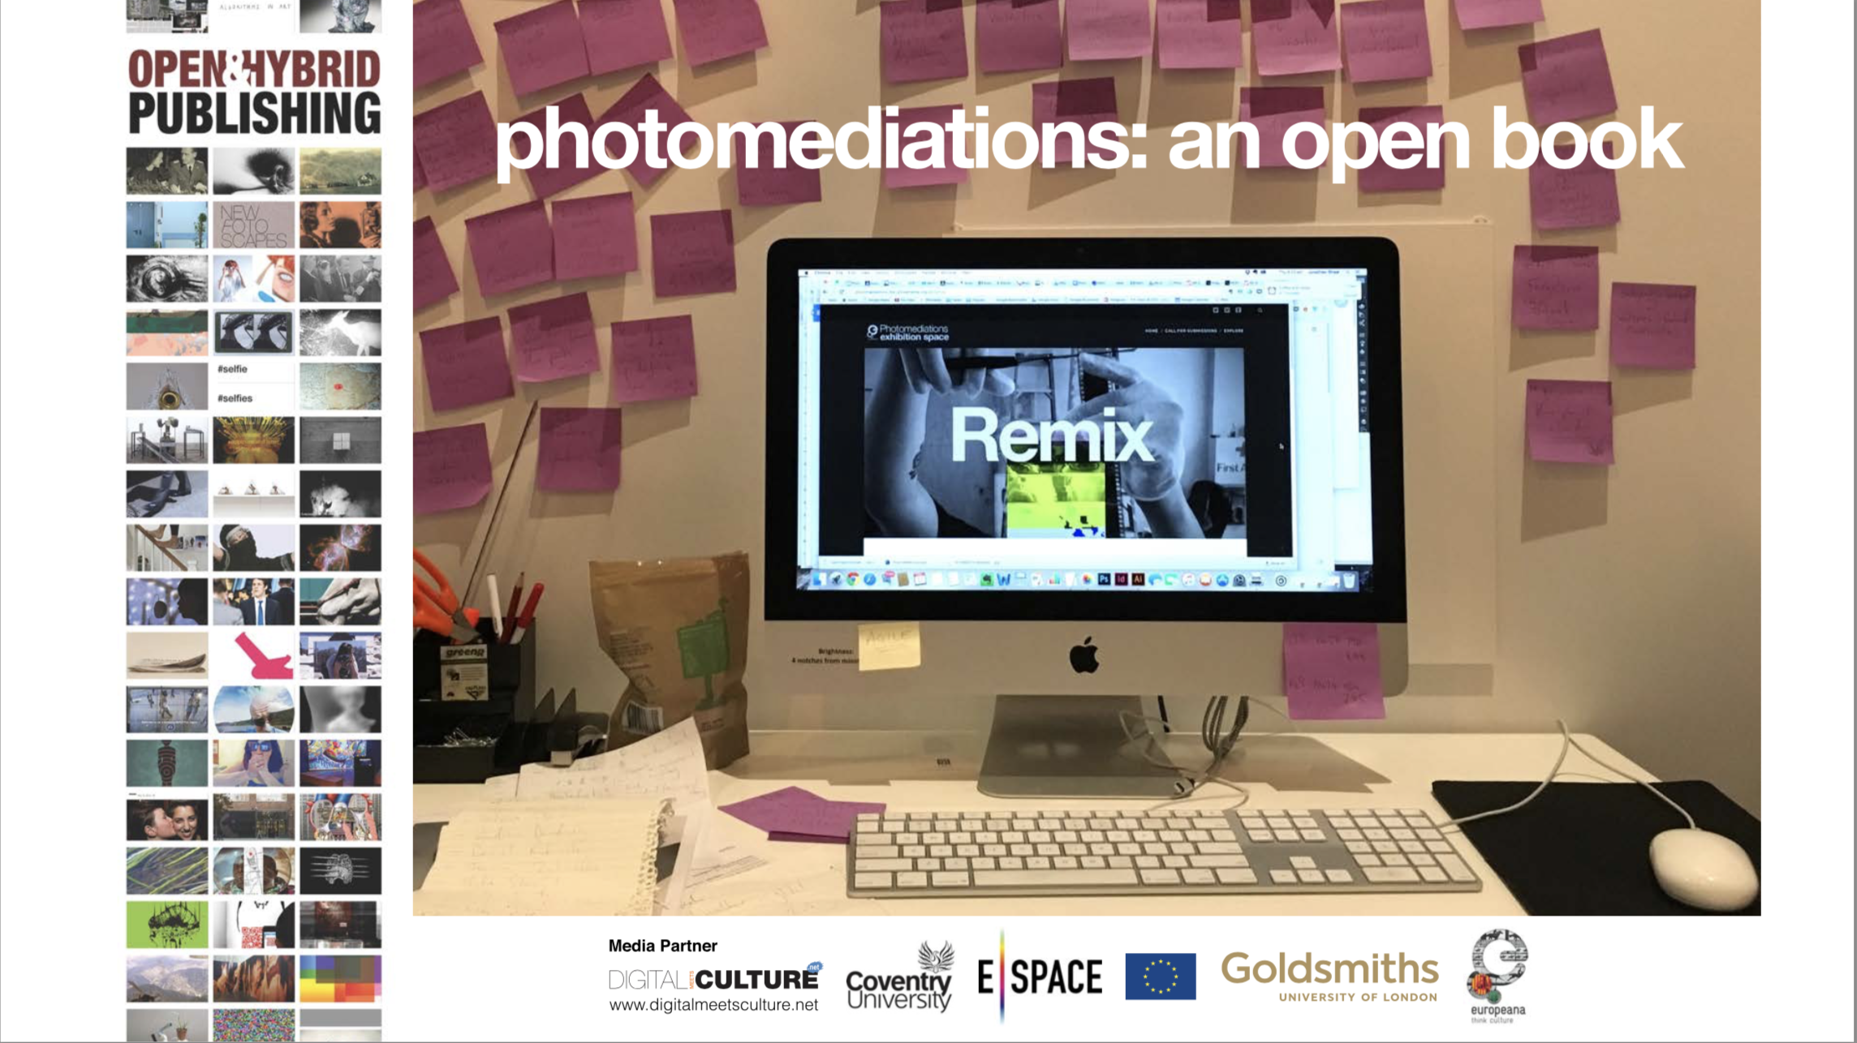

Slide 10
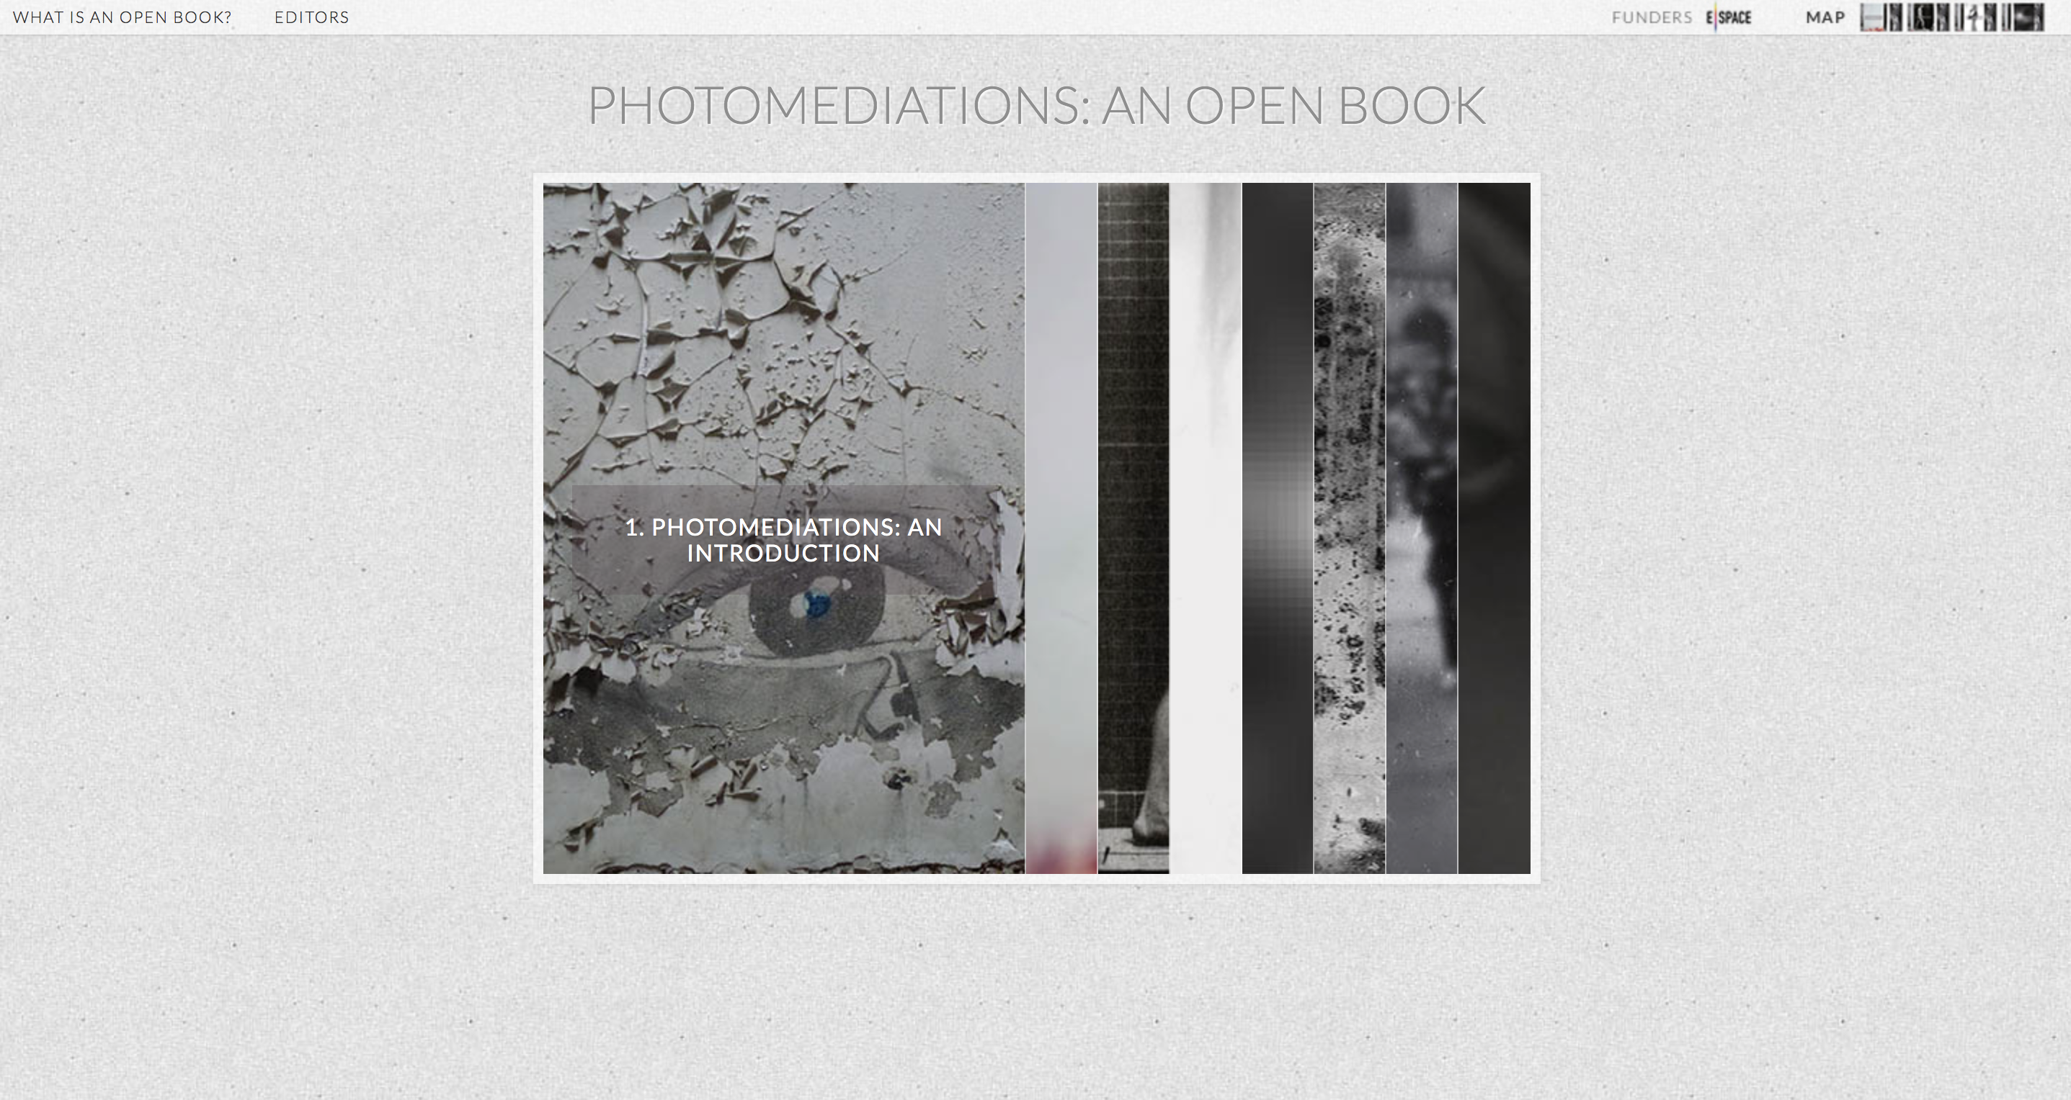
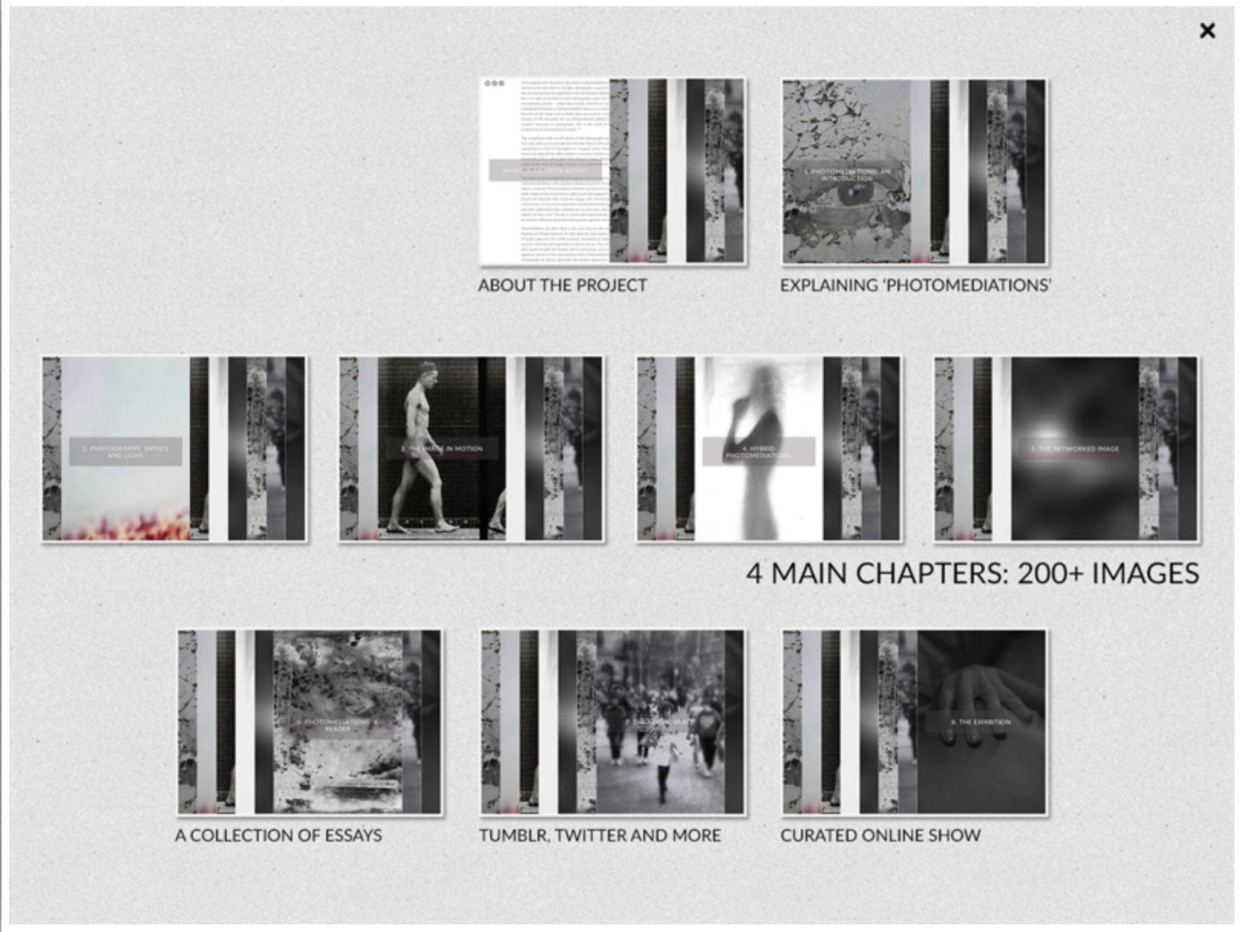
photomediationsopenbook.net

Slide 11
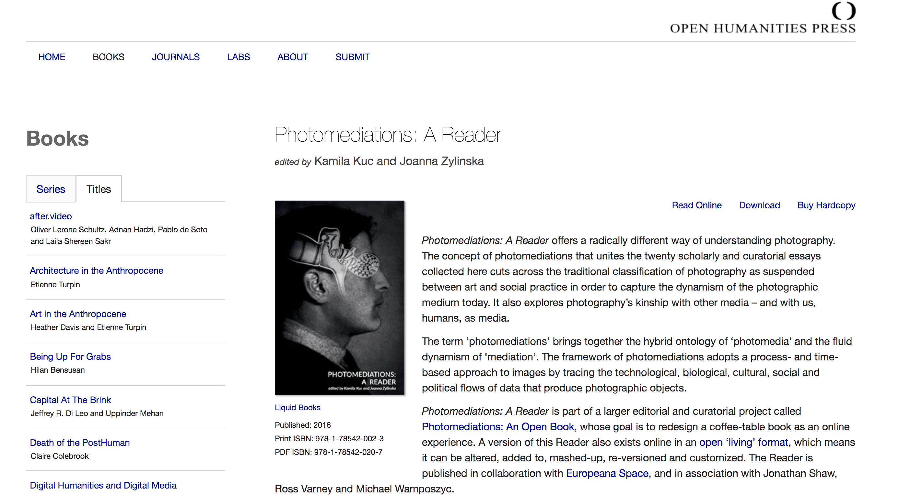
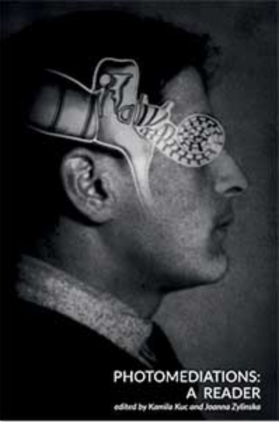

Slide 12
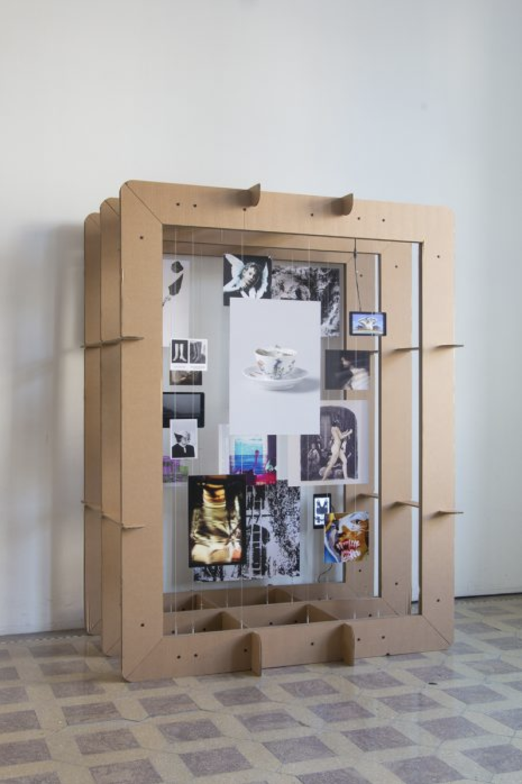
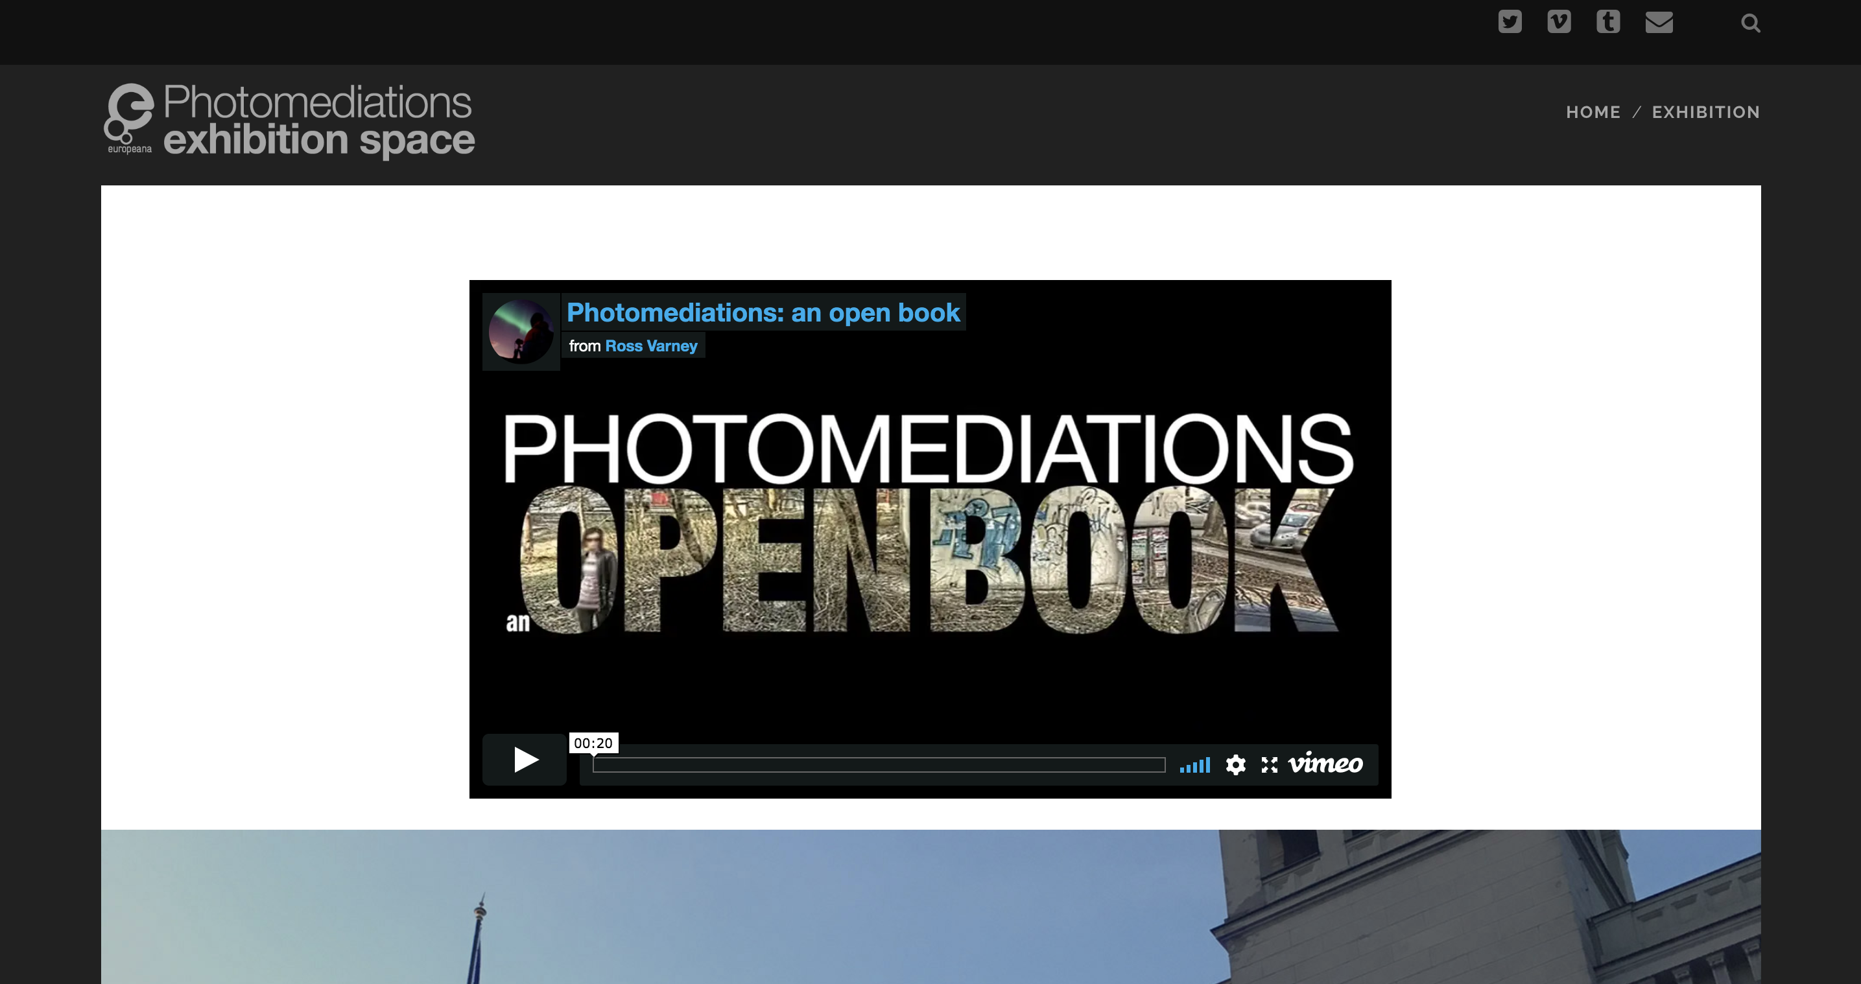
photomediations.disruptivemedia.org.uk

Slide 13
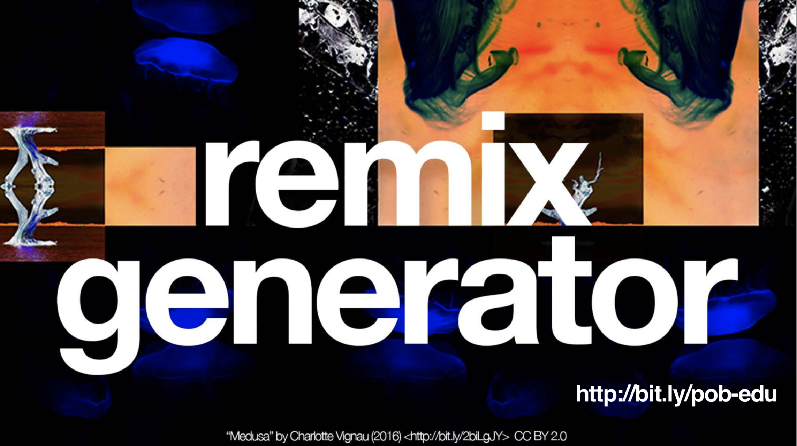
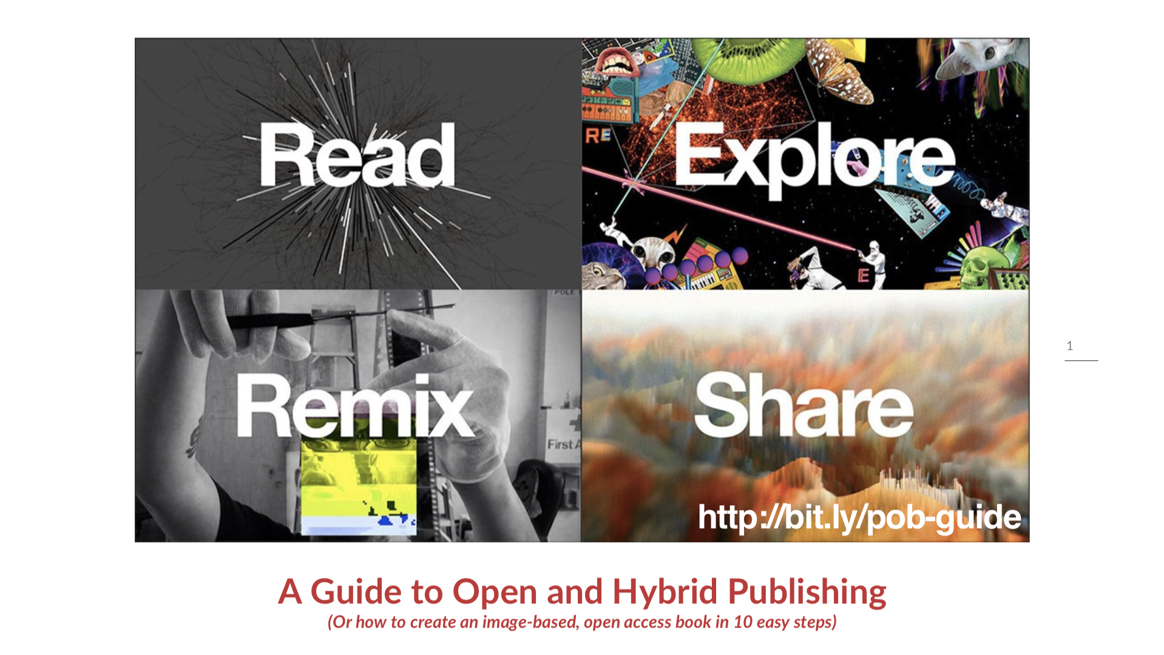
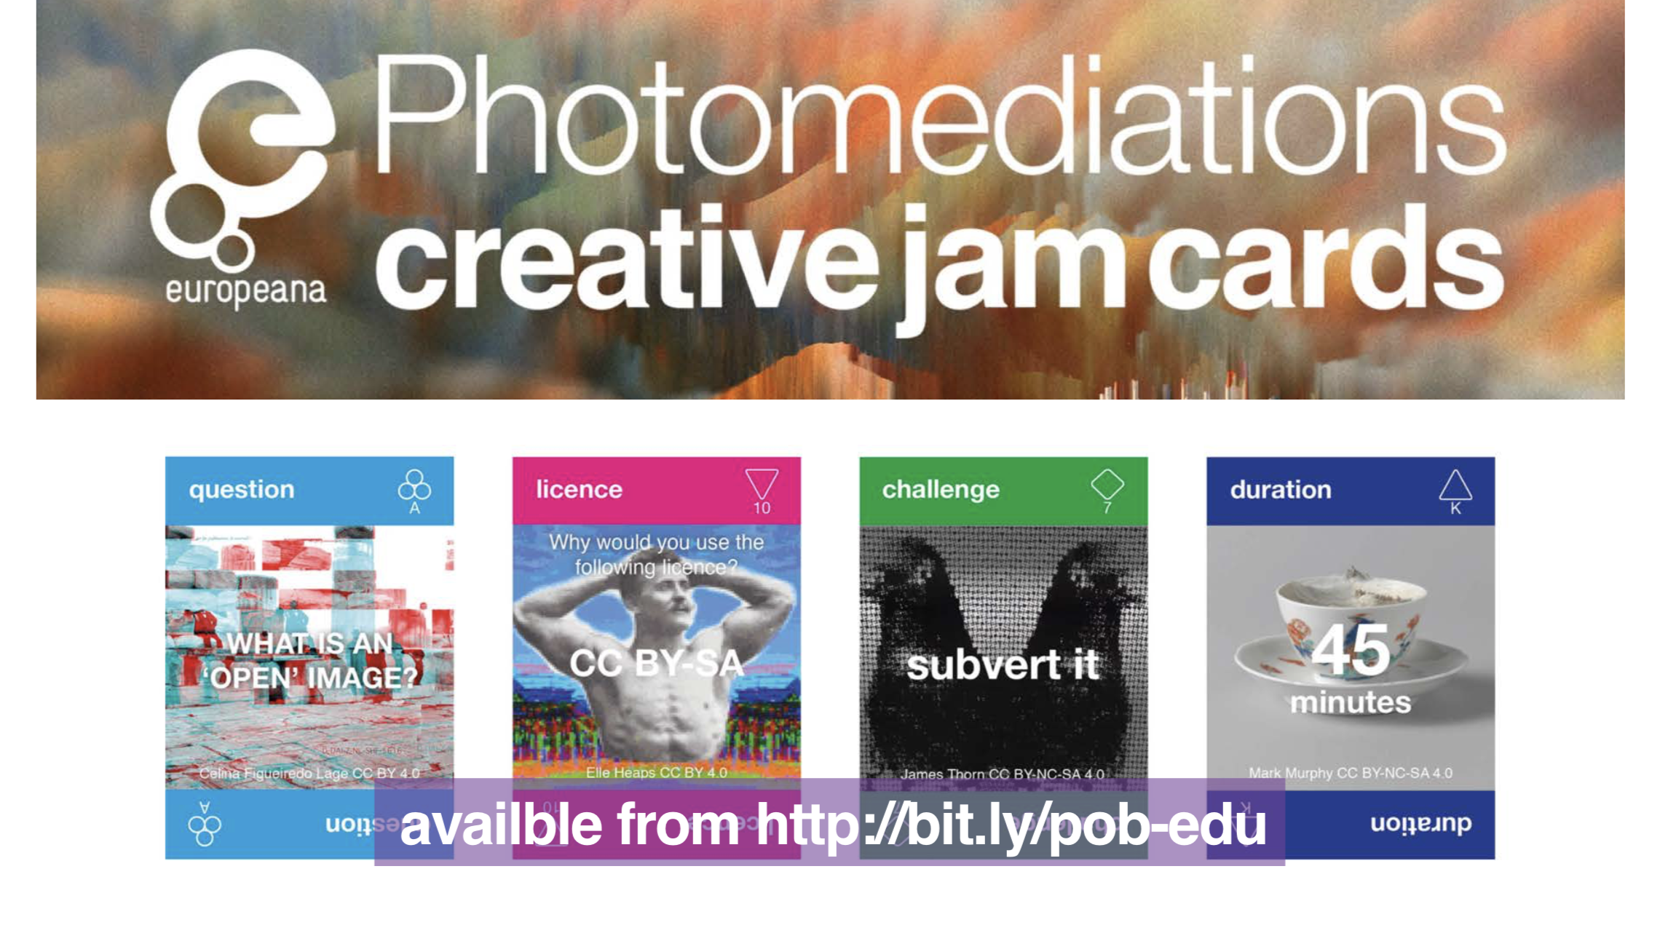

Slide 14
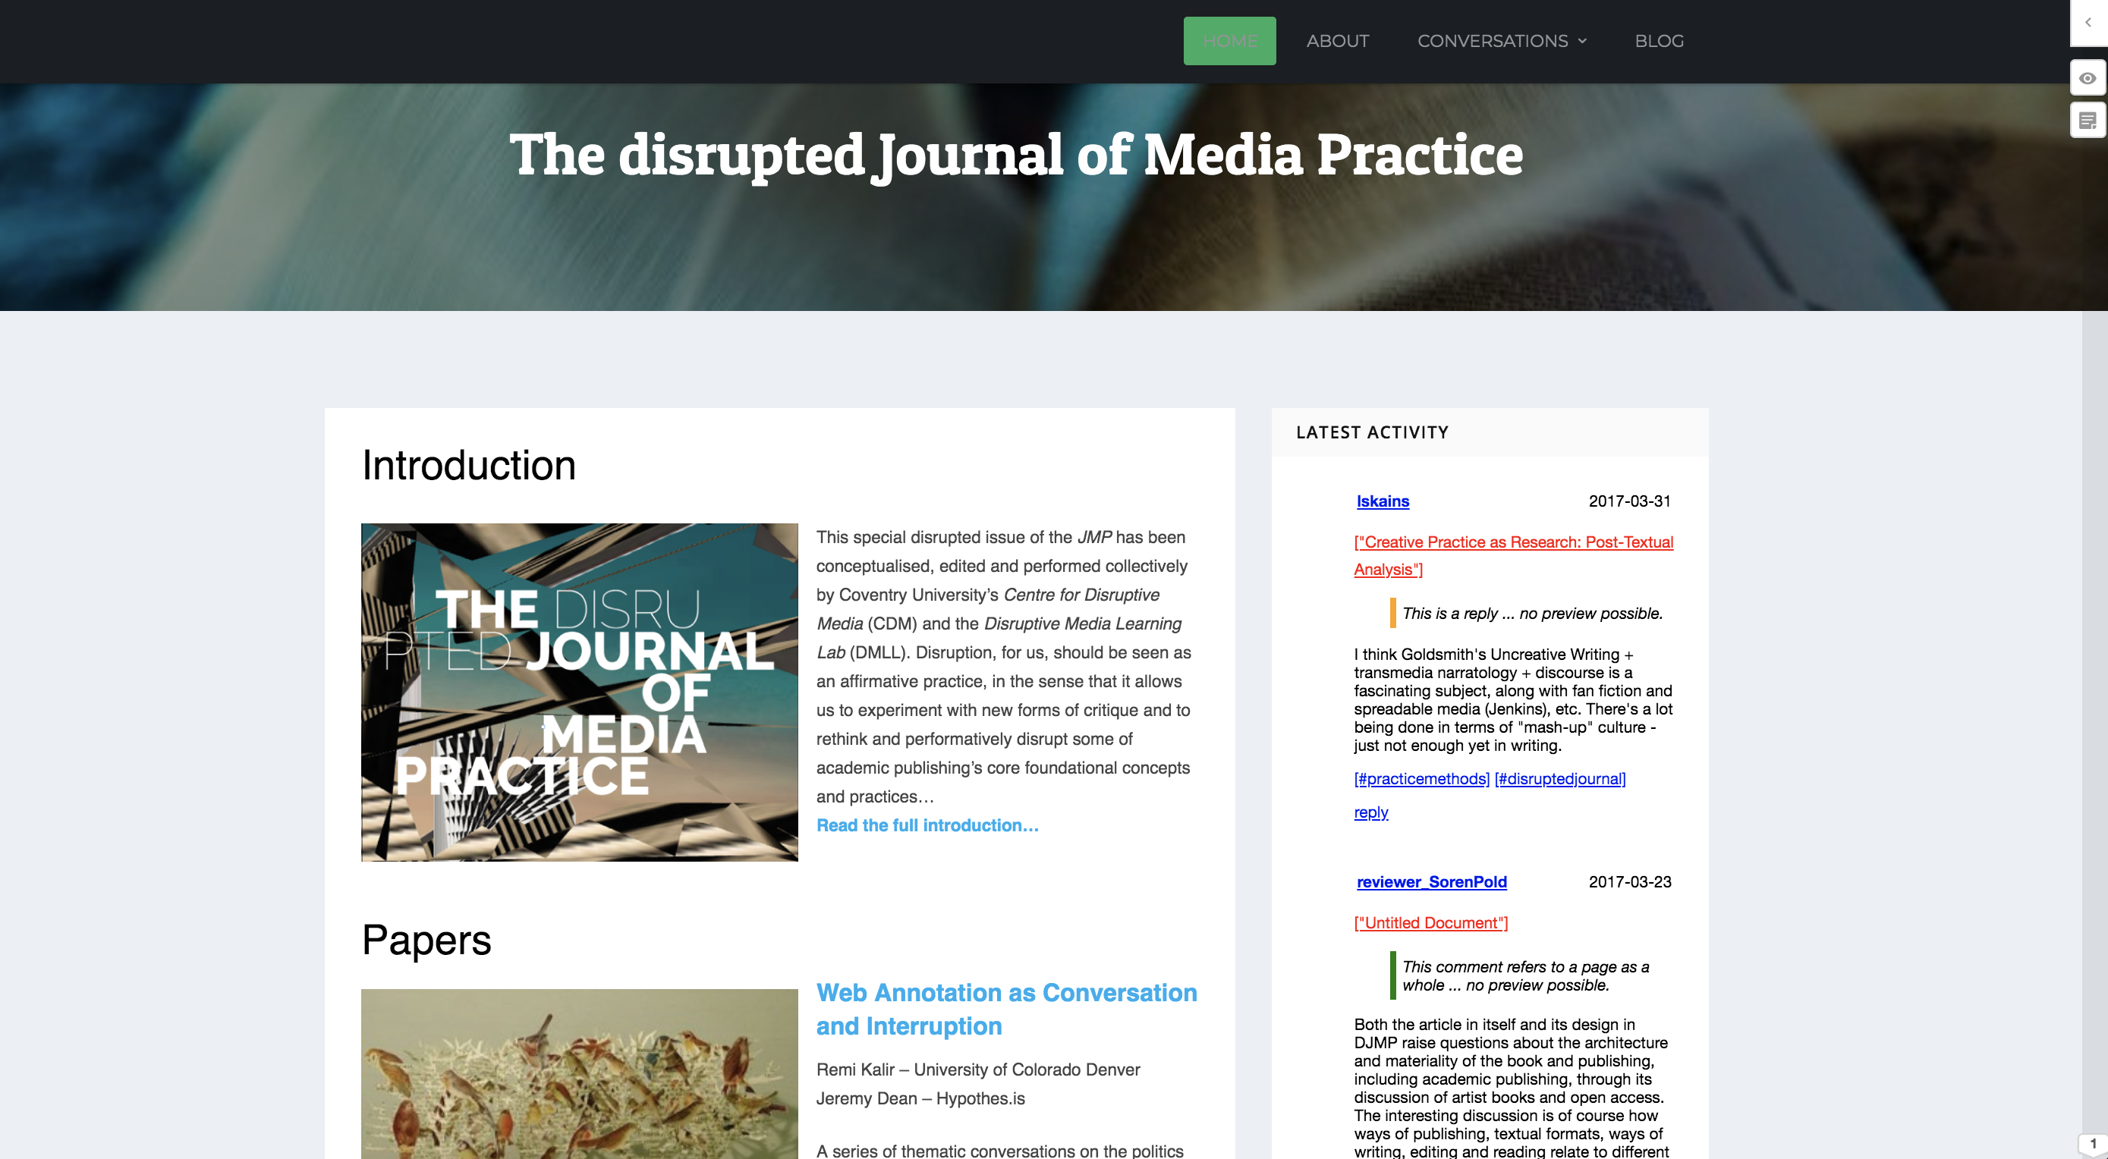

Slide 15
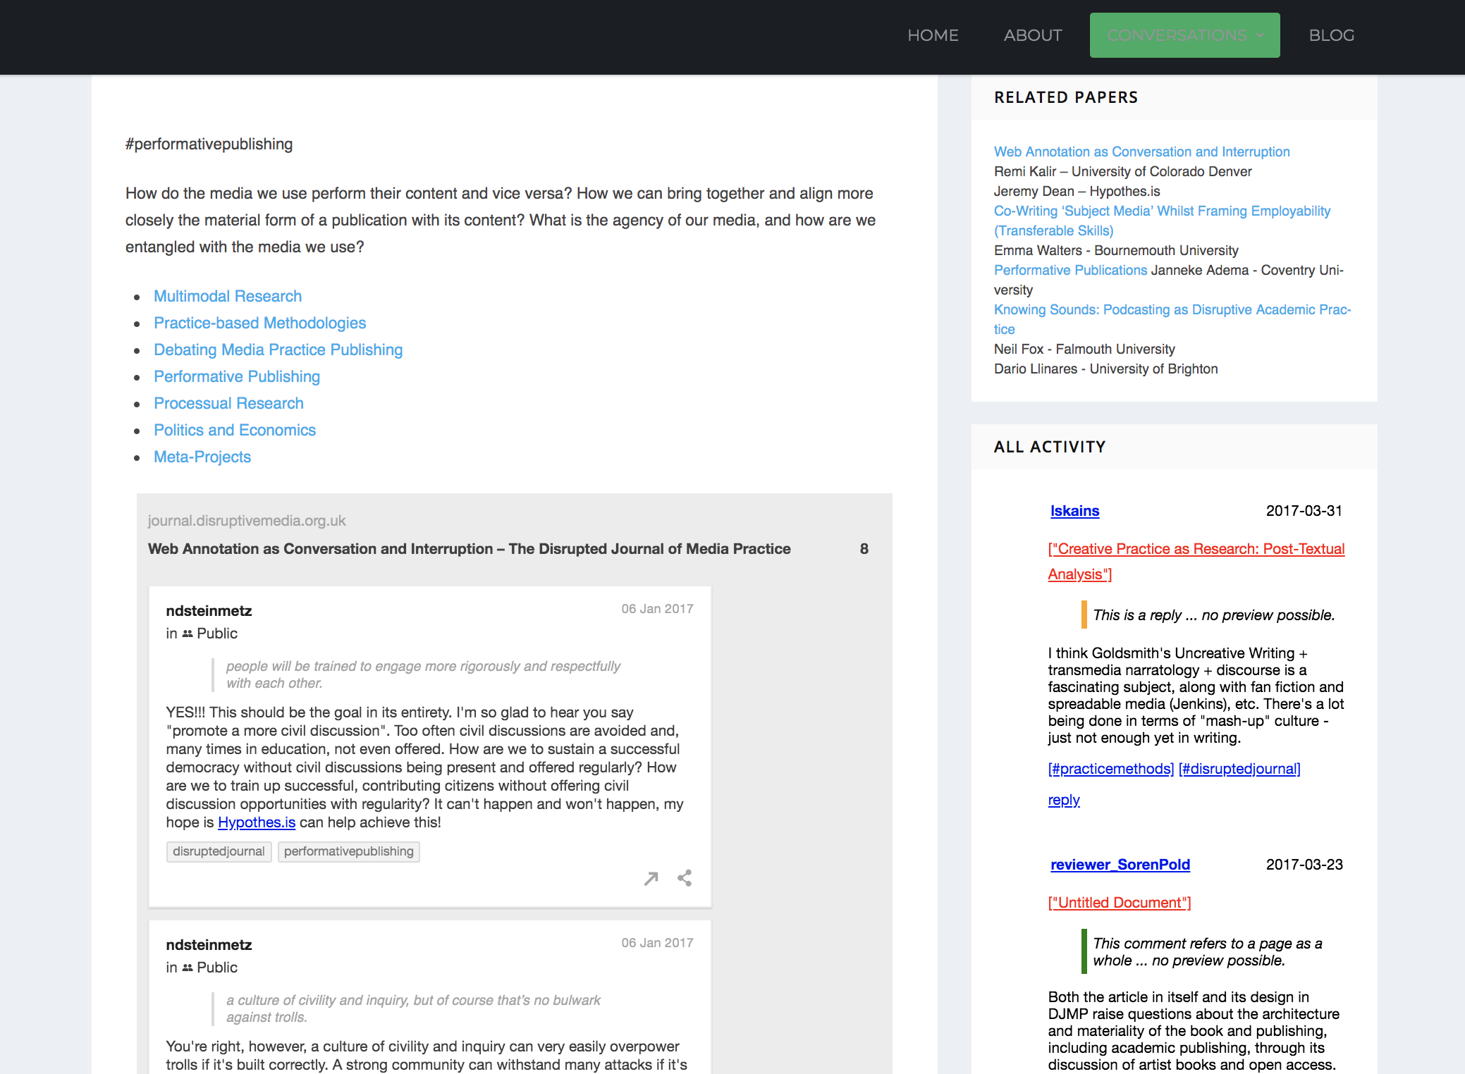

Slide 16
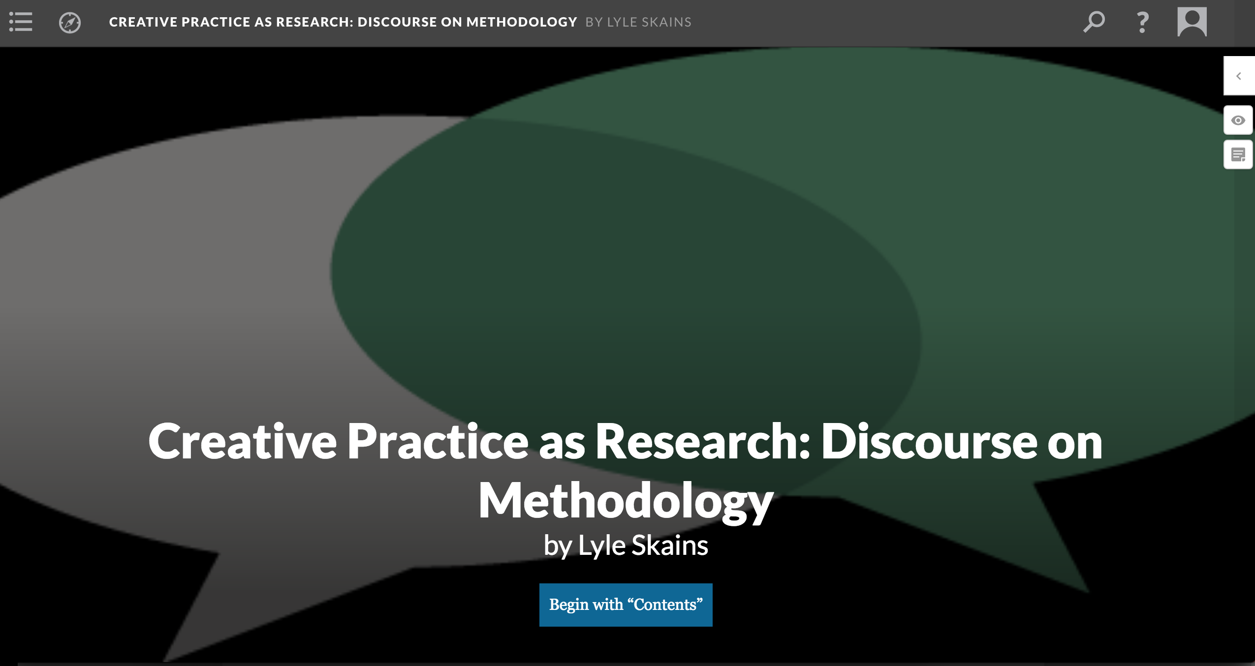

Slide 17
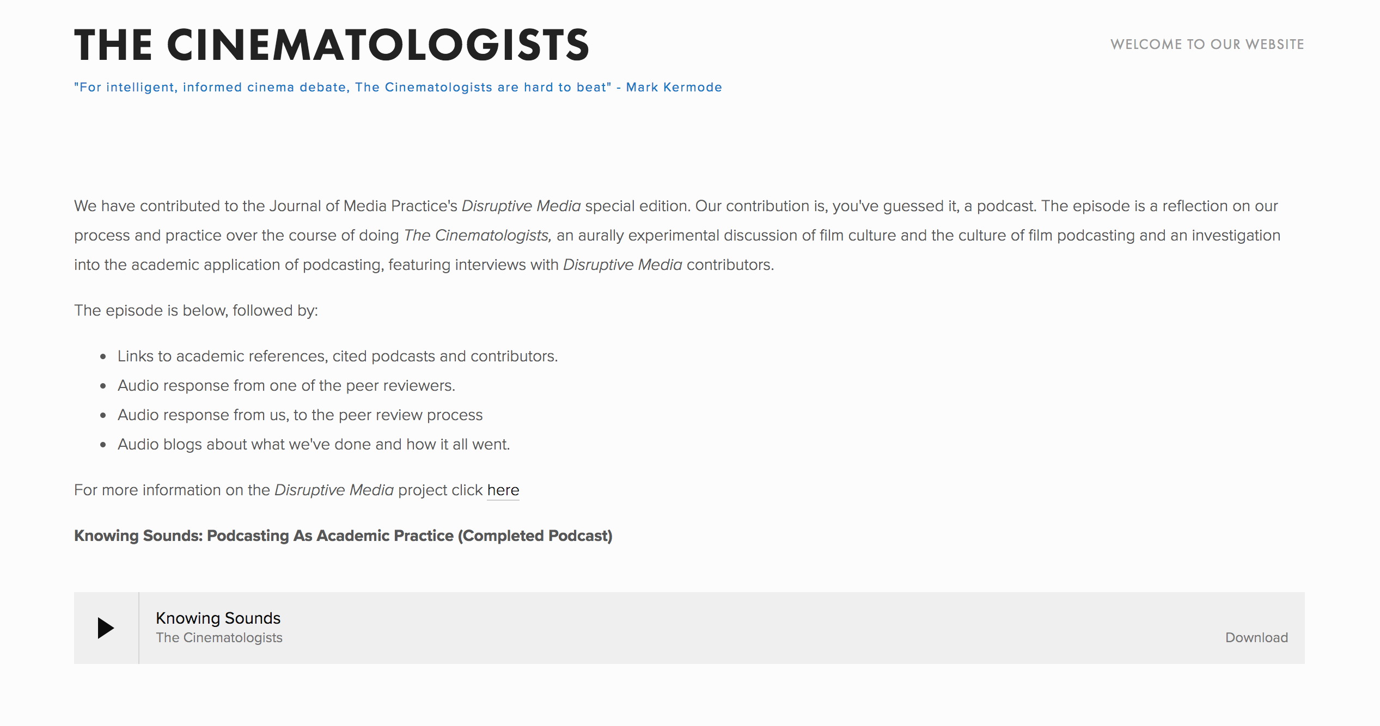

Slide 18
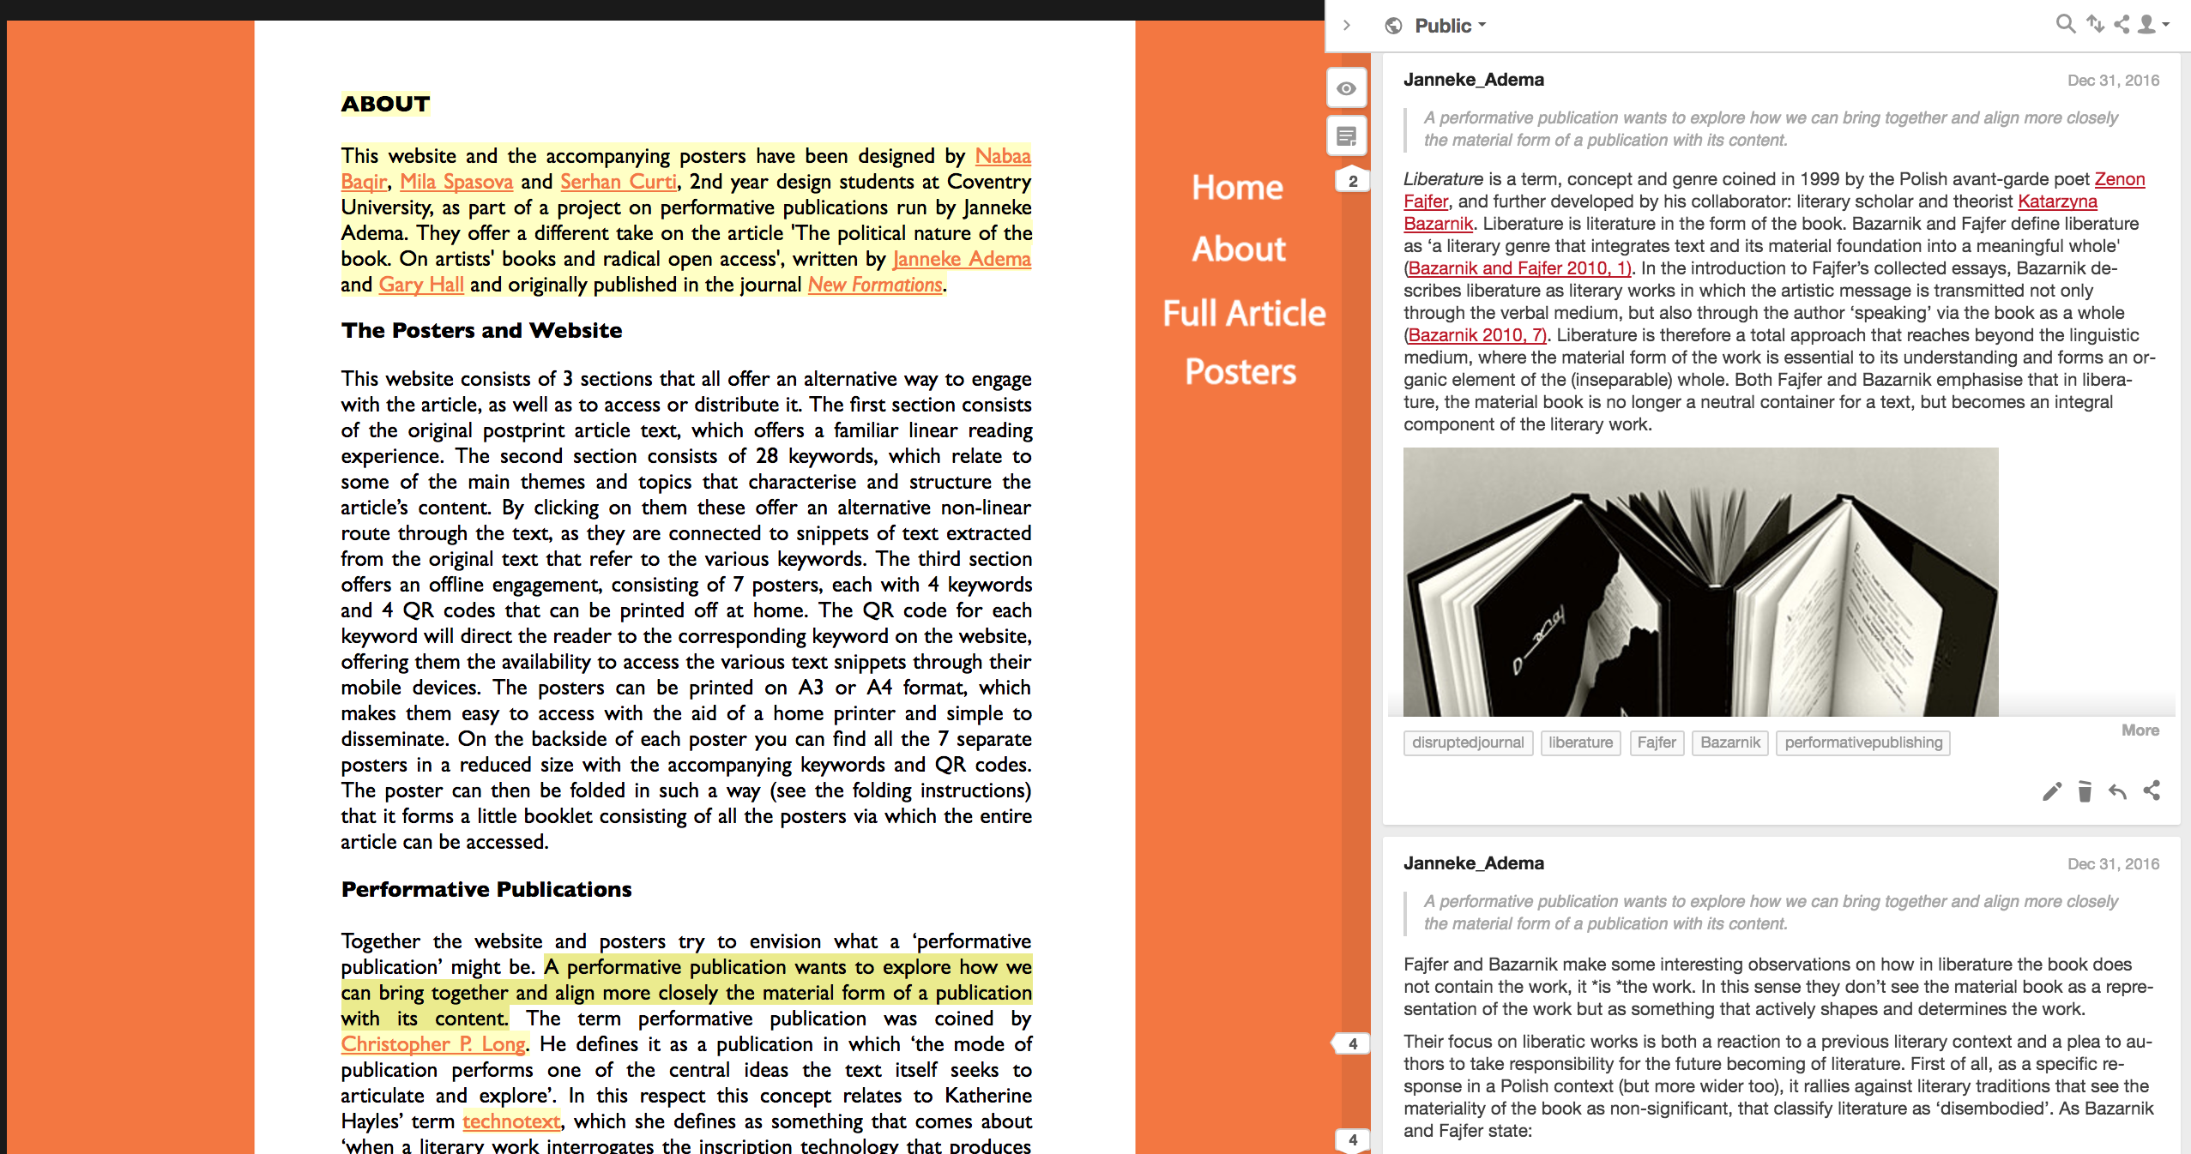

Slide 19
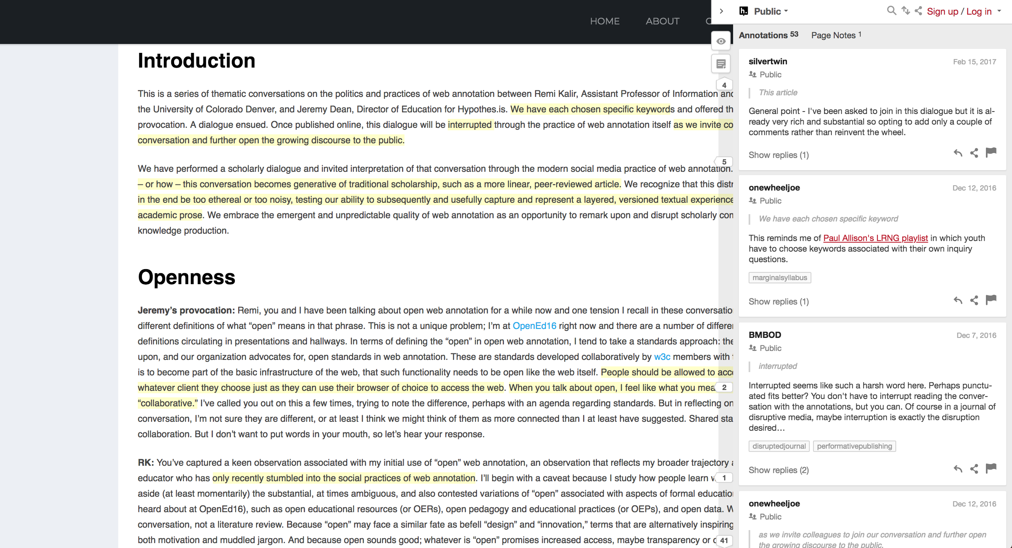
Open Peer Review

Slide 20
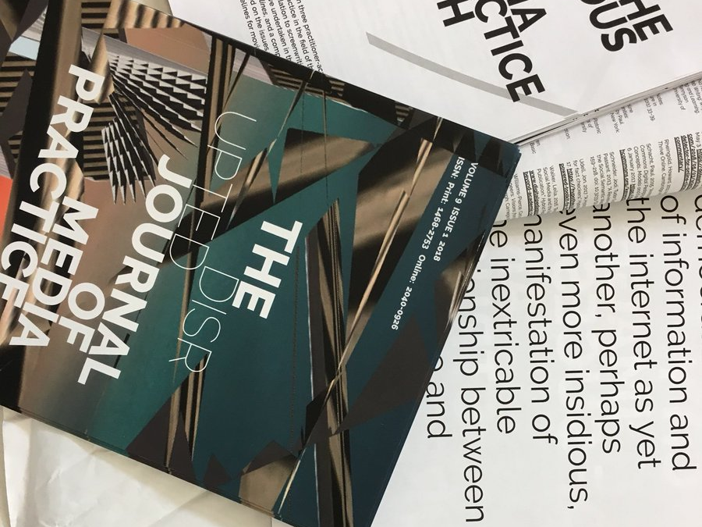
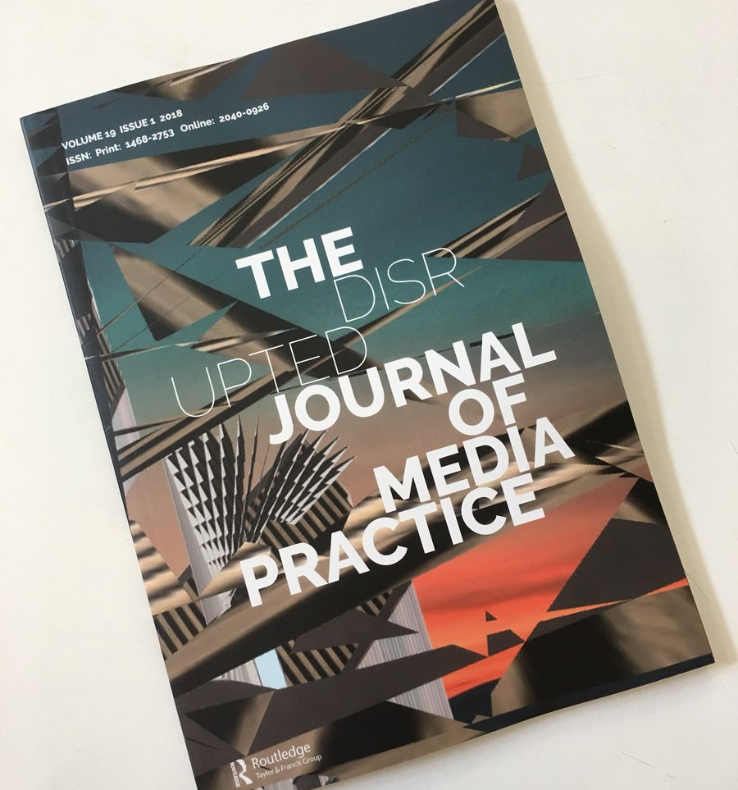

Slide 21
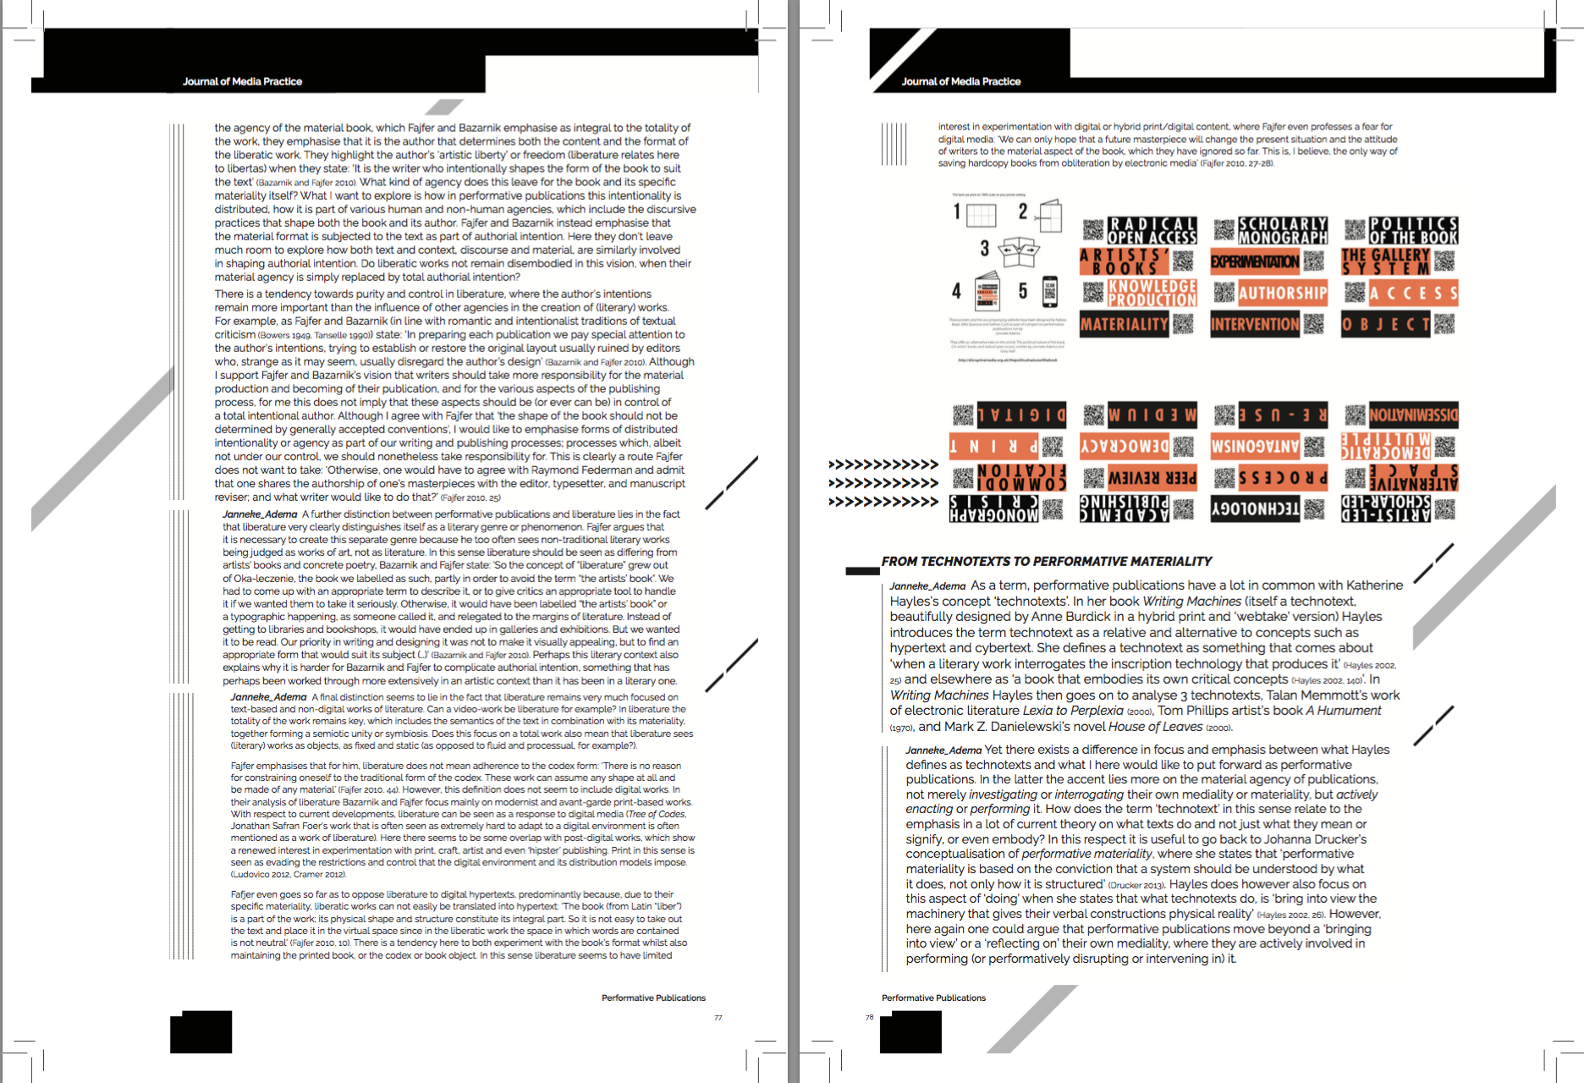
Print design versioning

