Slide 1

COPIM
Community-Led Open Publication Infrastructures for Monographs
https://www.flickr.com/photos/opensourceway/6555466069/in/photostream/

Slide 2
Overview
COPIM will address the key technological, structural, and organisational hurdles—around funding, production, dissemination, discovery, reuse, and archiving—which are standing in the way of the wider adoption and impact of open access books.
3 years: November 1st 2019 – 31 October 2022
Co-funded by Research England Development (RED) Fund (2,202,947)
A consortium of world-class universities, established scholar-led open access presses, libraries and infrastructure providers

Slide 3
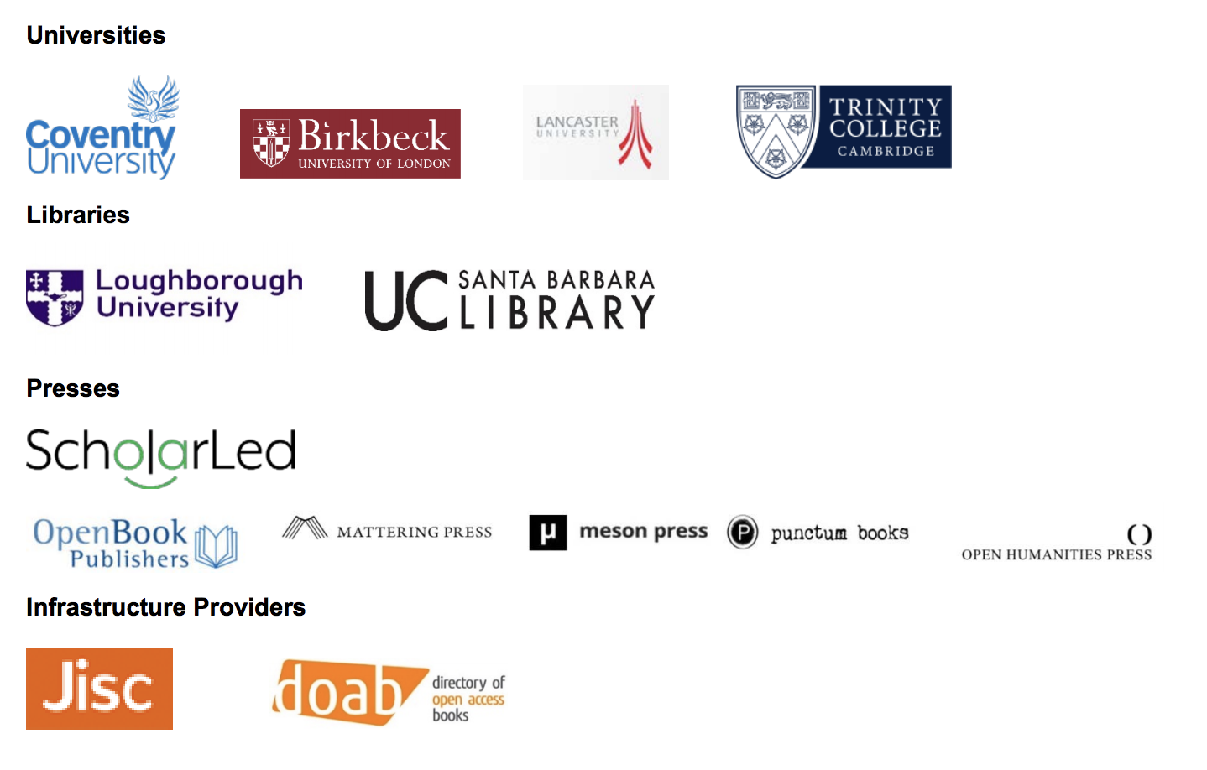
Consortium

Slide 4
Key technological, structural & organisational hurdles to wider adoption & impact of OA books
Integrated capacity-building amongst presses
Access to and development of funding channels
Development and piloting of appropriate business models
Cost reductions achieved by economies of scale
Mutually supportive governance models
Integration into library, repository, and digital learning environments
The re-use of and experimentation with OA books
The effective and robust archiving of OA content.

Slide 5
Aims
&
Objectives
Removing hurdles preventing new OA book initiatives to emerge and existing ones to adopt OA workflows
Developing consortial, institutional, and other funding systems
Showcasing alternative (non-BPC) business models
Supporting the creation of, interaction with and reuse of OA books
Knowledge transfer to stakeholders through various pilots

Slide 6
Build modular components to support the publication of OA books
infrastructures
business models
governance procedures
re-use strategies
preservation structures
outreach programs

Slide 7
WP2.
Revenue Infrastructures and Management Platform
Key deliverables and impacts
A fully functional consortial library funding platform
The ScholarLed pilot
An outreach program to the international library community
A model for a community-owned OA revenue programme for books
A consortium of librarians and publishers that can serve as a model for collaboration around OA monographs.

Slide 8
WP3. Knowledge Exchange & Piloting Alternative Business Models
Key deliverables and impacts
A pilot case to transition the business models of at least two extant publishers to new OA-amenable models
An online, open-source toolkit for booting up and running an OA book press
Knowledge dissemination about the new infrastructural provisions of the project
Cost reductions and alternative business models for OA monograph publishing.

Slide 9
WP4. Community Governance
Key deliverables and impacts
A model for the long-term management of consortial library funding programs
Assembly of a governance community of representative stakeholders
Official policies and procedures for self-governance and administrative management of the infrastructure
2 white papers based on community approved best practices for the governance of 1) open source community-owned infrastructures, and 2) OA book presses and consortia.

Slide 10
WP5.
Building an Open Dissemination System
Key deliverables and impacts
An Open Dissemination System enhancing the discovery and dissemination of OA monographs
A pilot case implementing the ODS infrastructure amongst the OA publishing partners;
A shared “best practices” digital catalogue to enable adoption of the ODS.

Slide 11
WP6. Experimental Publishing, Re-use and Impact
Key deliverables and impacts
A pilot of representative experimental books built on top and integrated within the COPIM infrastructure
An online resource detailing opportunities for experimental book publishing
Technologies and cultural strategies to promote OA book content discovery, interaction and reuse and the creation, development and interaction with emergent genres of scholarship
Reuse and engagement strategy for OA book publishers and scholars.

Slide 12
WP7.
Archiving and Digital Preservation
Key deliverables and impacts
Technical methods for effectively archiving complex digital research publications and for creating an integrated collection of content in different formats
Pilot case archiving a subset of ScholarLed publications in at least two different locations
A model which enables the expansion and uptake of the methods by other presses and libraries
Recommendations for best practice around legal and copyright issues that complicate effective archiving of complex digital research publications

Slide 13
Wider Benefits
A growing uptake of OA monographs internationally
Wider benefits for both HE institutions and HSS researchers.
Wider benefits for the general public, the economy and the creative industries.
Sustainable and workable transitions to an open publication ecosystem for monographs ensuring a diverse ecology of publishers.

Slide 14
Contact
More information: ademaj@uni.coventry.ac.uk

