Slide 1
Performative Publications and Recursive Publics
Janneke Adema
ACS Summer Institute
Zeppelin University
Friedrichshafen

Slide 2


Slide 3
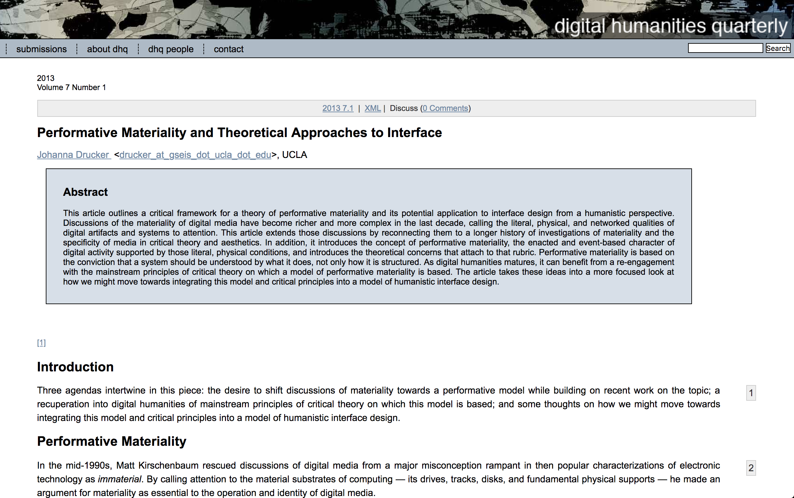

Slide 4
Free Software
'Free Software is a set of practices for the distributed collaborative creation of software source code that is then made openly and freely available through a clever, unconventional use of copyright law.' (Kelty 2008, 3)

Slide 5

Recursive Public
‘a public that is vitally concerned with the material and practical maintenance and modification of the technical, legal, practical, and conceptual means of its own existence as a public; it is a collective independent of other forms of constituted power and is capable of speaking to existing forms of power through the production of actually existing alternatives.’ (Kelty 2008, 3)

Slide 6
Recursive public
'Recursive publics are publics concerned with the ability to build, control, modify, and maintain the infrastructure that allows them to come into being in the first place and which, in turn, constitutes their everyday practical commitments and the identities of the participants as creative and autonomous individuals.' (Kelty 2008, 7)

Slide 7
Recursive Public
'The concept of a recursive public is a way of insisting on the importance to public debate of the unruly technical materiality of a political order, not just the embodied discourse (however material) about that order.' (Kelty 2008, 8)

Slide 8

Recursive Public
'A recursive public is a public that is constituted by a shared concern for maintaining the means of association through which they come together as a public.' (Kelty 2008, 28)

Slide 9
Recursive Public
'They are the builders and imaginers of this space, and the space is what allows them to build and imagine it.' (Kelty, 2008, 29)

Slide 10
Recursive Public
'It is this fact that is the strongest confirmation that they are a recursive public, a form of public that is as concerned with the material practical means of becoming public as it is with any given public debate.' (Kelty, 2008, 113)

Slide 12
Performative Materiality
'Performative materiality suggests that what something is has to be understood in terms of what it does, how it works within machinic, systemic, and cultural domains. (Johanna Drucker, 2013)

Slide 13
Performative Materiality
'Performative materiality draws on studies in cognition, perception, reader-response, textual hermeneutics, interface design, and curiously, it is supported by empirical and theoretical approaches. It shifts the emphasis from acknowledgement of and attention to material conditions and structures towards analysis of the production of a text, program, or other interpretative event.' (Drucker, 2013)

Slide 14
Performative Materiality
'In this framework, we chart the shift from a concept of things as entities to a concept of them as events, from a notion of what is to that which is always in flux, from a literal to a contingent materiality that is exposed by the performative dimension of use.' (Drucker, 2013).

Slide 15
Performative Materiality
'The performance of a work provoked by a material substrate is always situated within historical and cultural circumstances and particulars and expresses ideology at every level of production, consumption, implementation and design.’ (Drucker, 2013)

Slide 16
Performative materiality
'How to bring these conceptions of materiality into the design of digital humanities projects? The answer is not to reinvent humanities theory, or critical epistemology, but to call it back into play in the design process.' (Drucker, 2013)

Slide 17
Performative Publication
'A performative publication wants to explore how we can bring together and align more closely the material form of a publication with its content.' (Adema, 2018).

Slide 18
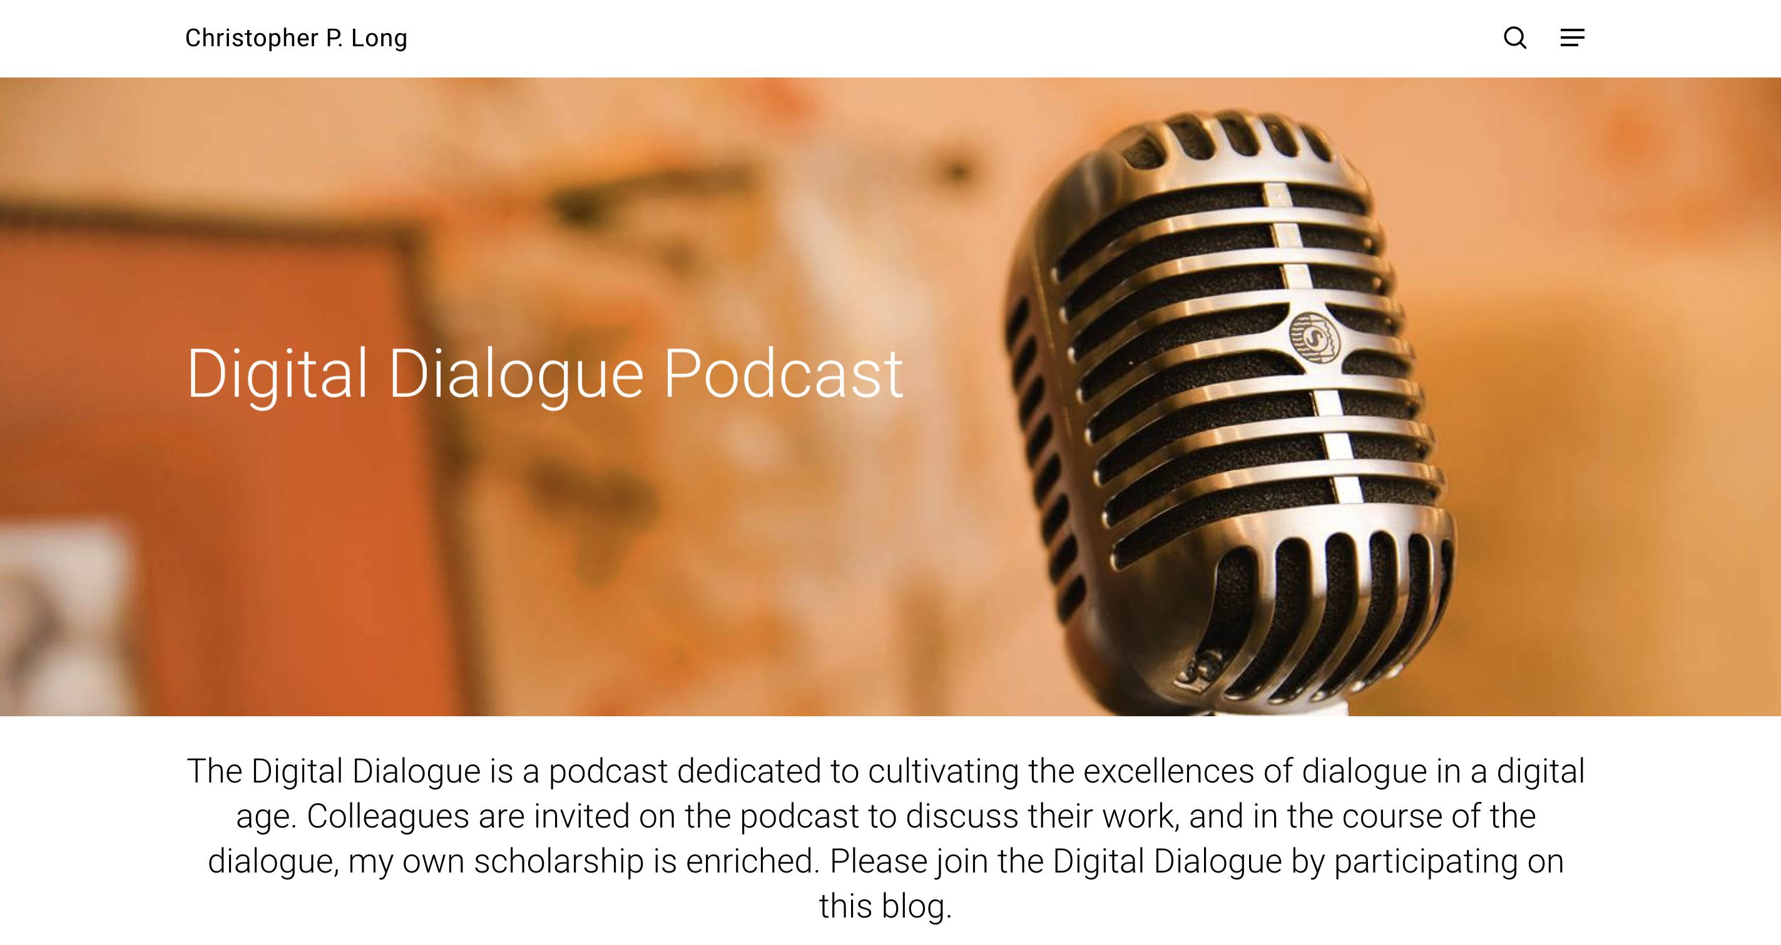
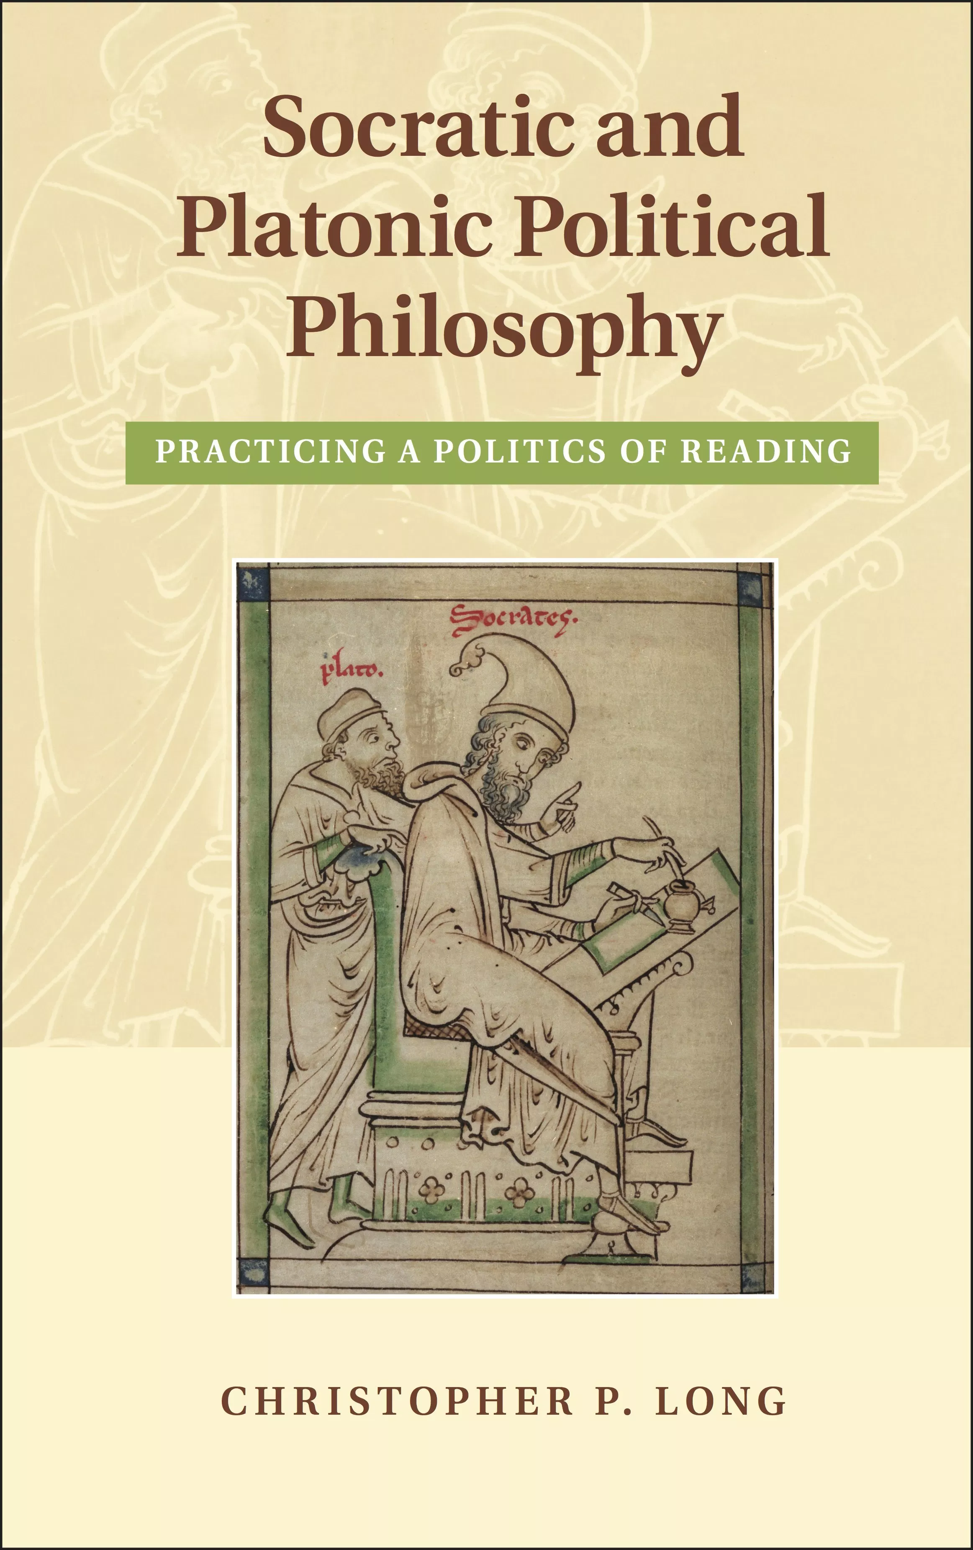
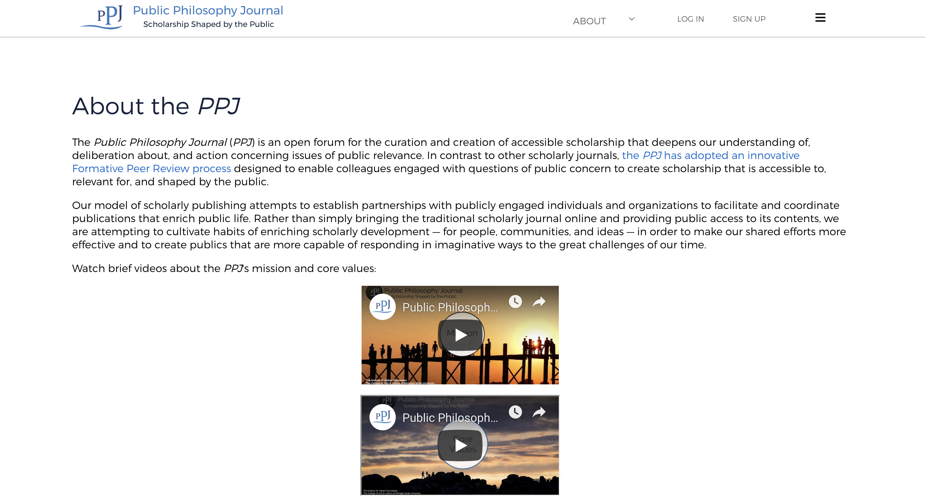

Slide 19
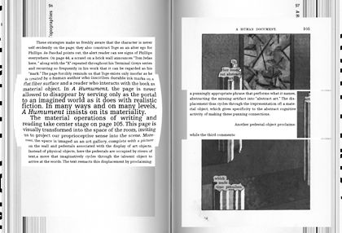
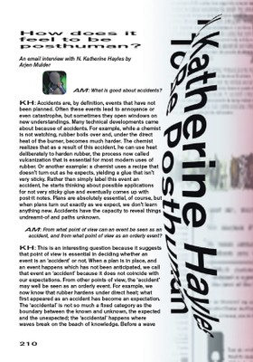
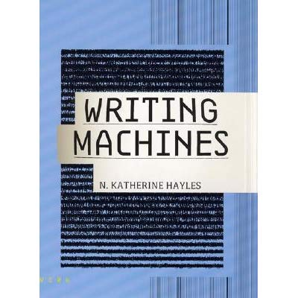
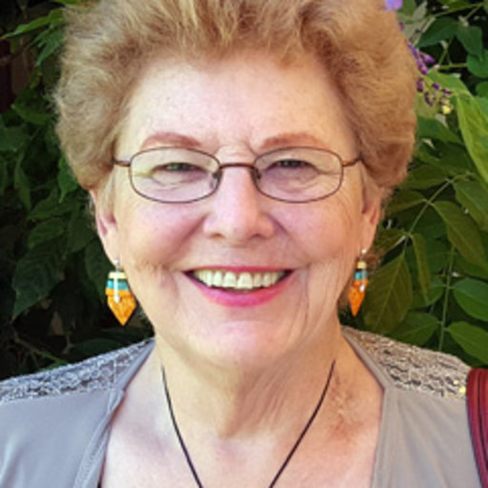

Slide 20
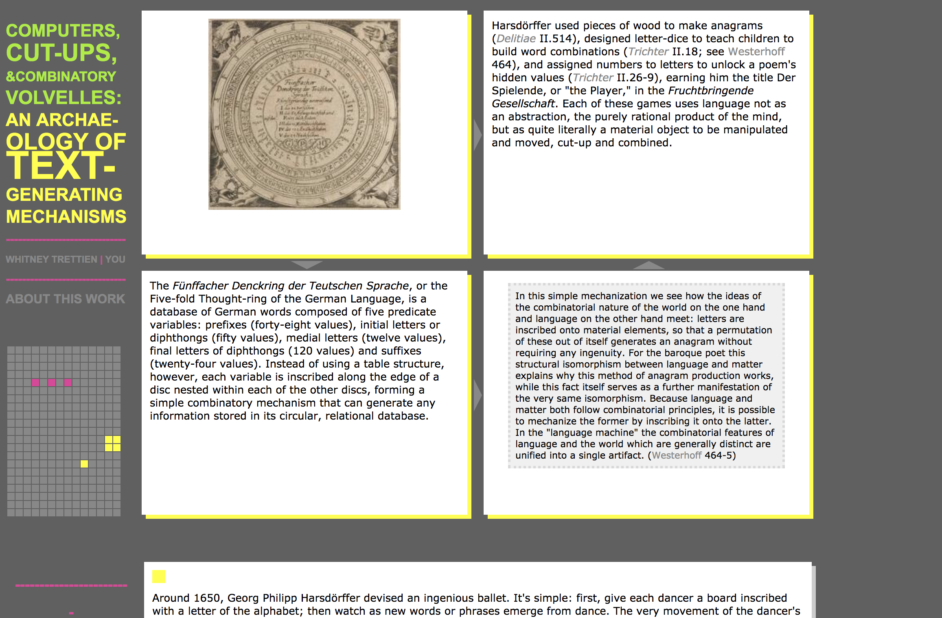

Slide 21
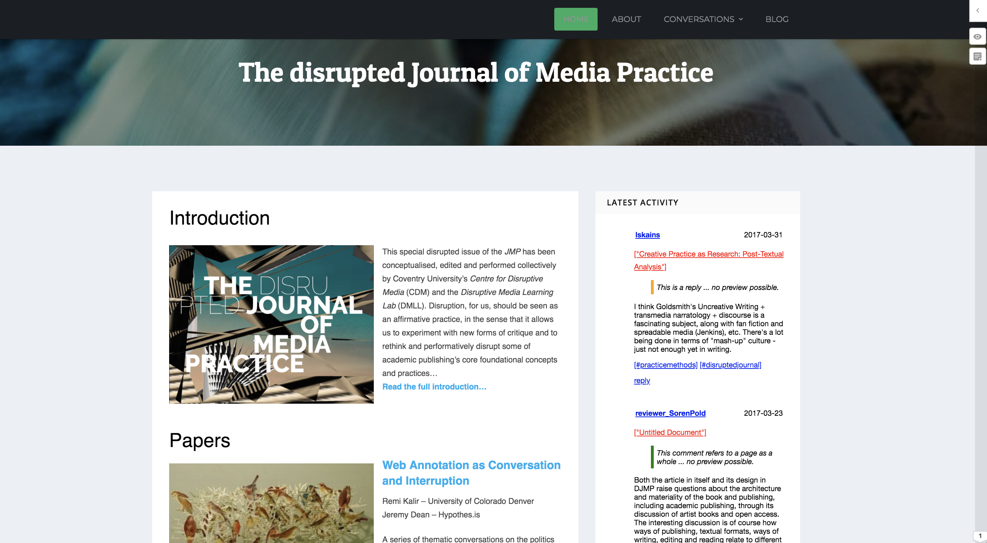

Slide 22
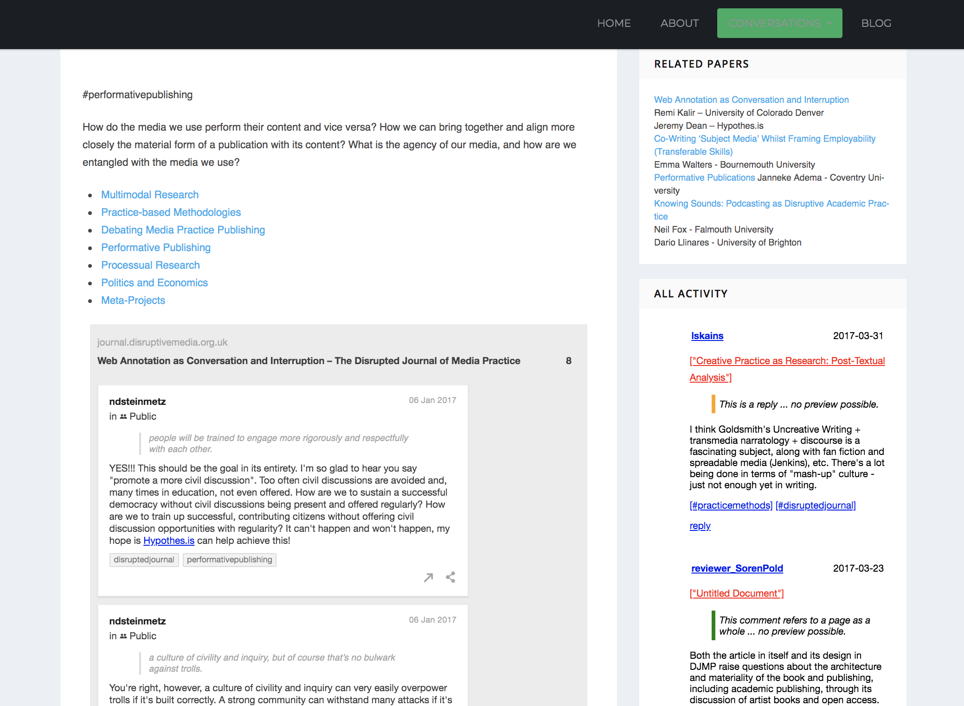

Slide 23
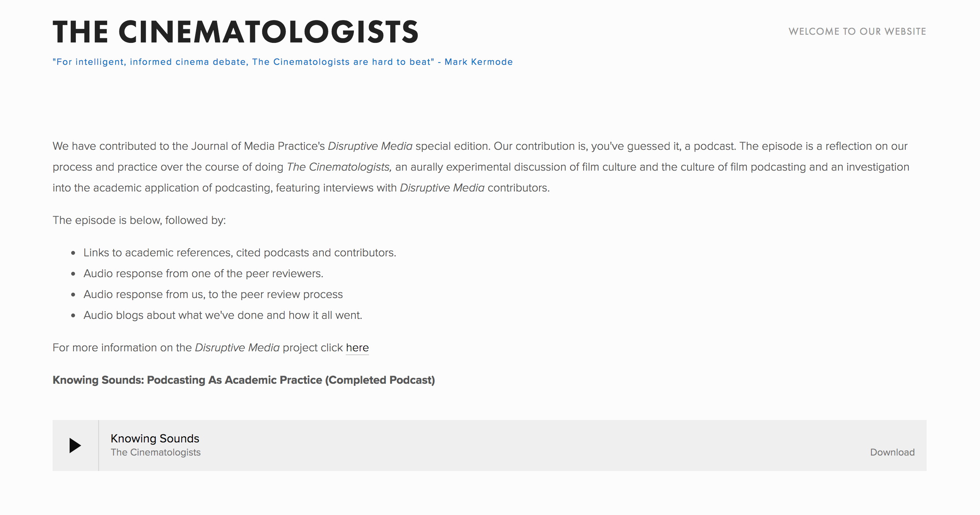

Slide 24
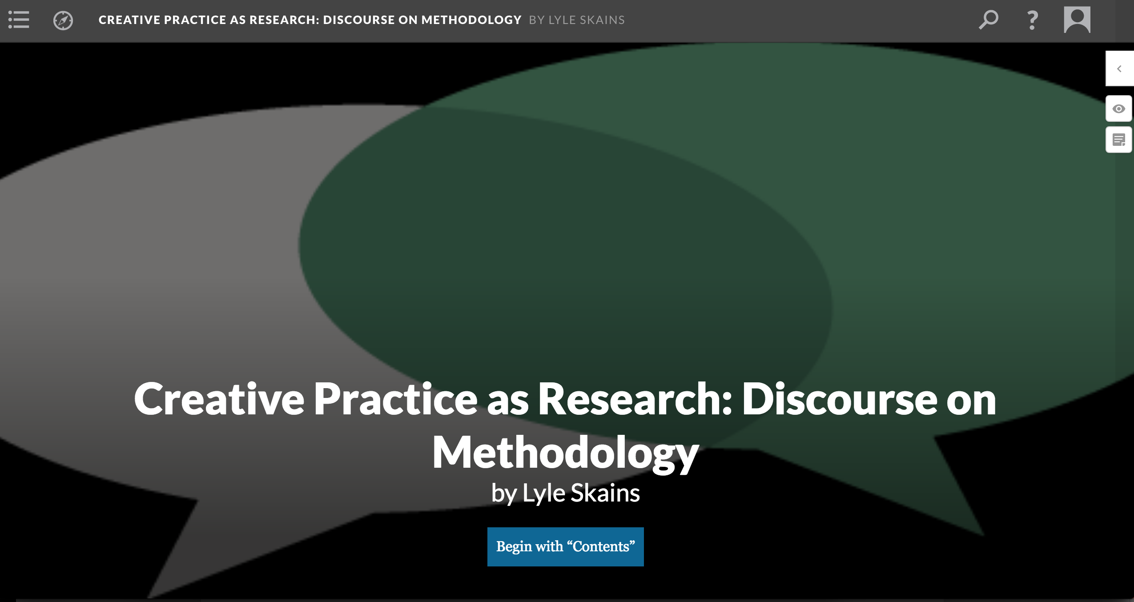

Slide 25
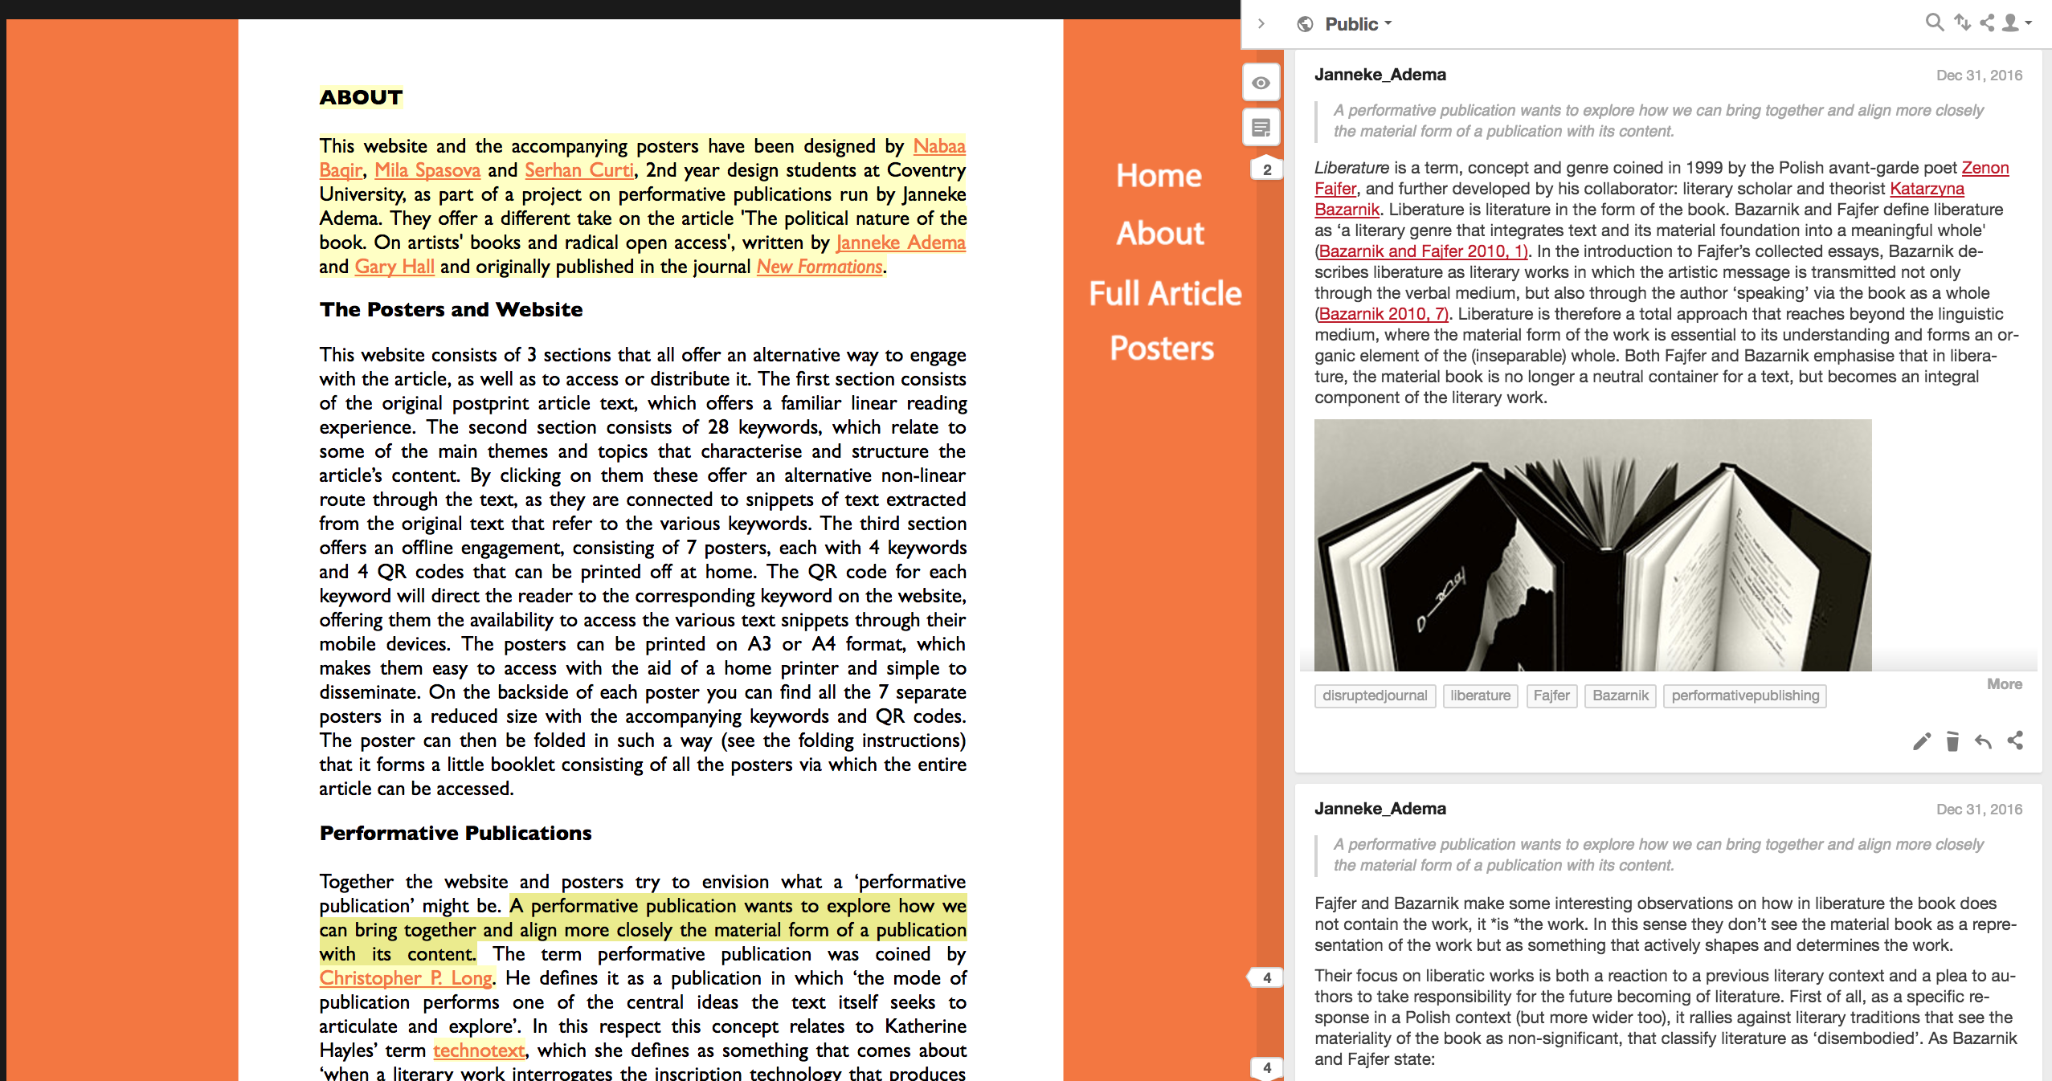

Slide 26
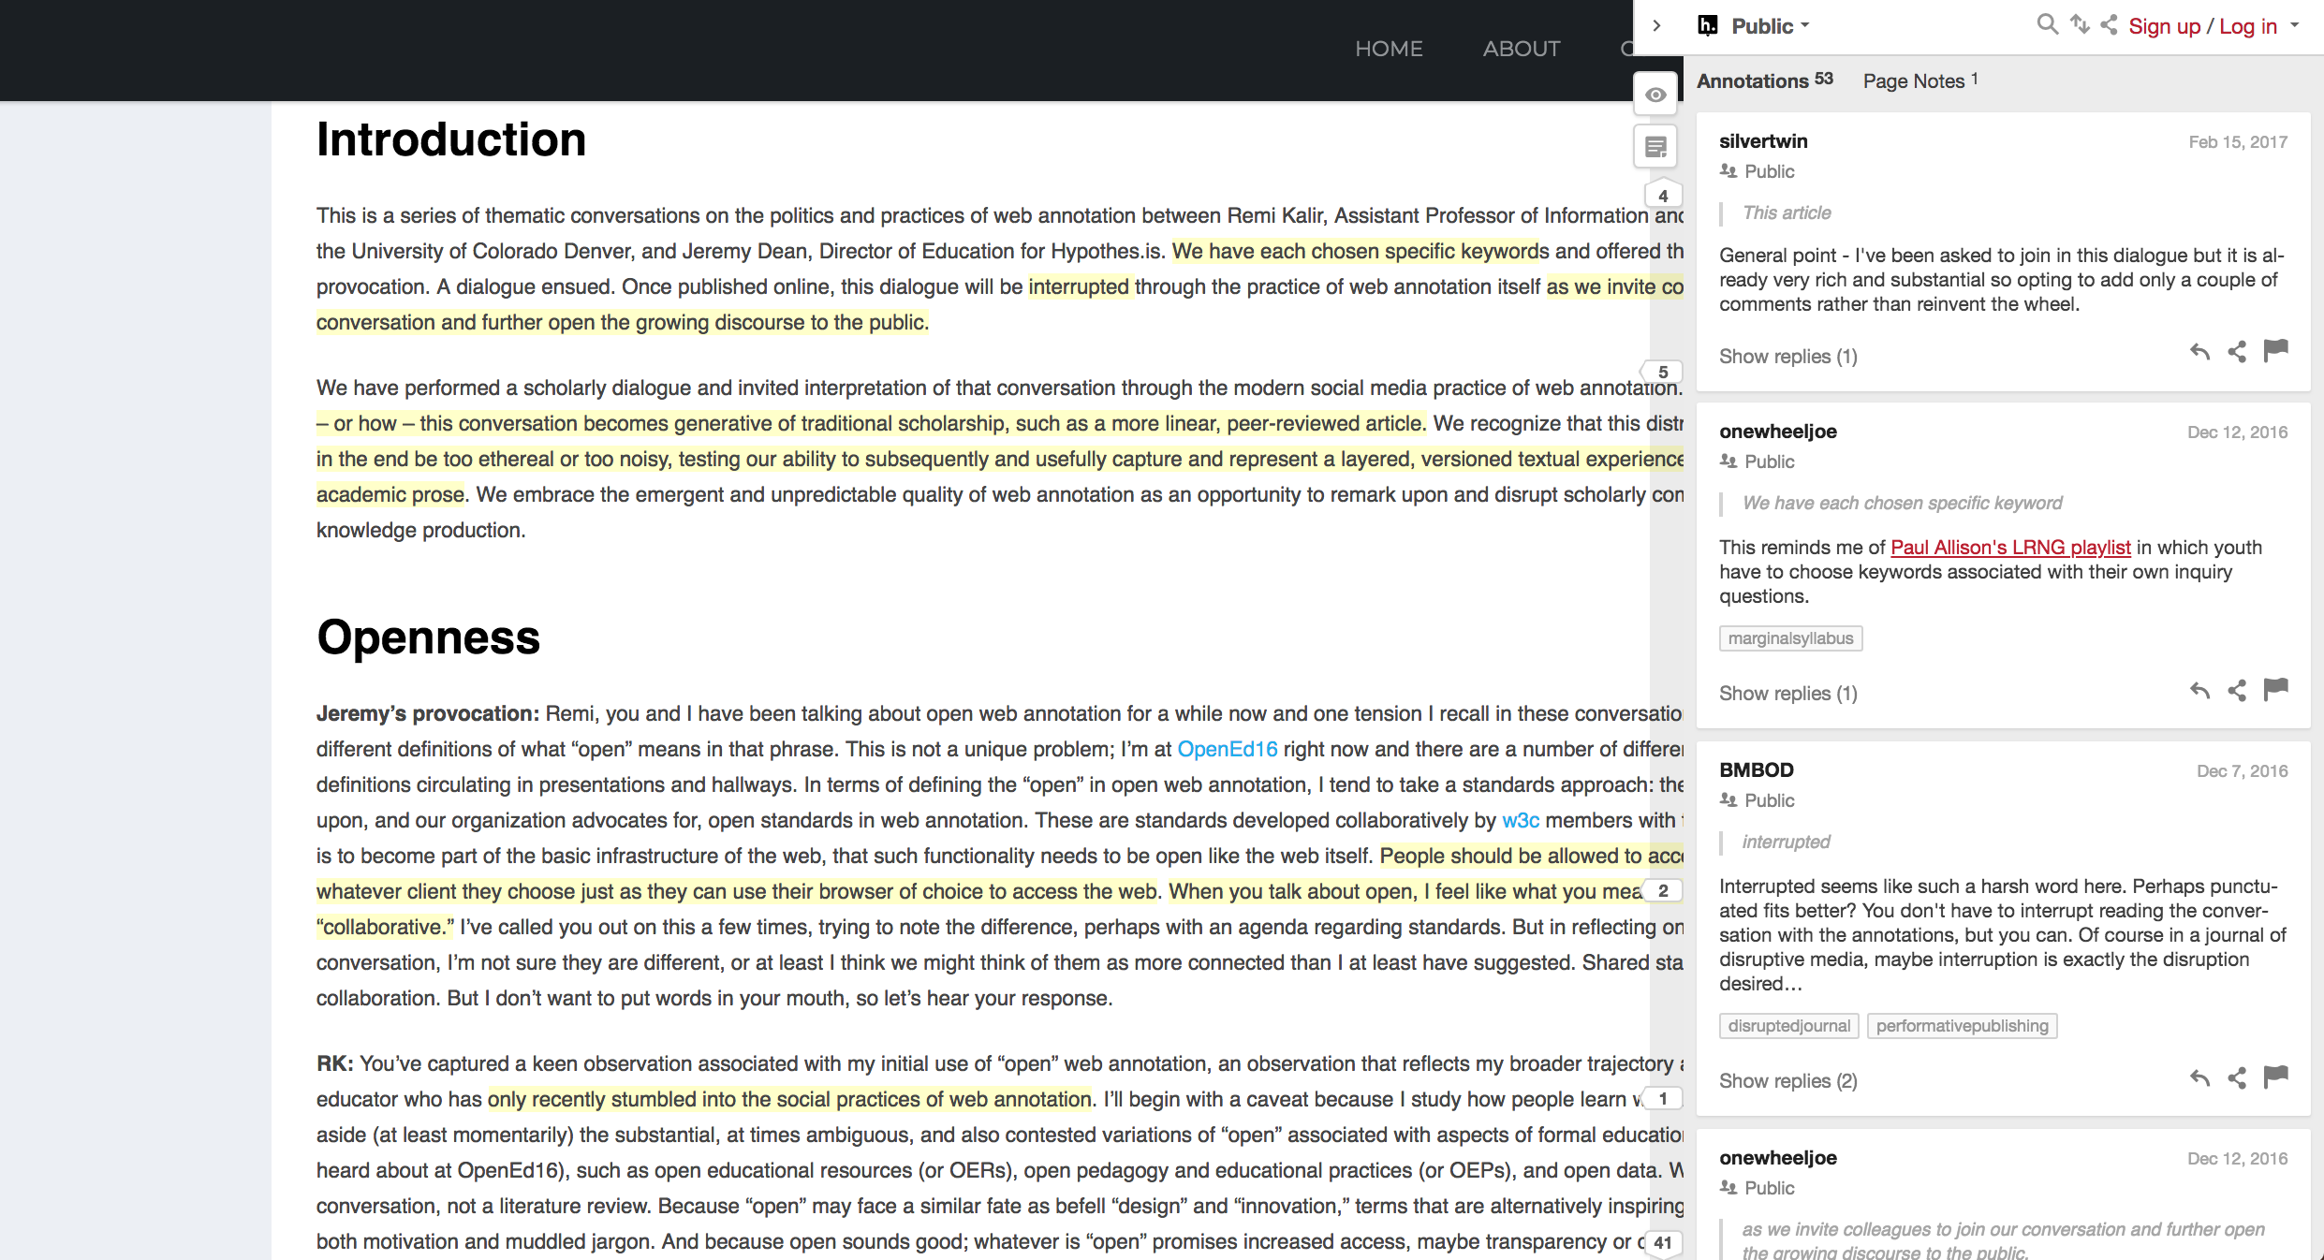
Open Peer Review

Slide 27
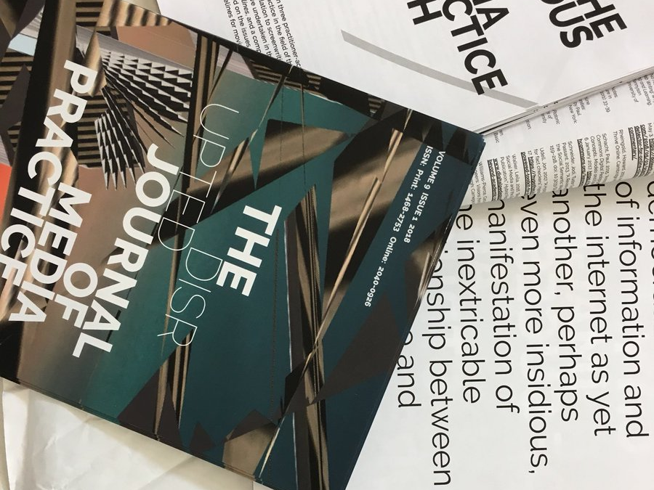
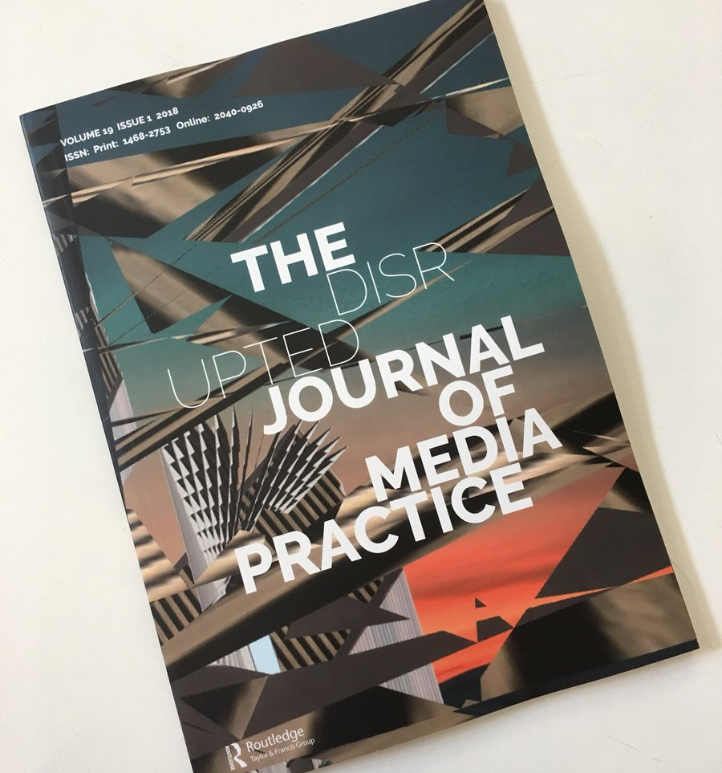

Slide 28
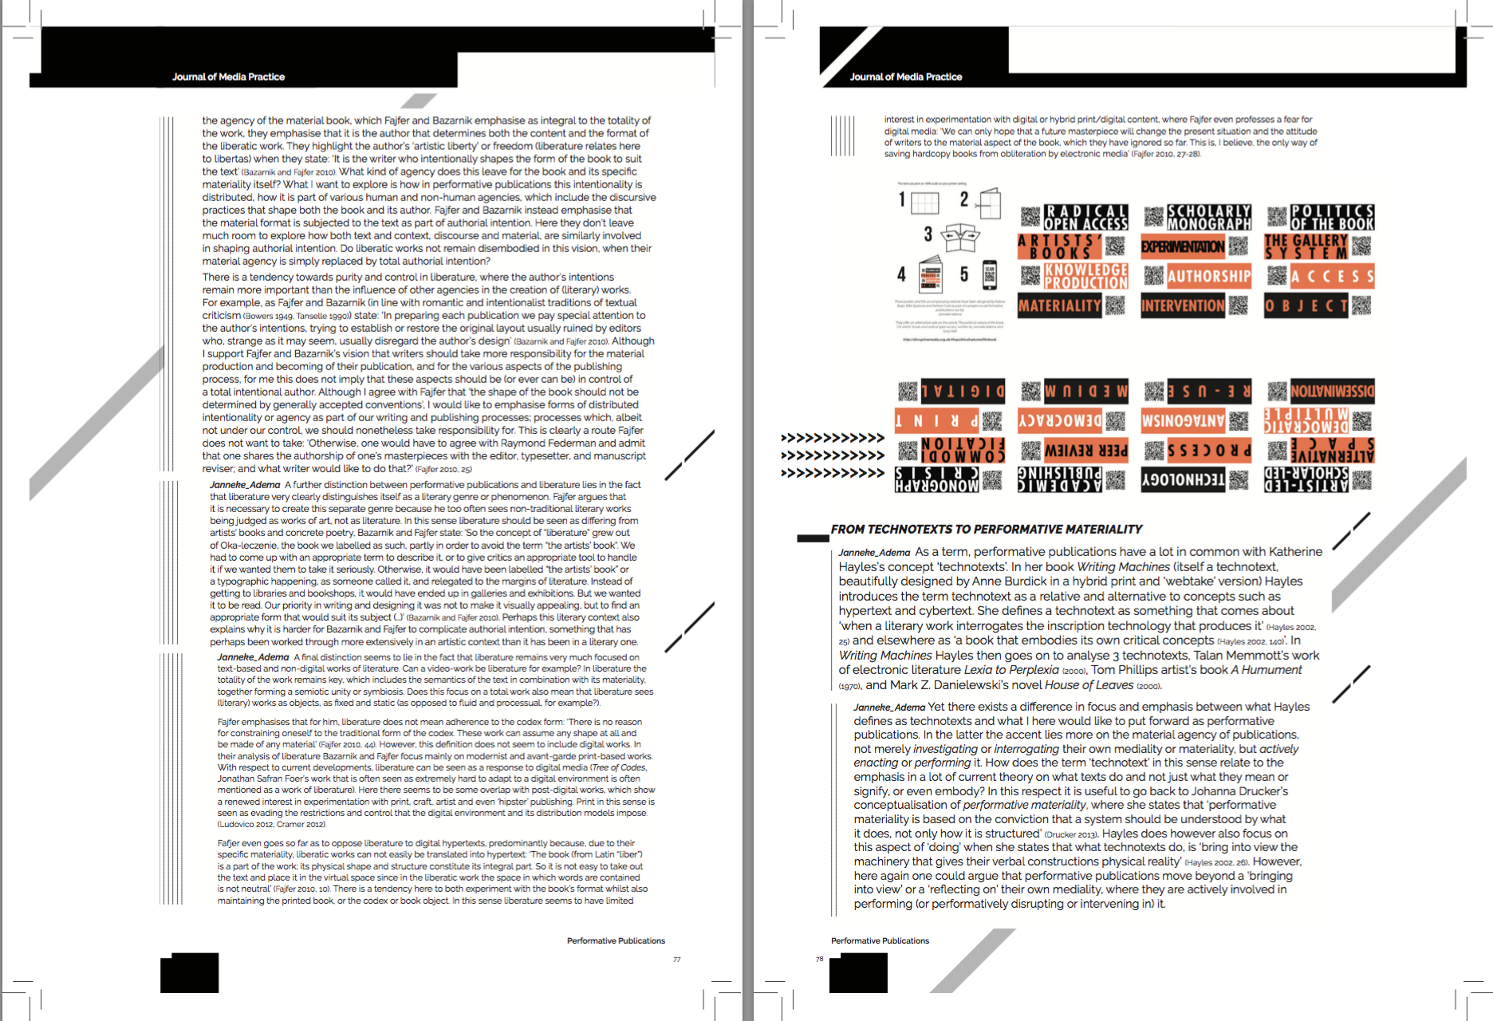
Print design versioning

Slide 29
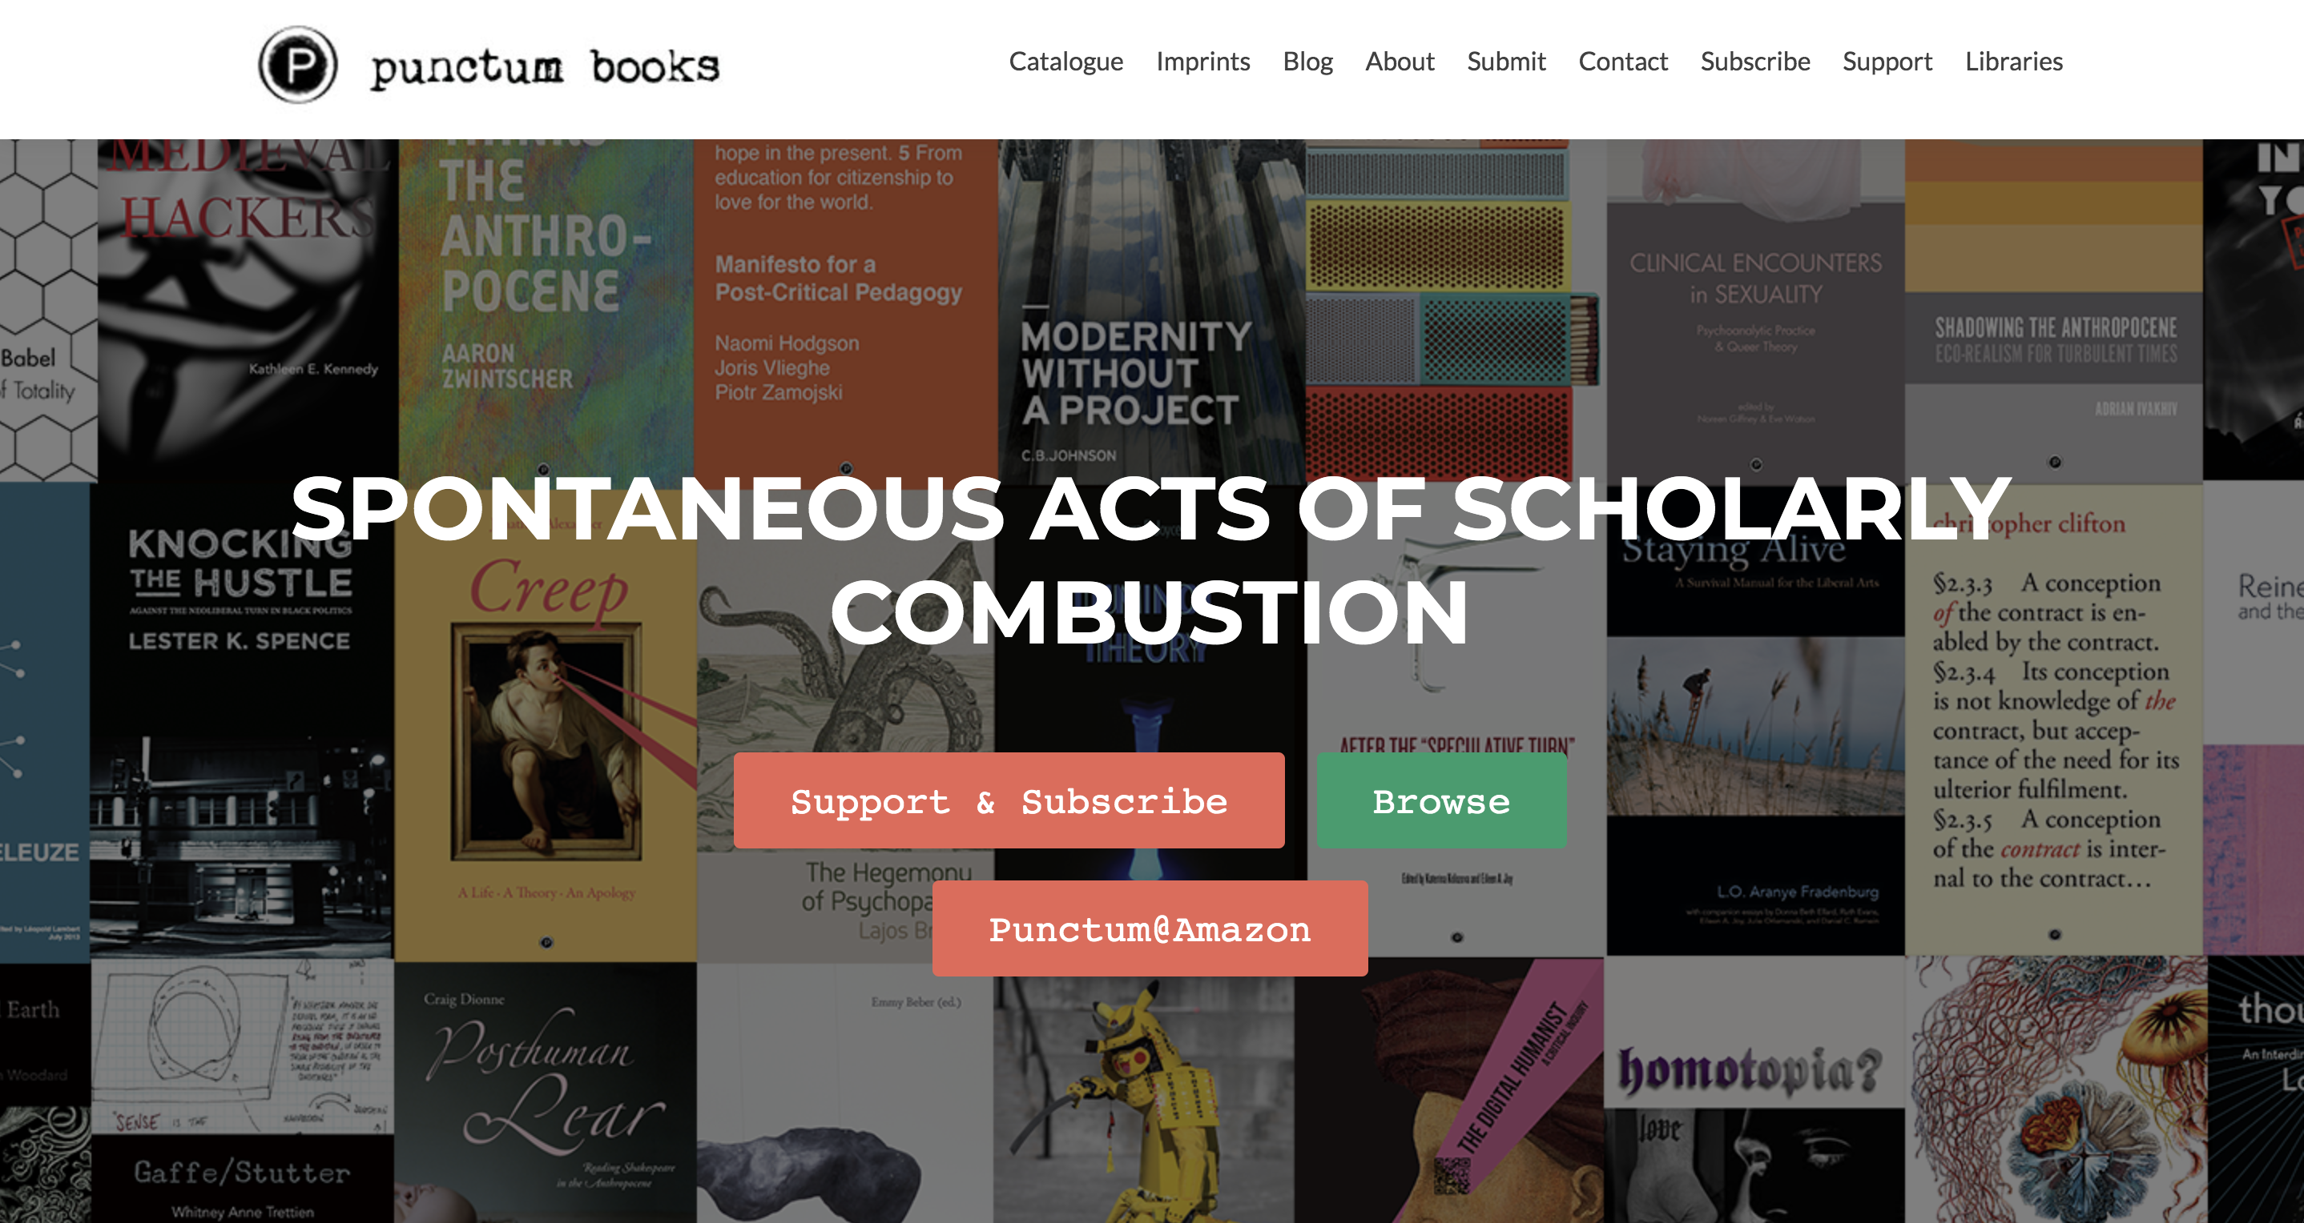
Punctum books
At punctum books, we are concerned to continue lavishing attention on the printed book as a cultural arts artifact with certain sensually phenomenological presencing and time-traveling powers, while we also want to make as many of our publications as possible available in open-access, digital form and also in special web-based environments with navigational structures that are not merely analogues nor surrogates for the print-based medium. And this is because we are pluralists who believe that a ‘biodiversity’ of intellectual matter and media are critical to the cultivation and fostering of the most lively and vibrant public commons possible. We believe, further, that such ‘biodiversity’ is critical to liberty and democracy, or to what Ivan Illich once memorably advocated for as “the protection, the maximum use, and the enjoyment of the one resource that is almost equally distributed among all people: personal energy under personal control.”' (Eileen Joy, 2015)

Slide 30
'Who has access to the modes of being published, and who doesn’t? Open-Access (OA) should not just mean publications that are open to users and readers, with no impediments such as pay- and firewalls; it should also mean that the services necessary for the production of publication (understood as the formation of publics and counter-publics ‘seeded’ by new works, however they may be ‘delivered’) should be accessible to all. Fully open to authors and open to readers. This point is rarely discussed as if it matters when publishers and academics gather to discuss the future of publishing in a digital world, occasions on which they often appear intent on figuring out ways to continue, in changing times, to maintain the ‘legitimacy’ and ‘prestige’ of their exclusive (and exclusionary) Establishments.' (Joy, 2015)

Slide 31

Readings
Drucker, Johanna. 2013. “Performative Materiality and Theoretical Approaches to Interface” 7 (1). http://digitalhumanities.org/dhq/vol/7/1/000143/000143.html.
Joy, Eileen. 2015. “Let Us Now Stand Up for Bastards – Punctum Books.” Punctum Books (blog). February 11, 2015. https://punctumbooks.com/blog/let-us-now-stand-up-for-bastards/.
———. 2016. “It Is the Connection of Desire to Reality That Possesses Revolutionary Force, or, Why I Decided Not to Commit Suicide, After All.” In the Middle (blog). January 13, 2016. http://www.inthemedievalmiddle.com/2016/01/it-is-connection-of-desire-to-reality.html.
Kelty, Christopher M. 2008. Two Bits: The Cultural Significance of Free Software. Duke University Press Books.

