Slide 1
The Digital Humanities Beyond The Digital And The Human: Imagining New Relationalities For Knowledge Production
Janneke Adema
Centre for Postdigital Cultures
Coventry University
DHI Beirut 2019

Slide 2
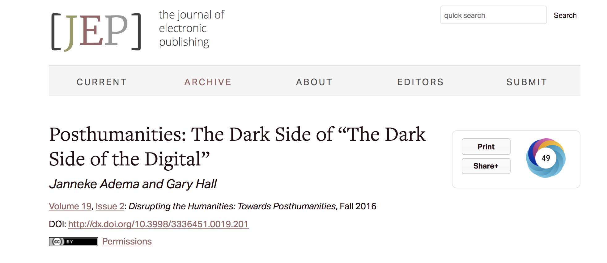

Slide 3
Structure
Posthumanities
New forms of iterative and processual publishing
    Living Books about Life and The disruptive Journal of Media Practice
New forms of organisation around publishing and research
    The Radical Open Access Collective and ScholarLed

Slide 4
Decentering the Human in the (Digital) Humanities
Lack of critical engagement with the underlying humanistic aspects of the humanities
Lack of critical exploration of the consequences of the digital for how we do practice and theory
Over-emphasising the human subject (e.g. author/data subject)

Slide 5
Posthumanities
What are the implications of the decentering of the human and of the rise of digital technologies for the humanities, for theory, for how we practice the (digital) humanities, for how we create, perform, disseminate and access it?

Slide 7
Versioning
Materiality
Differential Texts (Perloff)
Linearity
Iteration (itra; other - Derrida)
Deformative and Performative (McGann)
Technotext (Hayles)

Slide 8
Living Books about Life (Open Humanities Press)

Slide 10
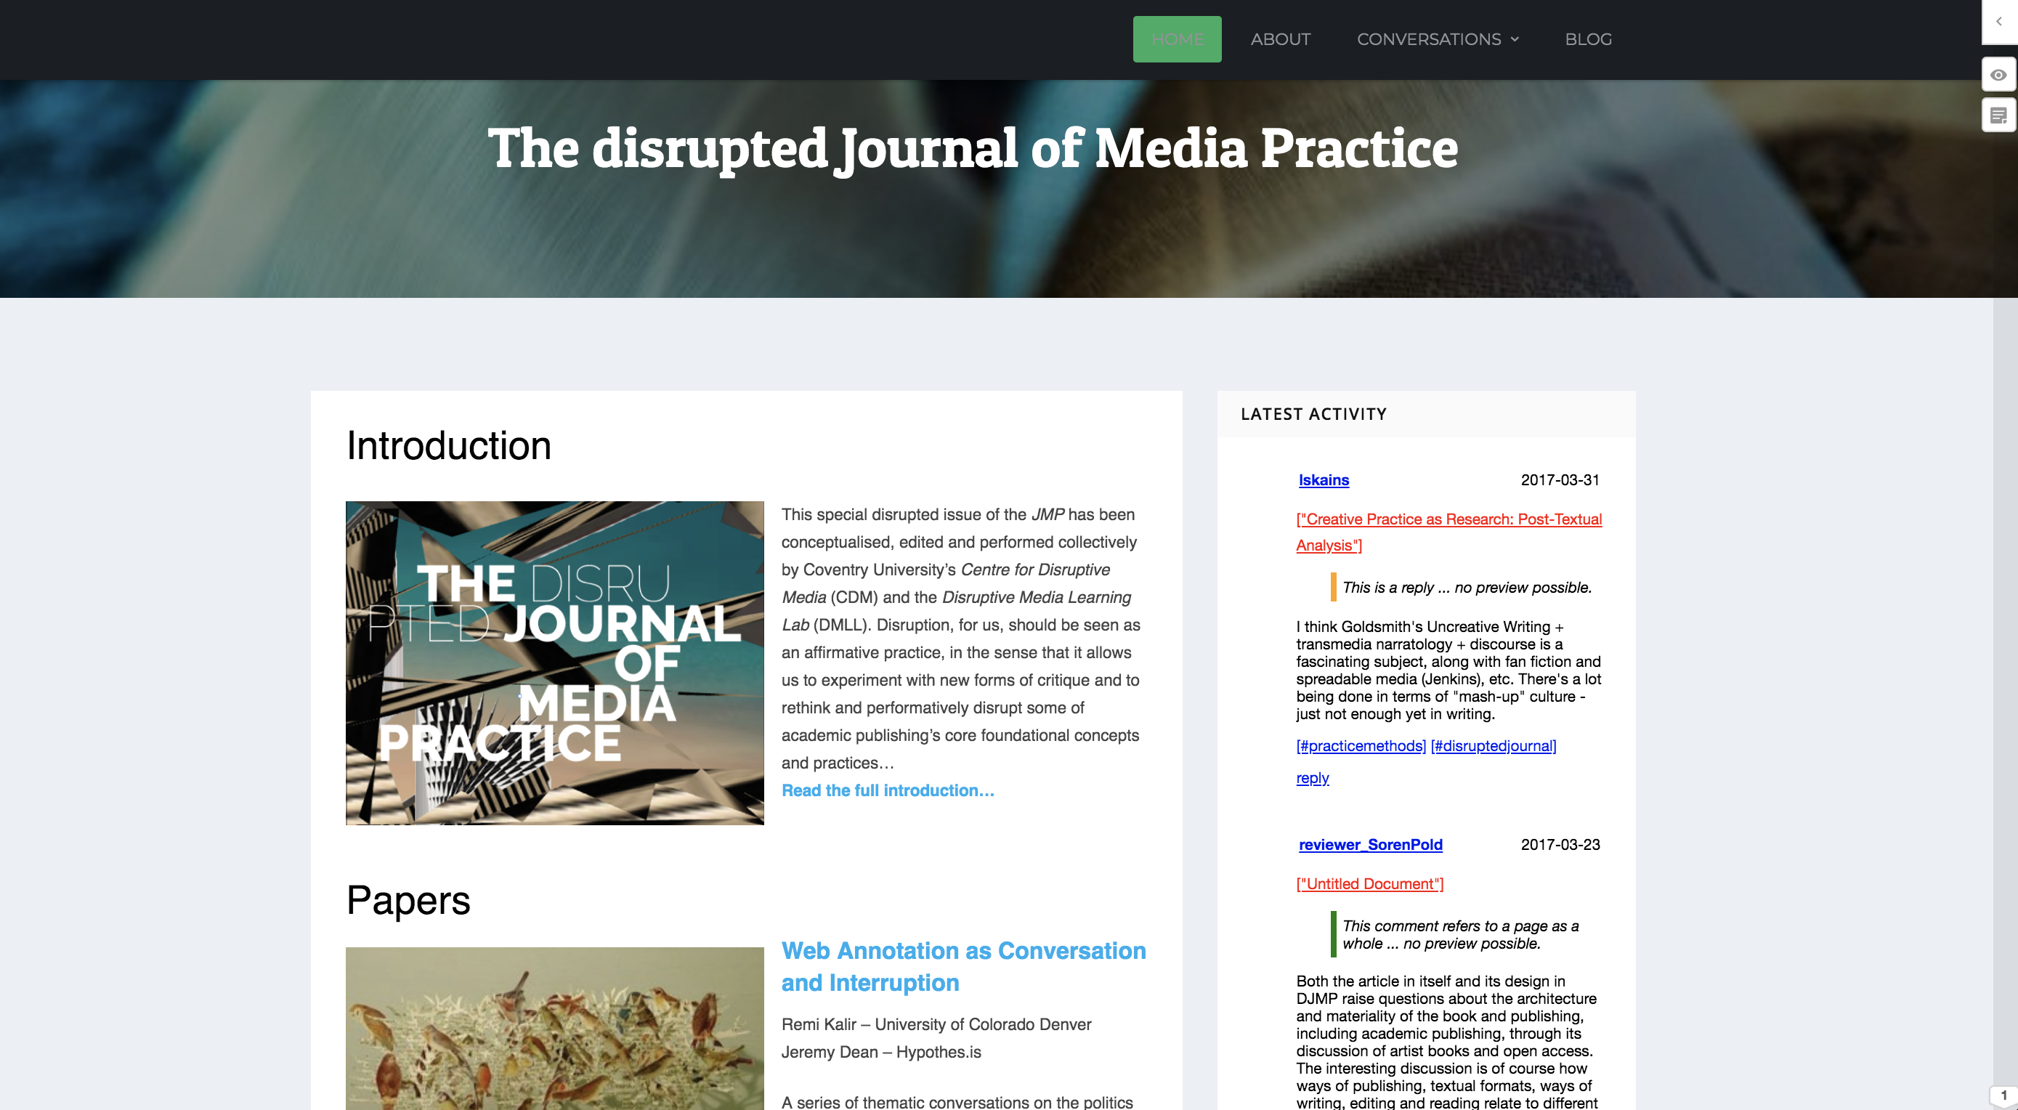

Slide 11
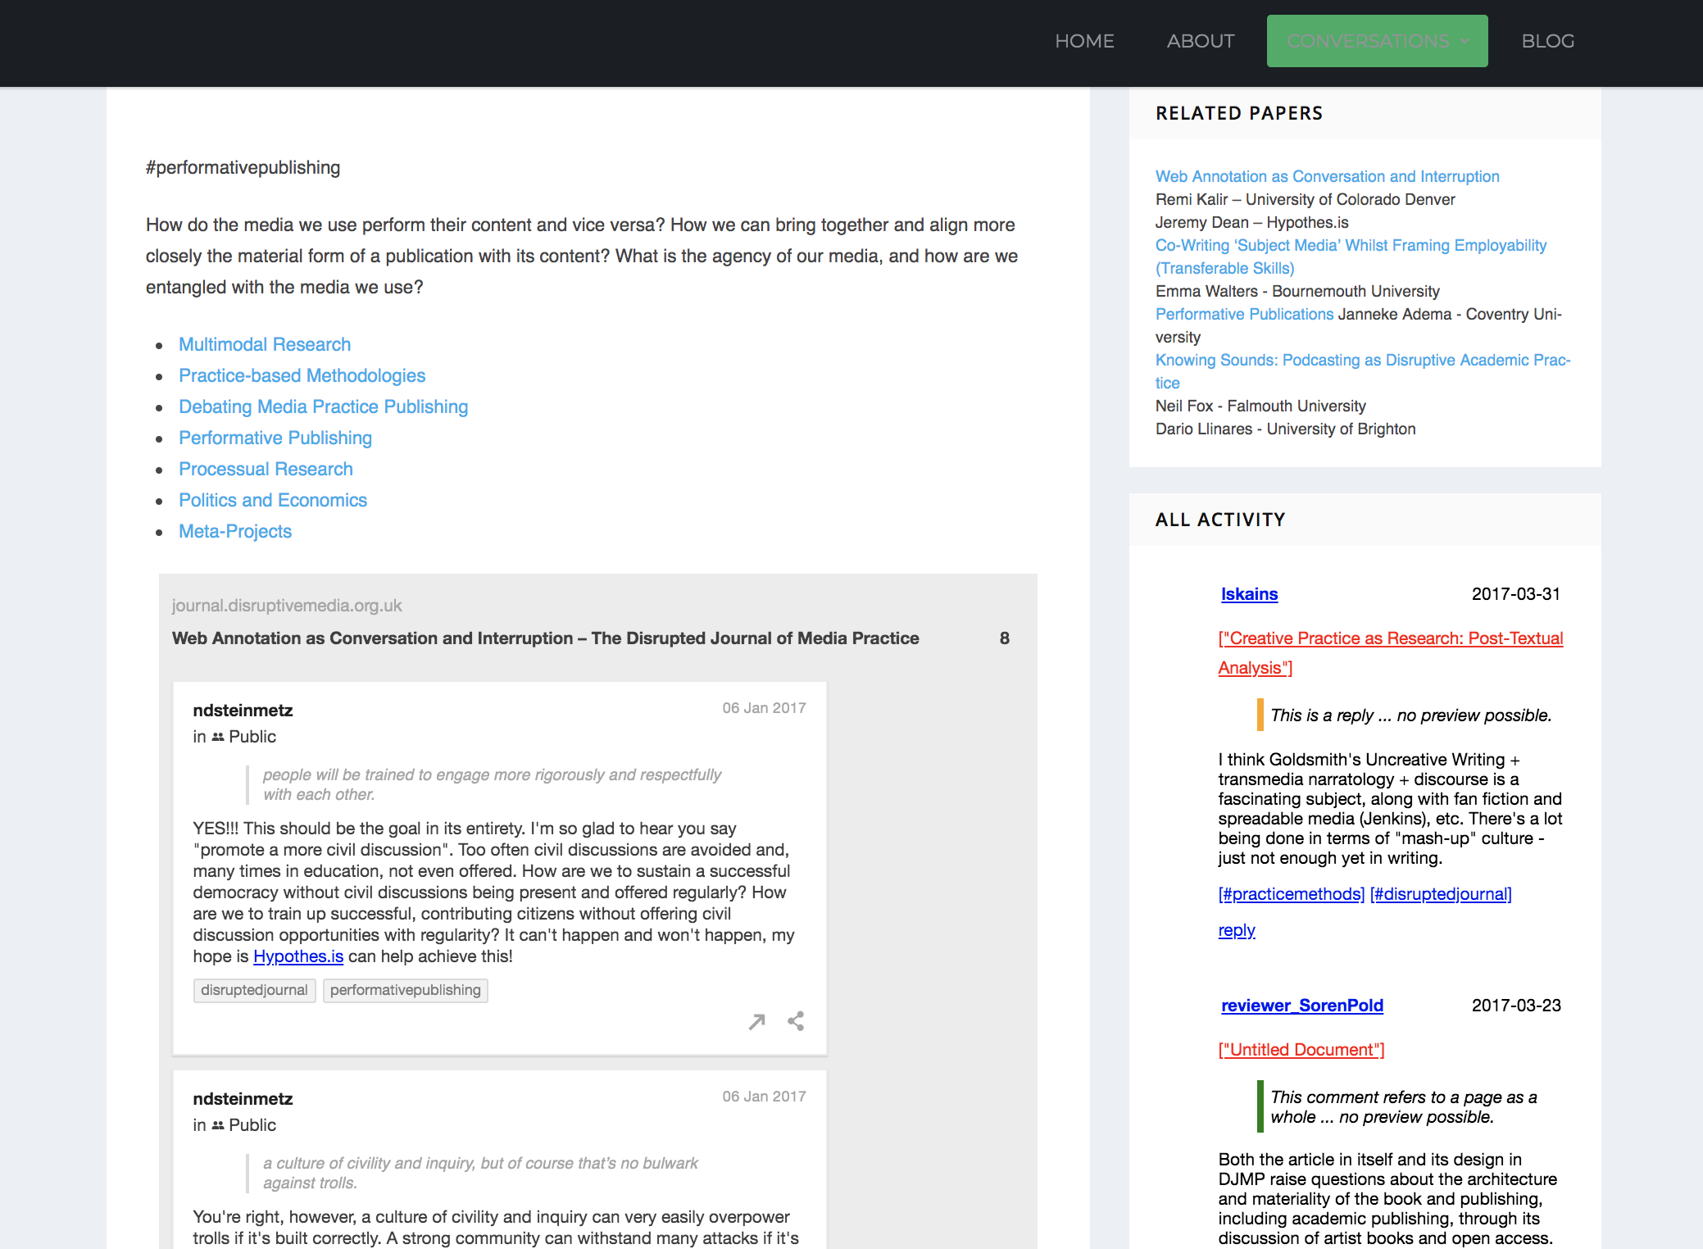

Slide 12
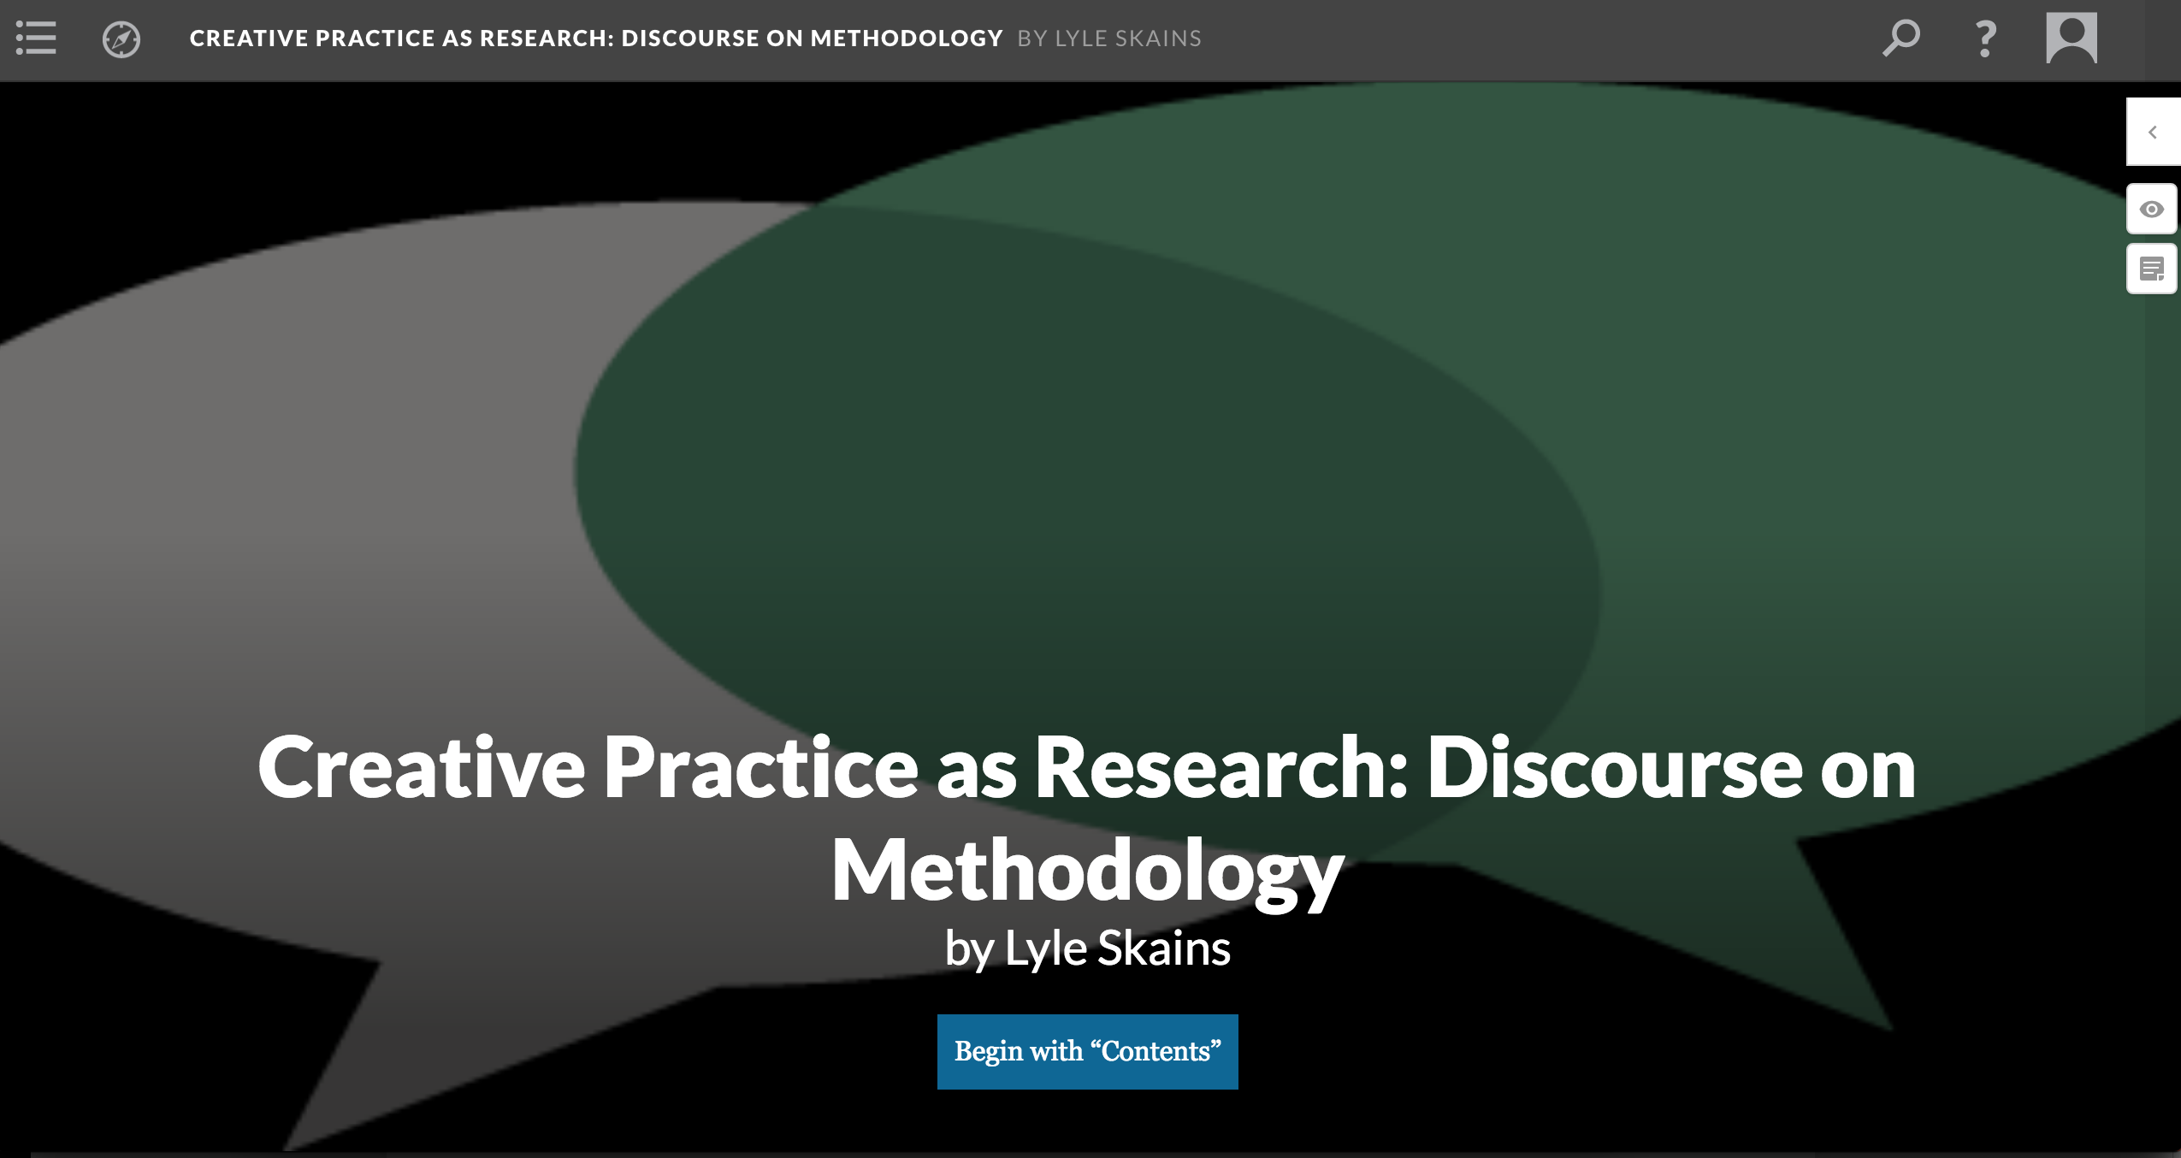

Slide 13
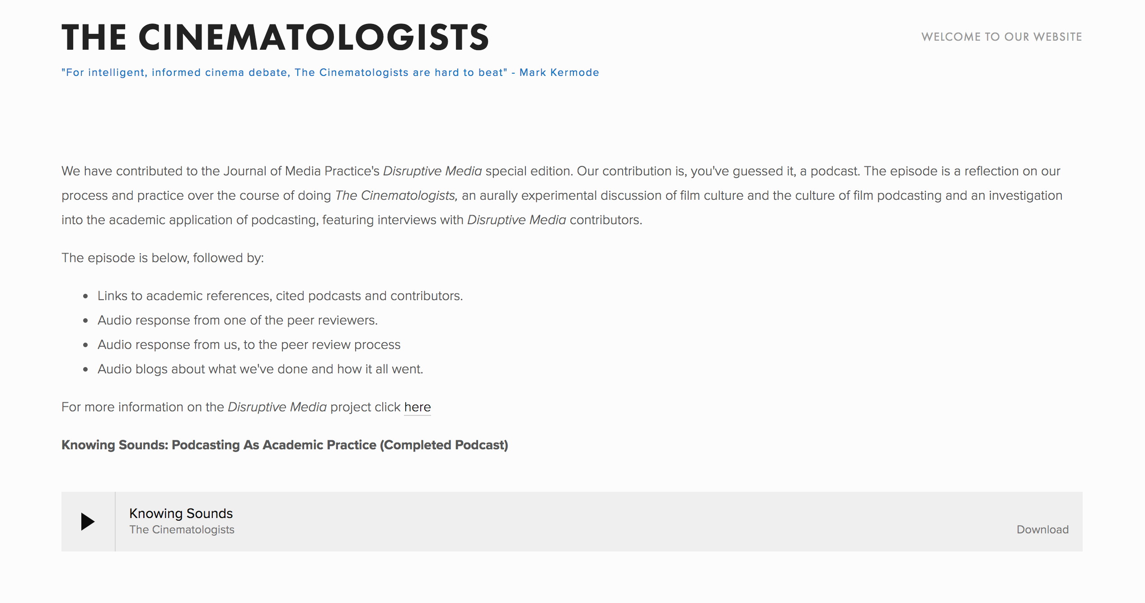

Slide 14
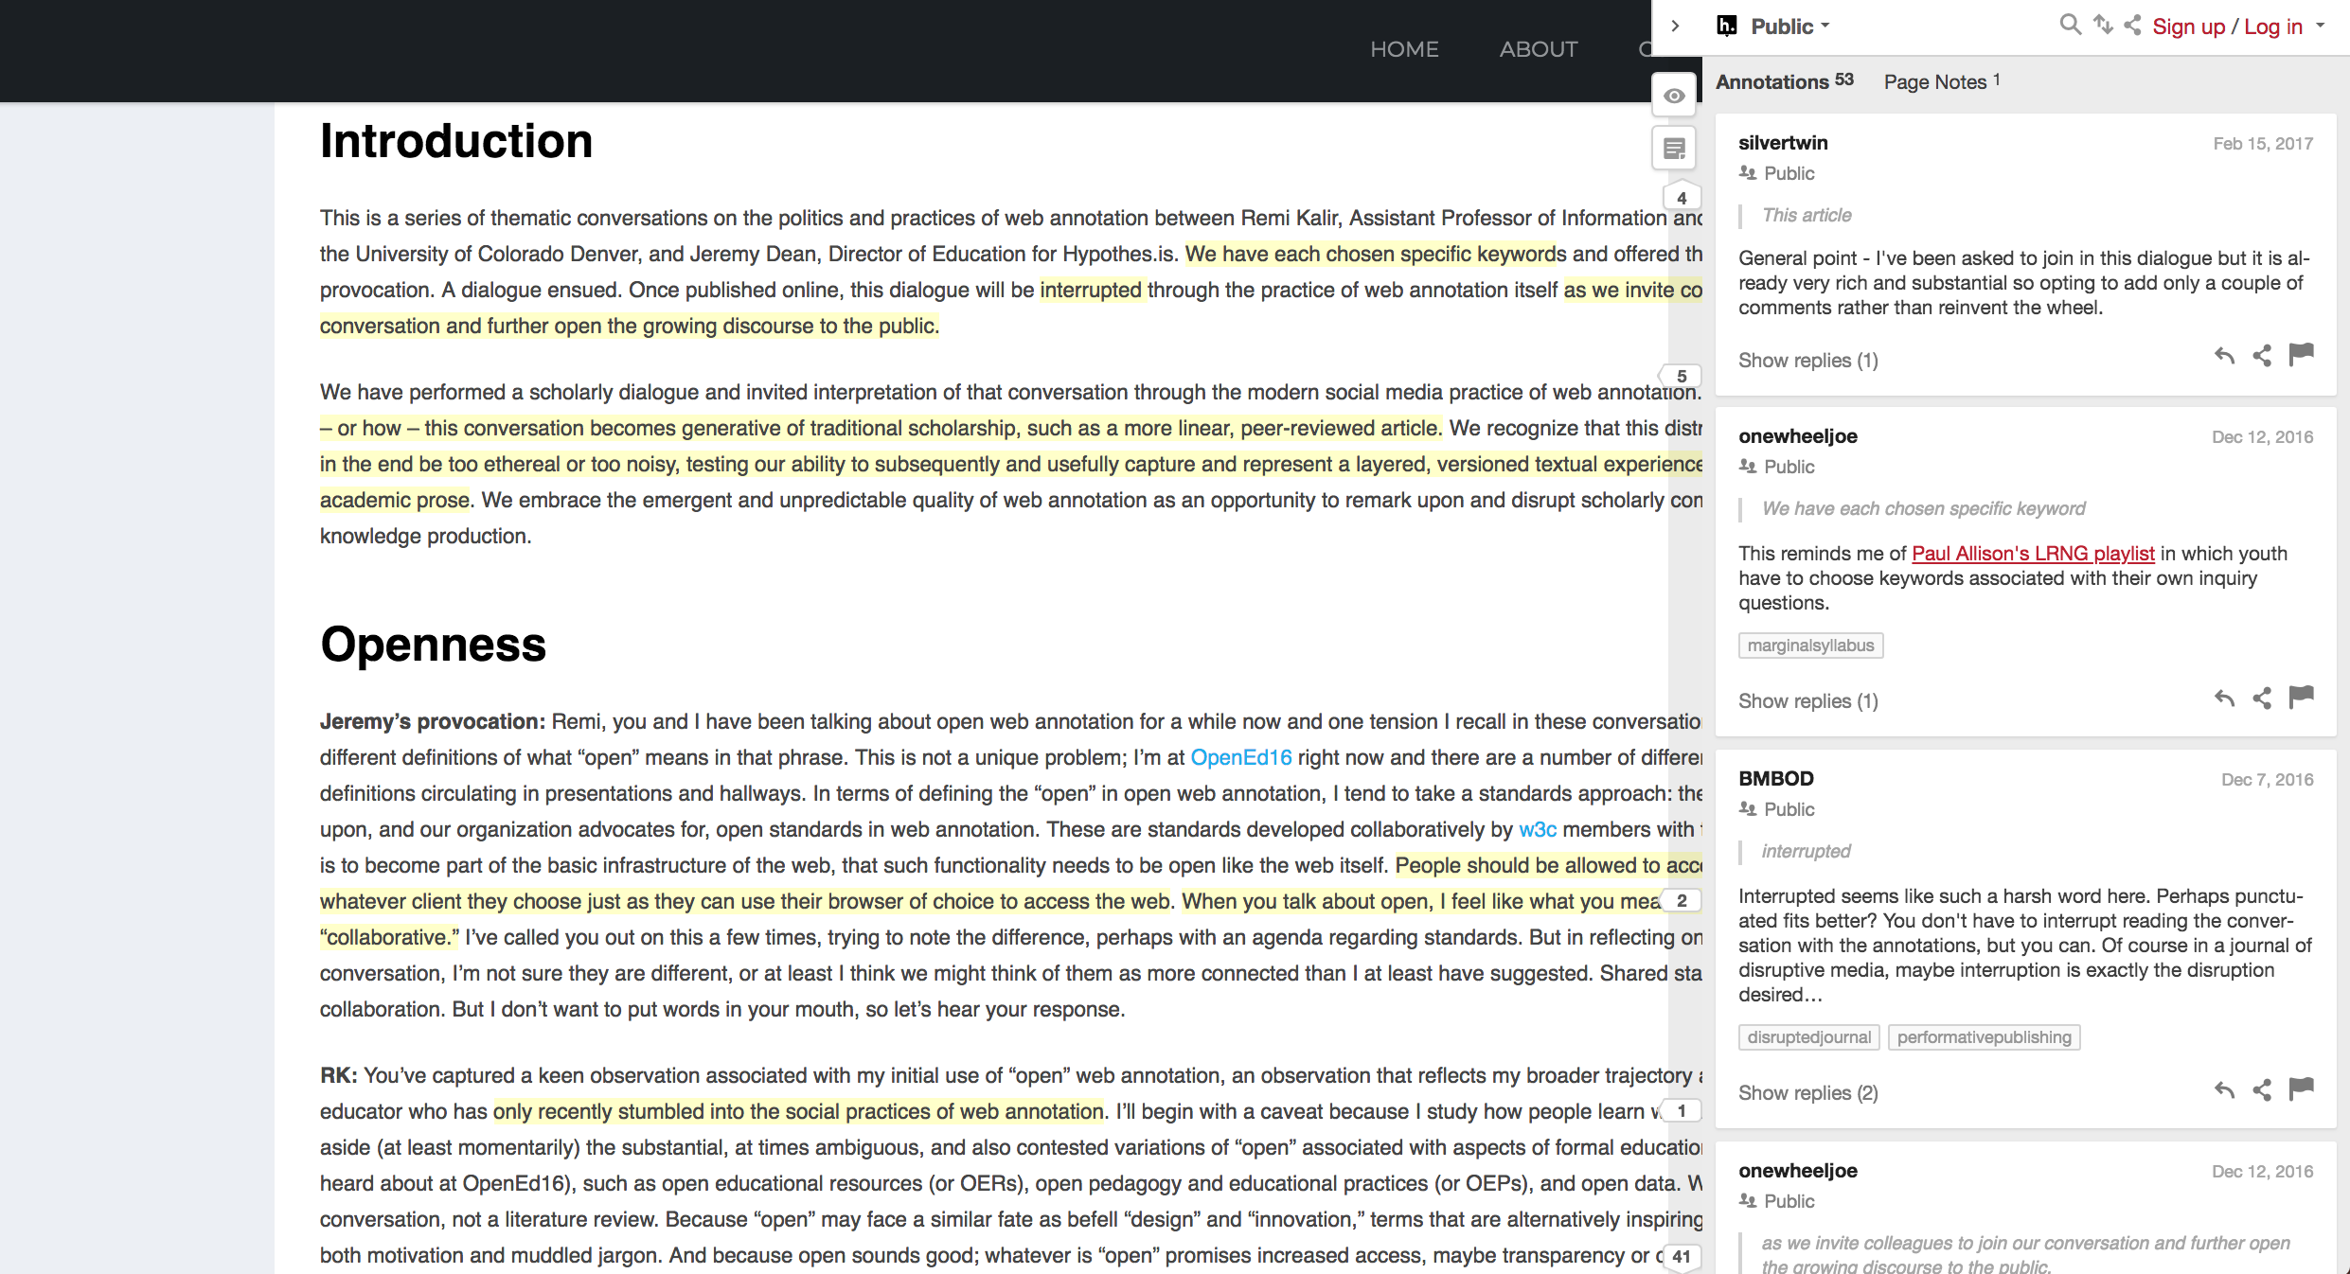
Open Peer Review

Slide 15
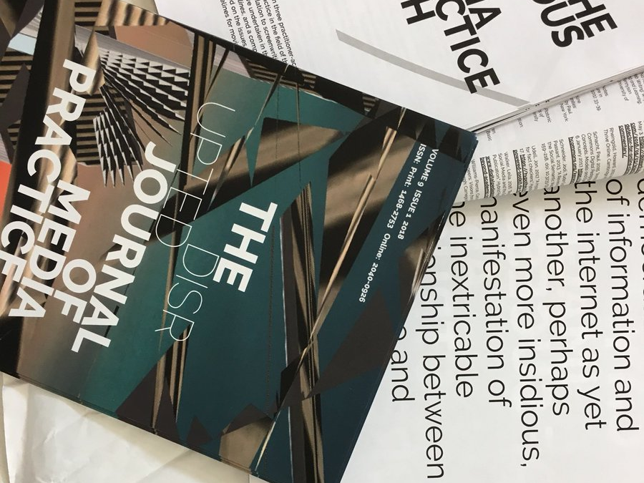
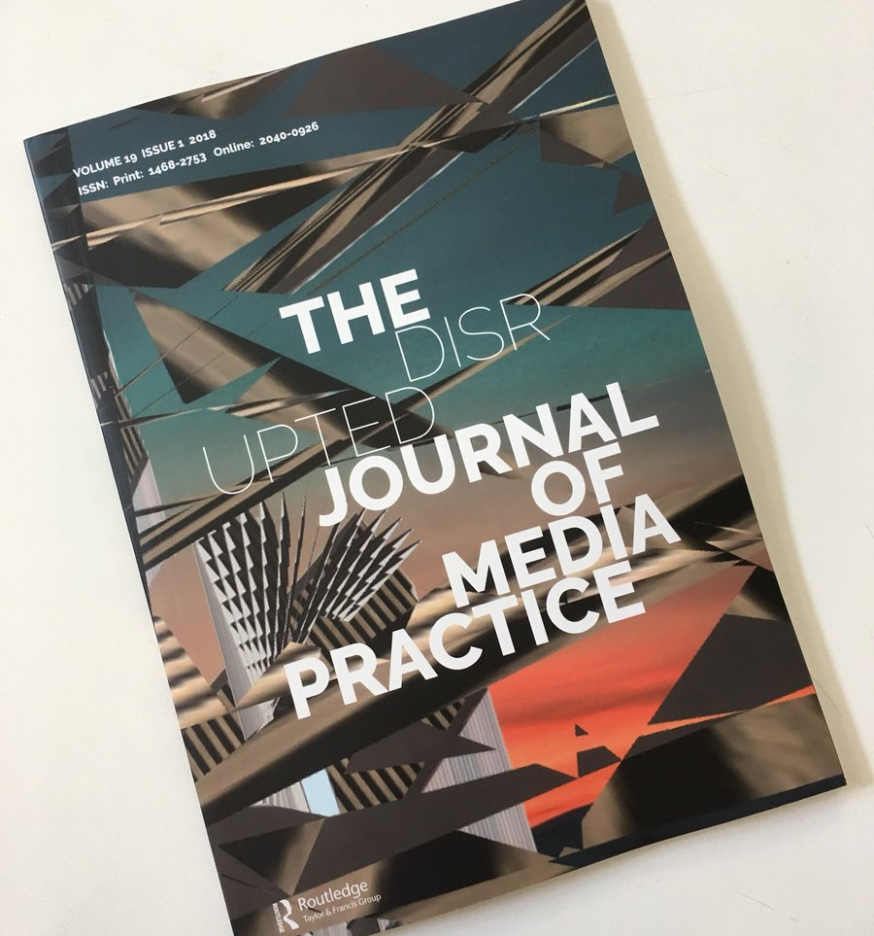

Slide 16
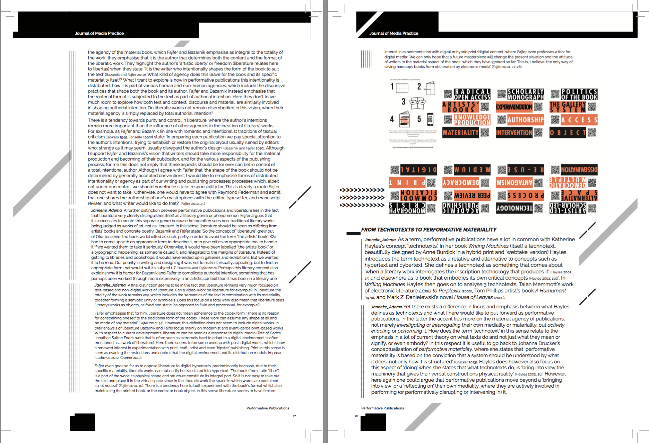
Print design versioning

Slide 17

Repositioning Open Access
Critiques of the Status Quo/Reimagining Scholarship
Experimentation
New and underserved cultures of knowledge
Ethics of Care

Slide 18
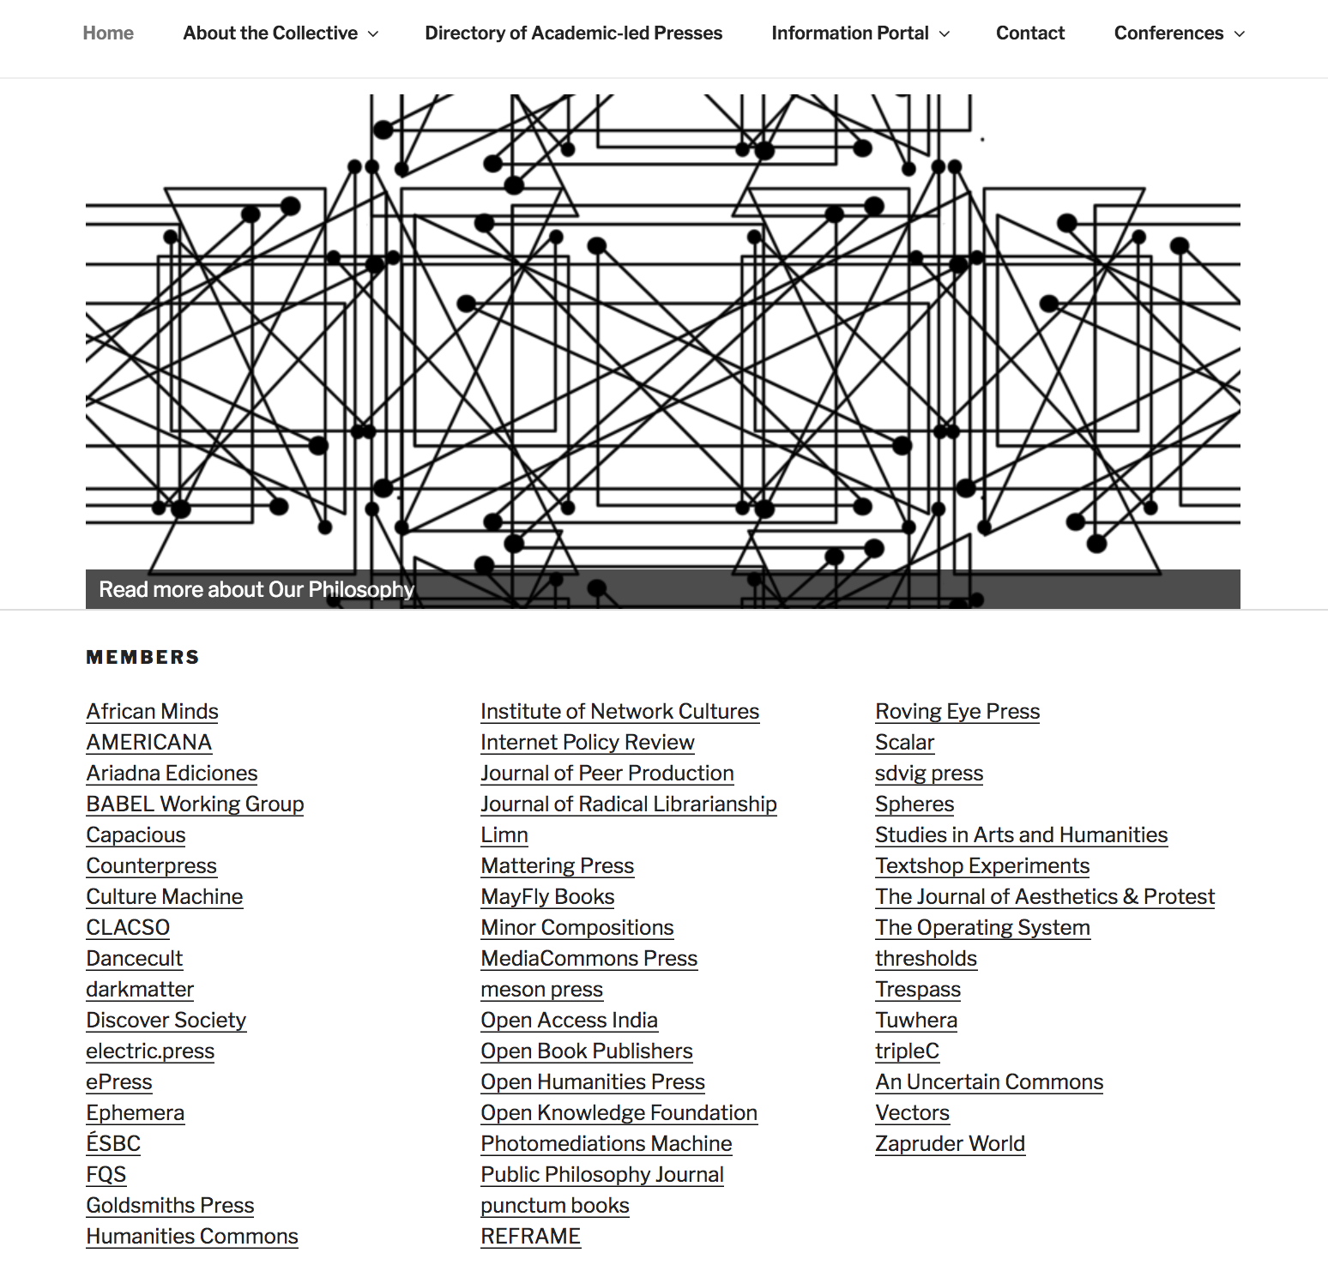


Slide 19
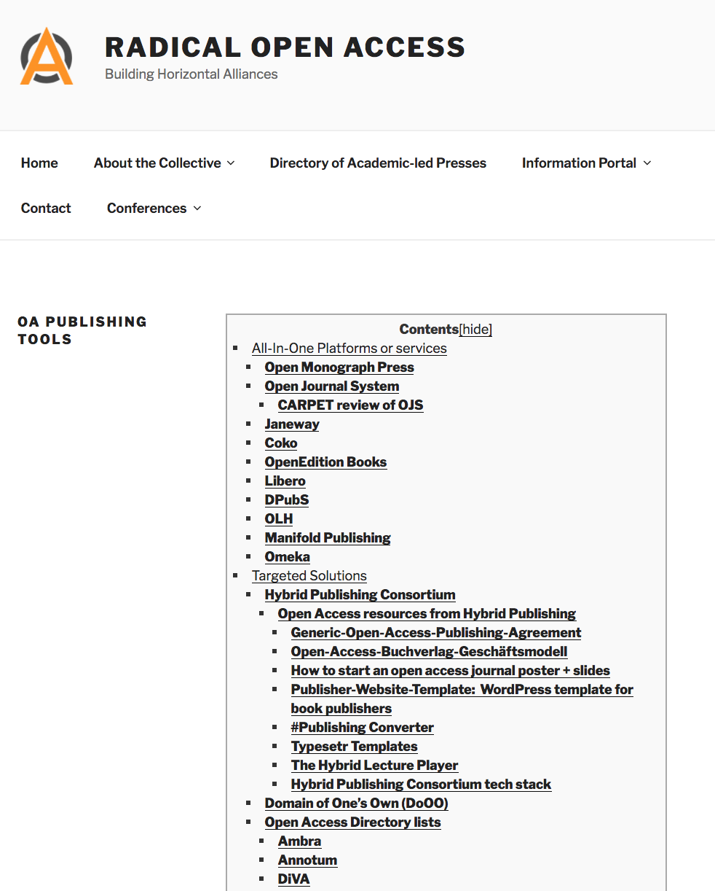
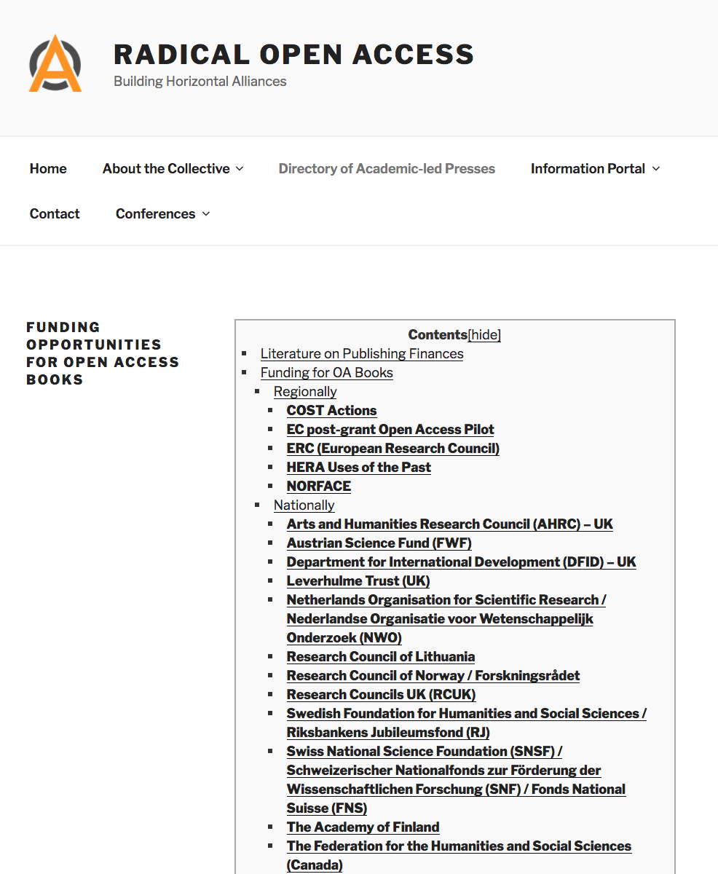

Slide 20
Scaling Small
Scaling through horizontal and vertical collaborations
Working to capacity: 50 books (punctum), 30 (LSP/OBP), 5 (OHP/Mattering)
Transparency and openness about funding models and costs
Bringing down BPCs or fee-waivers
Open source software, platforms and tools
Resources and skills sharing
Experimenting with a variety of different models:
  communal editing/publishing: Language Science Press and OHP
  Crowd-sourcing/donations/consortia

Slide 21
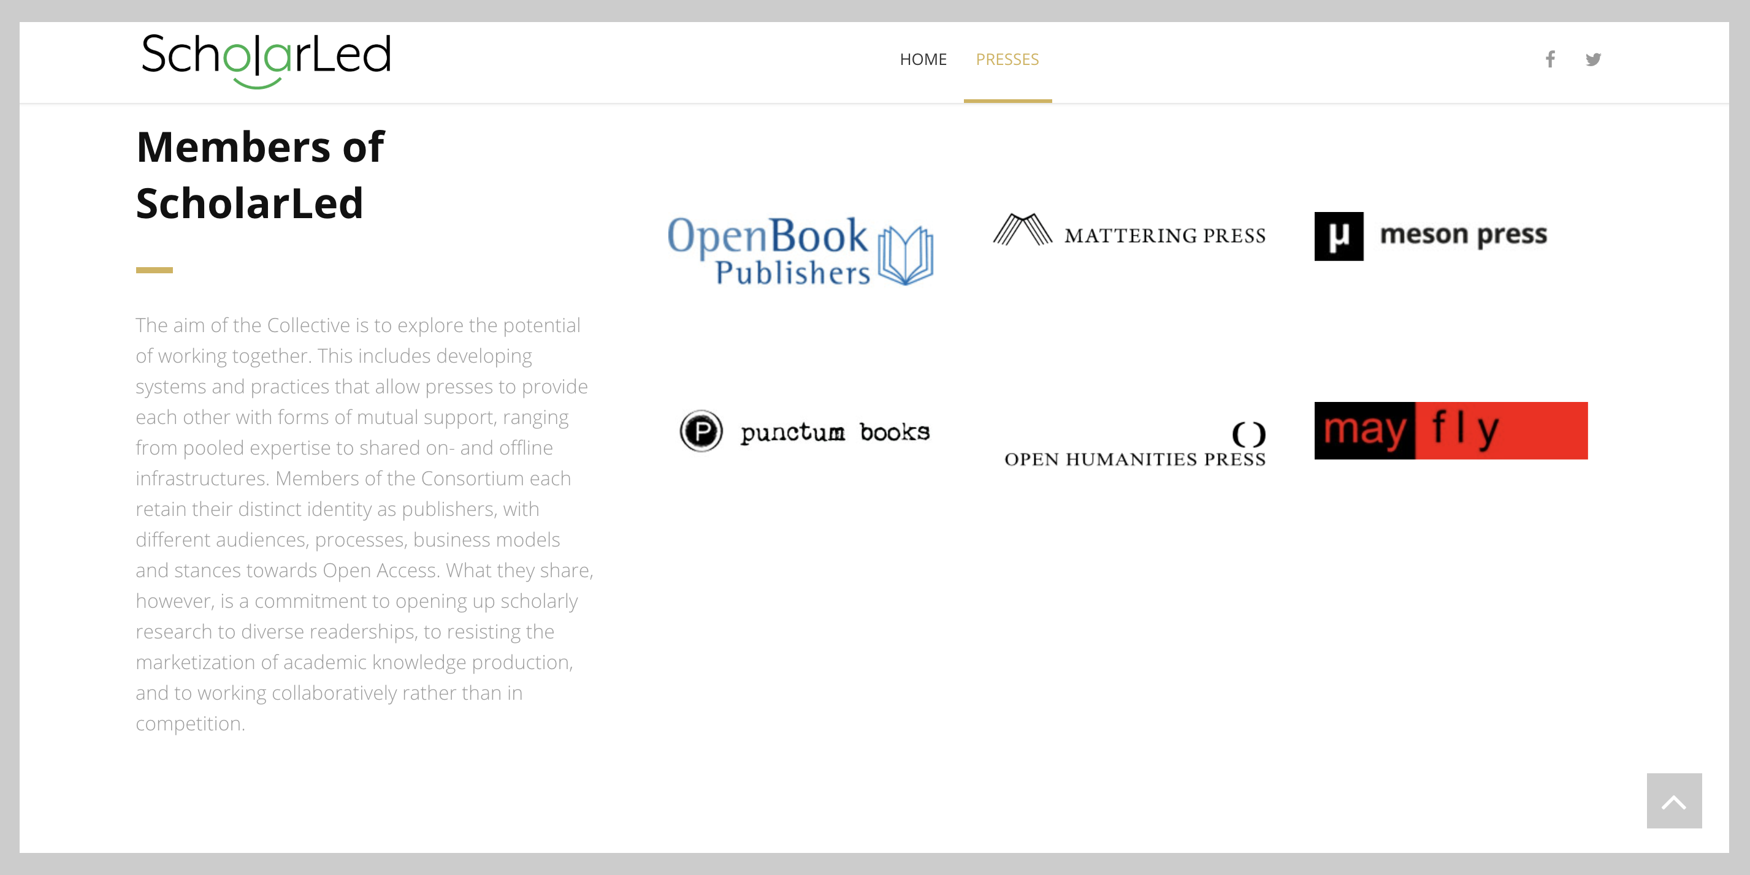

Slide 22
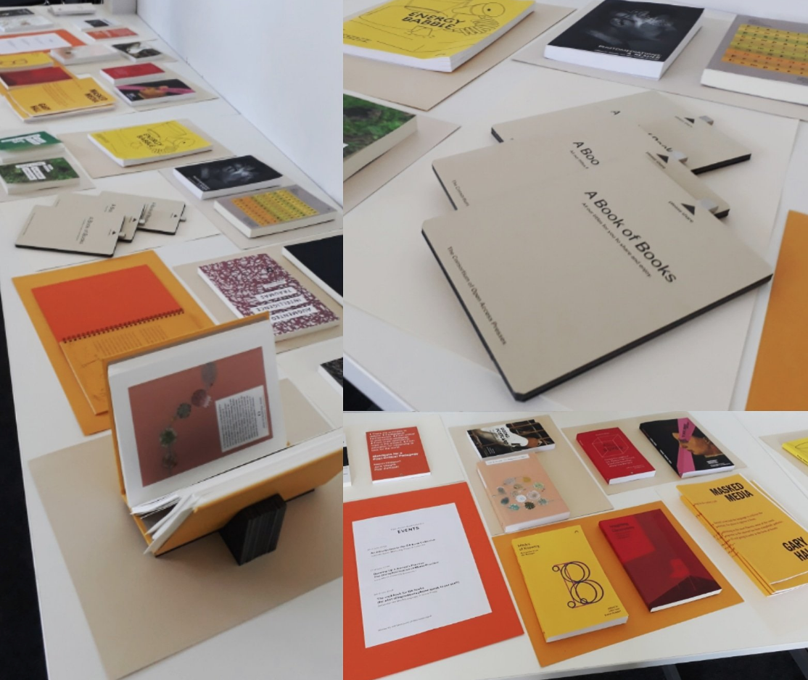

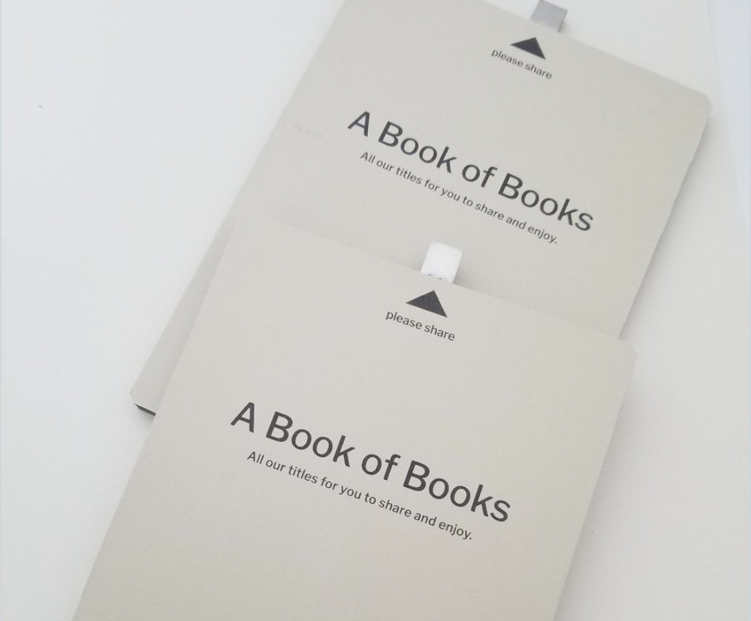
Dissemination and Discovery of OA Books
Library Integration
Collective Conference Presence and Book Stand
Archiving Multimodal OA Monographs

Slide 23
ademaj@uni.coventry.ac.uk
@Openreflections
Radicaloa.co.uk
@RadicalOA
Scholarled.org
@ScholarLed

